Slide 1
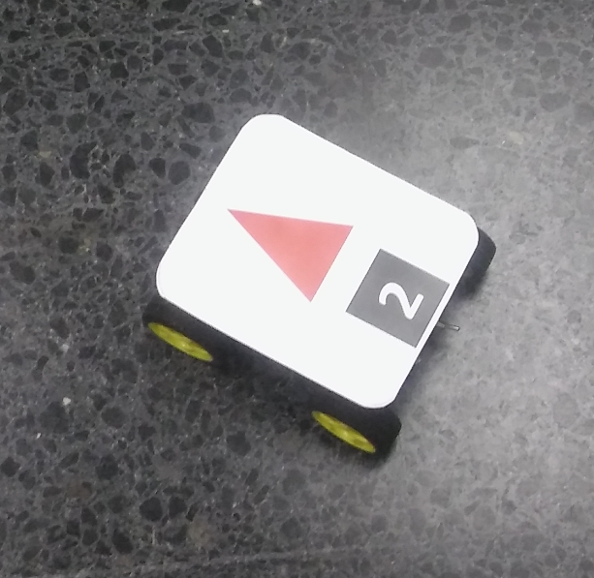

Coordinates in pixels
of the vertices of the
triangles detected.
Camera
FPGA
(Red binarization)
HPS
(Extract vertices)
Send to
uvispace-main-controller

