Slide 1
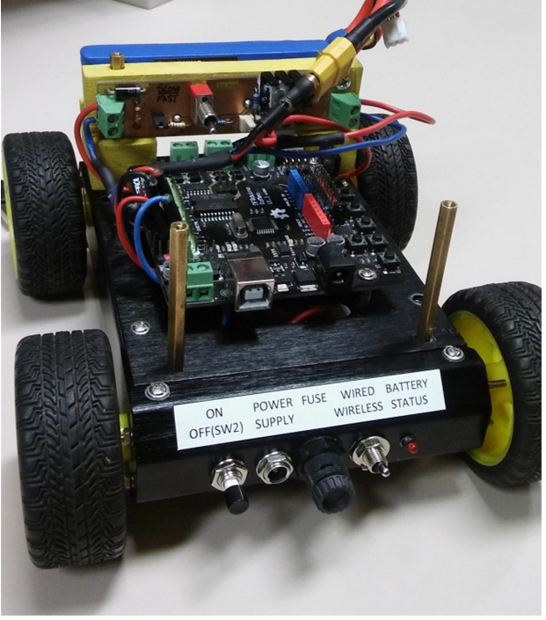
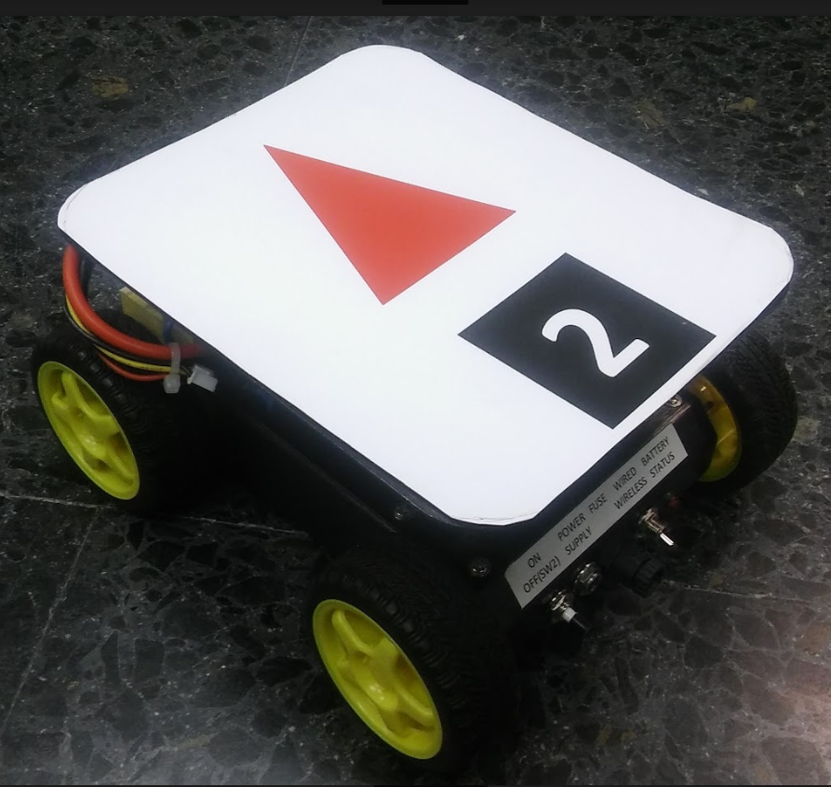
CHARGER BOARD
BATTERY
ARDUINO ROMEO
BACK PANEL

