Slide 1
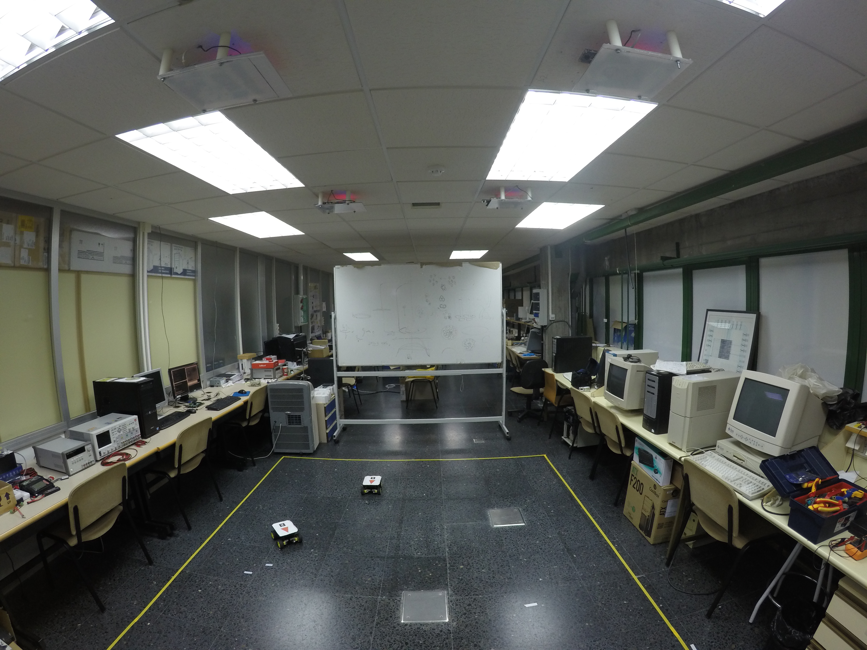
CAMERA 2
CAMERA 3
CAMERA 4
CAMERA 1
CAMERA 4
X
Y

