Slide 1
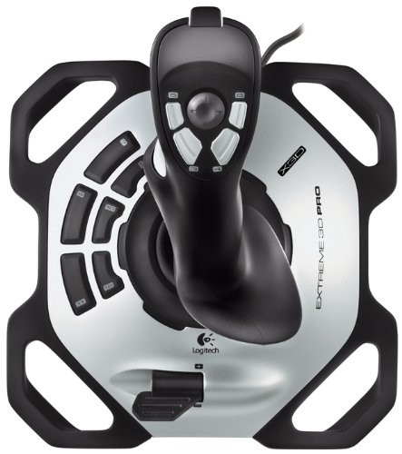
Close Gripper
Upper Joint
Open Gripper
Next Point
Previous Point
Enable Rotate
Enable Lower
Enable Upper
Lower Joint
Lock/Unlock Speed
Base Joint
Speed

