Slide 1
ARM Templates
Purshottam A

Slide 2
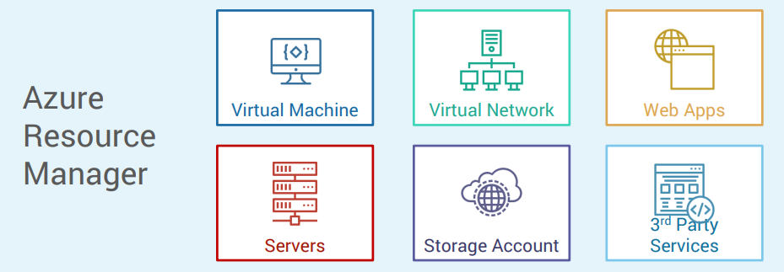
ARM

Slide 3
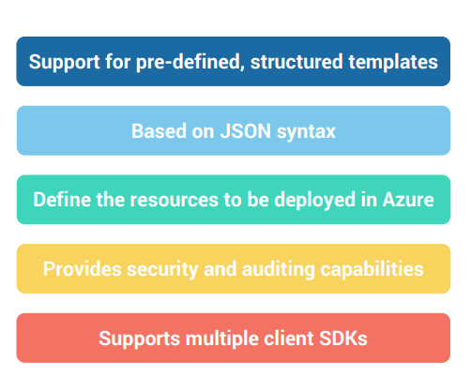
Features

Slide 4
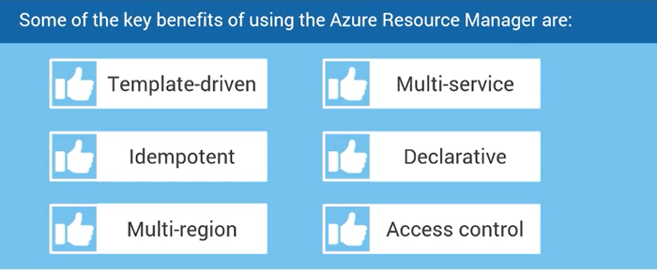
Benefits of an ARM template

Slide 5
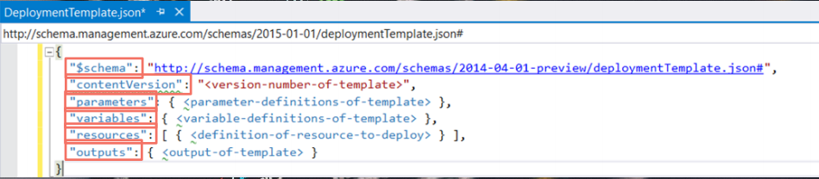
Structure of an ARM template

Slide 6

Structure of an ARM template

Slide 7
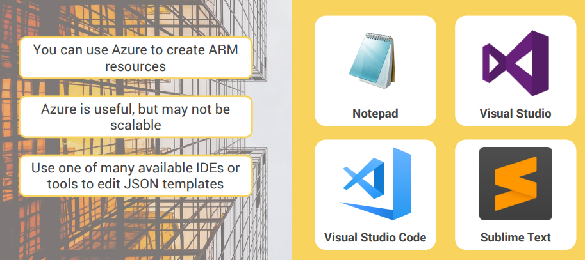
Tools to Edit an ARM template

Slide 8
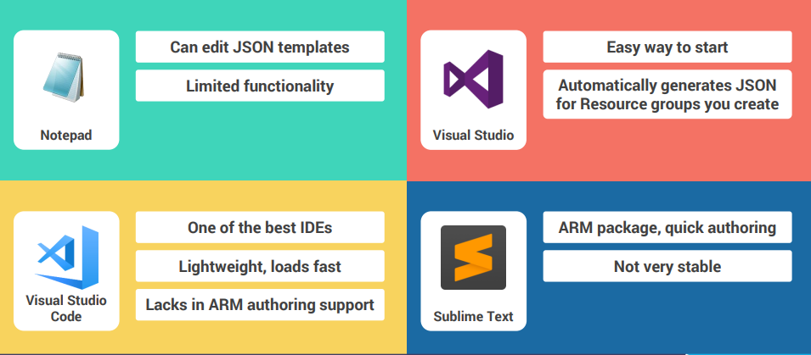
Tools to Edit an ARM template

