Slide 1

REAL ESTATE MANAGEMENT SYSTEM
This system will be used to manage property listings, tenant details, and rental payments.
NAME:UWAKEZA KAMIKAZI MERVEILLE
Group : F
ID:27893

Slide 2
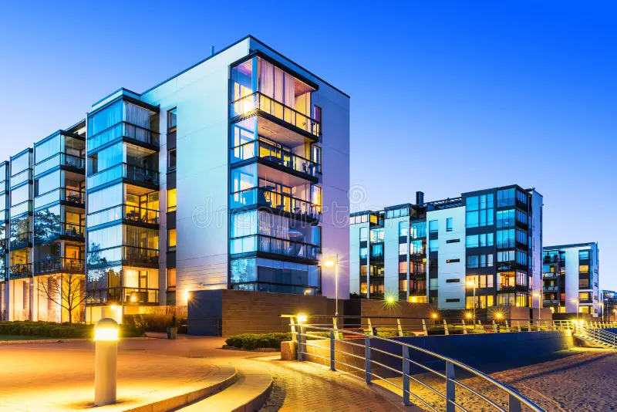
This system can be used in :
This system can be used in :
Property maintenance and repair
Construction management system
Property listings and sales
This system is beneficial to : property managers ,customers, government ,tenants and renters, buyers and investors etc.
Outcomes expected:
Enhances tenant and customer satisfaction
Centralized data management

Slide 3
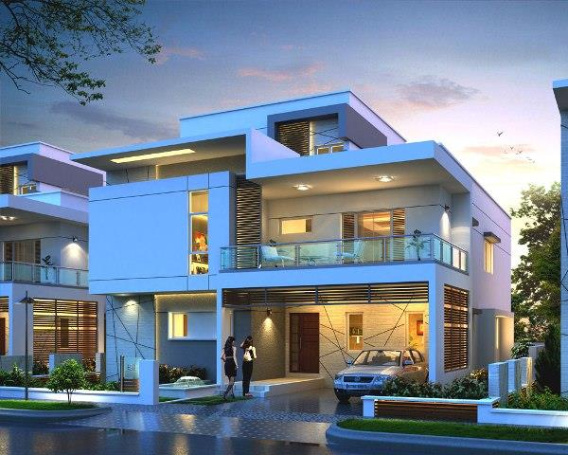
Main entities:
Properties
Tenants
Payments
Objectives :Operational efficiency
Data centralization and accessibility
Financial management
Benefits of the solution :Increased revenue reduced error
Better decision making
Relationships:
Properties and landlord(one-to-many)
Properties and tenants(one-to-one or one-to- many)
Tenants and payments(one-to-many)

