Slide 1
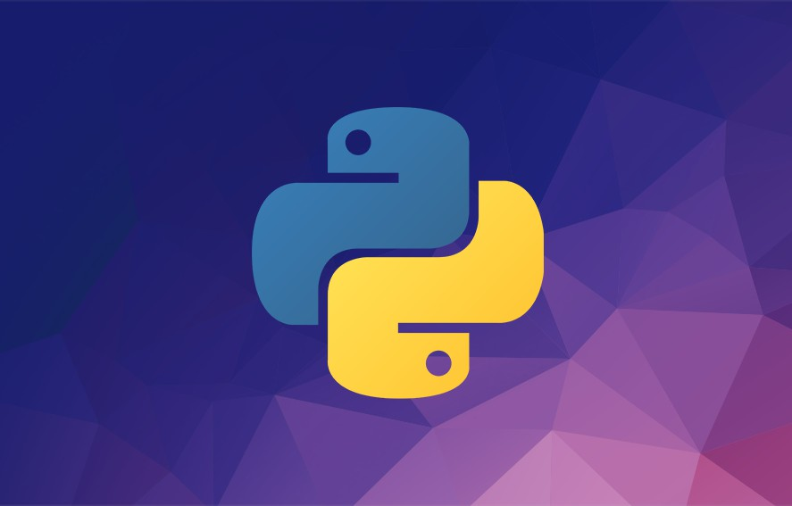
Python Cheat Sheet
Mosh Hamedani
Code with Mosh (codewithmosh.com)
1st Edition

Slide 2
About this Cheat Sheet
This cheat sheet includes the materials I’ve covered in my Python tutorial for Beginners on YouTube. Both the YouTube tutorial and this cheat cover the core language constructs but they are not complete by any means.
If you want to learn everything Python has to offer and become a Python expert, check out my Complete Python Programming Course:
http://bit.ly/complete-python-course

Slide 3

About the Author
Hi! My name is Mosh Hamedani. I’m a software engineer with two decades of experience and I’ve taught over three million how to code or how to become a professional software engineer. It’s my mission to make software engineering simple and accessible to everyone.
https://codewithmosh.com
https://youtube.com/user/programmingwithmosh https://twitter.com/moshhamedani https://facebook.com/programmingwithmosh/

Slide 4
Variables ..................................................................................................5
Comments .................................................................................................5
Receiving Input ........................................................................................5
Strings ......................................................................................................6
Arithmetic Operations .............................................................................7
If Statements ............................................................................................8
Comparison operators ............................................................................8
While loops ...............................................................................................8
For loops ...................................................................................................9
Lists ...........................................................................................................9
Tuples ........................................................................................................9
Dictionaries.............................................................................................10
Functions.................................................................................................10
Exceptions................................................................................................11
Classes......................................................................................................11
Inheritance .............................................................................................12
Modules ...................................................................................................12
Packages..................................................................................................13
Python Standard Library ......................................................................13 Pypi .........................................................................................................14 Want to Become a Python Expert? ........................................................14

Slide 5
Variables
We use variables to temporarily store data in computer’s memory.
price = 10
rating = 4.9
course_name = ‘Python for Beginners’ is_published = True
In the above example,
price is an integer (a whole number without a decimal point)
rating is a float (a number with a decimal point)
course_name is a string (a sequence of characters)
is_published is a boolean. Boolean values can be True or False.
Comments
We use comments to add notes to our code. Good comments explain the hows and whys, not what the code does. That should be reflected in the code itself. Use comments to add reminders to yourself or other developers, or also explain your assumptions and the reasons you’ve written code in a certain way.
# This is a comment and it won’t get executed. # Our comments can be multiple lines.
Receiving Input
We can receive input from the user by calling the input() function.
birth_year = int(input(‘Birth year: ‘))
The input() function always returns data as a string. So, we’re converting the result into an integer by calling the built-in int() function.

Slide 6
Strings
We can define strings using single (‘ ‘) or double (“ “) quotes.
To define a multi-line string, we surround our string with tripe quotes (“””).
We can get individual characters in a string using square brackets [].
course = ‘Python for Beginners’
course[0] course[1] course[-1] course[-2]
# returns # returns # returns # returns
the first character the second character
the first character from the end the second character from the end
We can slice a string using a similar notation:
course[1:5]
The above expression returns all the characters starting from the index position of 1 to 5 (but excluding 5). The result will be ytho
If we leave out the start index, 0 will be assumed.
If we leave out the end index, the length of the string will be assumed.
We can use formatted strings to dynamically insert values into our strings:
name = ‘Mosh’
message = f’Hi, my name is {name}’
message.upper()
# to convert to uppercase
message.lower()
# to convert to lowercase
message.title()
# to capitalize the first letter of every word
message.find(‘p’) # returns the index of the first occurrence of p
(or -1 if not found)
message.replace(‘p’, ‘q’)

Slide 7
To check if a string contains a character (or a sequence of characters), we use the in
operator:
contains = ‘Python’ in course
Arithmetic Operations
+
-
*
/
# returns a float
//
# returns an int
%
# returns the remainder of division
# exponentiation - x ** y = x to the power of y
**
Augmented assignment operator:
x = x + 10
x += 10
Operator precedence:
parenthesis
exponentiation
multiplication / division
addition / subtraction

Slide 8
If Statements
if is_hot:
print(“hot day”) elif is_cold:
print(“cold day”) else:
print(“beautiful day”)
Logical operators:
if has_high_income and has_good_credit:
...
if has_high_income or has_good_credit:
...
is_day = True is_night = not is_day
Comparison operators
a > b
a >= b (greater than or equal to) a < b
a a a
<= b
== b (equals)
!= b (not equals)
While loops
i = 1
while i < 5: print(i) i += 1

Slide 9
For loops
for i in range(1, 5): print(i)
range(5): generates 0, 1, 2, 3, 4
range(1, 5): generates 1, 2, 3, 4
range(1, 5, 2): generates 1, 3
Lists
numbers = [1, | 2, | 3, | 4, | 5]
numbers[0] |  |  | # | returns | the | first item
numbers[1] |  |  | # | returns | the | second item
numbers[-1] |  |  | # | returns | the | first item from the end
numbers[-2] |  |  | # | returns | the | second item from the end
numbers.append(6) numbers.insert(0, numbers.remove(6) numbers.pop() numbers.clear() numbers.index(8) numbers.sort() numbers.reverse() numbers.copy()
# adds 6 to the end
6) # adds 6 at index position of 0 #
# # # # # #
removes 6 removes the removes all returns the
last item the items
index of first occurrence of 8
sorts the list reverses the list
returns a copy of the list
Tuples
They are like read-only lists. We use them to store a list of items. But once we define a tuple, we cannot add or remove items or change the existing items.
coordinates = (1, 2, 3)
We can unpack a list or a tuple into separate variables:
x, y, z = coordinates

Slide 10
Dictionaries
We use dictionaries to store key/value pairs.
customer = {
“name”: “John Smith”, “age”: 30, “is_verified”: True
}
We can use strings or numbers to define keys. They should be unique. We can use any types for the values.
customer[“name”] customer[“type”] customer.get(“type”,
# #
“silver”) #
returns “John Smith” throws an error returns “silver”
customer[“name”] = “new name”
Functions
We use functions to break up our code into small chunks. These chunks are easier to read, understand and maintain. If there are bugs, it’s easier to find bugs in a small chunk than the entire program. We can also re-use these chunks.
def greet_user(name): print(f”Hi {name}”)
greet_user(“John”)
Parameters are placeholders for the data we can pass to functions. Arguments
are the actual values we pass.
We have two types of arguments:
Positional arguments: their position (order) matters
Keyword arguments: position doesn’t matter - we prefix them with the parameter name.

Slide 11
# Two positional arguments greet_user(“John”, “Smith”)
# Keyword arguments
calculate_total(order=50, shipping=5, tax=0.1)
Our functions can return values. If we don’t use the return statement, by default
None is returned. None is an object that represents the absence of a value.
def square(number): return number * number
result = square(2) print(result) # prints 4
Exceptions
Exceptions are errors that crash our programs. They often happen because of bad input or programming errors. It’s our job to anticipate and handle these exceptions to prevent our programs from cashing.
try:
age = int(input(‘Age: ‘)) income = 20000
risk = income / age print(age)
except ValueError:
print(‘Not a valid number’) except ZeroDivisionError:
print(‘Age cannot be 0’)
Classes
We use classes to define new types.
class Point:
def init (self, x, y): self.x = x
self.y = y def move(self):
print(“move”)

Slide 12
When a function is part of a class, we refer to it as a method.
Classes define templates or blueprints for creating objects. An object is an instance of a class. Every time we create a new instance, that instance follows the structure we define using the class.
point1 = Point(10, 5) point2 = Point(2, 4)
init is a special method called constructor. It gets called at the time of creating new objects. We use it to initialize our objects.
Inheritance
Inheritance is a technique to remove code duplication. We can create a base class
to define the common methods and then have other classes inherit these methods.
class Mammal:
def walk(self): print(“walk”)
class Dog(Mammal): def bark(self):
print(“bark”)
dog = Dog() dog.walk() dog.bark()
# inherited from Mammal # defined in Dog
Modules
A module is a file with some Python code. We use modules to break up our program into multiple files. This way, our code will be better organized. We won’t have one gigantic file with a million lines of code in it!
There are 2 ways to import modules: we can import the entire module, or specific objects in a module.

Slide 13
# importing the entire converters module import converters converters.kg_to_lbs(5)
# importing one function in the converters module from converters import kg_to_lbs
kg_to_lbs(5)
Packages
A package is a directory with init .py in it. It can contain one or more modules.
# importing the entire sales module from ecommerce import sales sales.calc_shipping()
# importing one function in the sales module from ecommerce.sales import calc_shipping calc_shipping()
Python Standard Library
Python comes with a huge library of modules for performing common tasks such as sending emails, working with date/time, generating random values, etc.
Random Module
import random
random.random() random.randint(1, 6)
# returns a float between 0 to 1 # returns an int between 1 to 6
members = [‘John’, ‘Bob’, ‘Mary’]
leader = random.choice(members) # randomly picks an item

Slide 14
Pypi
Python Package Index (pypi.org) is a directory of Python packages published by Python developers around the world. We use pip to install or uninstall these packages.
pip install openpyxl
pip uninstall openpyxl
Want to Become a Python Expert?
If you’re serious about learning Python and getting a job as a Python developer, I highly encourage you to enroll in my Complete Python Course. Don’t waste your time following disconnected, outdated tutorials. My Complete Python Course has everything you need in one place:
12 hours of HD video
Unlimited access - watch it as many times as you want
Self-paced learning - take your time if you prefer
Watch it online or download and watch offline
Certificate of completion - add it to your resume to stand out
30-day money-back guarantee - no questions asked
The price for this course is $149 but the first 200 people who have downloaded this cheat sheet can get it for $14.99 using the coupon code CHEATSHEET:
http://bit.ly/complete-python-course

