Slide 1
Introduction to React
A workshop for COMP 523 Aaron Smith Monday, Feb. 10, 2020

Slide 2


What is React?
• • • • •
React is a JavaScriptframework Used for front endweb development Think of jQuery, but more structured Created and used by Facebook Famous for implementing a virtual dom

Slide 3







Timeline of front-end JavaScript frameworks
jQuery* (2006)
AngularJS (2010)
React (2013)
Vue (2014)
Angular (2014)
* jQuery is more often considered a librarythan a framework

Slide 4
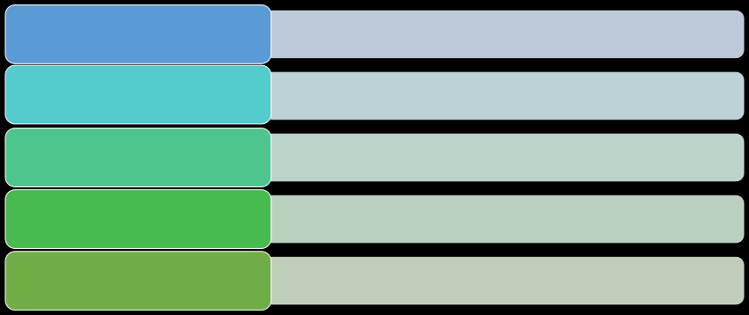
Common tasks in front-end development
App state User actions Templates
Routing
Data fetching
Data definition, organization, and storage
Event handlers respond to user actions
Design and render HTML templates
Resolve URLs
Interact with server(s) through APIs and AJAX

Slide 5
Fundamentals of React
1.
JavaScript and HTML in the same file (JSX)
2.
Embrace functional programming
3.
Components everywhere

Slide 6



JavaScriptand HTMLin the same file
HTML
CSS
JS
JSX
CSS or JSS
Traditional approach
React approach

Slide 7

JSX: the React programming language
const first = "Aaron"; const last = "Smith";
const name = <span>{first} {last}</span>;
const list = (
const listWithTitle = (
<ul>
<>
<li>Dr. David Stotts</li> <li>{name}</li>
<h1>COMP 523</h1> <ul>
</ul>
<li>Dr. David Stotts</li> <li>{name}</li>
);
</ul>
</>
);

Slide 8
“React is just JavaScript”

Slide 9
Functional programming
1.
Functions are “first class citizens”
2.
Variables are immutable
3.
Functions have no side effects

Slide 10
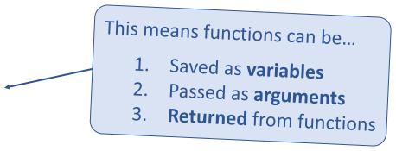



Functional programming
Functions are “first class citizens”
let add = function() {
console.log('Now adding numbers'); const five = 3 + 2;
};
function foo() {
return function() {
console.log('What gets printed?');
function performTask(task) {
};
task(); console.log('Task performed!');
}
}
foo foo(); foo()();
performTask(add);

Slide 11
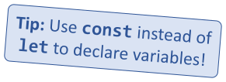


Functional programming
Variables are immutable
let a = 4;
a = 2; // Mutates `a`
let b = [1, 2, 3];
b.push(4); // Mutates `b`
let c = [...b, 4]; // Does not mutate `b`

Slide 12

Functional programming
Functions have no side effects
const b = [];
function hasSideEffects() {
b = [0];
}

Slide 13
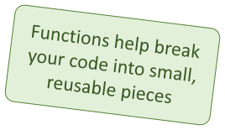


Components
Components are functions for user interfaces
Input
x
Output
number
Math function:
let y = f(x);
Input
x
Output
HTML
Component function:
let y = <FancyDivvalue={x} />;

Slide 14
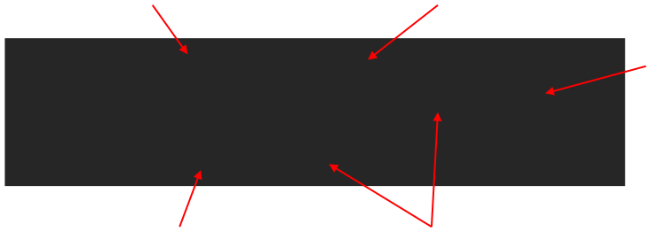
Anatomy of a React component
The component is just
Inputs are passed through a
a function
single argument called “props”
The function
export default function MyComponent(props) {
outputs HTML
return <div>Hello, world! My name is {props.name}</div>;
}
const html = <MyComponent name="aaron" />;
The function is executedas if
Parameters are passed in
it was an HTML tag
as HTML attributes

Slide 15
Component rendering
• •
When a component function executes, we say it “renders” Assume components mayre-render at any time
Our job is to ensure that every time the component re-renders, the correct output is produced

Slide 16
“In React, everything is a component”

Slide 17
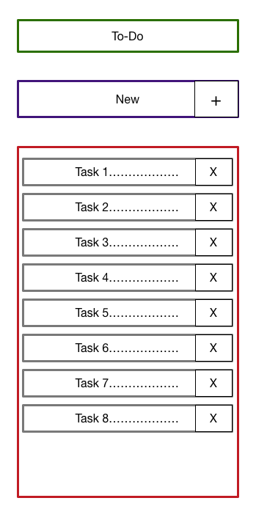
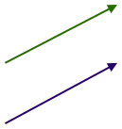


Todoapplication
Big idea:
Title
▪
A digital to-do list
TodoForm
First step:
▪
mockup / wireframe
TodoList
Todo

Slide 18
Creating a new React app
Creating a new React app is simple!
1.Install Node.js
npxcreate-react-app app-name
2. Run: 3.New app created in folder:
./app-name

Slide 19
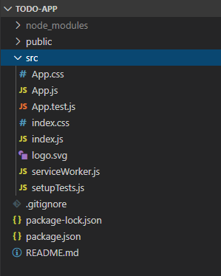

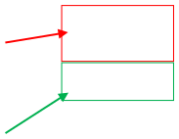

Anatomy of a new React app
publicholds the initial html
document and other static assets
Appis a boilerplate starter component
index.jsbinds
React to the DOM
package.json
configures
npm dependencies

Slide 20


Component Hierarchy
Title
TodoForm
App
Title
TodoList
TodoForm
TodoList
Todo
Todo
Todo
Todo

Slide 21
Special list keyproperty
• • • • •
Situation:Display a dynamic array of elements Must specify a special “key” property for each element The key of an item uniquely identifies it Used byReactinternally for render optimization Can be any unique value (string or number)

Slide 22
What are hooks?
Hooks:Special functions that allow
Built-in hooks:
developers to hook into stateand lifecycleof React components.
useState useEffect
useReducer
useMemo
useRef
useCallback
We will cover
State:One or more data values
these today
associated with a React component
instance.
We will notcover
Lifecycle:The events associated with a
React component instance (create,
render, destroy, etc).
these today

Slide 23

First React hook:
Purpose:
useState
1.Remember values internally when the component re-renders 2.Tell React to re-render the component when the value changes
Syntax:
const [val, setVal] = useState(100);
The current value
A setter function to
The initial value to use
change the value

Slide 24
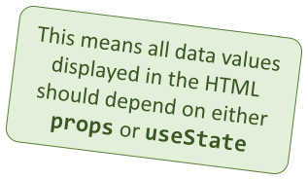
Predicting component re-rendering
A component will only re-render when…
1.A value inside propschanges
–or –
2.A useStatesetter is called

Slide 25

Second React hook:
Purpose:
useEffect
Act as an observer, running code in response to value changes
Syntax:
useEffect(() => {
console.log(`myValue was changed! New value: ${myValue}`);
}, [myValue]);
A list of values such that changes
The code to run when
should trigger this code to run
values change

Slide 26
Building a React project
•
When you’re ready to launch your app, run this command:
npm run build
•
This bundles your app into CSS/JS/HTML files and puts them in the /build folder
These files can be served from an AWS S3 bucket
•

Slide 27
3rdparty components and libraries
• • • • • •
React-Router Redux Material-UI Bootstrap Font-Awesome SWR

