Slide 1
Front-end Development with React.js

Slide 2


What is React?
React is a JavaScript framework
Used for front end web development
Think of jQuery, but more structured
Created and used by Facebook
Famous for implementing a virtual dom

Slide 3





Timeline of front-end JavaScript frameworks
jQuery* | AngularJS | React | Vue | Angular
(2006) | (2010) | (2013) | (2014) | (2014)
jQuery is more often considered a library than a framework

Slide 4
Common tasks in front-end development
App state User actions Templates Routing
Data fetching
Data definition, organization, and storage Event handlers respond to user actions Design and render HTML templates Resolve URLs
Interact with server(s) through APIs and AJAX

Slide 5
Fundamentals of React
JavaScript and HTML in the same file (JSX)
Embrace functional programming
Components everywhere

Slide 6
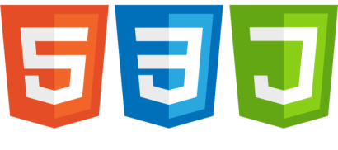


JavaScript and HTML in the same file
HTML CSS
JS
JSX CSS or JSS
Traditional approach
React approach

Slide 7
“React is just JavaScript”

Slide 8
Functional programming
Functions are “first class citizens”
Variables are immutable
Functions have no side effects

Slide 9


Functional programming
Variables are immutable
let a = 4;
a = 2; // Mutates `a`
let b = [1, 2, 3]; b.push(4); // Mutates `b`
let c = [...b, 4]; // Does not mutate `b`

Slide 10
Anatomy of a React component
The component is just a function
Inputs are passed through a single argument called “props”
The function outputs HTML
export default function MyComponent(props) {
return <div>Hello, world! My name is {props.name}</div>; }
const html = <MyComponent name="aaron" />;
The function is executed as if it was an HTML tag
Parameters are passed in as HTML attributes

Slide 11
Component rendering
When a component function executes, we say it “renders”
Assume components may re-render at any time
Our job is to ensure that
every time the component re-renders, the correct output is produced

Slide 12
“In React, everything is a component”

Slide 13
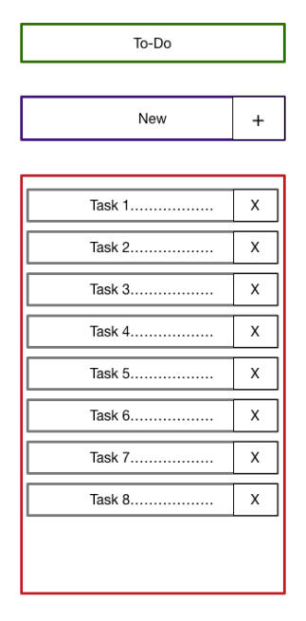
Todo application
Big idea:
A digital to-do list
First step:
mockup / wireframe
Title
TodoForm
TodoList
Todo

Slide 14
Creating a new React app
Creating a new React app is simple!
Install Node.js
Run: npx create-react-app app-name
New app created in folder: ./app-name

Slide 15
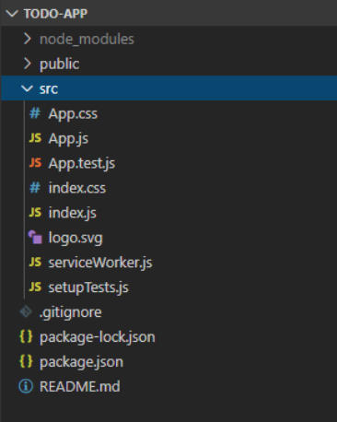
Anatomy of a new React app
public holds the initial html document and other static assets
App is a boilerplate starter component
index.js binds React to the DOM
package.json configures npm dependencies

Slide 16
Component Hierarchy
Title
TodoForm
TodoList
Todo
App
Title TodoList TodoForm
Todo Todo Todo

Slide 17
Special list key property
Situation: Display a dynamic array of elements
Must specify a special “key” property for each element
The key of an item uniquely identifies it
Used by React internally for render optimization
Can be any unique value (string or number)

Slide 18
What are hooks?
Hooks: Special functions that allow developers to hook into state and lifecycle of React components.
State: One or more data values associated with a React component instance.
Lifecycle: The events associated with a React component instance (create, render, destroy, etc).
Built-in hooks:
We will cover these today
We will not cover these today
useState useEffect useReducer useMemo useRef useCallback

Slide 19
First React hook: useState
Purpose:
Remember values internally when the component re-renders
2. Tell React to re-render the component when the value changes Syntax:
const [val, setVal] = useState(100);
The current value | A setter function to | The initial
 | change the value | value to use

Slide 20
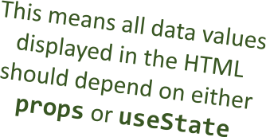
Predicting component re-rendering
A component will only re-render when…
A value inside props changes
or –
A useState setter is called

Slide 21
Second React hook: useEffect
Purpose:
Act as an observer, running code in response to value changes Syntax:
useEffect(() => {
console.log(`myValue was changed! New value: ${myValue}`); }, [myValue]);
A list of values such that changes should trigger this code to run
The code to run when values change

Slide 22
Building a React project
When you’re ready to launch your app, run this command:
npm run build
This bundles your app into CSS/JS/HTML files and puts them in the /build folder
These files can be served from an AWS S3 bucket

