Slide 1

The Ultimate React.js Guide
Created by JS Mastery
Visit jsmastery.pro for more

Slide 2

What’s in the guide?
Learning JavaScript libraries and frameworks can be overwhelming. There are many libraries to choose from, and no proper step-by-step guides that’ll teach you how to use these libraries to their fullest potential.
That’s why, in this guide, you’ll learn the most popular
JavaScript library, used by hundreds of thousands of
developers worldwide - React.js. This guide covers the complete React.js roadmap,
JavaScript prerequisites, essential React.js concepts,
and project ideas that you can build & deploy and put
up on your portfolio and get a job.
Uwihanganye Obed

Slide 3



Brought to you by JSM
This guide will provide you with useful information and actionable steps, but if you truly want to dominate the competition and secure a high-paying job as a full-stack software developer, jsmastery.pro is the answer.
Read until the end for more information and
special discounts!
// With your help on
projects and watching your
videos I was able to land a
$110k/yr React job at a
company in San Diego, CA!
― Jake Simon
Full Stack Developer at Tragic Media
Say
<header>
to JSM Pro
<section id=”hero”>
<h1>
Start Learning
</h1>
<h2>
<!-- React.js -->
<!-- Next.js -->
Web Development
500k+ supporters
<!-- Blockchain -->
</h2>
<!-- Solidity -->
<h1>
Right Now
</h1>
https:
//
jsmastery.pro
JavaScript Mastery
Uwihanganye Obed

Slide 4
Introduction to React.js
React.js is a front-end JavaScript library for building user interfaces. It was developed by Facebook and is maintained by Facebook and the open-source community.
React.js is a phenomenal library that is easy to
understand, has excellent cross-platform support,
has a fantastic community, and is one of the most
loved libraries out there.
There are also two great React.js competitors: Vue.js,
Angular. These libraries and frameworks are mainly
used to create fast and efficient Single Page
Applications. Although these are great technologies,
taking a quick look at Google trends, we can clearly
see that React.js is still in the lead by far.
https:
jsmastery.pro
JavaScript Mastery
//
Uwihanganye Obed

Slide 5

JavaScript prerequisites
You might be wondering, what are the prerequisites to learn such a great JavaScript library?
There’s only one prerequisite and that is - JavaScript. Do not jump straight into React.js without
understanding the topics I've mentioned below.
Before learning React, you should have a
good understanding of these JavaScript topics:
Basic Syntax
ES6+ features Arrow functions Template literals
Uwihanganye Obed

Slide 6
JavaScript prerequisites
Array Methods
Object property shorthand Destructuring Rest operator Spread operator Promises Async/Await syntax Import and export syntax
https:
Uwihanganye Obed
//
jsmastery.pro
JavaScript Mastery

Slide 7
React.js Roadmap
Basic things to learn in React.js
File & Folder structure
Components JSX Props State Events Styling Conditional Rendering
https:
Uwihanganye Obed
//
jsmastery.pro
JavaScript Mastery

Slide 8
React.js Roadmap
Learn about React.js Hooks - the essential hooks to learn:
useState
useEffect useRef useContext useReducer useMemo useCallback
https:
jsmastery.pro
JavaScript Mastery
//
Uwihanganye Obed

Slide 9
React.js Concepts
Components
React JS is a component-based front-end library which means that all parts of a web application are divided into small components.
A component is a small piece of the User interface.
Every React.js application is a tree of components.
Components let you split the UI into independent,
reusable parts. So when you're building an
application with React, you'll build independent and
reusable components, and then you'll combine
them to build a full fledged web application.
https:
Uwihanganye Obed
//
jsmastery.pro
JavaScript Mastery

Slide 10
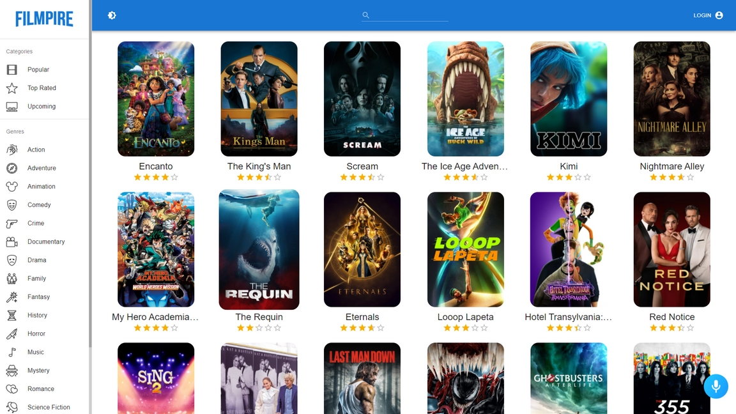
Components explanation
Let's take an example to represent what are React.js components:
First project of the JSM Pro Platform
filmpire.netlify.app
This website is entirely built in React.js. So imagine we're building this website. How would we make it?
https:
Uwihanganye Obed
//
jsmastery.pro
JavaScript Mastery

Slide 11
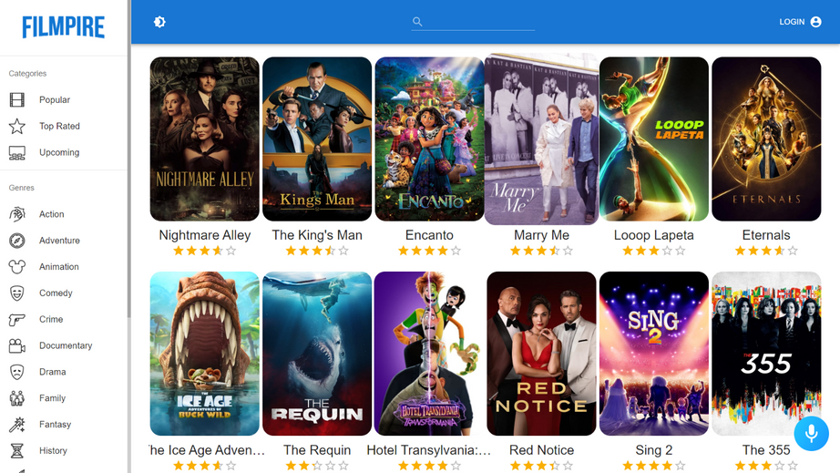

Components explanation
Firstly we'll split the User Interface into small components like Sidebar, Search bar, and Movies, including several single movie components with names and ratings.
Search bar
Sidebar
Movies
Single movie component
https:
jsmastery.pro
JavaScript Mastery
//
Uwihanganye Obed

Slide 12
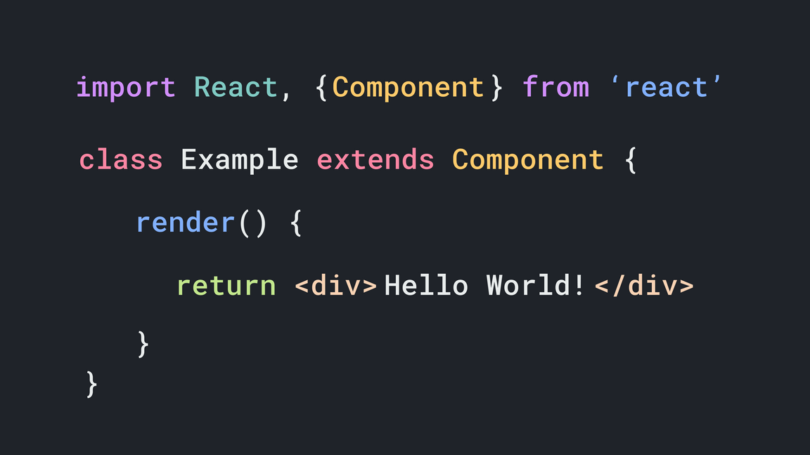
Components explanation
In React, there are two types of components - Functional Components & Class Component
Class-based Component
https:
jsmastery.pro
JavaScript Mastery
//
Uwihanganye Obed

Slide 13
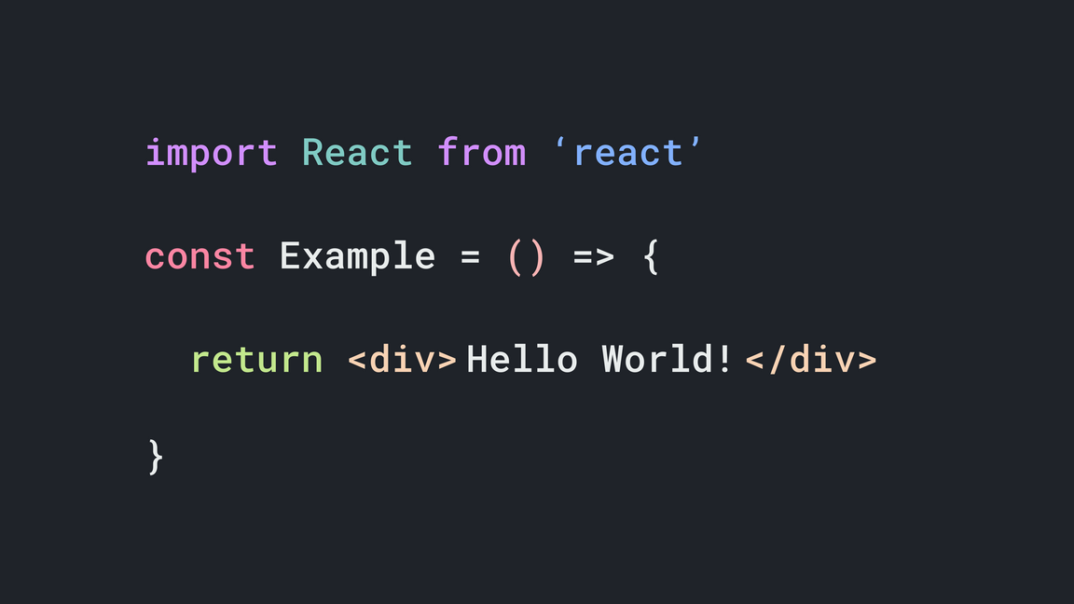
Components explanation
If you don't fully understand, how to use classes, what are the class methods, and what does 'extends' means, don’t you worry at all. Class based are not being used at all anymore and they were replaced by their simpler counterparts
Functional Component
https:
jsmastery.pro
JavaScript Mastery
//
Uwihanganye Obed

Slide 14
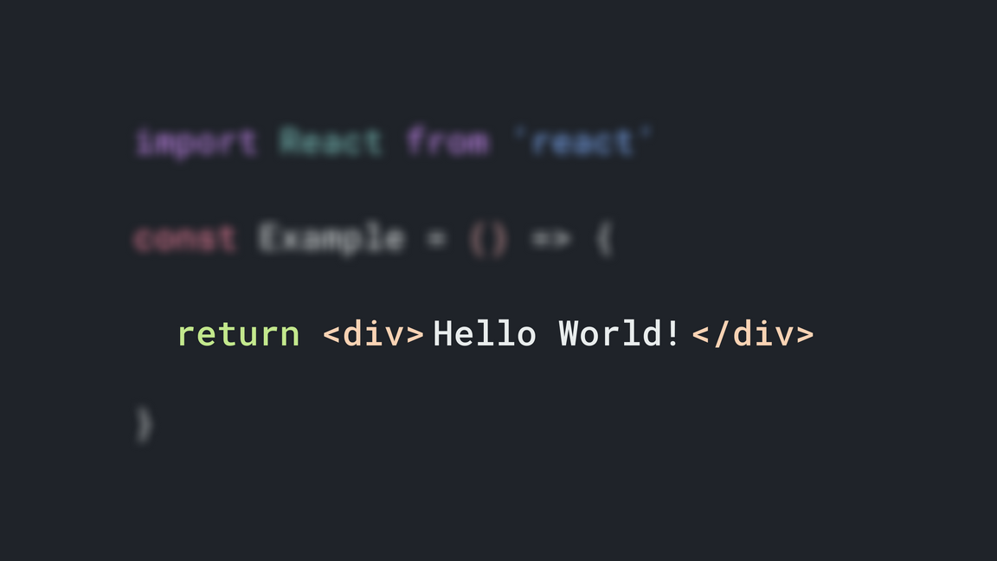
Components explanation
That's it! This is a React Component. You can see how easy it is.
You might be thinking, why are we writing HTML
when returning something.
This tag syntax is neither a string nor HTML.
It is called
JSX
.
https:
Uwihanganye Obed
//
jsmastery.pro
JavaScript Mastery

Slide 15
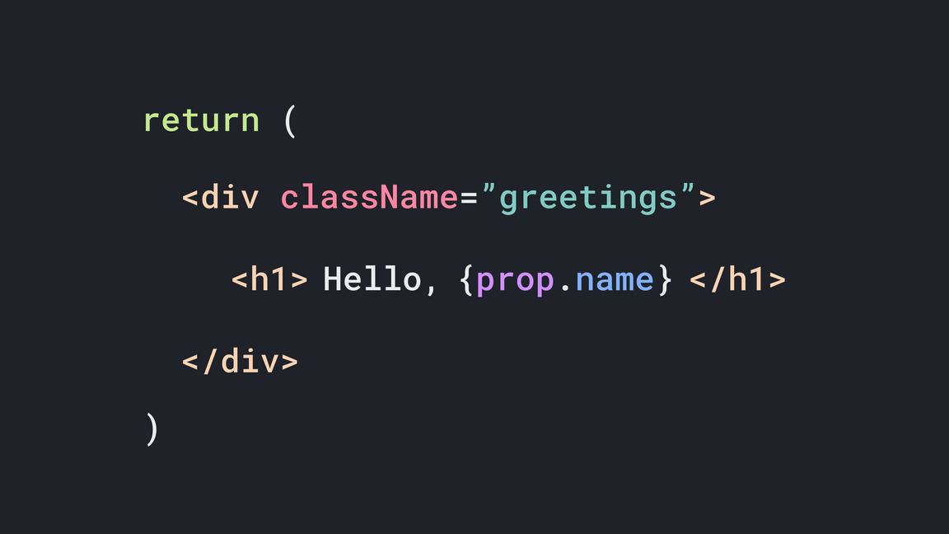
JSX - JavaScript XML
JSX is a syntax extension to JavaScript. It is used in React to describe what the UI should look like. JSX may remind you of a template language, but it comes with the full power of JavaScript.
JSX produces React "elements". JSX forms the core
syntax of React..
https:
jsmastery.pro
JavaScript Mastery
//
Uwihanganye Obed

Slide 16
JSX - JavaScript XML
There are a few differences between HTML & JSX, although generally it’s incredibly similar. Some of the differences are:
Writing className instead of class,
className
class
Because the class is a reserved keyword in JavaScript. Since we use JSX in React, the extension of JavaScript, we have to use 'className' instead of the class attribute.
https:
jsmastery.pro
JavaScript Mastery
//
Uwihanganye Obed

Slide 17
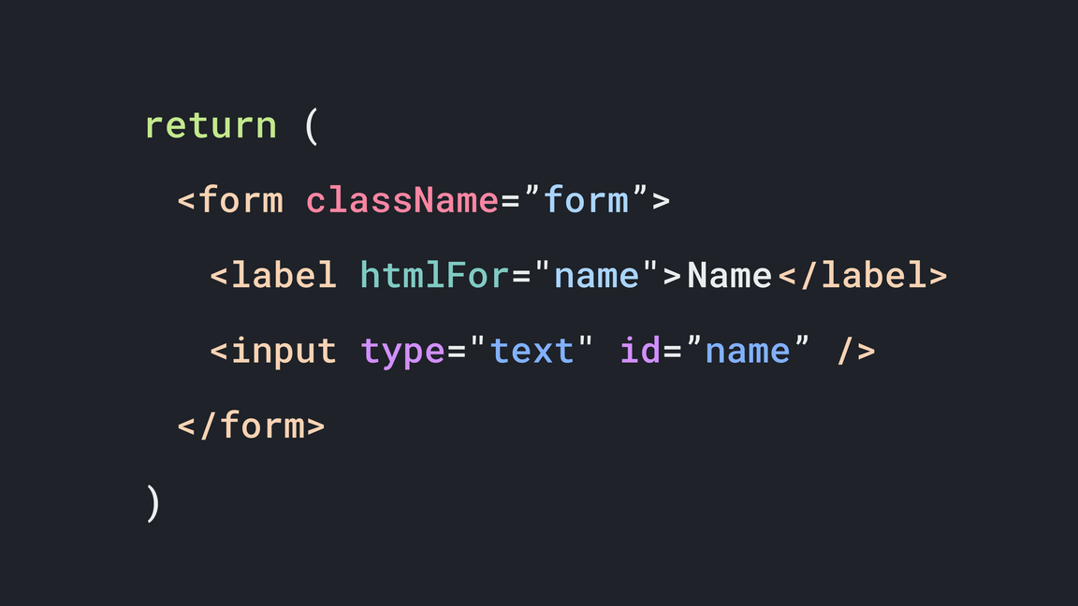
JSX - JavaScript XML
Same as class, there’s also one more reserved keyword of JavaScript that is used in HTML. That is the ‘for’ attribute used with the <label> element.
So, to define for attribute in JSX, you do it as ‘htmlFor’
<label htmlfor=””>
<label for=””>
https:
jsmastery.pro
JavaScript Mastery
//
Uwihanganye Obed

Slide 18
JSX - JavaScript XML
One of the major differences between HTML and JSX is that in JSX, you must return a single parent element, or it won't compile.
You can use ‘React fragments’ instead of divs
<>...</>
<div>...</div>
You can also use divs instead of React fragments, it’s not necessary to use a particular, but using ‘React fragments’ makes the code more readable.
https:
Uwihanganye Obed
//
jsmastery.pro
JavaScript Mastery

Slide 19
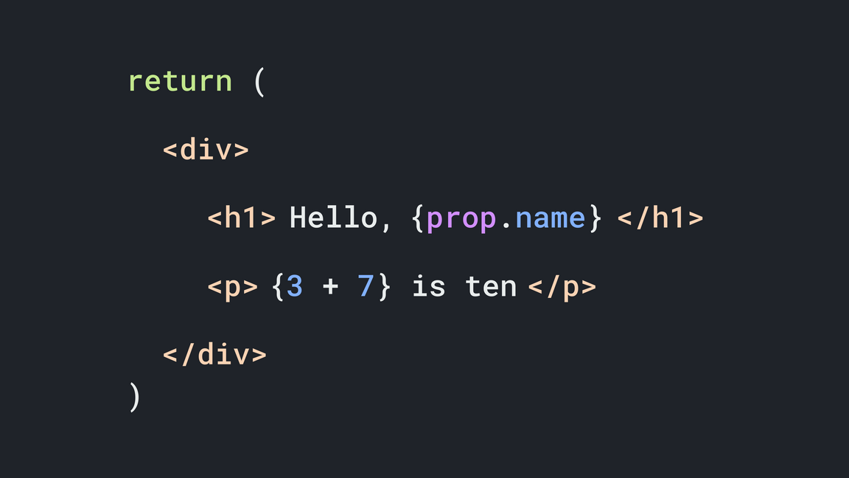
JSX - JavaScript XML
You can implement JavaScript directly in JSX. To use JavaScript expressions, we use curly brackets {...}
Whereas in HTML, you need a script tag or an external JavaScript file to implement JavaScript
https:
jsmastery.pro
JavaScript Mastery
//
Uwihanganye Obed

Slide 20
What are Props?
To make our components accept different data, we can use props. Props are arguments passed into React components. They are passed to components via HTML attributes.
Props is just a shorter way of saying properties. We use props in React to pass data from one
component to another (from a parent component
to child components), But you can't pass props
from a child component to parent components.
Data from props is read-only and cannot be
modified by a component receiving it from outside.
https:
jsmastery.pro
JavaScript Mastery
//
Uwihanganye Obed

Slide 21
What is State?
A State is a plain JavaScript object used by React to represent a piece of information about the component's current situation. It's managed in the component (just like any variable declared in a function).
The state object is where you store property values
that belongs to the component. When the state
object changes, the component re-renders. State data can be modified by its own component,
but is private (cannot be accessed from outside)
https:
//
jsmastery.pro
JavaScript Mastery
Uwihanganye Obed

Slide 22
What is Events?
An event is an action that could be triggered as a result of the user action or a system-generated event. For example, a mouse click, pressing a key, and other interactions are called events.
Handling events with React elements is similar to
handling events on DOM elements. There are just
some syntax differences.
React events are named using camelCase,
rather than lowercase.
With JSX you pass a function as the event
handler, rather than a string.
https:
jsmastery.pro
JavaScript Mastery
//
Uwihanganye Obed

Slide 23
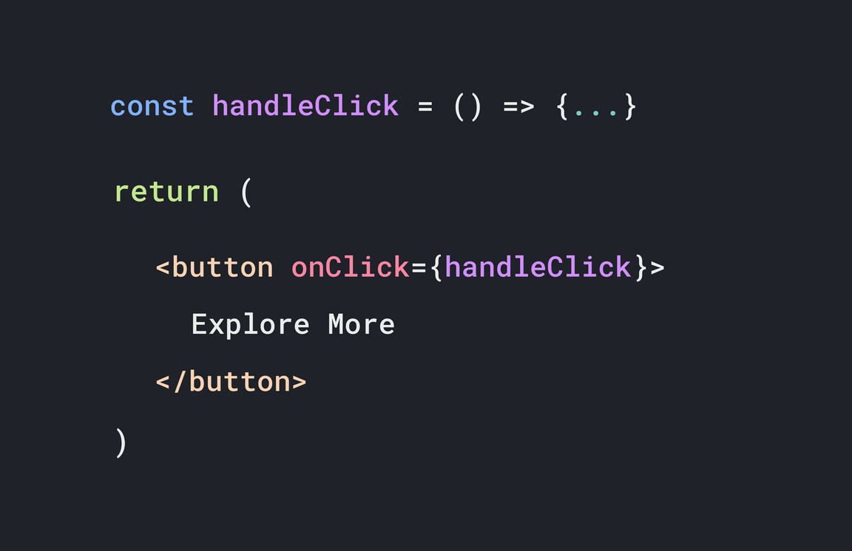
How to add Events?
https:
jsmastery.pro
JavaScript Mastery
//
Uwihanganye Obed

Slide 24
What are React.js Hooks?
Hooks are a new addition to React in version 16.8 that allows you to use state and other React features, like lifecycle methods. Using hooks makes your code cleaner.
Hooks don't work inside classes — they let you use
React without classes.
Hooks let you always use functions instead of having
to constantly switch between functions, classes,
higher-order components, and render props. Nowadays, hooks are widely used. So you should
start using it as well. You can also create your own
Hooks to reuse stateful behavior between different
components.
https:
jsmastery.pro
JavaScript Mastery
//
Uwihanganye Obed

Slide 25








Project Ideas
Real Estate App
Cryptocurrency App Travel Companion App ECommerce Web Shop Voice Assistant News App Portfolio Website Voice Powered Budget Tracker Blog App with CMS
https:
Uwihanganye Obed
//
jsmastery.pro
JavaScript Mastery

Slide 26








Project Ideas
Social Media Web App
Modern UI/UX Website Chat App Video Chat App Progressive Web Apps Covid-19 Tracker App Google Search Clone Premium Landing Page
https:
Uwihanganye Obed
//
jsmastery.pro
JavaScript Mastery

