Slide 1
Document Processing with Docling
From Scanned Documents to AI-ready Data
Outreachy contribution
Janine Robi Makorre

Slide 2

The Problem
Working with scanned documents is difficult:
Text is not structured
Content is not searchable
Not usable for AI systems
Goal:
Turn raw PDFs into structured, searchable, AI-ready data

Slide 3
Approach (Pipeline)
End-to-End Pipeline:
PDF → OCR → Markdown → Analysis → RetrievalTools
Tools used:
Docling
Tesseract
EasyOCR
RapidOCR

Slide 4
Why These OCR Engines?
Three OCR engines were selected to represent different approaches:
Tesseract→ reliable, strong structure preservation
EasyOCR→ deep learning-based, flexible, and multilingual
RapidOCR→ fast, lightweight, efficient pipeline
Each offers a different balance of:
Speed
Accuracy
formatting consistency

Slide 5
Evaluation Criteria (Key Metrics)
The comparison focused on:
extraction accuracy
structure preservation
noise levels
suitability for downstream tasks
Goal:
Identify which OCR output is most useful for AI workflows

Slide 6
OCR Comparison (Core Insight)
Key Observations:
Tesseract→ best structural consistency
EasyOCR→ flexible but introduces more noise
RapidOCR→ best balance between speed and quality
Insight:
No single OCR engine is perfect — the best choice depends on the use case

Slide 7
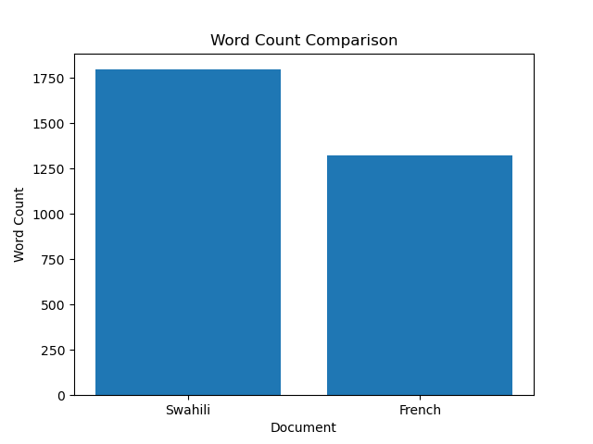
OCR Output Size Comparison
Both documents contain a similar number of words after OCR processing.
This shows that all engines are able to extract comparable amounts of text.
However, quantity alone does not reflect quality — structure and noise must also be considered.

Slide 8
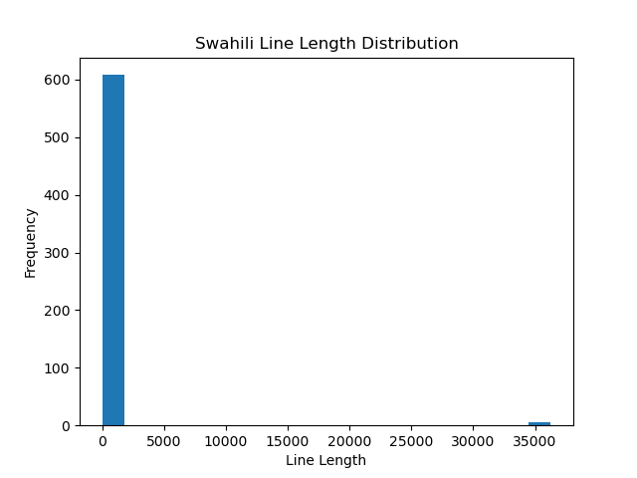
Swahili Document Structure
The Swahili document contains mostly short lines.
This reflects its structured format (phrases and lists).
OCR preserves this structure, but may introduce noise in segmented content.

Slide 9
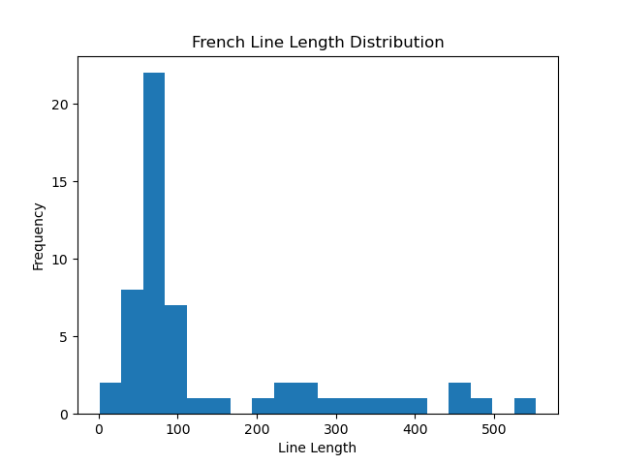
French Document Structure
The French document shows longer and more varied line lengths.
This reflects paragraph-style text with continuous sentences.
OCR handles this format more smoothly, resulting in more consistent output.

Slide 10
Semantic Retrieval
From OCR to AI
OCR outputs were converted into embeddings to enable meaning-based search.
Process:
clean text
split into chunks
generate embeddings
retrieve relevant content
This enables:
semantic search
RAG-style workflows

Slide 11
Example Query:
Query: “How do I greet someone in Swahili?” Retrieved Output:
“Habari” (Hello)
“Shikamoo” (Respectful greeting)
Insight:
The system retrieves meaning, not just keywords

Slide 12
Challenges & Debugging
Key Challenges:
Windows permissions (symlink errors)
Python environment conflicts
OCR model setup delays
Resolution:
standardized environment
enabled developer mode
ensured consistent setup
Insight:
Environment setup is critical for reliable pipelines

Slide 13
Real-World Applications
This pipeline can be applied to:
digitizing scanned records
making documents searchable
enabling AI systems to query unstructured data
OCR is not the end
it is the foundation for AI workflows

Slide 14
Key Findings
Some Key Findings:
All OCR engines produced usable outputs
Tesseract → most stable structure
EasyOCR → flexible but noisier
RapidOCR → best speed-quality balance
Most importantly:
OCR quality directly impacts downstream AI performance

Slide 15
Limitations & Future Work
Limitations
OCR struggles with complex layouts
Output still requires cleaning
Retrieval quality depends on OCR quality
Future Improvements
better preprocessing
layout-aware OCR
improved chunking strategies

Slide 16
Closing
From raw documents → structured knowledge
This project demonstrates:
OCR enables transformation
Structured data enables understanding
Understanding enables AI

Slide 17
Thank you!!!!

