Slide 1
Logo
Classifier
V 1.0

Slide 2
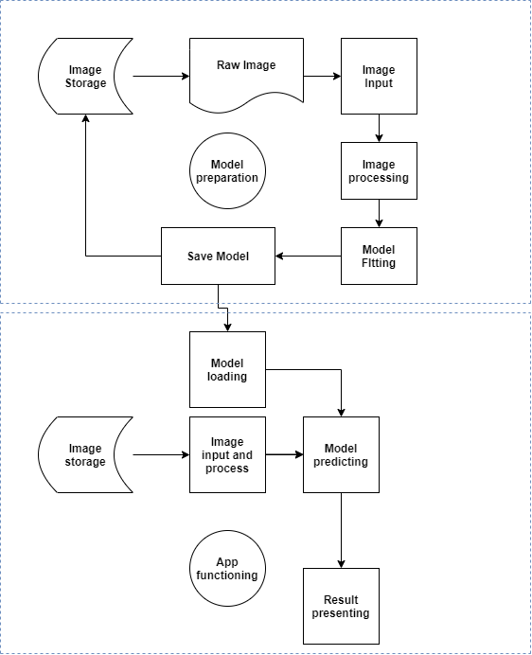

Slide 3
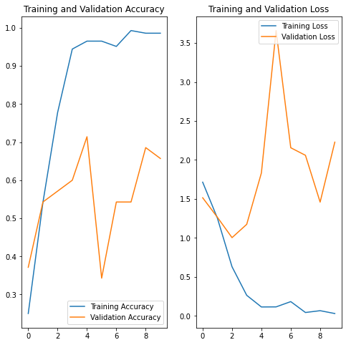

Slide 4
https://github.com/UxxUnet/cv_materials

