Slide 1
Project2-The Bankers
Team: Caitlin, Fatima, Marquel, Shabana, Uyenvy

Slide 2
Tech Stack
Java,
PostgreSQL,
Spring Data,
Spring Boot,
Spring ORM,
React,
Spring Framework,
Spring MVC

Slide 3
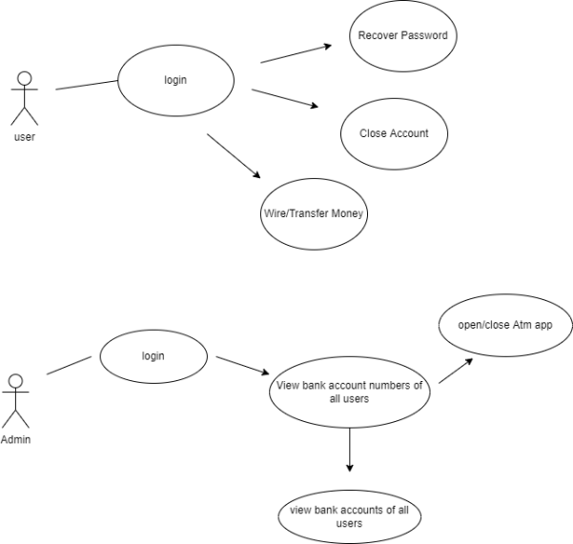
ERD

Slide 4
Features
Login
logout
login as an admin
view account balance
close account
transfer money
manage users

Slide 5
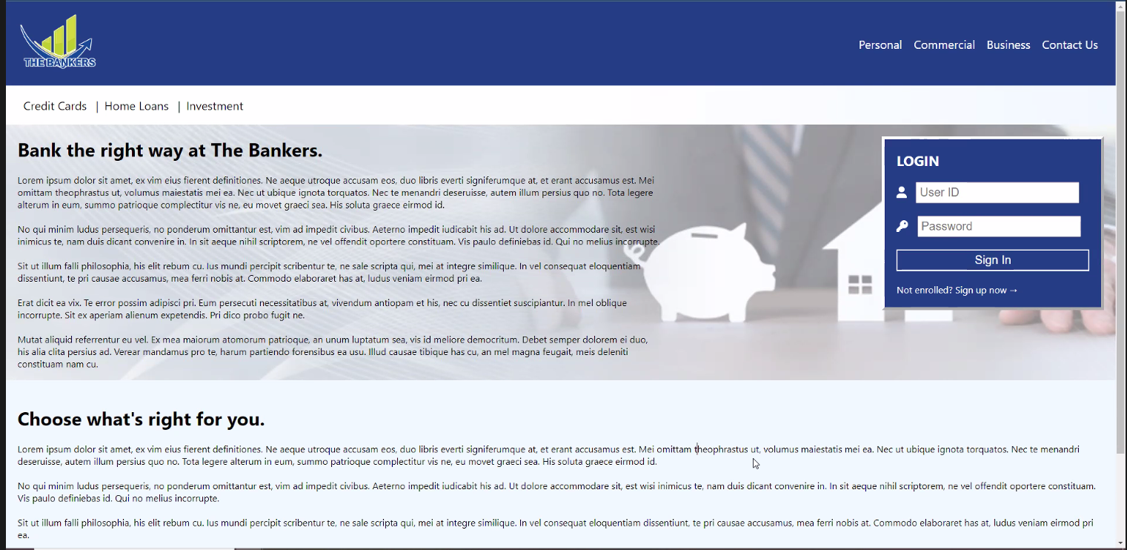
Live Demo

