Slide 1


Uyenvy Nguyen’s p0 project
An Ecommerce mock website

Slide 2


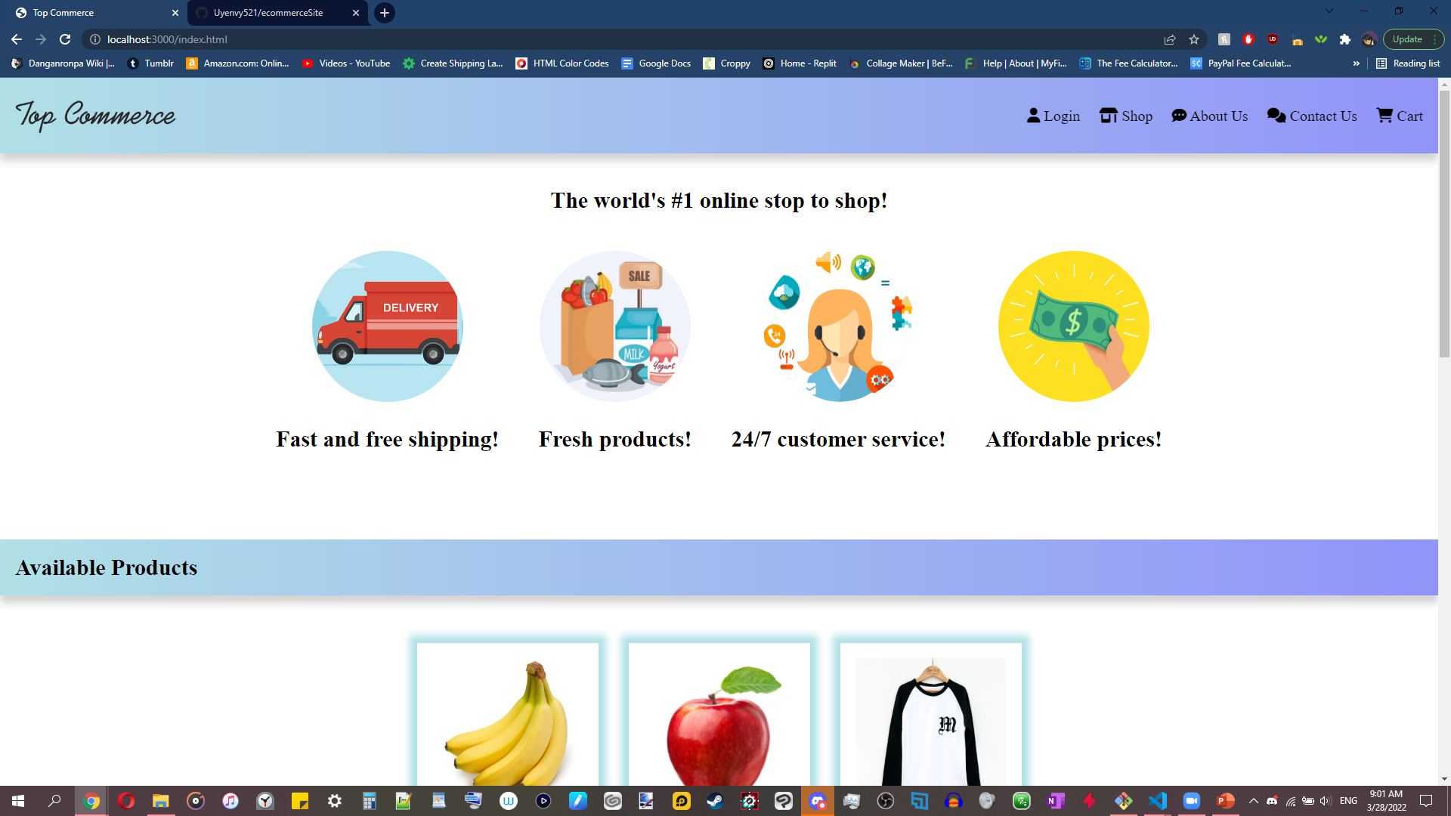
Features Required
Basic & Admin users
Login & out
New user registration
Cart order, edit, and checkout
Users can edit their nickname and view order history
Admin can add & remove users; view all users & orders; add & remove inventory
Required fields popup
SPA styled!

Slide 3
Thank you for your time!

