Slide 1

RentEZ
FINAL PROJECT PRESENTATION · GROUP 2
Car rental on five independently deployable microservices
John Ling · Sachin Agrawal · Quek Shen An · Muhammad Nur Hakim Bin Azman
Graduate Certificate in Architecting Scalable Systems · 16 Oct 2026
github.com/Uygnis/NUS-ISS-ASS-Practice-Module
Notes:
Good afternoon. We're presenting RentEZ, a car rental platform built as five independently deployable microservices on AWS.

Slide 2
Agenda
AGENDA
# | Section | What we cover
01 | Overview | Business problem, platform thinking, scope
02 | Project Conduct | Status, outstanding issues, milestones, team
03 | Logical Architecture & Design | Key decisions, bounded contexts, DDD
04 | Physical Architecture & Design | AWS deployment, persistence, book-and-pay
05 | DevOps & Development Lifecycle | Source control, pipeline, findings
06 | Demo | Use cases, performance, autoscaling
 | Q&A | Questions and answers
RentEZ · Group 2 · 02
Notes:
Times in minutes, presentation + Q&A. The demo needs its full 10 minutes.

Slide 3
Context and Business Problem
01 OVERVIEW · 2 + 1 MIN
Context
Business problem
Customers browse, book, pay, get notified
Staff run the fleet; admins run users and refunds
Five services that cannot read each other's tables
A car exists once: no double-booking
Money and bookings must always agree
A notification outage must not fail a booking
Our solution: every booking is guaranteed, every payment matches it, and capacity grows with demand
RentEZ · Group 2 · 03
Notes:
A car exists once. Every problem here is easy in one database. Our subject: how do you keep them true when the data is split across five services that cannot see each other's tables? That question drives every decision today.

Slide 4

Platform Thinking
01 OVERVIEW · 2 + 1 MIN
Producers
Platform
Consumers
Staff publish cars, maintenance
Services publish events
Date-range availability
Booking + payment saga
Customers book and pay
Notification reads events
Network effect: more cars draw more customers
Shared services: five services, each deployable alone
Open interfaces: REST APIs + outbox domain events
RentEZ · Group 2 · 04
Notes:
We didn't build one app; we built reusable capabilities that producers and consumers meet through one API edge. Infrastructure is self-service too: one command brings up an environment, and CI runs the same command.

Slide 5


Project Scope
01 OVERVIEW · 2 + 1 MIN
In scope
Out of scope
Customer, staff and admin flows
AWS deployment: dev + prod
CI/CD with SAST + SCA
k6 load and scalability tests
Real payment provider (in-process mock gateway)
Refresh tokens and token revocation
Queue-based autoscaling (KEDA), multi-region
Assumptions: student AWS budget (spot nodes, daily teardown); depth on correctness and scalability over feature breadth
RentEZ · Group 2 · 05
Notes:
We cut breadth so we could go deep on correctness and scalability.

Slide 6
Current Status and Outstanding Issues
02 PROJECT CONDUCT · 1.5 + 0.5 MIN
Outstanding issues
OVERALL COMPLETION
100%
Issue | Impact | Plan / owner
CPU-based HPA lags pool exhaustion | High | KEDA on pending connections / future
Frontend tests off in CI | Medium | Re-enable npm test
No token revocation or refresh | Medium | DynamoDB sessions / defer
CloudFront masks API 404s as 200 | Low | Scoped /api/* behaviour / defer
5 of 5 services + frontend deployed
RentEZ · Group 2 · 06
Notes:
All five services and the frontend are deployed on AWS in separate dev and prod environments. 71 backend tests on real PostgreSQL plus a 33-step smoke test. Outstanding issues stated up front; each has a known fix.

Slide 7
Milestones and Team Effort
02 PROJECT CONDUCT · 1.5 + 0.5 MIN
M1 · Services
M2 · Frontend
M3 · AWS + CI/CD
M4 · Load testing
M5 · Final demo
Aug · Done
29 Aug · Done
Mid Sep · Done
27 Sep · Done
16 Oct · Planned
Member | Role | Main contributions | Effort (h)
John Ling | DevOps | AWS infrastructure, CI/CD, SonarCloud | [__]
Sachin Agrawal | Frontend | React SPA, booking and admin pages | [__]
Quek Shen An | Architecture | Service boundaries, saga, load testing | [__]
Muhammad Nur Hakim Bin Azman | Backend | Spring Boot services and APIs | [__]
Total |  |  | [__]
RentEZ · Group 2 · 07
Notes:
Each member states their area and rough effort. Load testing in the last week of September was the most valuable work of the project.

Slide 8
Key Architectural Decisions: Logical
03 LOGICAL ARCHITECTURE & DESIGN · 7 + 2 MIN
ID | Decision | Rationale | Trade-off
AD-01 | Database per service (schema + role, no grants) | A boundary you can cross is not a boundary; db-isolation proves it | One RDS instance shared; no joins
AD-02 | No cross-service joins: snapshot or call the owner | Schemas stay private; bookings survive repricing | Duplicated car fields on booking
AD-03 | Saga + idempotency, no distributed transactions | 2PC blocks and does not work over HTTP | Compensation + reconciliation code
AD-04 | No dependency cycles: availability lives in reservation | Every service builds, tests and deploys alone | One endpoint moved out of catalog
AD-05 | Stateless JWT validated locally | Identity is never a bottleneck or SPOF | Permissions only as fresh as the token (15 min)
AD-06 | Degrade, don't cascade (partial: true, null not 0) | A confident zero is worse than "unknown" | Clients must handle missing sections
RentEZ · Group 2 · 08
Notes:
Six decisions. For each: what, and why. Database per service; no cross-service joins; saga instead of 2PC; no cycles; stateless identity; degrade don't cascade.

Slide 9
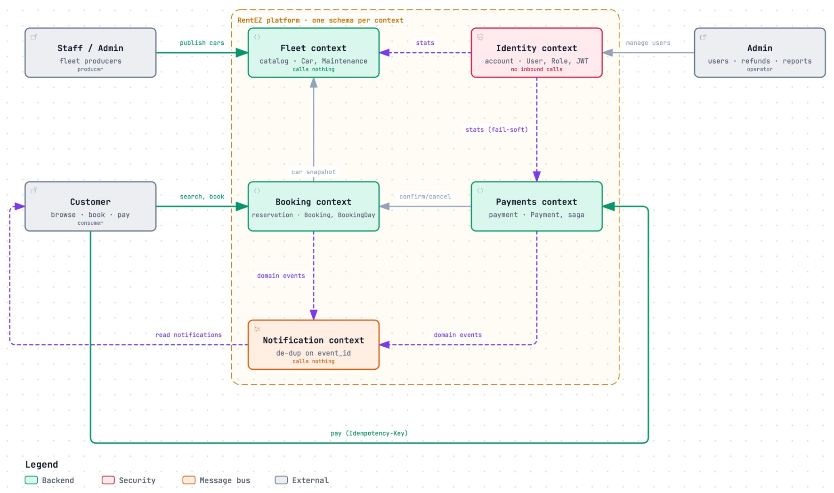

Logical Components
03 LOGICAL ARCHITECTURE & DESIGN · 7 + 2 MIN
Key components
Fleet cars, maintenance; calls nothing
Booking availability, bookings, snapshot
Payments payment saga, refunds
Notification consumes events; calls nothing
Identity JWT, admin dashboard; no callers
RentEZ · Group 2 · 09
Notes:
Read it outside in. Staff produce the fleet; customers book and pay; payments confirms back into booking; both publish domain events to notification. Fleet and Notification call nothing. Nothing calls Identity at runtime, which is why it can safely host the admin dashboard.

Slide 10
Domain-Driven Design for the Platform
03 LOGICAL ARCHITECTURE & DESIGN · 7 + 2 MIN
Producers
Platform core: bounded contexts
Consumers
REST APIs, DTOs only
Outbox domain events
Fleet
Booking
Customers via SPA
Notification subscribes
Dashboard reads stats
Payments
Notification
DDD PATTERNS USED
Aggregates: Booking
Events: outbox
ACL: car snapshot
Open host: Fleet API · JWT claims
RentEZ · Group 2 · 10
Notes:
Identity publishes a language: JWT claims. Fleet is an open host service. Booking snapshots car data as its anti-corruption layer. Payments and Booking are customer/supplier through idempotent confirm and cancel. Notification is a conformist consumer that de-duplicates by event_id. Domain events go through a transactional outbox: the business change and the event commit together.

Slide 11
Key Architectural Decisions: Physical
04 PHYSICAL ARCHITECTURE & DESIGN · 7 + 2 MIN
ID | Decision | Rationale | Trade-off
PD-01 | CloudFront as the only public entry (/ and /api/*) | Same origin: no CORS, certificate or domain | Edge rewrites 404s for the SPA
PD-02 | One ALB via IngressGroup; spot nodes; no NAT | ~70% cheaper; pods are stateless | Spot interruptions; public subnets + SGs
PD-03 | Persistent vs ephemeral layers + lease Lambda | $0.80/month idle, $0.21/hour running; no runaway bill | ~20 min to bring the cluster up
PD-04 | Separate dev and prod (own cluster, RDS, logs) | A load test on dev cannot starve the prod demo | Two of everything ephemeral
PD-05 | HPA per service + Cluster Autoscaler (2-5 nodes) | Capacity follows demand automatically | Notification needs queue-based scaling
RentEZ · Group 2 · 11
Notes:
Five physical decisions, each with its trade-off.

Slide 12
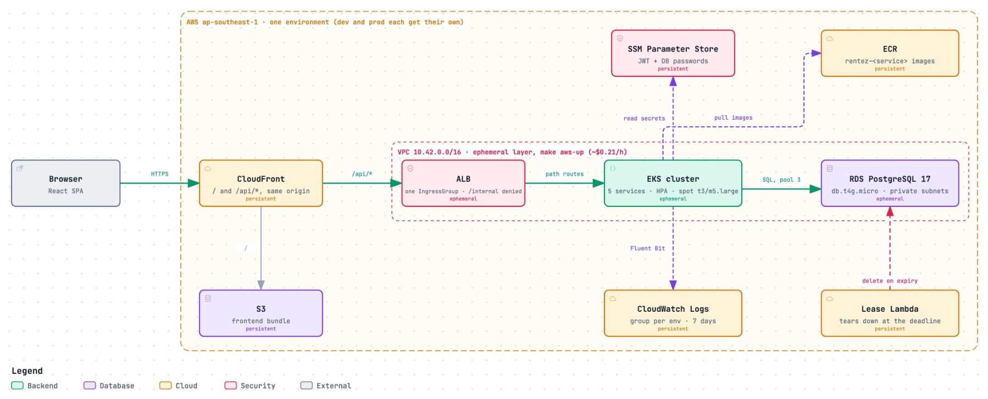

Physical Architecture
04 PHYSICAL ARCHITECTURE & DESIGN · 7 + 2 MIN
Network
VPC · one ALB · private RDS
Nodes
EKS · 2-5 spot nodes
Technologies
Java 21 · Spring Boot · React
Cloud services
CloudFront · S3 · ECR · RDS
RentEZ · Group 2 · 12
Notes:
A request enters CloudFront, which serves the SPA from S3 and forwards /api/* to one ALB, which routes by path to five services on EKS. RDS PostgreSQL 17 in private subnets. The lease Lambda deletes the ephemeral layer when its deadline passes.

Slide 13
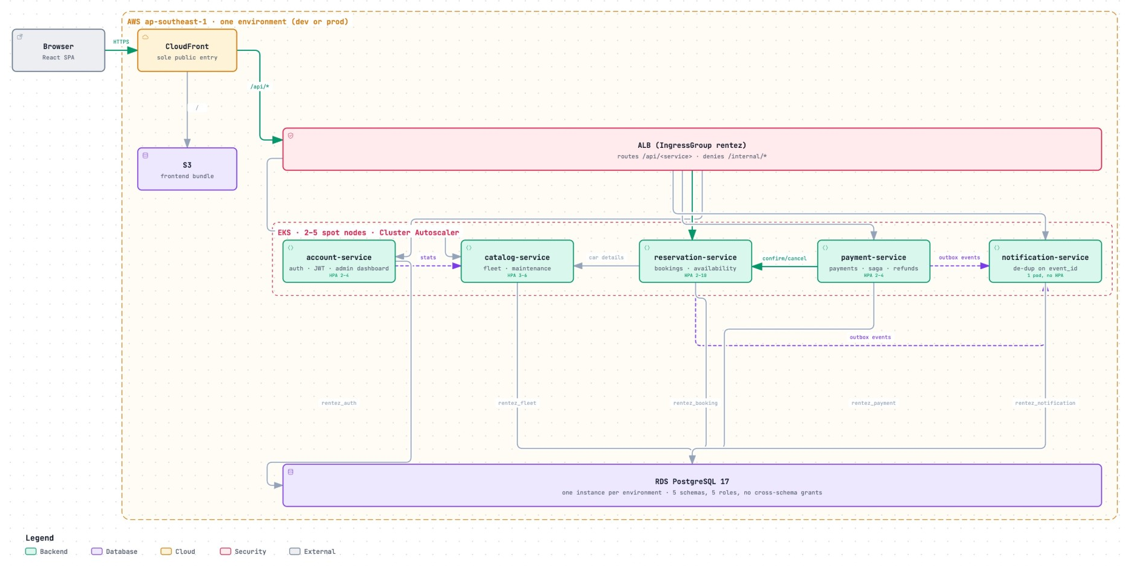
System Overview: Services on AWS
04 PHYSICAL ARCHITECTURE & DESIGN · 7 + 2 MIN
RentEZ · Group 2 · 13
Notes:
All five services with their HPA ranges and the calls between them; one schema each in one RDS instance.

Slide 14
Persistence Design
04 PHYSICAL ARCHITECTURE & DESIGN · 7 + 2 MIN
Data store | Type | Owning service | Data held | Why
PostgreSQL 17 (RDS) | Relational | All 5 | Own schema each | ACID, DB invariants
booking_day | PK (car_id, day) | reservation | Car per day | No double-booking
payment | UNIQUE keys | payment | Idempotency key | Safe retries
outbox_event | Table | reservation, payment | Pending events | Atomic with change
Consistency: schema per service; saga + outbox across services
Backup and retention: DB dumped to S3 on teardown; logs 7 days
RentEZ · Group 2 · 14
Notes:
Correctness lives in the database. A primary key has no window; check-then-insert does. Our test races eight threads for one car and exactly one wins.

Slide 15
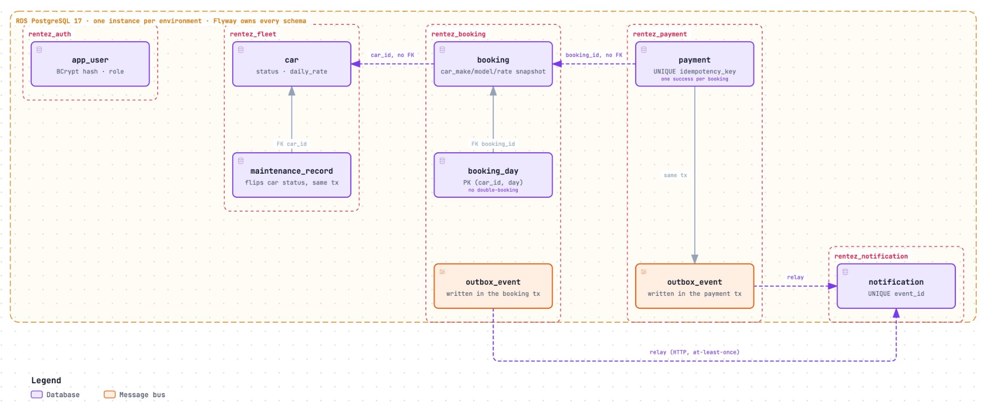
Persistence: Schema per Service
04 PHYSICAL ARCHITECTURE & DESIGN · 7 + 2 MIN
RentEZ · Group 2 · 15
Notes:
Five schemas, five roles, no grants across. Plain ids across schemas, foreign keys within. Outbox tables relay to notification, which de-duplicates on event_id.

Slide 16
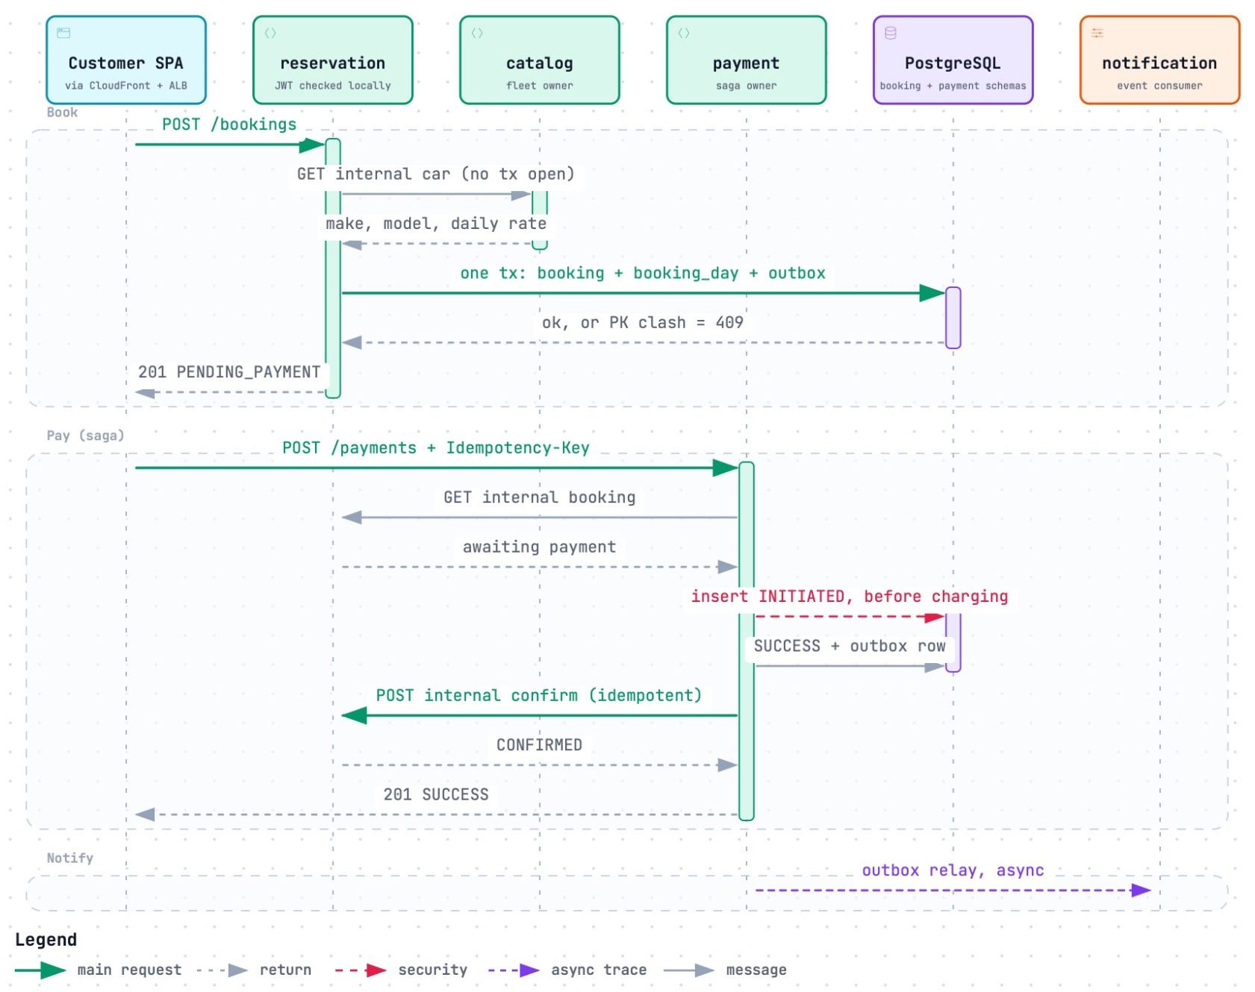

Representative Use Case: Book and Pay
04 PHYSICAL ARCHITECTURE & DESIGN · 7 + 2 MIN
Flow
Book: one tx, or 409
Pay: INITIATED before charge
Idempotent confirm, else compensate
Outbox relays the event
Why representative: exercises almost every decision
RentEZ · Group 2 · 16
Notes:
Holding a DB connection across the catalog call is the exact bug that capped us under 50 actions/s. Payment is written INITIATED before charging so money never moves unrecorded. If confirm times out, the reconciliation sweeper retries; confirm is idempotent.

Slide 17



Source Code and Artifact Management
05 DEVOPS & DEVELOPMENT LIFECYCLE · 6 + 1 MIN
Repositories
Branching and review
Artifacts
Monorepo on GitHub
5 standalone Maven services
No shared library or parent POM
feature/** → dev → main
PR + green CI on dev and main
sync-main auto-PRs; CODEOWNERS
ECR: rentez-<service>
Tagged short + full commit SHA
Secrets in SSM; Helm values per service
RentEZ · Group 2 · 17
Notes:
The branch is the environment selector: dev deploys to dev, main to prod. No shared library: each image builds alone, and releases stay independent.

Slide 18

DevOps Pipeline and Procedures
05 DEVOPS & DEVELOPMENT LIFECYCLE · 6 + 1 MIN
Commit
Build
Test
Scan
Package
Deploy
Monitor
GitHub
Maven
JUnit
CodeQL
Docker
Helm
Logs
Environments and promotion
Procedures
feature/** → dev (dev env) → main (prod env)
Deploy on CI success only, tested commit SHA
eksctl + CloudFormation + Helm
Tests + CodeQL + OWASP block the merge
Redeploy previous SHA with aws-deploy
JWT and DB passwords in SSM
RentEZ · Group 2 · 18
Notes:
CI runs the same make aws-deploy a developer runs: one script, two callers. aws-up provisions in about 20 minutes; aws-deploy ships code in about 3.

Slide 19
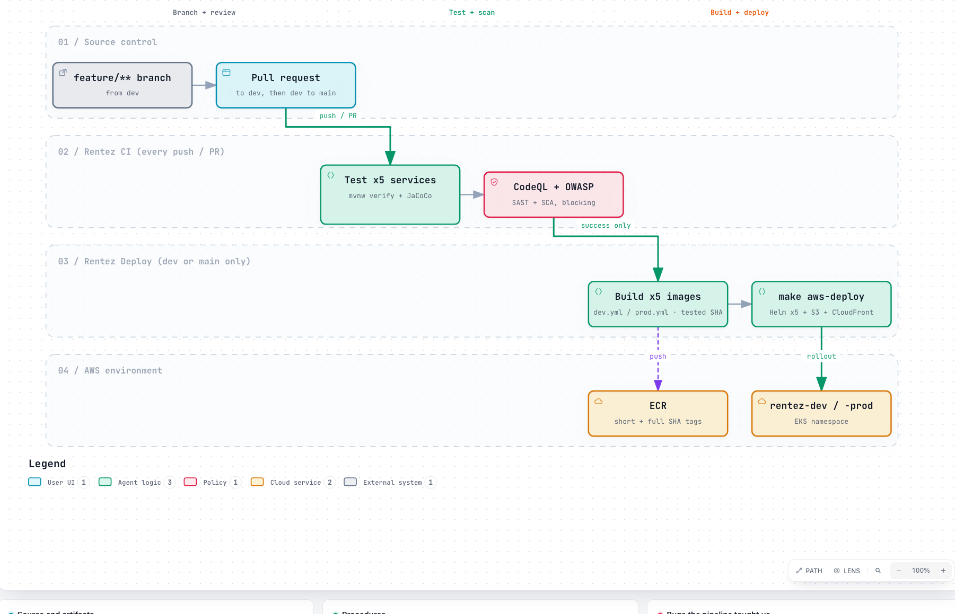
Pipeline: Branch to Running Pods
05 DEVOPS & DEVELOPMENT LIFECYCLE · 6 + 1 MIN
RentEZ · Group 2 · 19
Notes:
Real Postgres in tests, not H2: H2 differs on reserved words and JSON, and tests are the only place migrations and entity mappings are validated together.

Slide 20
Technical Findings and Issues
05 DEVOPS & DEVELOPMENT LIFECYCLE · 6 + 1 MIN
Finding / issue | Root cause | Resolution | Lesson learnt
Deadlock at 50 actions/s, CPU < 1% | Audit used REQUIRES_NEW: 2nd connection per write | Audit joins the caller's tx | Green tests do not mean it scales
Pool starved under load | Connections held across HTTP calls | No tx open during remote calls | Never wait on the network holding a lock
Overload never drained | 30 s pool wait, no HTTP timeouts | 2 s pool timeout + HTTP timeouts | Fail fast so the system recovers
Every error returned 401 | Error dispatch treated as anonymous | Permit ERROR dispatch | Masked errors hide the real cause
8 pods Pending for 15 min | Cluster Autoscaler v1.35 on k8s 1.31 | Pinned v1.31.5 + version guard | Verify autoscaling actually fires
Dev deploys shipped main's code | workflow_run github.sha = default branch | Deploy head_sha of the tested run | Run the pipeline, don't trust it
RentEZ · Group 2 · 20
Notes:
All 71 tests were green. Then we load-tested and collapsed at 50 actions per second with CPU under 1%. Blocked services don't use CPU, so the CPU autoscaler could never have helped until these were fixed.

Slide 21

05 DEVOPS · LOAD TEST RESULT
Before
After
<50
≥400
Actions/s supported locally after the five fixes: same hardware, same 3-connection pools, no new infrastructure
RentEZ · Group 2 · 21
Notes:
Our strongest result: from failing at 50 to passing at 400 actions per second, with p95 18 ms.

Slide 22
Performance on AWS
06 DEMO · 8 + 2 MIN
56
97
p95 ms at 100/s
p99 ms at 100/s
AWS dev, through CloudFront
Target < 1000 ms
0%
10
Error rate at 100/s
Reservation pods at peak (from 2)
Target < 1%
Nodes 2 → 3 via Cluster Autoscaler
RentEZ · Group 2 · 22
Notes:
k6 load test on AWS at 100 actions per second, and the stress test scaling result.

Slide 23
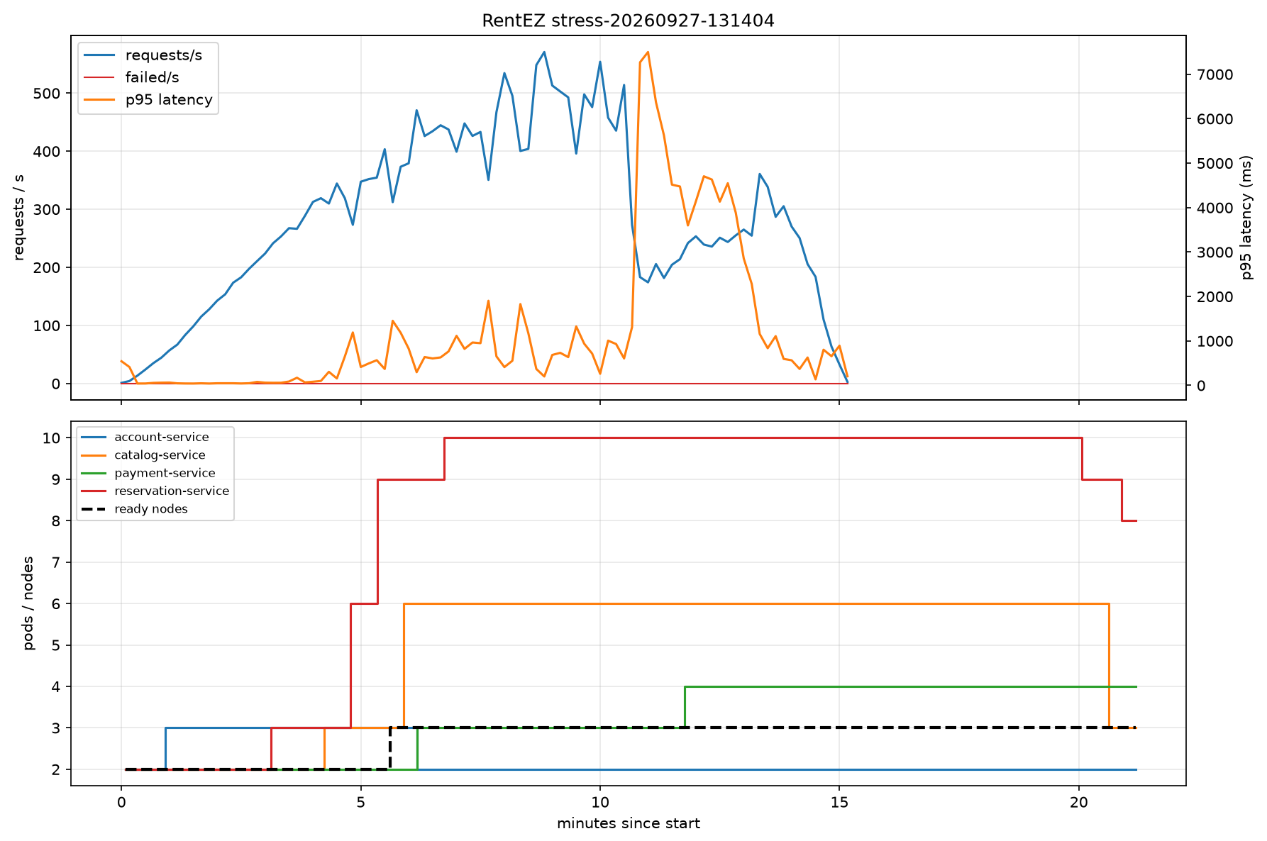
Scalability: Capacity Follows Demand
06 DEMO · 8 + 2 MIN
RentEZ · Group 2 · 23
Notes:
CPU crosses 60% at minute 3; reservation scales 2 to 10 pods; pods go Pending; the Cluster Autoscaler adds a third node; per-pod CPU falls from 200% to 60% while load is still at peak. Replicas hold 5 minutes after load stops, deliberately.

Slide 24

Demo Plan
06 DEMO · 8 + 2 MIN
Quality attributes
Key use cases
Attribute | What we show | Tool
Scalability | HPA 2→10 pods, new node under a spike | k6 spike + kubectl watch
Performance | SLO thresholds pass at 100/s | k6 load test
Maintainability | Commit → CI → deploy, new SHA running | GitHub Actions
Resilience | Dashboard partial: true with payment down | kubectl scale
Book and pay · 2 min
Race: 201 + 409 · 1 min
Payment replay · 1 min
RentEZ · Group 2 · 24
Notes:
Environment up 30 minutes before. Backup recording ready. Close on known limits: CPU is the wrong scaling signal for connection exhaustion (KEDA next), db.t4g.micro is the ceiling, HPA maximums cap peak.

Slide 25
Thank You
Questions and Answers
Group 2 · github.com/Uygnis/NUS-ISS-ASS-Practice-Module
Notes:
Correctness enforced by the database, no dependency cycles, and scalability proven with evidence. Questions?

Slide 26



Template Library
APPENDIX · NOT FOR PRESENTING
Duplicate a slide below, move it into your section, then replace the placeholders.
Diagrams
Numbers
Icons
Notes:
Template library. Hide or delete these slides before you present.

Slide 27
[Diagram Title]
[0X SECTION] · [X + Y MIN]
[Insert diagram: replace this box with your image]
[Project Name] · Team [__] · 21

Slide 28
[Two-Diagram Title]
[0X SECTION] · [X + Y MIN]
[Diagram A]
[Diagram B]
[Caption A, e.g. Before / Option 1]
[Caption B, e.g. After / Option 2]
[Project Name] · Team [__] · 22
Notes:
Template: two diagrams side by side, for before/after or two views of the same system.

Slide 29
[0X SECTION] · [DIAGRAM NAME]
[Insert large diagram: maximum area, no title]
[Project Name] · Team [__] · 23
Notes:
Template: diagram only, largest area. Use for detailed deployment or architecture diagrams.

Slide 30
[0X SECTION] · [X + Y MIN]
[___]
[What the number means, e.g. requests per second at peak]
[Context: compared with __, measured by __]
[Project Name] · Team [__] · 24
Notes:
Template: one big number. Use units in the number, e.g. 1,200 rps or 99.9%.

Slide 31
[Key Numbers Title]
[0X SECTION] · [X + Y MIN]
[___]
[___]
[___]
[Metric 1 label]
[Metric 2 label]
[Metric 3 label: the headline]
[Short context or target]
[Short context or target]
[Short context or target]
[Project Name] · Team [__] · 25
Notes:
Template: three key numbers. Put the most important one in the dark green tile.

Slide 32
[Results Title]
[0X SECTION] · [X + Y MIN]
[___]
[___]
[Metric 1]
[Metric 2]
[Context]
[Context]
[___]
[___]
[Metric 3]
[Metric 4]
[Context]
[Context]
[Project Name] · Team [__] · 26

Slide 33
[0X SECTION] · [X + Y MIN]
Before
After
[___]
[___]
[What changed, e.g. p95 response time after caching]
[Project Name] · Team [__] · 27

Slide 34


























Icon Set
TEMPLATE · ICON LIBRARY
Activity
Book
Chart
Chat
Check
CheckCircle
Clock
Cloud
Code
Database
Globe
GraduationCap
Home
Key
Lightbulb
Lightning
Link
Lock
PaperPlane
Play
Search
Settings
Star
ThumbsUp
Tool
Trust
Users
Verified
Warning
Wrench
Copy any icon into a slide · 28
Notes:
Icon library: all 30 icons in the brand green. Copy an icon and paste it into any slide. Change its colour to #F5F3EF on dark green backgrounds.

Slide 35




Icon Badges and Icon List
TEMPLATE · ICON MODULES
Plain
Solid circle
Soft circle
Outline square
Card tile
[Point 1] [One-line explanation]
[Point 2] [One-line explanation]
[Point 3] [One-line explanation]
[Project Name] · Team [__] · 29
Notes:
Icon modules: five badge styles on top, and an icon list below. Copy a badge, then change the icon name. Use one badge style per slide.

Slide 36





[Icon Cards Title]
[0X SECTION] · [X + Y MIN]
[Card 1]
[Card 2]
[Card 3]
[Card 4]
[Two short lines that explain this point]
[Two short lines that explain this point]
[Two short lines that explain this point]
[Two short lines that explain this point]
Key point: [One sentence that ties the four cards together]
[Project Name] · Team [__] · 30
Notes:
Template: four icon cards and an icon callout band. Delete a card for a three-card layout; the others stretch to fill.

