Slide 1
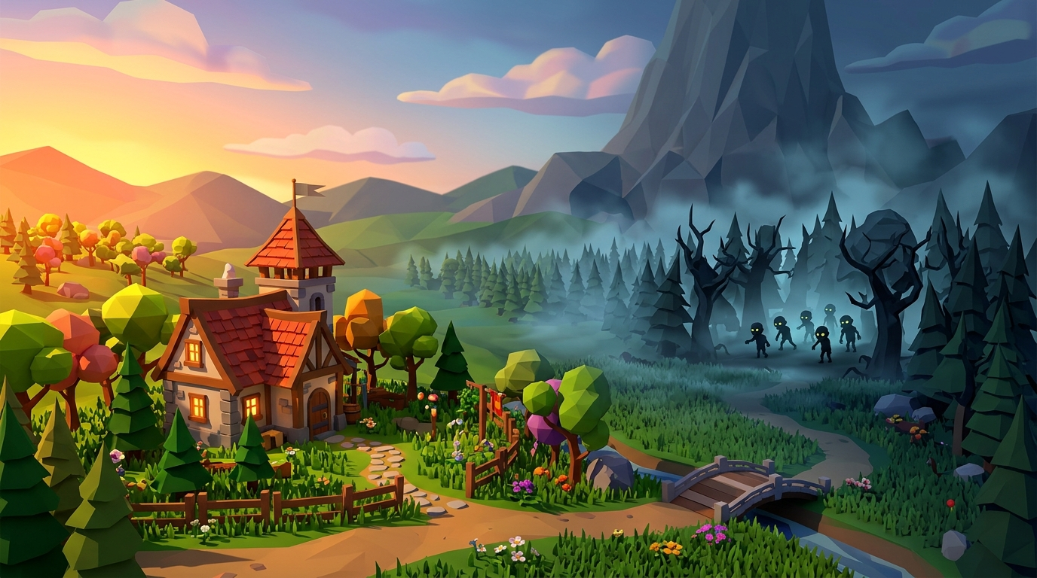
ZOMBIE HOUSE 3D
A third-person 3D defense game
CS427 - 3D Visualization and Game Development
University of Science, VNUHCM
Huynh Tran Uy | Tran My An | Nguyen Hoang Gia Han | Pham Bao Kha
Notes:
Source: project asset Assets/Textures/MainMenuBG.jpg. Introduce the team and the central premise: defend the house against zombie waves.

Slide 2
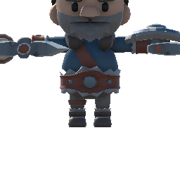
Game Concept
Protect the house while zombie waves advance.
GAMEPLAY SCREENSHOT
Insert a wide capture showing the player, house, and an active lane.
• Move through a low-poly 3D map and fight nearby enemies.
• Spend sun resources to place plant defenders.
• Clear every wave before the house health reaches zero.
Suggested capture: MapDay after the player spawns near the defended house.
CS427 | Zombie House 3D | 2
Notes:
Explain the round objective. Screenshot placeholder: capture the active MapDay scene with player, house, and enemies in view. Character portrait source: project asset Assets/Data/Characters/Portraits/Barbarian_Portrait.png.

Slide 3
Core Gameplay Loop
A round repeats one clear decision cycle.
1
2
3
4
Collect sun
Place plants
Fight zombies
Protect the house
Fund the defense
Cover key lanes
Support the defenses
Win after all waves
Loss condition: house health reaches zero.
Win condition: every configured zombie wave is cleared.
CS427 | Zombie House 3D | 3
Notes:
Describe the core loop from resource collection through plant placement and combat. The final slide distinguishes the two round outcomes.

Slide 4
Player Interaction
GAMEPLAY SCREENSHOT
Insert a third-person capture showing movement, camera angle, and melee range.
Direct player control
• Third-person movement and camera control.
• Melee attacks for nearby zombie threats.
• Plant selection, placement, and removal.
Suggested capture: player attacking beside a plantable square.
CS427 | Zombie House 3D | 4
Notes:
Show that the player actively participates rather than watching an automated defense. Screenshot placeholder: capture movement or a melee attack near a plantable square.

Slide 5


Plants and Sun Economy
Plants provide the strategic defense layer.
GAMEPLAY SCREENSHOT
Insert a capture of a planted Peashooter firing at approaching zombies.
• Collect sun as the resource for planting.
• Place defenders on valid plantable squares.
• Use Peashooter projectile attacks to pressure zombies.
CS427 | Zombie House 3D | 5
Notes:
Talk through the resource decision: sun enables placement, and plant positions determine lane coverage. Project asset portraits shown at lower left. Screenshot placeholder: show a Peashooter attacking zombies.

Slide 6
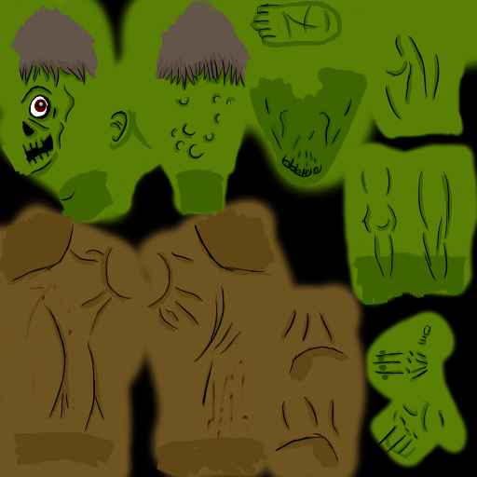
Zombie Waves and Base Defense
GAMEPLAY SCREENSHOT
Insert a capture with a zombie wave following a route toward the house.
Enemy pressure
• Zombies follow routes toward the house.
• Health and melee attacks define each encounter.
• Spider and zombie variants extend the enemy set.
• Waves end when all spawned enemies are cleared.
CS427 | Zombie House 3D | 6
Notes:
Focus on the defensive tension: enemies approach the house, while the player and plants must remove them before base health reaches zero. Screenshot placeholder: a wave and the house on the same frame. Project zombie texture appears as a supporting asset.

Slide 7

Feedback: UI, Minimap, and Audio
The game communicates the state of each round through visible and audible feedback.
UI / MINIMAP SCREENSHOT
Insert a capture that shows HUD, minimap, and a zombie marker.
• Minimap follows the player and identifies enemies.
• Win and lose panels close the round clearly.
• Separate music supports menus and gameplay maps.
• Sound effects reinforce UI, combat, plants, zombies, and results.
CS427 | Zombie House 3D | 7
Notes:
Use this slide to tie together orientation and feedback. Screenshot placeholder: make a capture with minimap and HUD visible. Minimap marker source: project asset Assets/Minimap/location_maker.png.

Slide 8
Maps and Technical Stack
Map variants
Technology
• Day, cloudy, and night scenes present the same defense concept with different moods.
• A tutorial map will introduce movement, planting, combat, removal, and objectives.
• Unity 6.3 LTS with Universal Render Pipeline.
• C# gameplay systems for input, waves, health, economy, UI, and audio.
• Git and GitHub branches for team integration.
MAP SCREENSHOT
Insert a wide capture of one final map variant.
CS427 | Zombie House 3D | 8
Notes:
Summarize how the team uses Unity 6.3 LTS, URP, C#, and GitHub. Screenshot placeholder: pick the strongest final map scene.

Slide 9
Team and Final Integration
Team
Final integration
Huynh Tran Uy
Core gameplay and zombie systems
Tran My An
Maps, menu, character selection, and win/lose UI
Nguyen Hoang Gia Han
Audio, integration support, QA, and report
Pham Bao Kha
Minimap, organization, and plantable squares
• Bring plantable squares, minimap, waves, house, and result UI into the main maps.
• Complete the tutorial scene and test the full route from Main Menu to game result.
• Balance waves, plant costs, enemy health, and audio levels through playtests.
Thank you
CS427 | Zombie House 3D | 9
Notes:
Close by assigning the team roles and emphasizing the remaining integration and testing work before the deadline.

