Slide 1

English Premier League (EPL) scoreline prediction model
By Uyi Erhabor
July 2025

Slide 2
Introduction
Presentation structure:
Methodology
Key Visualisation
Model selection
Model Evaluation

Slide 3
Methodology
Datasets:
Match data: epl_matches_messy
Team attributes data: team_attributes_messy
The combined dataset covered the 2019/20 – 2023/24 seasons
Data Preparation:
Carried out cleaning on the columns in each dataset
Explored the dataset by deriving useful information on each column
Created features from each dataset
Combined match and team attributes data
Analysis:
Built an XG Boost model to predict scorelines
Evaluated model

Slide 4
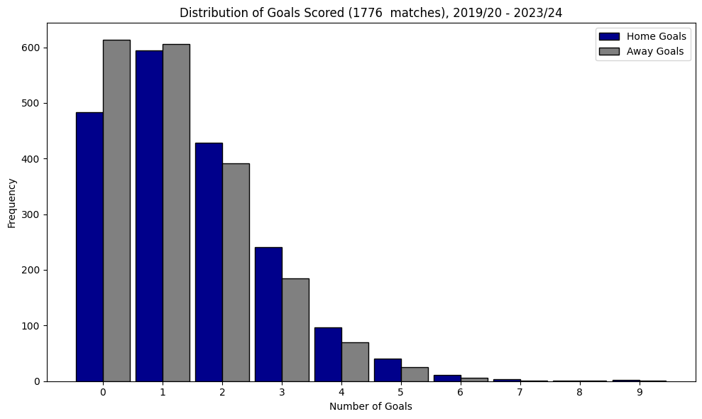
Distribution of goals

Slide 5
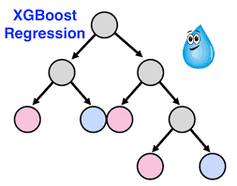
Model selection

Slide 6
Model Evaluation
R-squared: a measure of the combined importance of independent variables in a model in determining one or more dependent variables
R-squared (Home/Away): The R-squared value implies that the model provides a baseline for future predictions with additional features required to provide more robust scoreline predictions
Mean Absolute Error: a measure of the average absolute difference between predicted and actual values
Mean Absolute Error (MAE) (Home/Away): On average, the model's prediction of the number of goals the home team and away teams score is typically +/-1 goal of the actual number of goals scored
Overall Mean Absolute Error (MAE): The total average prediction error for a match's scoreline is approximately +/- 1 goal

