Slide 1

Chain of Custody Network
Layer 3 — Universal-access Applications & MRV Tools
User-friendly field apps: KYC/FaceID, GPS mapping, photo/video/sensor capture, offline sync.
Verifier consoles: Review queues, escalation, audit trails.
Buyer/investor portals: Browse verified credits, impact telemetry, purchase history.
Oracles & integrations: Drone/satellite/IoT feeds; REST/GraphQL APIs for ESG platforms, travel offsets, and government systems.
Layer 2 — Mission Control / Governance Engine
Role: Operational core for verification, aggregation, and reporting.
PoV validation: 50% AI (CV, GPS/timestamp checks, anomaly detection) + 50% human (audits, disputes, randomized QC).
Functions: SOP enforcement, role permissions, cross-project aggregation (CPA/PoA), data enrichment (satellite/weather/soil), metrics & BTR/NDC reporting.
Outputs: Compliance-ready datasets routed to L1 for issuance; dashboards for administrators and buyers.
MRV Tools
Universal-Access Apps
Governance Engine
Mission Control
Layer 1(s) - Country (Name) Sovereign Compliance & Anchoring Chain
Role: Legal + technical anchor with master government agreements.
What it does: Enforces methodologies and issuance rules, anchors verified MRV hashes, and mints data for credit issuance to a standard (ITMO, Verra, Gold, ICYCM, A6.4er)
Interfaces: IBC channels to every zone; APIs for registries and national reporting
Carbon Framework
Sovereign Chain
Interblockchain Communication
COSMOS SDK
Layer 0 - Framework for building custom blockchains with modular governance, validation, and application logic.
CometBFT (Consensus Engine)
High throughput without POW energy costs
Inter-Blockchain Communication Protocol
Each sovereign chain and zone exchange verified data and tokens without centralized intermediaries.

Slide 2


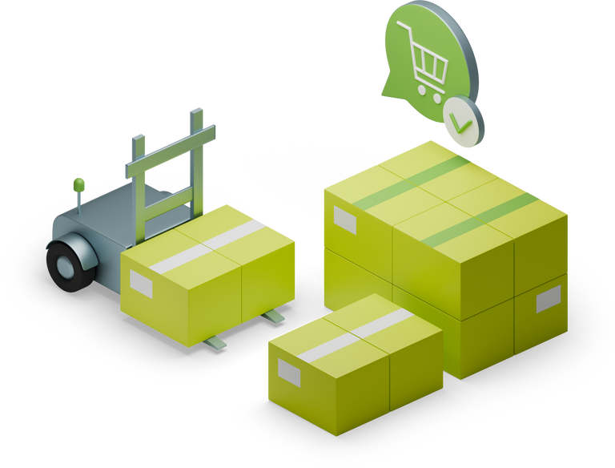





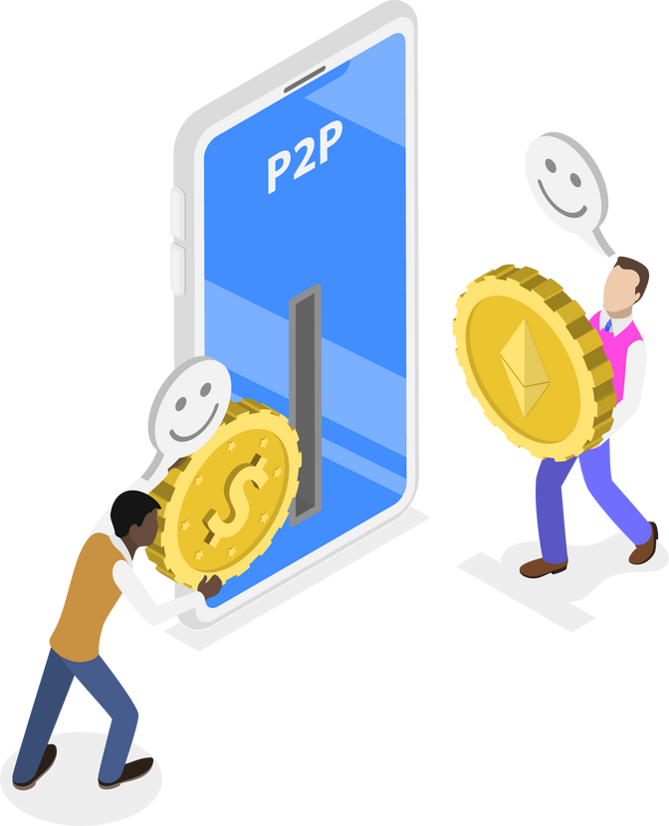
Turn-key, closed-loop precision dMRV Infrastructure
Data validate by Ai and Users
The Problems
1. Outdated, Manipulable Data
Paper-based MRV can be altered and lacks an immutable record.
2. Farmers Excluded
No recognized proof of work or impact for government/project payouts.
3. Fraud & Middlemen
Costly brokers control compliance packaging, enabling manipulation.
The Solutions
1. Immutable Data Anchoring (Layer 1)
AI + human PoV validates MRV and anchors it to a sovereign chain.
2. Direct Recognition for Farmers (Layer 3)
Simple, offline-ready apps create proof-of-record and track impact.
3. Automated Compliance Packaging (Layer 2)
Aggregates and formats verified data, removing the need for brokers.
Validated Task Completion for
e-wallet to payout
Smart contracts create records on chain
Standard compliance
management
Mobile App AI Assistant to help capture proof of planting
Continuous data enrichment and validation
Planter begins planting Coconut
Buyers purchase credible units of carbon credits enriched by tokenized data sets

