Slide 1

payahead
PURCHASE DECISION SUPPORT
Think before
you spend
Buy when it makes sense.
Budget context, purchase scenarios, and a checkout that stays under the buyer’s control.
pay-ahead.streamlit.app
github.com/UzaibBashir/PayAhead
Notes:
Project overview prepared from the PayAhead repository and its deployed Streamlit demo. The cover artwork is the project thumbnail in assets/payahead-thumbnail.png.

Slide 2
WHY PAYAHEAD
A price tag leaves out the rest of the month
PayAhead puts a purchase beside the budget choices it can affect.
Can I afford this without making bills or savings harder?
01
Know the budget
Income, expenses, debt, and savings
02
Compare choices
Buy now, wait, or explore a lower-cost option
The app brings monthly surplus, obligations, and a savings buffer into one decision view.
03
Keep approval personal
The buyer decides whether to continue to PayPal
Demo profiles and catalog values are fictional.
PAYAHEAD · THE IDEA
02 / 07
Notes:
Source: README.md; frontend/streamlit_app.py and backend/app.py. All profile values in the public demo are clearly labeled as simulated.

Slide 3
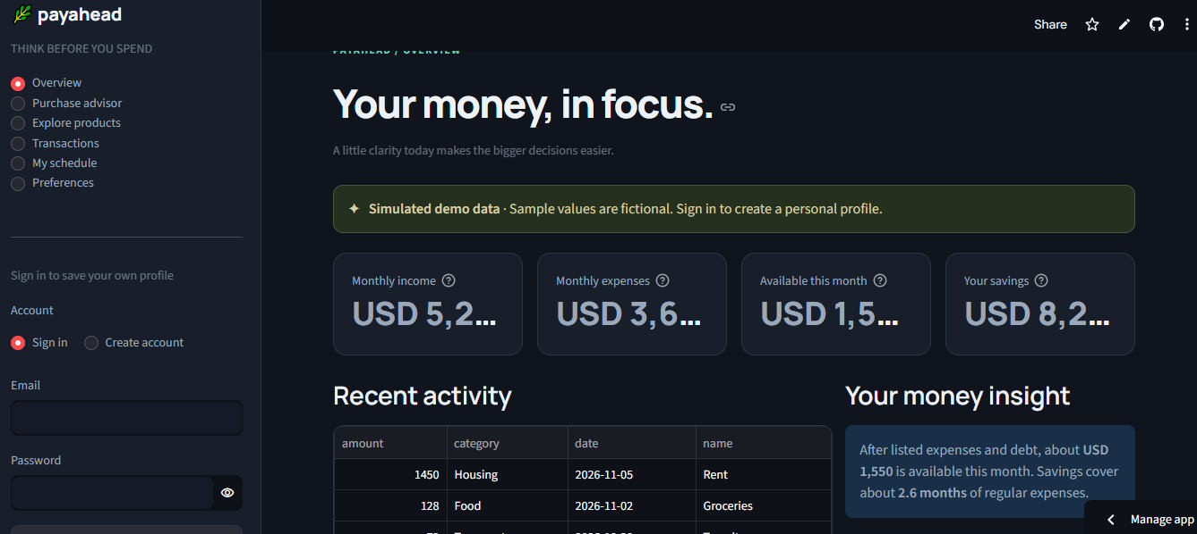
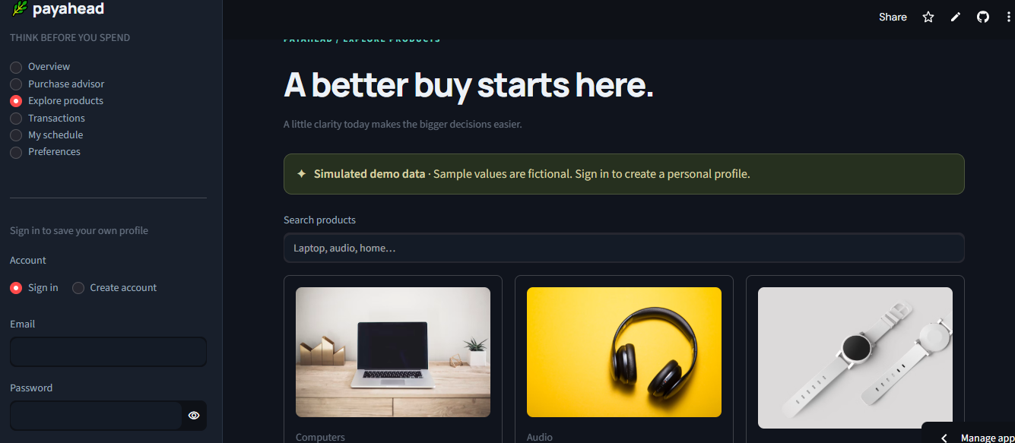
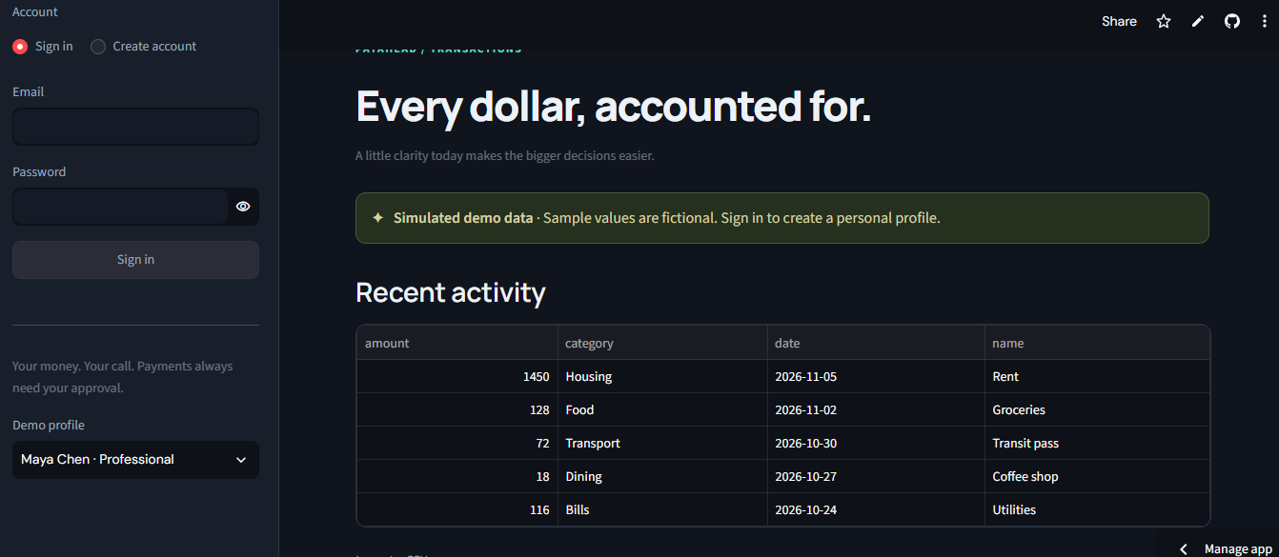
PRODUCT TOUR
One workspace for the decision and the follow-through
A quick look at the deployed interface using its fictional demo profile.
Budget overview
Product explorer
Transactions
Monthly summary and recent activity
Curated catalog and product context
Activity table and CSV import
CSV uploads are limited to 2 MB per file. The sample data is fictional.
PAYAHEAD · STREAMLIT INTERFACE
03 / 07
Notes:
Screenshots in this slide are local project captures in assets/Capture.PNG, assets/Capture6.PNG, and assets/Capture7.PNG. They show demo content only.

Slide 4
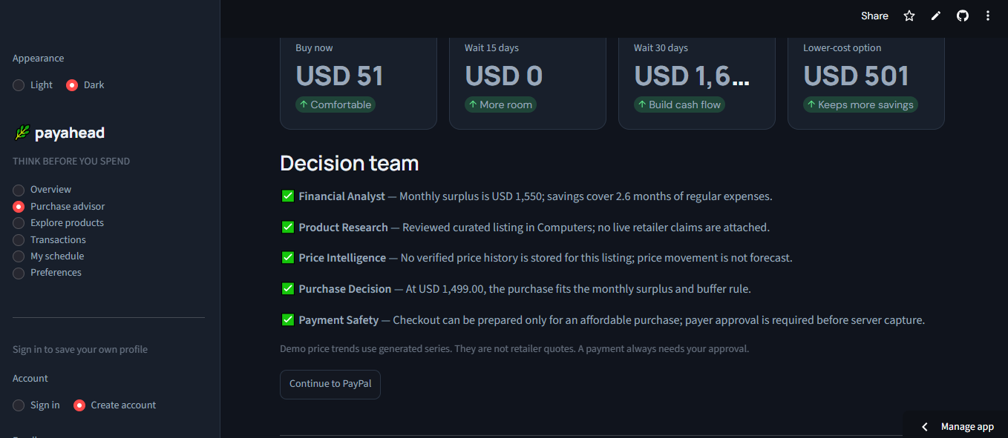
PURCHASE ADVISOR
Scenarios make the trade-offs visible
The recommendation is an evidence-backed estimate, not a promise.
What the review considers
Budget fit
Monthly surplus and savings buffer
Timing
Buy now, wait, or lower-cost options
Evidence
Five structured specialist findings
Payment
Separate buyer approval before capture
Educational estimates only · demo price histories are synthetic
PAYAHEAD · RULE-BASED GUIDANCE
04 / 07
Notes:
Source: backend/agents.py and backend/app.py. The five named specialists are deterministic functions, not autonomous generative agents. The screenshot is a demo capture and its values are illustrative.

Slide 5
HOW IT IS BUILT
A compact stack with clear responsibilities
The Streamlit app calls the application logic in the same process.
Streamlit
Flask logic
Database
→
→
User interface
Demo and signed-in flows
Profiles, transactions
Rules and payment routes
SQLite locally
Supabase Postgres when hosted
PAYPAL SANDBOX
OAuth 2.0
→
Orders API v2
→
Buyer approval
→
Server capture
Server token
Create CAPTURE order
Hosted Sandbox page
Verify status, amount, currency
Expense categorization: scikit-learn by default; optional PyTorch MLP. Optional LLM explanations are off by default.
PAYAHEAD · TECHNOLOGY
05 / 07
Notes:
Sources: README.md, docs/ARCHITECTURE.md, docs/PAYPAL_INTEGRATION.md, docs/AI_MODELS.md, docs/AI_PROVIDERS.md. PayPal is configured for Sandbox, never live payments.

Slide 6
AI AND SAFEGUARDS
Machine learning helps organize; rules keep the decision grounded
Models assist with category labels and explanations, not payment authorization.
TOOLS IN THE PROJECT
scikit-learn
Decision boundaries
TF-IDF + Logistic Regression for transaction categories; Isolation Forest flags unusual amounts for review.
Affordability is calculated with deterministic rules.
PyTorch
AI text explains supplied facts; it cannot approve checkout.
Optional MLP for deep-learning expense categorization; trained on synthetic descriptions.
All sample transactions, catalog prices, and price histories are synthetic.
OpenAI · Gemini · Groq
Expense models have not been validated on real bank statements.
Optional explanation adapters. The mock provider is the default; output cannot change financial figures.
PAYAHEAD · RESPONSIBLE USE
06 / 07
Notes:
Sources: backend/ai/providers.py, backend/ml/deep_expense.py, backend/scripts/train_models.py, backend/scripts/benchmark_expense_dl.py, docs/AI_MODELS.md. LLM providers are optional; the deployed app uses the mock explanation provider unless configured.

Slide 7
CURRENT STATE
What is ready—and what still needs validation
The public demo is usable with fictional sample data; end-to-end integrations need their own checks.
Available now
Before calling it end-to-end
Streamlit demo with overview, product explorer, advisor, and transaction views
01
Run a full Sandbox approval and capture with configured app and buyer credentials.
Light and dark appearance options
02
Verify account creation and saved data on the hosted Supabase project.
CSV transaction import with a 2 MB per-file limit
03
Evaluate expense categories on representative, authorized data.
Supabase Postgres configuration for hosted persistence
04
Live retailer prices are not connected; price histories are illustrative.
Live demo pay-ahead.streamlit.app
GitHub github.com/UzaibBashir/PayAhead
PAYAHEAD · NEXT STEPS
07 / 07
Notes:
Sources: README.md, docs/DEMO_GUIDE.md, docs/PAYPAL_INTEGRATION.md, docs/AI_MODELS.md. The PayPal checkout order/capture code has mocked tests, but a full Sandbox purchase using the project’s own buyer and app credentials has not been completed.

