Slide 1
KPIT APEX LAB
Summer Internship Program | Academic Year 2025-2026
Safety Supervisor ECU
with Emergency Brake Assist
A prototype Automotive Safety ECU built on STM32, integrating LIDAR and IMU sensing with CAN-based emergency brake control.
Submitted By: Uzair Shaikh, Om Raut, Sahil Deshmukh
Guided By: Isheet Patel
Safety Supervisor ECU with Emergency Brake Assist
1

Slide 2

INTRODUCTION
Why an Emergency Brake Assist ECU?
Delayed driver reaction is one of the leading causes of rear-end collisions. Even an attentive driver needs time to perceive an obstacle, decide, and brake — during which the vehicle keeps moving. Advanced Driver Assistance Systems (ADAS), particularly Automatic Emergency Braking (AEB), close this gap by monitoring the surroundings and intervening automatically when required.
Core Idea
This project implements a prototype Safety Supervisor ECU on an STM32 Nucleo-F446RE. It continuously reads LIDAR and IMU sensor data, classifies the vehicle into a safety state, and issues emergency braking commands over CAN to a FireBird V robot acting as the experimental vehicle.
Sense distance → Classify risk → Alert the driver → Brake automatically, reproducing the core logic of modern AEB systems on an embedded, low-cost platform.
Safety Supervisor ECU with Emergency Brake Assist
2

Slide 3




GOALS
Project Objectives
Real-Time Obstacle Sensing
Three-Level Safety Classification
Continuously measure distance to obstacles using the LIDAR Lite v3HP and monitor vehicle motion via the MPU6050 IMU.
Classify the vehicle into Normal, Warning, or Emergency states based on live sensor data.
CAN-Based Brake Control
Logging & Visualization
Transmit emergency braking commands from the STM32 ECU to the FireBird V robot over a CAN bus.
Log sensor data and safety states on a Raspberry Pi and present them on a live dashboard.
Safety Supervisor ECU with Emergency Brake Assist
3

Slide 4
DESIGN
System Architecture
FireBird V Robot
CAN Bus
Executes brake / motion commands
Sensors
STM32 Nucleo-F446RE
LIDAR Lite v3HP + MPU6050 IMU
Safety Supervisor ECU — state classification
UART
Raspberry Pi 4B
Logging + live dashboard
Driver Alerts
LED • Buzzer • LCD Display
Safety Supervisor ECU with Emergency Brake Assist
4

Slide 5
BUILD
Hardware Components
Component | Role in the System
STM32 Nucleo-F446RE | Central ECU — sensor processing, state logic, alerts & CAN control
FireBird V Robot | Experimental vehicle platform; executes braking and motion commands
LIDAR Lite v3HP | Laser sensor for real-time obstacle distance measurement (I2C)
MPU6050 IMU | 6-axis accel + gyro for vehicle motion and deceleration data (I2C)
MCP2515 CAN Module (x2) | SPI-to-CAN controllers linking the STM32 ECU and FireBird V robot
Raspberry Pi 4B | Data logging, CSV storage and dashboard visualization (Python)
LCD, LEDs & Buzzer | Visual and audible driver-alert indicators for each safety state
Safety Supervisor ECU with Emergency Brake Assist
5

Slide 6
BUILD
Software Technologies
Tool | Purpose
Arduino IDE/STM32CubeIDE | Firmware development, debugging and flashing for the STM32 ECU
STM32CubeMX | Graphical config of I2C, SPI, CAN, GPIO and timer peripherals
Atmel Studio | Programming and debugging the FireBird V robot's ATmega2560
Python | Raspberry Pi logging scripts, serial parsing and dashboard visuals
Raspberry Pi OS | Linux environment for logging and monitoring application
Safety Supervisor ECU with Emergency Brake Assist
6

Slide 7



CORE LOGIC
Safety State Classification
NORMAL
WARNING
EMERGENCY
Safe distance from obstacle
Obstacle getting closer
Collision risk very high
Full-speed operation continues; system keeps monitoring
Yellow LED + buzzer alert; gradual motor speed reduction
Red LED + buzzer; controlled rapid motor stop via CAN
Hysteresis and moving-average filtering on the LIDAR readings prevent rapid oscillation between states near threshold boundaries.
Safety Supervisor ECU with Emergency Brake Assist
7

Slide 8
CONTROL
CAN Communication & Brake Assist
Two MCP2515 CAN controllers — one on the STM32 ECU, one on the FireBird V — form a CAN bus between the two platforms. Brake commands are given the highest CAN message priority for fastest transmission, and bus-termination resistors keep signal integrity high.
Safety State | Command Sent Over CAN
Normal | Continue at current speed
Warning | Gradual reduction to ~50% speed
Emergency | Controlled rapid motor stop
Why CAN?
CAN is the standard, noise-resistant, multi-node protocol used across modern automotive networks — ideal for reliable safety-critical commands.
Safety Supervisor ECU with Emergency Brake Assist
8

Slide 9
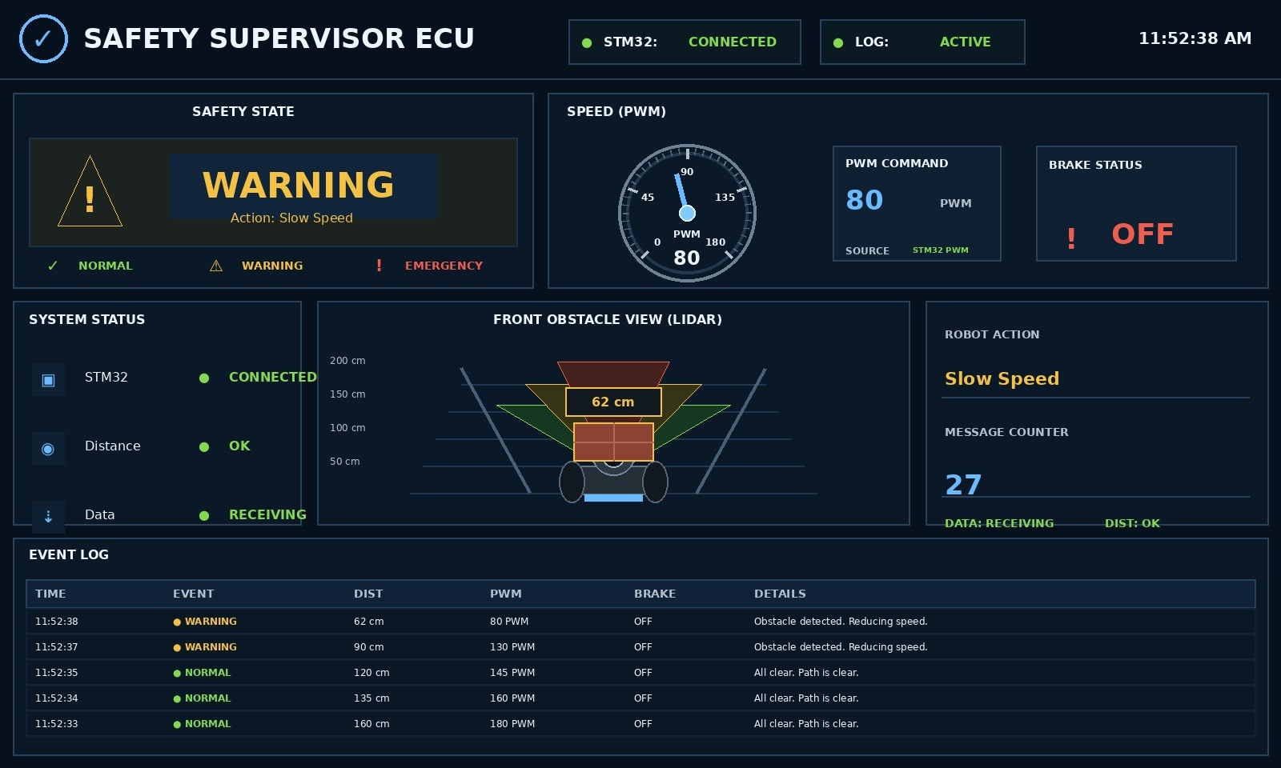
MONITORING
Data Logging & Dashboard
The STM32 ECU streams safety-state, distance and IMU data to a Raspberry Pi 4B over UART. A Python script parses and logs each reading to CSV with a timestamp, while a live dashboard visualizes vehicle state, PWM speed, brake status and a rolling event log.
Structured UART packet with start/end markers
Buffered CSV logging with timestamps
Live dashboard: state, speed, brake status, events
Raspberry Pi dashboard — live safety state, PWM speed and event log
Safety Supervisor ECU with Emergency Brake Assist
9

Slide 10
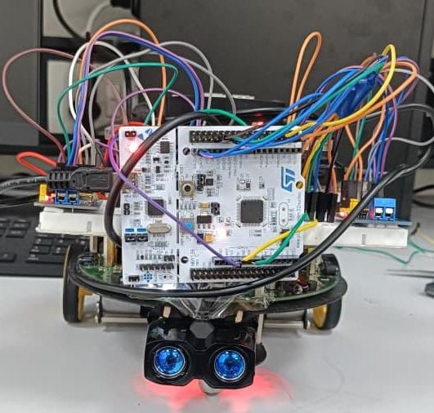
VALIDATION
Testing & Results
3
2
Safety states validated
(Normal / Warning / Emergency)
CAN nodes communicating
(STM32 ECU ↔ FireBird V)
End-to-End
Extended
Pipeline verified — sensing to
braking to logging
Continuous-run reliability
testing completed
Validated through static and dynamic obstacle tests, with objects at varying distance and approach speed confirming correct state transitions and brake responses.
Safety Supervisor ECU with Emergency Brake Assist
10

Slide 11
RELEVANCE
Real-World Application Scenarios
Scenario | Risk | ECU Response
Lead vehicle brakes suddenly | High | Emergency stop if time-to-collision is unsafe
Pedestrian crosses ahead | High | Immediate emergency braking; event logged
Child runs out near school zone | Very High | Highest priority; immediate stop + alert
Animal appears on road | High | Warning or Emergency based on distance/speed
Lead vehicle slows gradually | Medium | Warning state; alert driver, prepare to slow
Rain, fog or dust noise | Medium | Extra sampling; degraded safe mode if uncertain
Safety Supervisor ECU with Emergency Brake Assist
11

Slide 12






WHAT'S NEXT
Future Scope
Multi-Sensor Fusion
GPS Tracking
Cloud Logging
Add thermal camera and radar with LIDAR for stronger obstacle classification
Route monitoring and fleet-level supervision
Remote, real-time access to logs via Wi-Fi / cellular
Drowsiness Detection
Embedded AI
FreeRTOS Integration
Camera-based driver monitoring as an added safety layer
On-ECU object detection and predictive collision avoidance
Deterministic task scheduling for safety-critical timing
Safety Supervisor ECU with Emergency Brake Assist
12

Slide 13
SUMMARY
Conclusion
The Safety Supervisor ECU project successfully demonstrates a working prototype automotive safety system — combining real-time LIDAR/IMU sensing, three-level safety state classification, CAN-based emergency brake control, and Raspberry Pi data logging on a low-cost embedded platform.
Reliable sensor integration and real-time decision-making
Verified CAN-based communication between STM32 ECU and FireBird V robot
Automatic emergency braking with multi-modal driver alerts
Continuous data logging and live dashboard visualization
Safety Supervisor ECU with Emergency Brake Assist
13

Slide 14
Thank You
Safety Supervisor ECU with Emergency Brake Assist
With sincere thanks to:
Isheet Patel — Project Mentor, KPIT APEX LAB
Parag Narkhede & Suraj Vashishtha — for technical support throughout development
KPIT APEX LAB — for the opportunity to work on this internship project
Safety Supervisor ECU with Emergency Brake Assist
14

