Slide 1
SEMINAR BY CoC
01
FYP Road-Map:
PROPOSE
Proposal, Development & Execution
02
DEVELOP
Department of Computer Engineering
COMSATS University Islamabad, Lahore Campus
03
TEST
Engr. Dr. Jehangir Arshad
04
Asst. Professor | Ph.D. Supervisor | Registered Engineer (PEC No. COMP/7371)
Ph.D. in Information and Communication Engineering
E-MAIL: jehangirarshad@cuilahore.edu.pk
PROFILE LINK: https://scholar.google.com/citations?user=_WnfDB4AAAAJ&hl=en#
EXECUTE
2026 • FYP Seminar

Slide 2
01 • FYP FOUNDATION
Final Year Project in Computer Engineering
02
A year-long project that evolves through three written phases.
THE PROPOSAL
THE PROGRESS REPORT
THE FINAL REPORT
Define the problem, scope, objectives & plan.
Build on the proposal; document progress.
Consolidate implementation, results & contribution.
During this one year, 4 presentations are conducted by the department
01
Proposal Presentation
02
Progress Presentation FYP 1
03
Final Internal Presentation
04
External Visa
Stakeholders
Student • Supervisor/Co-supervisor • FYP Committee • External
COMSATS University Islamabad • Department of Computer Engineering

Slide 3
01 • FYP FOUNDATION
FYP course at a glance
03
Course snapshot
Academic placement
What the FYP connects
Course Title
Final Year Project I, & Final Year Project II
Course Code: CPE 490
Credit Hours: 6 [FYP I (0,3), FYP II (0,3)]
Semester
7th & 8th
Resource Person
Supervisors/Co-Supervisors from ECE Faculty
Course knowledge → engineering problem → technical solution → communication → sustainable impact
Objectives
01
02
To enable the student to integrate and apply the knowledge and skills acquired in various courses.
Student should be able to independently acquire requisite knowledge to propose a technical solution to a complex engineering problem in a timely and ethical manner.
03
04
Student should be able to work independently or in a team and be able to communicate and justify the proposed solution effectively.
Student should be able to demonstrate a broad understanding of the UN SDG global challenges. In addition, the technical solution presented and accomplished in FYP should be mapped to the relevant UN sustainable development goals (SDG) 2015 where applicable.
COMSATS University Islamabad • Department of Computer Engineering

Slide 4
01 • FYP FOUNDATION
Eligibility criteria
04
When can students start?
Minimum academic requirement
Why departments start earlier
As per CUI policy, the students are eligible to register FYP Part-I at the start of their 7th semester provided they have completed a minimum 80 credit hours.
As the right selection of project and finding the supervisor has always been an important step and is time taking, therefore the departments within the Faculty of Engineering (FoE) offers FYP at the beginning of the 6th semester to ensure that students can effectively work on their FYP right after the commencement of the 7th semester.
6th semester
7th semester
8th semester
Project + supervisor selection
FYP-I
FYP-II
COMSATS University Islamabad • Department of Computer Engineering

Slide 5
02 • ROAD-MAP
FYP procedure: from offering to final submission
05
01
FYP offering by faculty members
02
Project enrolment within department in 6th Semester kickoff report (KOR)
03
FYP Part-1 Registration (03 Credit Hours) 7th Semester
04
Evaluation of Part-1 (end of 7th semester)
05
FYP Part-2 Registration (03 Credit Hours) 8th Semester
06
Submission of First Draft of Thesis
07
Evaluation of FYP Part-2 (8th Semester)
08
Internal Presentation
09
External Presentation
10
Results compilation and Submission of final thesis copies to exam department
COMSATS University Islamabad • Department of Computer Engineering

Slide 6
02 • ROAD-MAP
Flow chart of FYP procedure
06
Call for FYP
Projects
Project
Selection
FYP-I
Registration
FYP-I
Evaluation
FYP-II
Registration
Final Thesis
Submission
External
Presentation
Internal
Presentation
FYP-II
Evaluation
First Draft
of Thesis
The process is sequential — each stage produces the evidence needed for the next.
COMSATS University Islamabad • Department of Computer Engineering

Slide 7
03 • OUTCOMES
What students should demonstrate after FYP
07
C01
C02
Utilize fundamental knowledge of science and engineering to identify a complex engineering problem and propose a viable solution. (C3‐PLO1)
Provide a critical review of previous work in the field, and a theoretical foundation for the approach taken in the project. (C4‐PLO2)
C03
C04
Design a system, component, or process that provides a feasible solution to a complex engineering problem which subsequently leads in achieving UN sustainable development goals. (C5‐PLO3)
Investigate the solution in a methodical way including but not limited to necessary literature survey, experiment design and synthesis of information. (C6‐PLO4)
C05
C06
Describe the proposed solution’s societal implications such as its health and safety aspects in accordance with UN sustainable development goals. (A3-PLO6)
Describe the proposed solution’s sustainable development considerations keeping in view the criteria given in UN sustainable development goals. (A3-PLO7)
C07
C08
Develop a solution in accordance with the norms of engineering practice and professional ethics also proposed in UN sustainable development goal targeting responsible consumption and production. (A3‐ PLO8)
Contribute to the project goals both as an individual and a team player. (A3‐PLO9)
C09
C10
Effectively communicate and justify the developed solution and be able to demonstrate the project to any general audience. (A2‐PLO10)
Demonstrate management skills to achieve project goals in a timely manner. (A3‐PLO11)
C11
Demonstrate an ability to independently seek and acquire knowledge required for successful project completion. (A3‐PLO12)
COMSATS University Islamabad • Department of Computer Engineering

Slide 8
03 • OUTCOMES
Important: prior write-up is your foundation
08
The three written phases are derived from the phase before them.
PROPOSAL
PROGRESS REPORT
FINAL FYP
Think deeply, read widely, plan the study.
Evolve from the proposal — do not reinvent it.
Consolidate the work, results and contribution.
Work smart
Use future tense
Keep scope aligned
Put time and effort into thinking and reading about your topic at the Proposal phase.
FYP proposal is an outline of proposed research to be undertaken in future. Example: “A survey method will be employed…”
FYP Scope should map on Sustainable Development Goals (SDGs) as per PEC requirement.
Strictly follow the format provided by the department i.e., font sizes etc.
COMSATS University Islamabad • Department of Computer Engineering

Slide 9

03 • OUTCOMES
Sustainable Development Goals (SDGs)
09
by United Nations 2030 Agenda
This will be accomplished by bringing together their respective governments, businesses, media, institutions of higher education, and local NGOs to improve the lives of the people in their country by the year 2030.
MAP YOUR FYP TO THE RELEVANT SDG(S)
UN 2030 Agenda • FYP scope and sustainability

Slide 10
04 • PROPOSAL WRITING
Structure of FYP proposal
10
01
Title Page
02
Table of Contents
03
Abstract
04
Introduction
05
Methodology
05.1
Hardware and Software
05.2
Project Planning and Time Line
06
References
Writing principle
Each section should answer a clear question: What is the problem? What is known? What will you do? How will you plan it? What sources support it?
COMSATS University Islamabad • Department of Computer Engineering

Slide 11
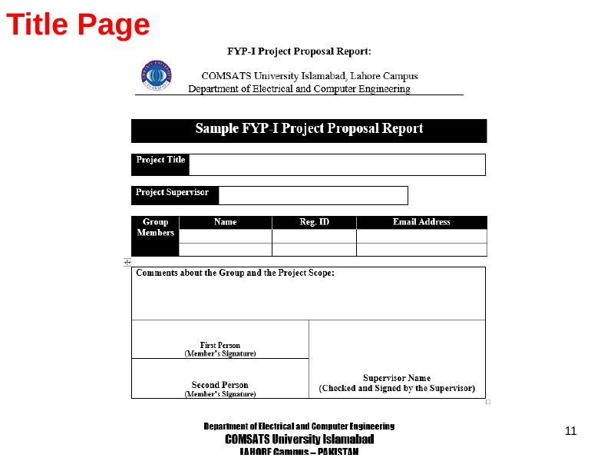
04 • PROPOSAL WRITING
Title page: format example
11
Use the department-provided format; preserve required font sizes and structure.
COMSATS University Islamabad • Department of Computer Engineering

Slide 12
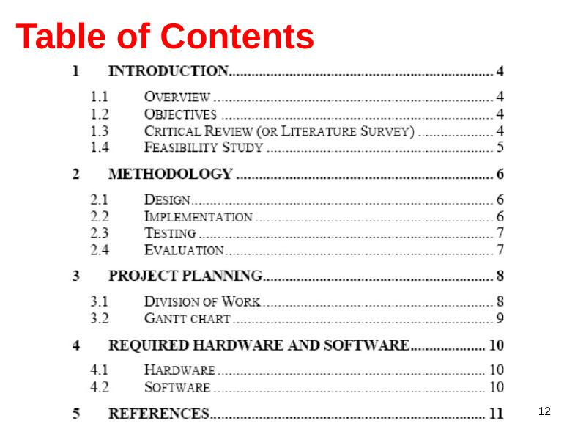
04 • PROPOSAL WRITING
Table of contents: format example
12
Use the department-provided format; preserve required font sizes and structure.
COMSATS University Islamabad • Department of Computer Engineering

Slide 13
04 • PROPOSAL WRITING
Abstract: tell the complete story in 200–300 words
13
A concise abstract should allow a non-specialist to understand why the project matters and what it aims to accomplish.
Summary
Objectives
A summary of 200-300 words
Concisely and Clearly provide objectives
Story
Importance
Must Narrate a complete story of your work
Explains why the project is important
Aim & how
Risks
States what the FYP aims to accomplish and how
identifies possible problems or complications
Audience
is written for a non-specialist
COMSATS University Islamabad • Department of Computer Engineering

Slide 14
04 • PROPOSAL WRITING
Content of an abstract
14
Aims & Objectives
Problem Statement / Complications
Methodology
2–3 Sentences
1–2 Sentences
3–4 Sentences
01
02
03
Novelty
Findings / Contribution / Results
Application as per SDGs
1–2 Sentences
2–3 Sentences
2–3 Sentences
04
05
06
Rule of thumb: concise • coherent • complete
COMSATS University Islamabad • Department of Computer Engineering

Slide 15
04 • PROPOSAL WRITING
Introduction: frame the problem before the solution
15
1 • Define the purpose
2 • Give only the needed context
Start by clearly defining the purpose of your research. What practical or theoretical problem does the research respond to, or what research question did you aim to answer?
You can include brief context on the social or academic relevance of your topic, but don’t go into detailed background information. Define specialized terms concisely.
3 • State the objective
4 • Keep tense consistent
After identifying the problem, state the objective of your research. Use verbs like “investigate,” “test,” “analyze,” or “evaluate” to describe exactly what you set out to do.
This part of the abstract can be written in the present or past simple tense but should never refer to the future, as the research is already complete.
The proposal itself describes work that will be undertaken — keep proposal language in future tense where appropriate.
COMSATS University Islamabad • Department of Computer Engineering

Slide 16
04 • PROPOSAL WRITING
Content of an introduction
16
Aims and Objectives as per SDGs
Problem Statement / Complications
Existing / Related Studies
Proposed Methodology
2–3 Paragraphs
1–2 Paragraphs
1–2 Pages in a Summary Table
3–4 Paragraphs
How its New
Objectives / Deliverables
Deliverables
System Overview Diagram
1–2 Paragraph
Bullet Points
Bullet Points
System-level visual
COMSATS University Islamabad • Department of Computer Engineering

Slide 17
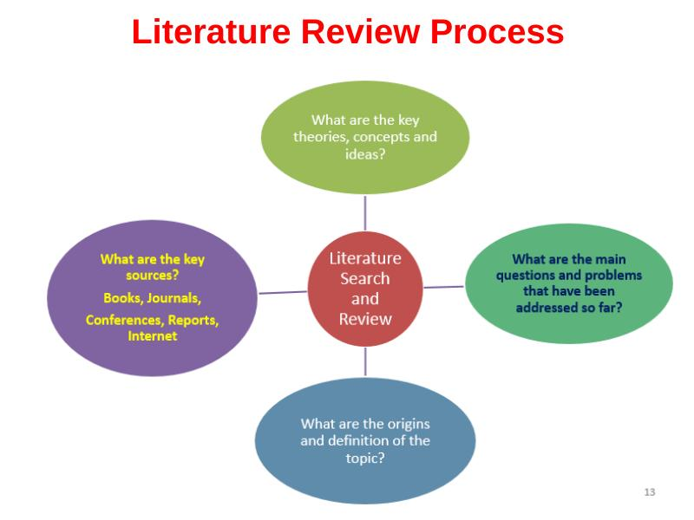
05 • EVIDENCE & METHODOLOGY
Literature review process
17
A literature review should connect four questions:
1. What are the key theoretical concepts?
2. What are the main research themes and trends?
3. What are the limitations / gaps?
4. What direction should the proposed work take?
Read → compare → synthesize → identify the gap
COMSATS University Islamabad • Department of Computer Engineering

Slide 18
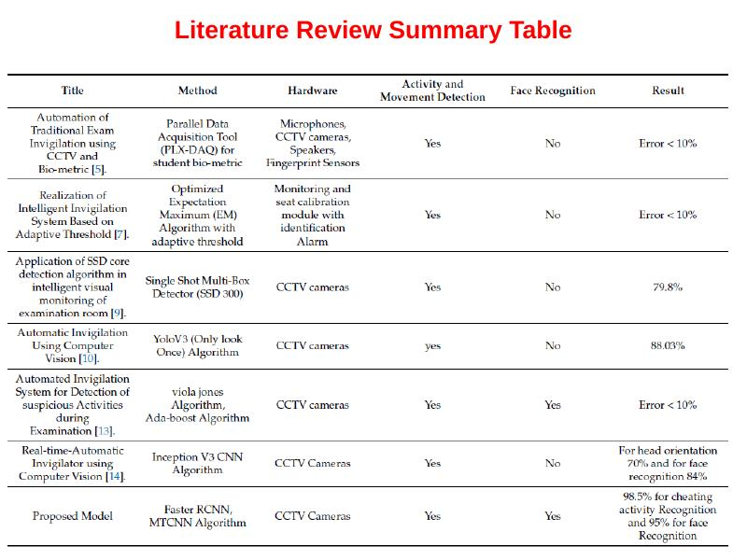
05 • EVIDENCE & METHODOLOGY
Literature review summary table
18
Use a comparison table to expose methods, datasets, limitations, gaps and results.
COMSATS University Islamabad • Department of Computer Engineering

Slide 19
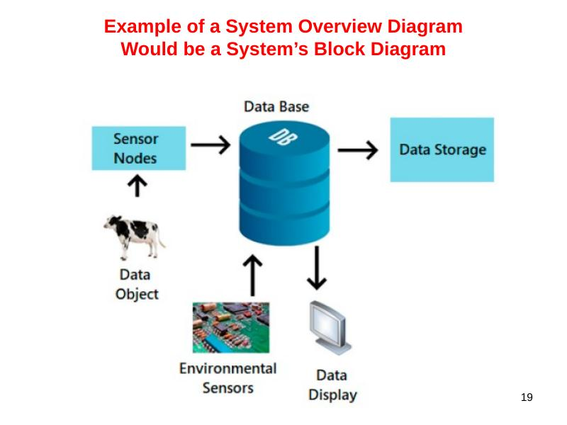
05 • EVIDENCE & METHODOLOGY
Example of a system overview diagram
19
Would be a System’s Block Diagram
INPUT / SENSORS
PROCESSING
STORAGE
OUTPUT
Data source
Core logic
Data layer
User view
COMSATS University Islamabad • Department of Computer Engineering

Slide 20
05 • EVIDENCE & METHODOLOGY
Methodology: explain how the solution will be built and assessed
20
Begin your methodology with a clear description of proposed: literature survey/ feasibility study and/or a critical review.
Q1
Q2
Q3
Q4
Q5
What is the history of your project topic?
What are experts in the field discussing that relates to your topic?
What are the trade-offs?
What is the latest research?
What is the state-of-the-art in your project area?
Flow Chart of Methodology
LITERATURE / FEASIBILITY
DESIGN
IMPLEMENTATION
TESTING
EVALUATION
Understand the field
Select the approach
Build the system
Verify each part
Measure vs. objectives / baselines
COMSATS University Islamabad • Department of Computer Engineering

Slide 21
05 • EVIDENCE & METHODOLOGY
Example: Design → Implementation → Testing → Evaluation
21
DESIGN
IMPLEMENTATION
TESTING
EVALUATION
Figure out what the sub-problems are and what approach to take or what theory to investigate.
Theory based
Conceptual
Build it
Tools?
Technical skills based
How are you going to ensure that it [the program/ game/ etc.] works correctly?
Look at the project from a micro level
Include experiments
Look at system results
Test each part of the system
Make sure that design and implementation work
Evaluate your perspective results relative to your stated objective:
Measure performance
Compare your system/model with one or more (a) baseline systems/models, and/or (b) similar competing systems/models
COMSATS University Islamabad • Department of Computer Engineering

Slide 22
06 • EXECUTION
Project planning: make the work visible
22
All projects require planning including an outline of who in the team is doing what and when; thus, you will need to include a Gantt chart.
What a Gantt chart shows
How to read it
Track progress
A horizontal axis represents the total time span of the project, broken into days, weeks or months.
The vertical axis represents the tasks that make up the project.
Horizontal bars of varying lengths represent sequences, timing, and time span for each task.
Bar spans may overlap when activities happen during the same time span.
As the project progresses, secondary bars, arrowheads, or darkened bars may indicate completed work.
A vertical line represents the report date.
Planning principle
WHO
WHAT
WHEN
STATUS
Team responsibility
Task / deliverable
Timeline
Progress
COMSATS University Islamabad • Department of Computer Engineering

Slide 23
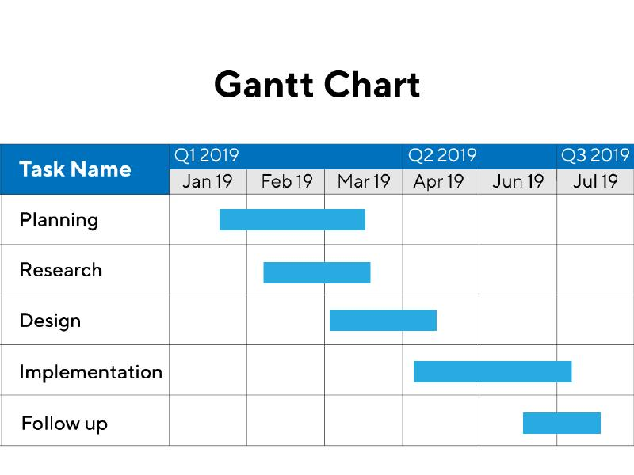
06 • EXECUTION
Gantt chart: example
23
Plan the sequence — then update the chart as work is completed.
COMSATS University Islamabad • Department of Computer Engineering

Slide 24
07 • ACADEMIC INTEGRITY
Plagiarism, citations and references
24
What is plagiarism?
Citations are required
Plagiarism is presenting someone else's work or ideas as your own, with or without their consent, by incorporating it into your work without full acknowledgement. All published and unpublished material, whether in manuscript, printed or electronic form, is covered under this definition.
Throughout the three steps of write-up, you must provide citations whenever you paraphrase and/or summarize someone else’s ideas and when you use a direct quote.
Why it matters
Cite visual content
Check originality
Not providing citations makes your team look like a bunch of amateurs. Second, it discredits your work. Third, providing no citations equals plagiarism-the academic equivalent to robbery.
Best if to provide reference of Figures, Equations, and Text.
Plagiarism Can be checked Through different tools including Turnitin, Online Plagiarism Choker etc.
Cite ideas • cite figures • cite equations • cite text
COMSATS University Islamabad • Department of Computer Engineering

Slide 25
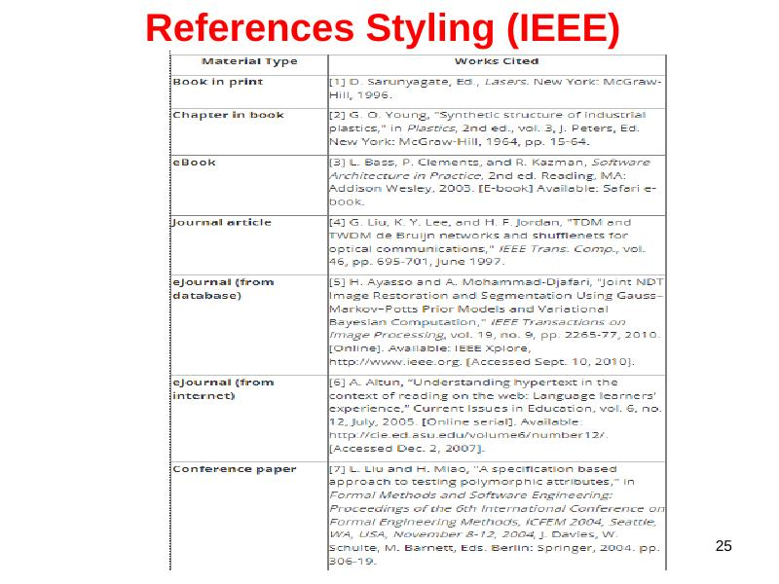
07 • ACADEMIC INTEGRITY
References styling: IEEE
25
Follow the required IEEE reference format consistently throughout the report.
COMSATS University Islamabad • Department of Computer Engineering

Slide 26
07 • ACADEMIC INTEGRITY
Tools for writing, referencing and originality
26
01
02
MS Word
Latex (https://www.overleaf.com/user/emails/primary-email-check)
03
04
Endnote for referencing
Mendeley for referencing
05
06
Turnitin Plagiarism checker
Grammerly (https://app.grammarly.com/)
07
Quilbot (https://quillbot.com/)
Choose tools that support writing quality, citation management and originality checks.
COMSATS University Islamabad • Department of Computer Engineering

Slide 27
08 • CLOSING
References
27
[1]
Jailani, Nik Intan Syahiddatul Ilani, Al-Fahim Mubarak Ali, and Syahrulanuar Ngah. “Final Year Project Allocation System Techniques: A Systematic Literature Review.” In 2022 IEEE 12th Symposium on Computer Applications & Industrial Electronics (ISCAIE), pp. 99-104. IEEE, 2022.
[2]
Teo, Y., and Duan Juat Ho. “A systematic approach to the implementation of final year project in an electrical engineering undergraduate course.” IEEE transactions on education 41, no. 1 (1998): 25-30.
[3]
Berndtsson, Mikael, Jorgen Hansson, Björn Olsson, and Björn Lundell. Planning and Implementing your Final Year Project—with Success!: A Guide for Students in Computer Science and Information Systems. Springer Science & Business Media, 2002.
[4]
Uziak, Jacek. “Position of the final year project in an engineering curriculum.” Global Journal of Engineering Education 17, no. 3 (2015): 113-118.
COMSATS University Islamabad • Department of Computer Engineering

Slide 28
TAKE THE NEXT STEP
Build the FYP
with purpose.
Any Question?
?
Join Research and Career Relevant Social Media Forums i.e.,
Google Scholar, LinkedIn, Research Gate, GitHub etc.,
Thank you
PROPOSAL → DEVELOPMENT → EXECUTION
Engr. Dr. Jehangir Arshad
Department of Computer Engineering • CUI Lahore

