Slide 1
AI Model for
Vehicle Identification and Tracking
Team: FYP22059
Presenter: ASIM, Uzair Bin Colangoy [3035603071]
Presenter: Young, Chak Fung(John) [3035468160]
Supervisor: Dr T.W. Chim

Slide 2
Outline
Background
Motivation
Objectives
Methodology and Illustrations
Data Collection
Data Labelling
Model Implementation
Model Deployment
Limitations
Suggestions
Q & A

Slide 3
Background
Losing an motor vehicle is a very expensive and stressful experience.
It is a common phenomenon in urban spaces.
Searching for stolen vehicles can take long periods of time without guarantee of success.

Slide 4
Motivation
Searching for stolen motor vehicles relies on a manual system.
A very labor intensive process.
Is very time consuming.
Is prone to human errors.

Slide 5
Objectives
Object Detection ML model
Database server
Mobile App Interface for Notifications

Slide 6
Methodology and Illustrations
Cameras will be positioned adjacent to busy highways
Camera communicate with a central database server
Time stamped notifications alert authorities on positive matches.

Slide 7
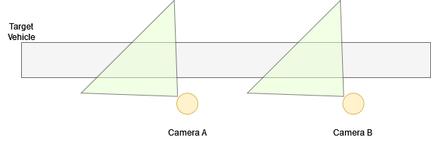
Methodology and Illustrations

Slide 8
Data Collection
Video feed collected near Queen Mary’s Hospital
1080p @ 30 fps
Oppo A38 mobile phone camera
Video stripped into individual frames
Using ffmpeg library
Videos taken at three different angles

Slide 9
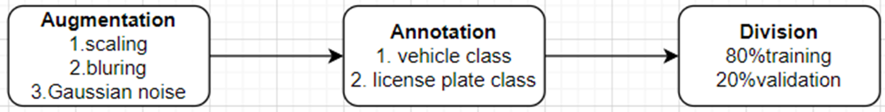
Data Labelling
1. Augmentation
Upscaling
´Downscaling
Blurring to cancel noise
2. Annotation
3. Division

Slide 10
Model Implementation

Slide 11
Model Deployment

Slide 12
Limitations
The size of license plate number is relatively small
Real-time detection
Live video needs to be passed to the app to analyze and extract data like location, time, screenshot, etc.

Slide 13
Suggestions

Slide 14
Q & A
Thank you

Slide 15
References

