Slide 1
AI Model for
Vehicle Identification and Tracking
Team: FYP22059
Presenter: ASIM, Uzair Bin Colangoy [3035603071]
Presenter: Young, Chak Fung (John) [3035468160]
Supervisor: Dr T.W. Chim

Slide 2
Outline
Background
Motivation
Objectives
Methodology and Illustrations
Data Collection
Data Labelling
Model Implementation
Model Deployment
Limitations
Suggestions
Q & A

Slide 3
Background
Losing an motor vehicle is a very expensive and stressful experience.
It is a common phenomenon in urban spaces.
Searching for stolen vehicles can take long periods of time without guarantee of success.

Slide 4
Motivation
Searching for stolen motor vehicles relies on a manual system.
A very labor intensive process.
Is very time consuming.
Is prone to human errors.

Slide 5
Objectives
Object Detection ML model
Database server
Mobile App Interface for Notifications

Slide 6
Methodology and Illustrations
Cameras will be positioned adjacent to busy highways
Camera communicate with a central database server
Time stamped notifications alert authorities on positive matches.

Slide 7
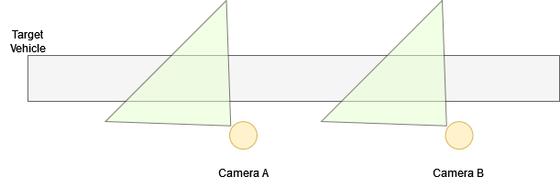
Methodology and Illustrations

Slide 8
Data Collection
Video feed collected near Queen Mary’s Hospital
1080p @ 30 fps
Oppo A38 mobile phone camera
Video stripped into individual frames
Using ffmpeg library
Videos taken at three different angles

Slide 9
Data Labelling
Augmentation
Upscaling
Downscaling
Blurring to cancel noise
Annotation
Vehicle Type
Vehicle Color
License plate number
Division

Slide 10
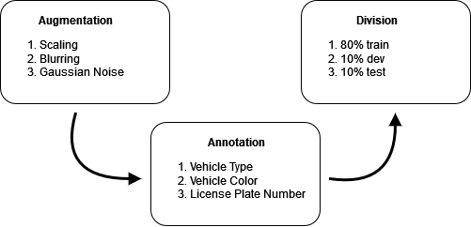
Data Labelling

Slide 11
Model Implementation
Employs convolutional neural networks (CNN) to detect objects in real-time
Workflow of CNN
1. Input image
2. Convolution layer(Kernel)
3. Pooling layer
4. Classification
Notes:
´Interprets three layers of colors(RGB) stacking one on top of each other
Detects markings, patterns, objects.

Slide 12
Why do we choose CNN over other algorithm?
Effective in reducing parameters
Good for processing images with high dimensionality

Slide 13
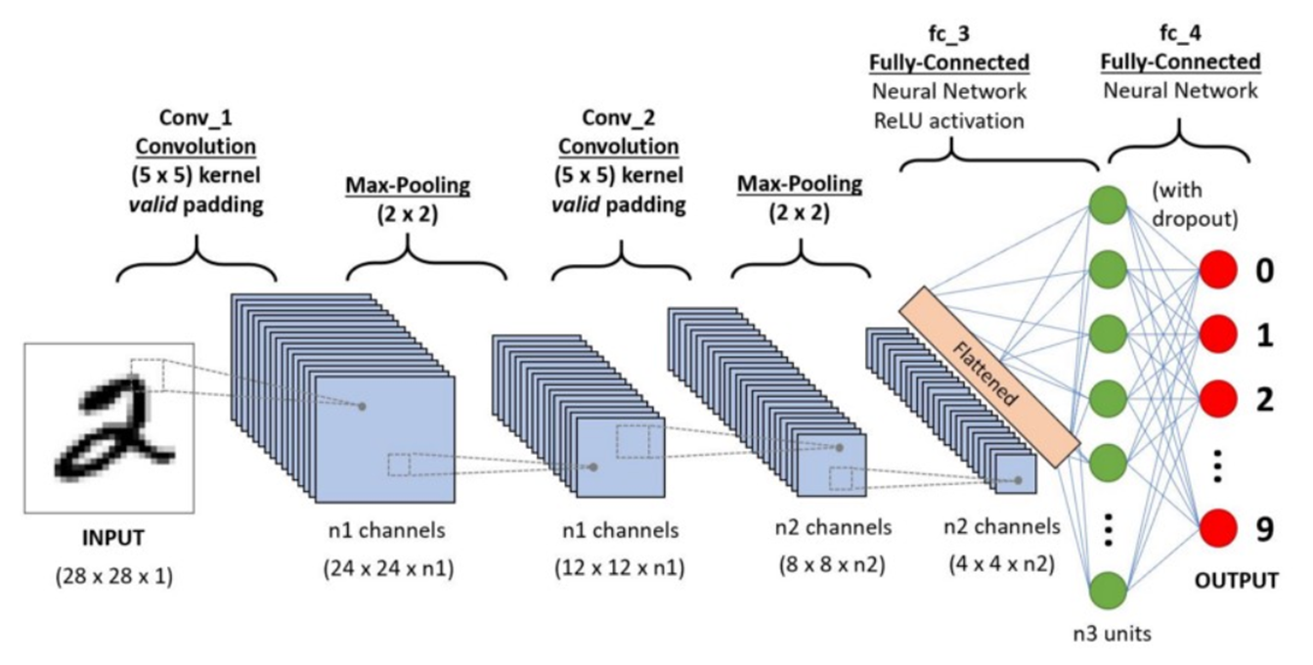
First Step of CNN
Input images
Color space identified
Dimension reduced while keeping features

Slide 14
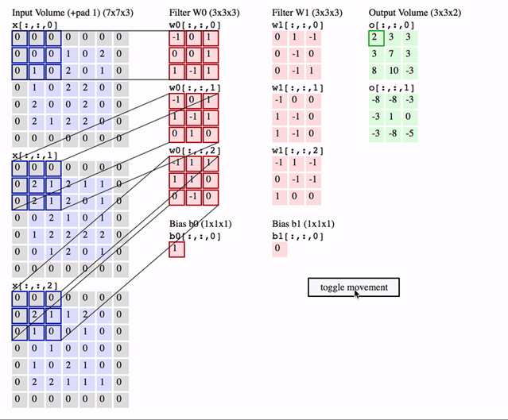
Second step of CNN
2. Convolution layer
Data convolved
Image Dimensions = n1 x n2 x 1,
where n1=height, n2=breath,
1=no. of channels
Notes:
´Like a flashlight(filter or kernel) shining on a photo(input)!

Slide 15
Third Step of CNN
3. Pooling layer
Max pooling or pooling
Notes:
Max pooling is used to reduce the noise of the images

Slide 16
Model Deployment

Slide 17
Limitations
Model cannot make independent decisions.
Must refer to database server to determine if vehicle is stolen
Cannot predict path stolen vehicle will take
Model trained on data obtained in Hong Kong
Might perform poorly if deployed overseas
Mobile App Interface written in Kotlin
Incompatible iOS phones.

Slide 18
Recommendations
An ML model to predict if vehicle is stolen
Watches for suspicious behaviour such as swerving and reckless driving.
An ML model to predict paths taken by stolen vehicles.
Can use google maps api to analyze traffic and make decisions
Collect training data from other cities to supplement training data collected in Hong Kong.
Recreate the Mobile App Interface in Swift for iOS compatibility.

Slide 19
Q & A
Thank you

Slide 20
References

