Slide 1
AI Model for
Vehicle Identification and Tracking
Team: FYP22059
Presenter: ASIM, Uzair Bin Colangoy [3035603071]
Presenter: Young, Chak Fung (John) [3035468160]
Supervisor: Dr T.W. Chim

Slide 2
Outline
Background
Motivation
Objectives
Software Architecture
Methodology and Illustrations
Data Collection
Data Handling
Model Implementation
CNN - Choice & Steps
Project Deployment
Limitations
Suggestions
Q & A

Slide 3
Background
Losing an motor vehicle is a very expensive and stressful experience.
It is a common phenomenon in urban spaces.
Searching for stolen vehicles can take long periods of time without guarantee of success.

Slide 4
Motivation
Searching for stolen motor vehicles relies on a manual system.
A very labor intensive process.
Is very time consuming.
Is prone to human errors.

Slide 5
Objectives
Object Detection ML model
Database server
Mobile App Interface for Notifications

Slide 6
Software Architecture
The video feed from the cameras is processed and fed to a trained CNN model.
This extracts the details of the vehicle such as model, color and license plate number.
These details can then be compared against a database of known missing vehicles.
The system will use SQLite3 as a backend database engine. Data of the stolen vehicles is stored in database for matching.

Slide 7
Methodology and Illustrations
Cameras will be positioned adjacent to busy highways
Camera communicate with a central database server
Time stamped notifications alert authorities on positive matches.

Slide 8
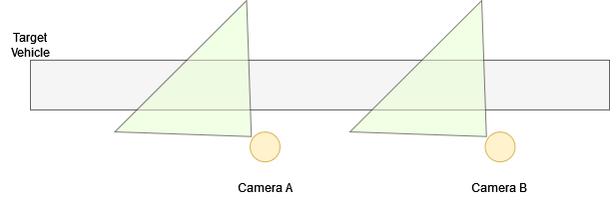
Methodology and Illustrations

Slide 9
Data Collection
Video feed collected near Queen Mary’s Hospital
1080p @ 30 fps
Oppo A38 mobile phone camera
Video stripped into individual frames
Using ffmpeg library
Videos taken at three different angles

Slide 10
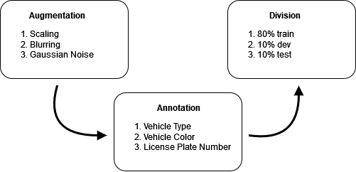
Data Handling

Slide 11
Model Implementation
Employs convolutional neural networks (CNN) to detect objects in real-time
Workflow of CNN
1. Input image
2. Convolution layer(Kernel)
3. Pooling layer
4. Classification
Notes:
´Interprets three layers of colors(RGB) stacking one on top of each other
Detects markings, patterns, objects.

Slide 12
Why do we choose CNN over other algorithm?
Effective in reducing parameters
Good for processing images with high dimensionality
Feature of classification algorithm like Support Vector Machine.
Use pixel level value as feature vector
Lose spatial interaction between pixels

Slide 13
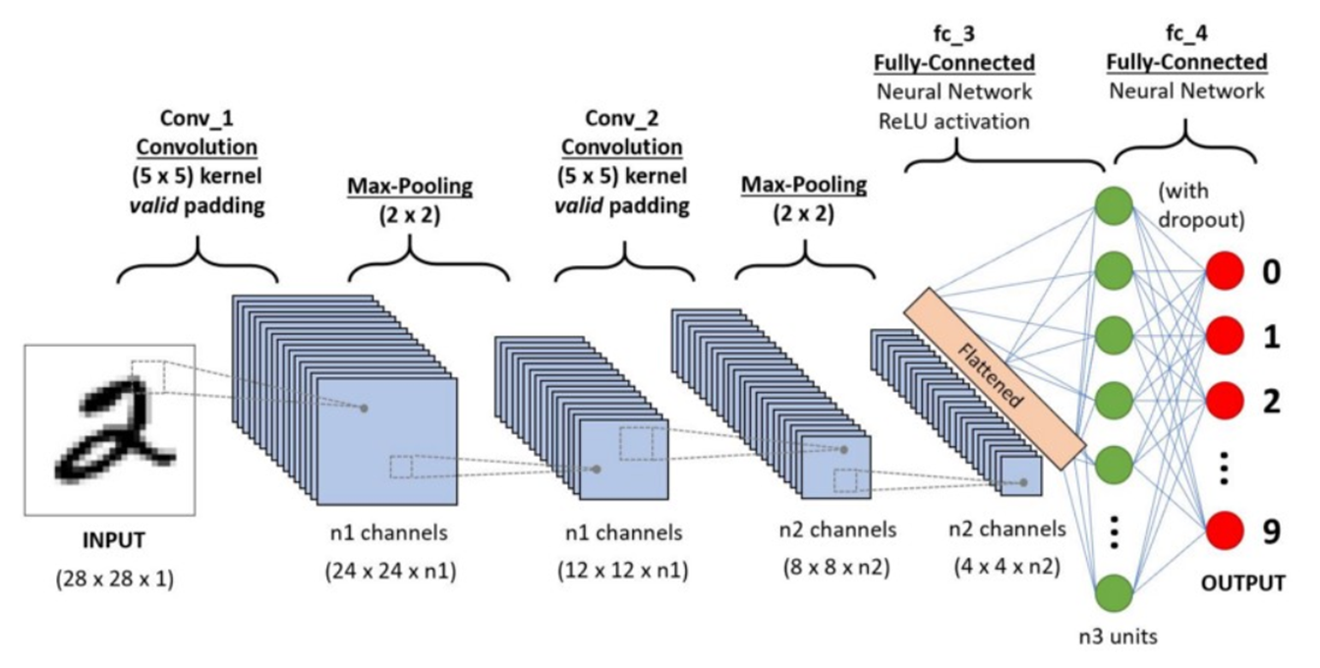
First Step of CNN - Input
Color space identified
Dimension reduced while keeping features

Slide 14
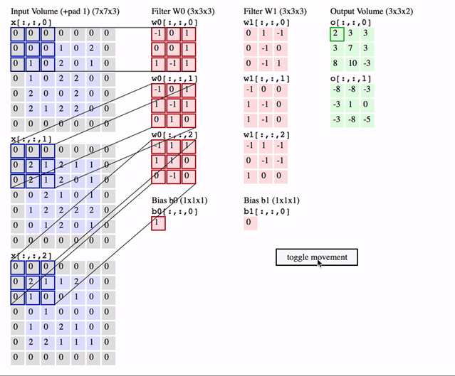
Second Step of CNN - Convolution
Data convolved
Image Dimensions = n1 x n2 x 1,
where n1=height, n2=breath,
1=no. of channels
Notes:
´Like a flashlight(filter or kernel) shining on a photo(input)!

Slide 15
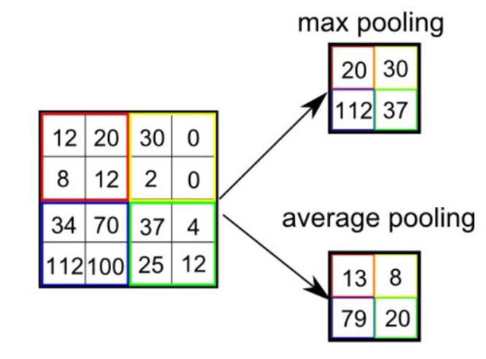
Third Step of CNN - Pooling layer
Decrease the computation power for processing data
Decrease the spatial size of feature
Max pooling or average pooling
Notes:
Max pooling is used to reduce the noise of the images

Slide 16
Last Step of CNN - Classification
Known as output layer
Distinguish between dominating and low-level feature
Provide space for learning non-linear functions
Convert output to multi-layer perception

Slide 17
Project Deployment
Database Server will be deployed on a web server.
The Camera App Interface and Notifications App Interface will be deployed on Google Play Store.

Slide 18
Project Deployment - Camera App Interface
Kotlin Mobile App
Applies Object Detection model on camera input stream
Sends information to database server

Slide 19
Project Deployment - ML Model
Object Detection Model and Optical Character Recognition model will be wrapped in the Camera App Interface
Models converted using TFLite to run using mobile phones hardware
Characteristics of vehicles is recognized and sent to database server for testing.
Allows for parallelization of ML instances.
Reduces the need for powerful computational severs.

Slide 20
Project Deployment - Database Server
Holds data about stolen vehicles
Receives input from cameras and tests for positive match
Creates a list of positive matches which can be watched by notification apps.

Slide 21
Project Deployment - Notifications App Interface
Kotlin Mobile App
Pings database server periodically for updates
Can notify law enforcement of stolen vehicles spotted
It can retrieve essential data from database server:
Location of camera that spotted the vehicle
Time the vehicle was spotted

Slide 22
Limitations
Model cannot make independent decisions.
Must refer to database server to determine if vehicle is stolen
Cannot predict path stolen vehicle will take
Model trained on data obtained in Hong Kong
Might perform poorly if deployed overseas
Mobile App Interface written in Kotlin
Incompatible iOS phones.

Slide 23
Recommendations
An ML model to predict if vehicle is stolen
Watches for suspicious behaviour such as swerving and reckless driving.
An ML model to predict paths taken by stolen vehicles.
Can use google maps api to analyze traffic and make decisions
Collect training data from other cities to supplement training data collected in Hong Kong.
Recreate the Mobile App Interface in Swift for iOS compatibility.

Slide 24
Q & A
Thank you

Slide 25
References
Bansari, S. (2019, February 13). Introduction to How CNNs Work. Medium.

