Slide 1
Data Structure Lab
BY
Uzair Hassan

Slide 2
Objectives of the Lecture
Understand what data structures are.
Learn about different types of data structures.
Understand the importance of data structures in computer science.
Get an overview of Big-O notation.

Slide 3
What is a Data Structure?
A data structure is a way of organizing and storing data in a computer
so that it can be accessed and modified efficiently.
Examples: Arrays, Linked Lists, Stacks, Queues, Trees, Graphs, etc.
Purpose: Data structures help in organizing large amounts of data, making
data retrieval and modification faster and easier.

Slide 4
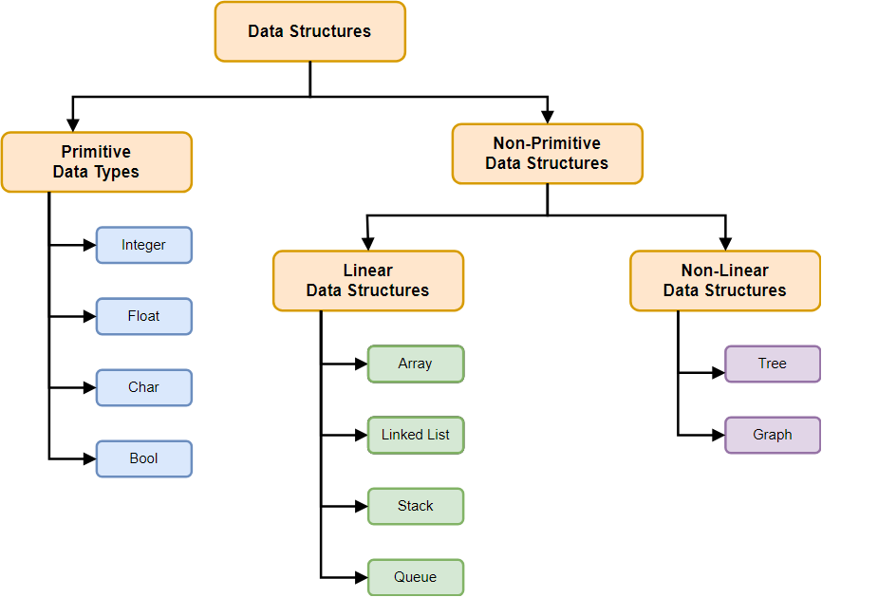

Slide 5
Importance of Data Structures
Efficiency: The choice of data structure impacts the performance of your program. Efficient
data structures lead to faster execution times and reduced resource usage.
Scalability: Handling large amounts of data requires careful organization. Using the right data
structure makes systems scalable.
Problem Solving: Many complex problems can be broken down into manageable parts by using the
right data structures.
Example: Searching a contact in your phone with a sorted list (Binary Search) is much faster
than searching in an unsorted list (Linear Search)

Slide 6
Why Data Structures Matter in Computer Science?
Algorithm Efficiency: A well-structured data set helps algorithms run faster. For example, sorting an array of numbers
can be done in O(n log n) using a more efficient algorithm like Merge Sort, as opposed
to O(n^2) with Bubble Sort.
Memory Optimization: Data structures can reduce memory usage. For instance, using a Linked List can save memory compared
to an array when the size of the data is not known in advance.
Real-World Applications: Data structures are used in various fields:
Databases: B-trees are used for indexing.
Operating Systems: Queues and stacks manage processes and memory.
Networks: Graphs are used to model networks (routers, devices).

Slide 7
What is Big-O Notation?
Definition: Big-O notation describes the upper limit of an algorithm's running time or space
requirements, representing the worst-case scenario.
Why is it Important?: It helps in determining the efficiency of algorithms by classifying them based on
their growth rate as the input size increases.
Example:
O(1): Constant time, the fastest possible algorithm. (e.g., Accessing an element in an array)
O(n): Linear time, the time grows proportionally to the input size. (e.g., Linear Search)
O(n^2): Quadratic time, time grows exponentially as input size increases. (e.g., Bubble Sort)

Slide 8
Common Time Complexities
O(1): Constant Time Example: Accessing an element in an array by index.
O(log n): Logarithmic Time Example: Binary Search in a sorted array.
O(n): Linear Time Example: Iterating through an array.
O(n log n): Log-Linear Time Example: Merge Sort, Quick Sort.
O(n^2): Quadratic Time Example: Bubble Sort, Selection Sort.

Slide 9
Example – Time Complexity Comparison
Linear Search: Time Complexity: O(n) Search through all elements one by one.
Binary Search (Sorted List): Time Complexity: O(log n) Divide and conquer approach; eliminate half of the elements at each step.
Visual Representation: Include a graph showing the growth rates of O(1), O(n), O(log n), and O(n^2).

Slide 10
Choosing the Right Data Structure
Efficiency: The right data structure allows efficient data access and manipulation.
Memory: Some data structures use less memory but may be slower (e.g., Linked Lists), while others use more memory but provide faster access (e.g., Arrays).
Operations: Different data structures are suitable for different tasks:
Stacks: Used for problems where the order matters (e.g., undo functionality).
Queues: Used for scheduling processes.
Trees: Used for hierarchical data storage (e.g., file systems).

Slide 11
Summary
Data structures are essential for organizing and managing data efficiently.
Choosing the correct data structure impacts algorithm performance and memory usage.
Big-O notation is a powerful tool to analyze and compare algorithm efficiency.
We will explore different data structures in detail in the upcoming lectures.

Slide 12
Overview of Time Complexity
Time complexity is a way to measure the time an algorithm takes to run
as a function of the input size.
It helps to compare algorithms and predict their performance on large inputs.
Types:
Best Case: The input is in the most favorable condition.
Average Case: The input is in a random condition.
Worst Case: The input is in the least favorable condition.

