Slide 1


Ramya Priya

Slide 2


Slide 3
Topics:
  Tags
  Input
  GeoLocation
  Graphics - Canvas & SVG
  Video/Audio
  Storage

Slide 4

<header>
<nav>
<article>
<aside>
<section>
<footer>

Slide 5
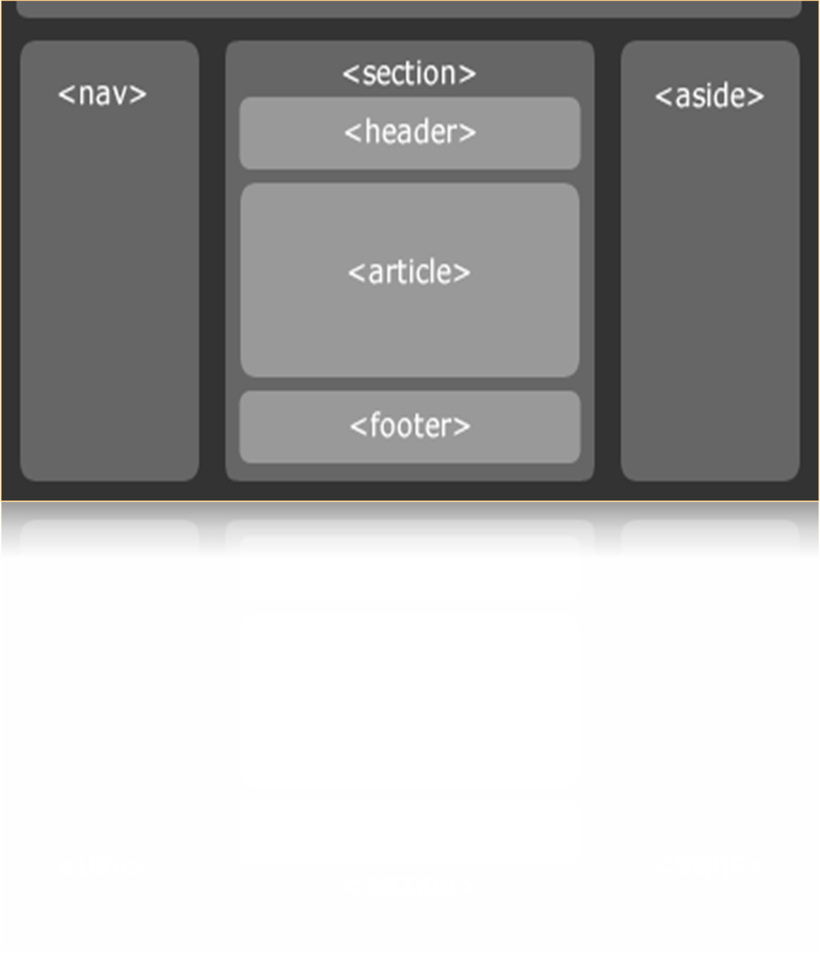
HTML 5 page structure

Slide 6
Tags - <article> vs. <section>:
"Authors are encouraged to use the article element instead of the section element when it would make sense to syndicate the contents of the element."
"Section is used when there is naturally a heading at the start of the section."

Slide 7

Date
Color
Datetime
Email
Month
Number
Range

Slide 8
Search
Tel
Time
url
Week

Slide 9


Slide 10
GeoLocation:
  navigator.geolocation.getCurrentPosition() - obtain the user's current location
  navigator.geolocation.watchPosition() - watches for changes in a user's location

Slide 11
Graphics: Canvas & SVG:
Canvas - is a new HTML element which can be used to draw graphics using scripting (usually JavaScript).

Slide 12
Graphics: Canvas & SVG:
"SVG - Scalable Vector Graphics (SVG) is a standard from the W3C which is built on top of XML. The SVG standard describes ways that graphics can be drawn for use on the web." (http://www.svgbasics.com/index.html)

Slide 13


Slide 14
Audio / Video:
  Offers the ability to easily embed media into HTML documents
  Media playback can be controlled via JS and media events
  A flash fallback could be provided for browsers that don't support HTML5 media
  Supports audio & video without any third party(adobe & flash plugins).

Slide 15


Slide 16
Storage:
  Session and Local Storage—provides a js interface to key-value storage.
  Web Databases—RDBMS support for storing structured data inside the browser.
  Application Cache—Local Cache
Notes:
Application Cache
providing the ability to define a list of files the browser should store locally and not request from the server again (until you explicitly signal the browser that you have something new to offer). Strategically used, this allows for the creation of web applications that can be used completely offline.
Allows you to define files that the browser, after the first request, should not request again (until you say otherwise). If used properly, this facilitates the creation of applications that can be used offline.

Slide 17

Supports media without any third party controls.
Full support for css3.
Video & audio Controls.
New Elements.
Web applications.

Slide 18

Supports only modern browsers.
Although parts of the language are stable, the language itself is considered as work in progress, so technically, any of the elements could change at any time.

Slide 19

<accronym>
<applet>
<basefont>
<big>
<center>
<dir>
<font>
<frame>

Slide 20
<frameset>
<noframes>
<tt>
<strike>
<u>
<xmp>

Slide 21

Novalidate
Required
List
Placeholder
Min and max
Multiple

