Slide 1

CSC346-Computer Organization and assembly language Lab Lecture Semester-# Spring 2021
Prepared by:
Huma Chaudhry
M.Phil Computer Science

Slide 2
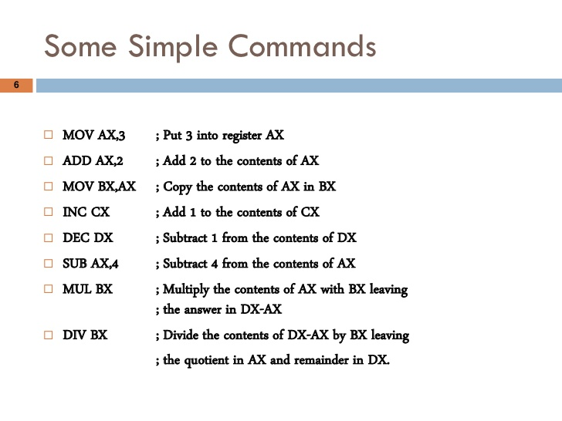

Slide 3
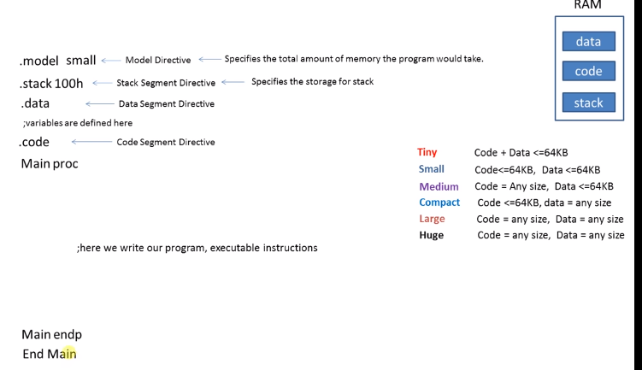
Assembly language syntax

Slide 4
General Purpose Registers
AX is the Accumulator Register:
it is used in input/output and arithmetic operations ADD,SUB,MUL,DIV in multiplication operation, the output is always stored in the AX register.
BX is known as the base register:
as it is used as a temporal memory storage and as an assistance to AX for arithmetic register.
CX is known as the counter register:
controls the loop as it stores the loop count in iterative operations.
DX is known as the data register:
It is also used in input/output operations. It is used to print the output on the console screen using data operations and divide operations involving large values.

Slide 5
LEA : Load effective address
LEA : Load effective address is used to move the address of the string,array,char etc to the specific register.example: DX

Slide 6
For comment in Assembly Code
The comments in the code are written by using a ";" .

Slide 7
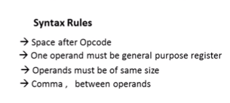
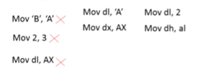
Syntax Rules

Slide 8
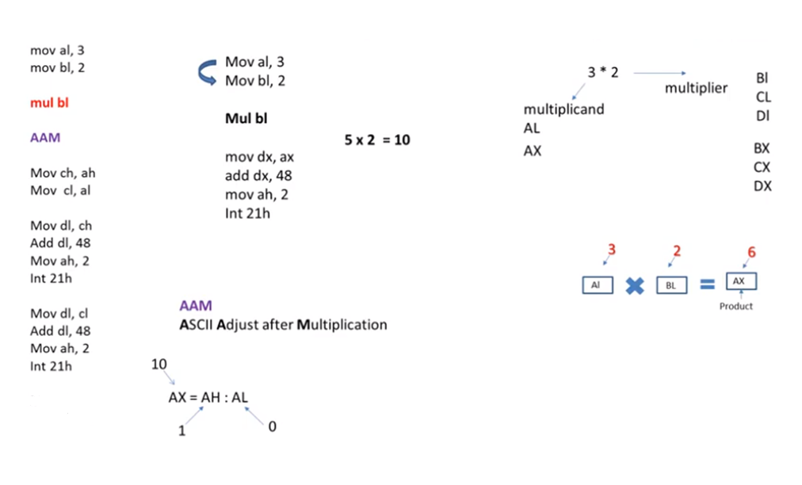
Program to multiply two numbers and print the number

Slide 9
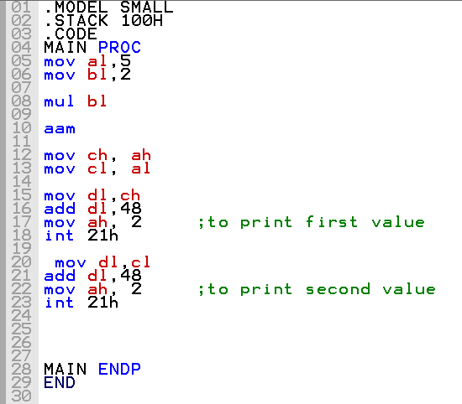
Program to multiply two numbers and print the number

Slide 10
Assignment
Write a program to take two input numbers from user and add first then subtract the values and print both the outputs on console.
Write a program to divide two numbers taken from user and print the output on console.

Slide 11
Q & A

