Slide 1
FROSTMIND
AI-driven cold-chain monitoring and intervention
Phase 7 | Deployment, Documentation & Presentation
Team FROSTMIND | AIoT project, Semester VII | November 2026
Notes:
Introduce the team and the one-line idea: FROSTMIND watches a refrigerated load, corrects the cooling unit by itself, and explains what happened. The row of dots is the box's 11-LED status strip, which you'll see working in the demo.

Slide 2



Cold chains fail silently. FROSTMIND senses, acts and explains
Sense
Act
Explain
A small ESP32 box reads temperature, humidity and the door every 2 seconds, and streams it through the driver's phone.
When its rule trips, the box fires an IR command at the cooling unit by itself: no human and no internet needed.
AI measures shelf life, picks the right temperature and checks which products can ride together. A local LLM explains each incident in plain English.
Everything runs on one laptop: no cloud account, and no data leaves the machine.
Notes:
Problem: loggers only record; by the time someone reads the log the product is lost. Our answer in three verbs. Stress that the box acts on its own (IR) and that all AI, including the LLM, runs locally.

Slide 3
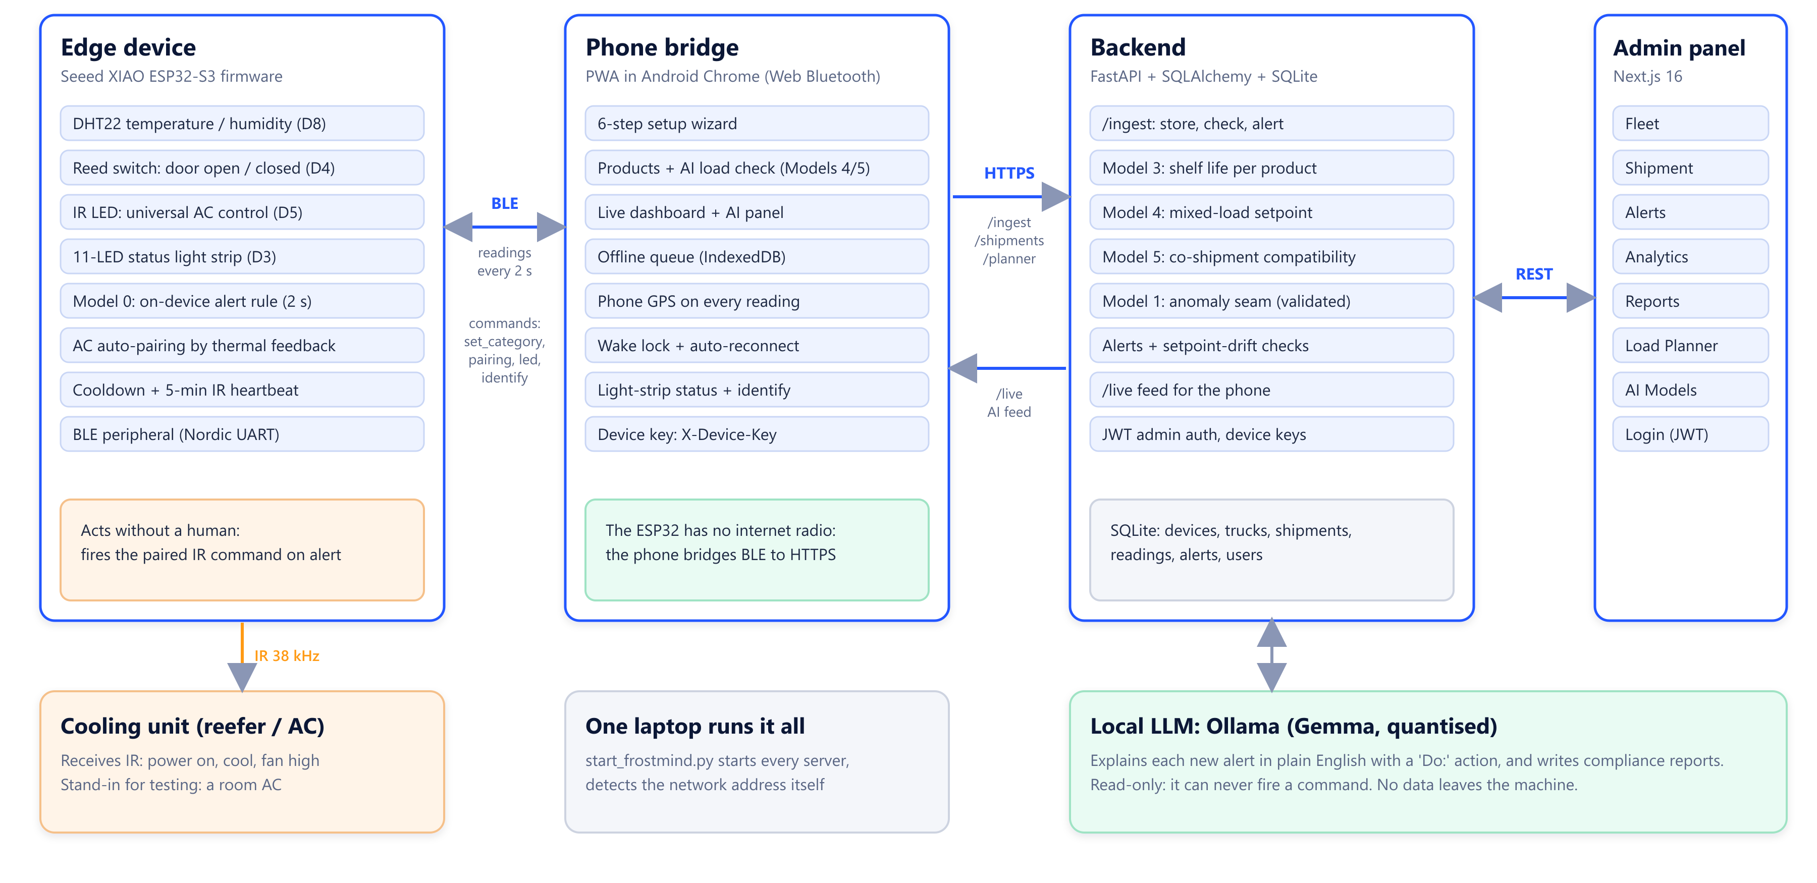
Four tiers, one data path
Notes:
Walk left to right: the ESP32 senses and acts; the phone bridges Bluetooth to HTTPS because the box has no internet radio; the FastAPI backend stores readings and runs the models; the admin panel is the fleet manager's view; the LLM sits beside the backend and only writes explanations.

Slide 4
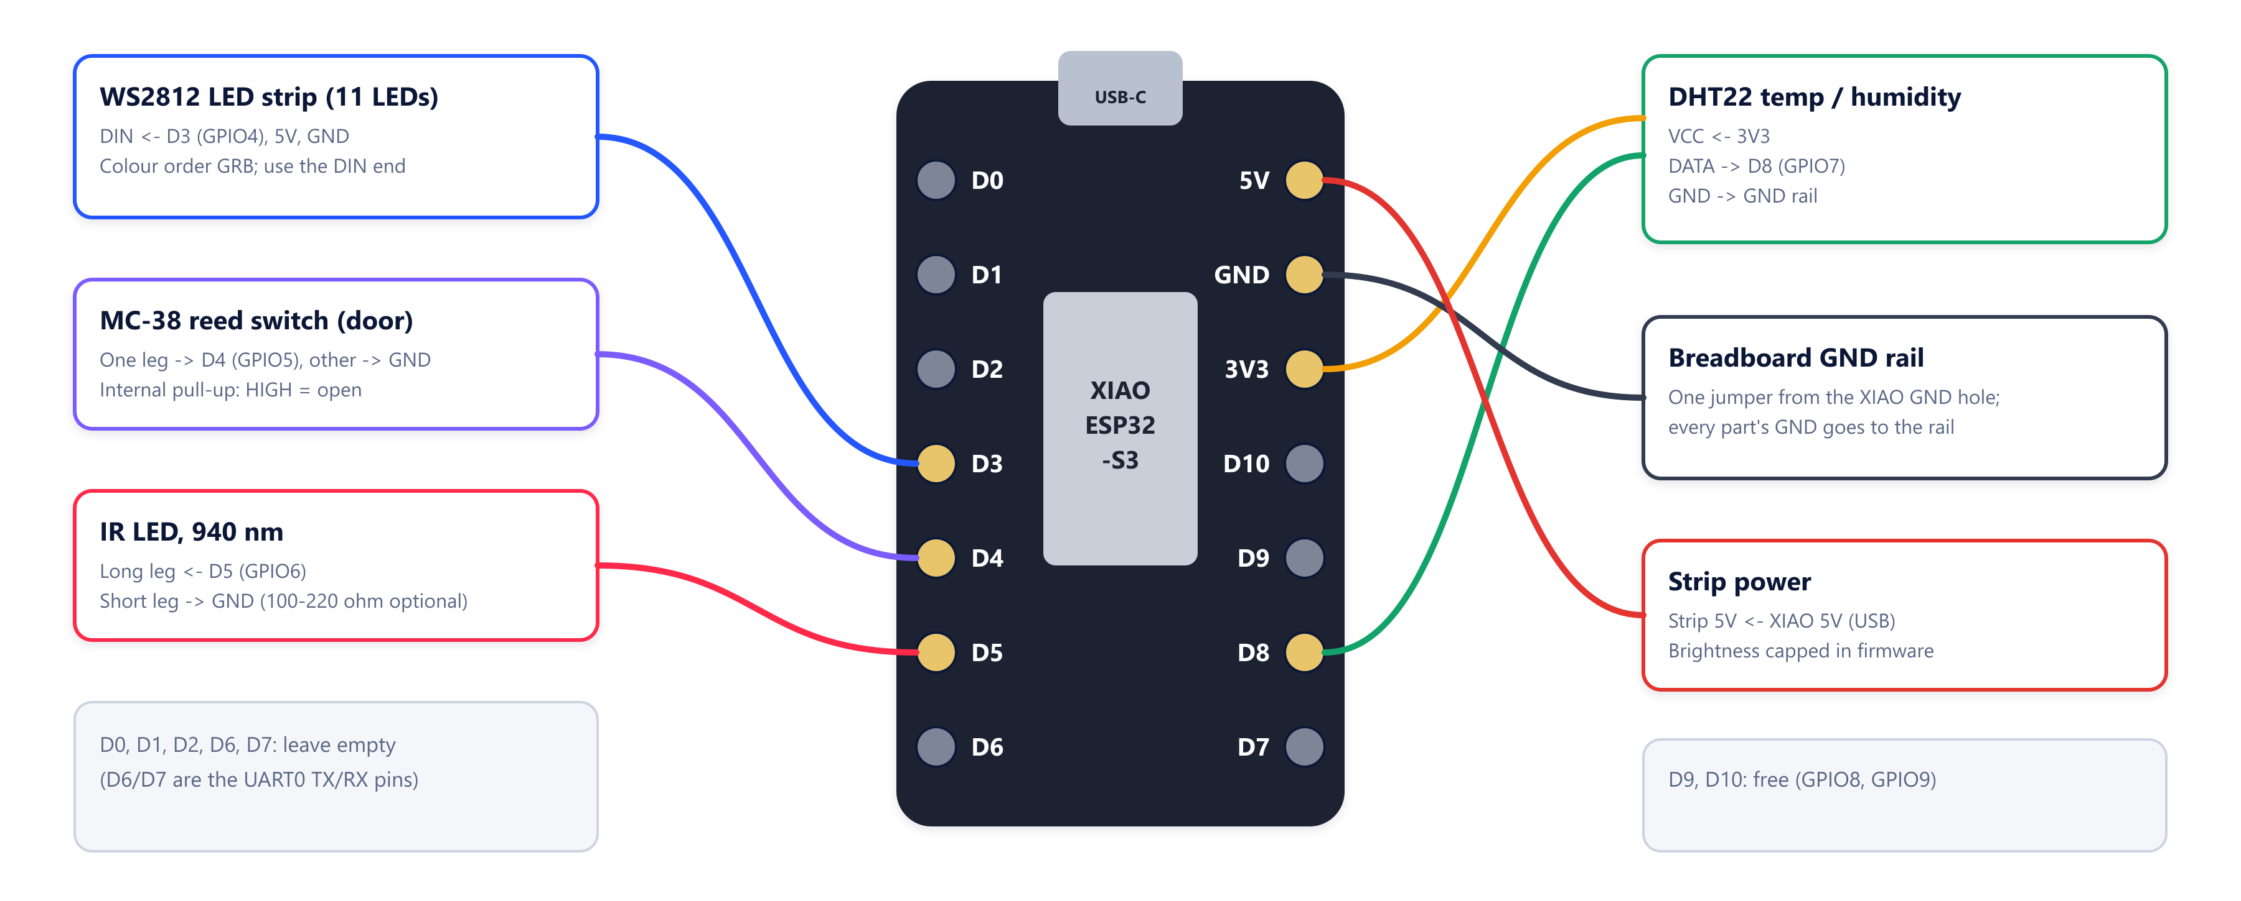
Hardware: a XIAO ESP32-S3 and five parts
Wire by the D-label, not the GPIO number: on this board D3 = GPIO4, D4 = GPIO5, D5 = GPIO6 and D8 = GPIO7.
Notes:
Parts: DHT22 on D8, reed switch on D4, IR LED on D5, 11-LED WS2812 strip on D3, all on one ground rail. Lesson learned: on the XIAO ESP32-S3 the D-number is not the GPIO number, which caused our early 'dead LED' bugs; every pin table now lists the pad first.

Slide 5
Seven AI components, staged to the data we have
Model 0
On-device rule
Rate of change, setpoint deviation, door time; fires the IR command
Live
Model 1
Anomaly detector
Isolation Forest, ROC-AUC 0.77-0.91 on 4 datasets; waits for our own data
Validated
Model 2
Root cause
Needs AC current draw (INA219), not sourced; deliberately not faked
Deferred
Model 3
Shelf life
Arrhenius kinetics per product; the most perishable one drives the trip
Live
Model 4
Mixed-load setpoint
Physics teacher + ML student; 0.16 °C error on unseen products
Live
Model 5
Compatibility
Random Forest on 13 pair features; ROC-AUC 0.930
Live
LLM
Explanations
Local Gemma via Ollama; read-only, it can never act
Live
Notes:
Design principle: rules and physics where there is no data yet, machine learning where real labelled data exists, and the LLM only explains. Only deterministic logic (Model 0) is allowed to trigger a physical action. Model 1 is trained and validated but correctly switched off until we have our own logged sessions; Model 2 needs a current sensor we never got, so we didn't fake it.

Slide 6
Models 4 & 5 beat the hand-written rules
MODEL 4 | one temperature for a mixed load
MODEL 5 | which products can ship together
0.16 °C
93.6 %
0.930
0.717
mean error on products it never saw
within ±0.5 °C of the physics optimum
ROC-AUC on unseen products, 30 splits
Matthews correlation (MCC)
Notes:
Model 4: a physics optimiser (the teacher) finds the temperature that minimises quality loss across all products, including chilling injury, freezing and the truck's real temperature wobble; a gradient-boosting student learned from 16,000 simulated loads and was tested on 4,000 loads of products it never saw. It's served only if it agrees with physics to 0.5 °C. Model 5: trained on 5,671 USDA expert-labelled pairs, evaluated on unseen products over 30 random splits; regulatory vetoes are added on top, and every 'keep apart' comes with a reason.

Slide 7
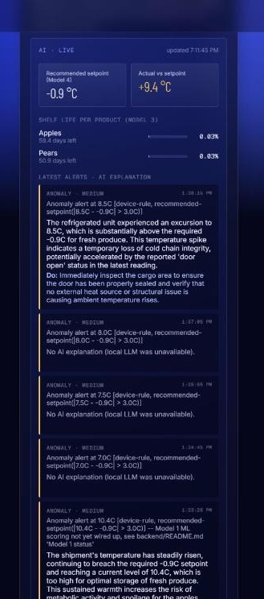

How much damage, and what to do about it
Model 3: shelf life, per product
Arrhenius kinetics integrates every reading. A threshold says 'too warm'; this says how much product life it cost.
1.31 %
of a vaccine's shelf life used by a 6-hour excursion to 12 °C
Local LLM: explains, never acts
“…an excursion to 8.5 °C, substantially above the required −0.9 °C for fresh produce… Do: immediately inspect the cargo area.”
Reached the driver's phone 7 seconds after the alert. If the LLM fails, the plain alert still stands.
Phone AI panel
Notes:
Model 3 turns the temperature history into shelf life used, per product; for a mixed load the most perishable product drives the number. The LLM gets the alert plus the model outputs and writes an assessment with a 'Do:' action. It runs in the background with a timeout and can never trigger anything physical. The quote is from our own end-to-end test.

Slide 8
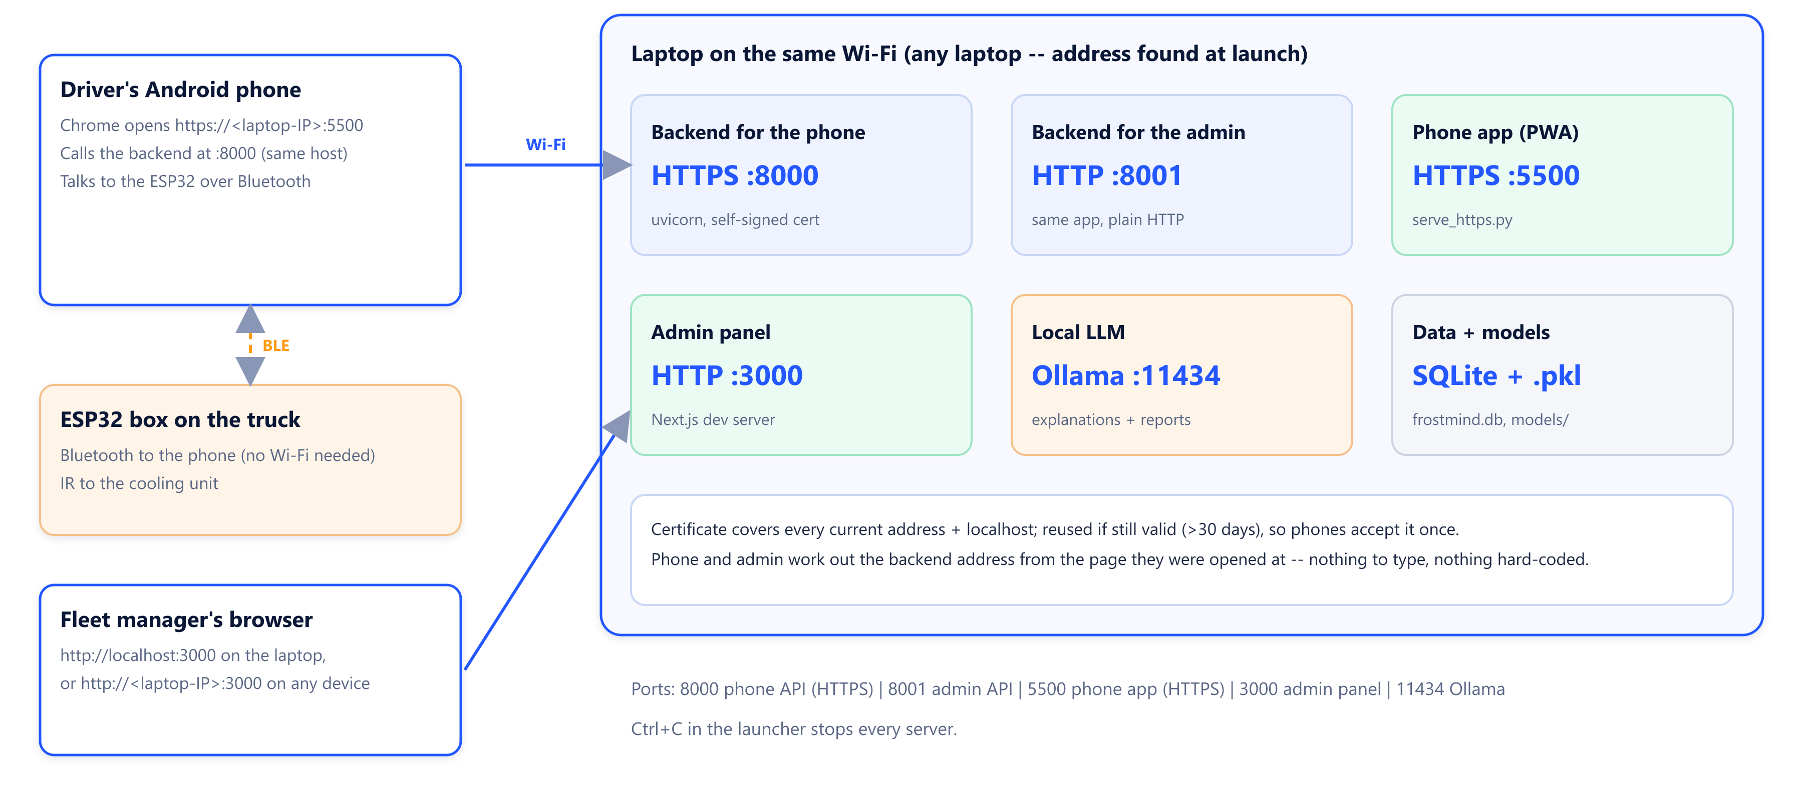
Deployment: one command on any laptop
python start_frostmind.py starts the backend, the phone app and the admin panel, and prints the addresses to open.
Notes:
Everything runs on one laptop on the same Wi-Fi as the phone. The phone opens the HTTPS app on port 5500 and talks to the backend on 8000; the admin panel is on 3000; Ollama is local on 11434. The ESP32 only talks to the phone over Bluetooth.

Slide 9




No IP lock: it works on whatever network you're on
Launcher finds the address
Detects the laptop's current LAN addresses on every start.
Fresh laptop in 5 commands
1 git clone …/frostmind
2 python -m venv .venv
3 pip install -r backend/requirements.txt
4 python scripts/train_all.py
5 python start_frostmind.py
Certificate reused
Covers every current address; kept while valid, so the phone accepts it once.
Phone follows the page
Calls the backend on the same host it was opened from; old saved addresses are ignored.
Admin works from any device
Then on the phone: accept the certificate at :8000/health and :5500, and follow the setup wizard.
API address follows the page host; the dev server allows the current addresses.
Notes:
This came from a real requirement: the system must run on a different laptop later without editing any address. Nothing in the code is tied to an IP. The model files aren't in Git, so a fresh laptop trains them with train_all.py.

Slide 10
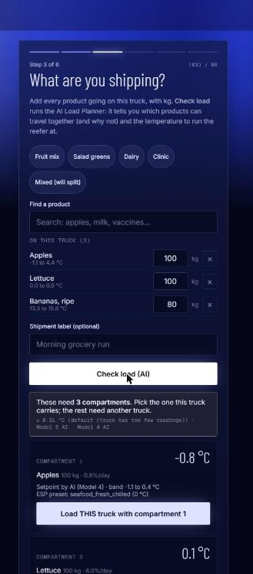
A driver sets up a truck in six guided steps
1
2
3
Pair
Register
What's on board?
Pick the box in Chrome's Bluetooth list. Errors come back as instructions.
The device ID comes from the connection. Nothing to type.
Add products and kg; the AI splits them into compartments with setpoints.
4
5
6
Pair the AC
Confirm data
Go live
Thermal-feedback sweep, with a manual fallback.
Waits for real readings; 'Flash the lights' proves the reverse path.
Upload queue, GPS and the live dashboard with the AI panel.
Notes:
The wizard never finishes on faith: step 5 waits for real readings (device to phone), and the Identify button makes the box play a rainbow (phone to device). Step 3 is where Models 4 and 5 meet the driver.

Slide 11
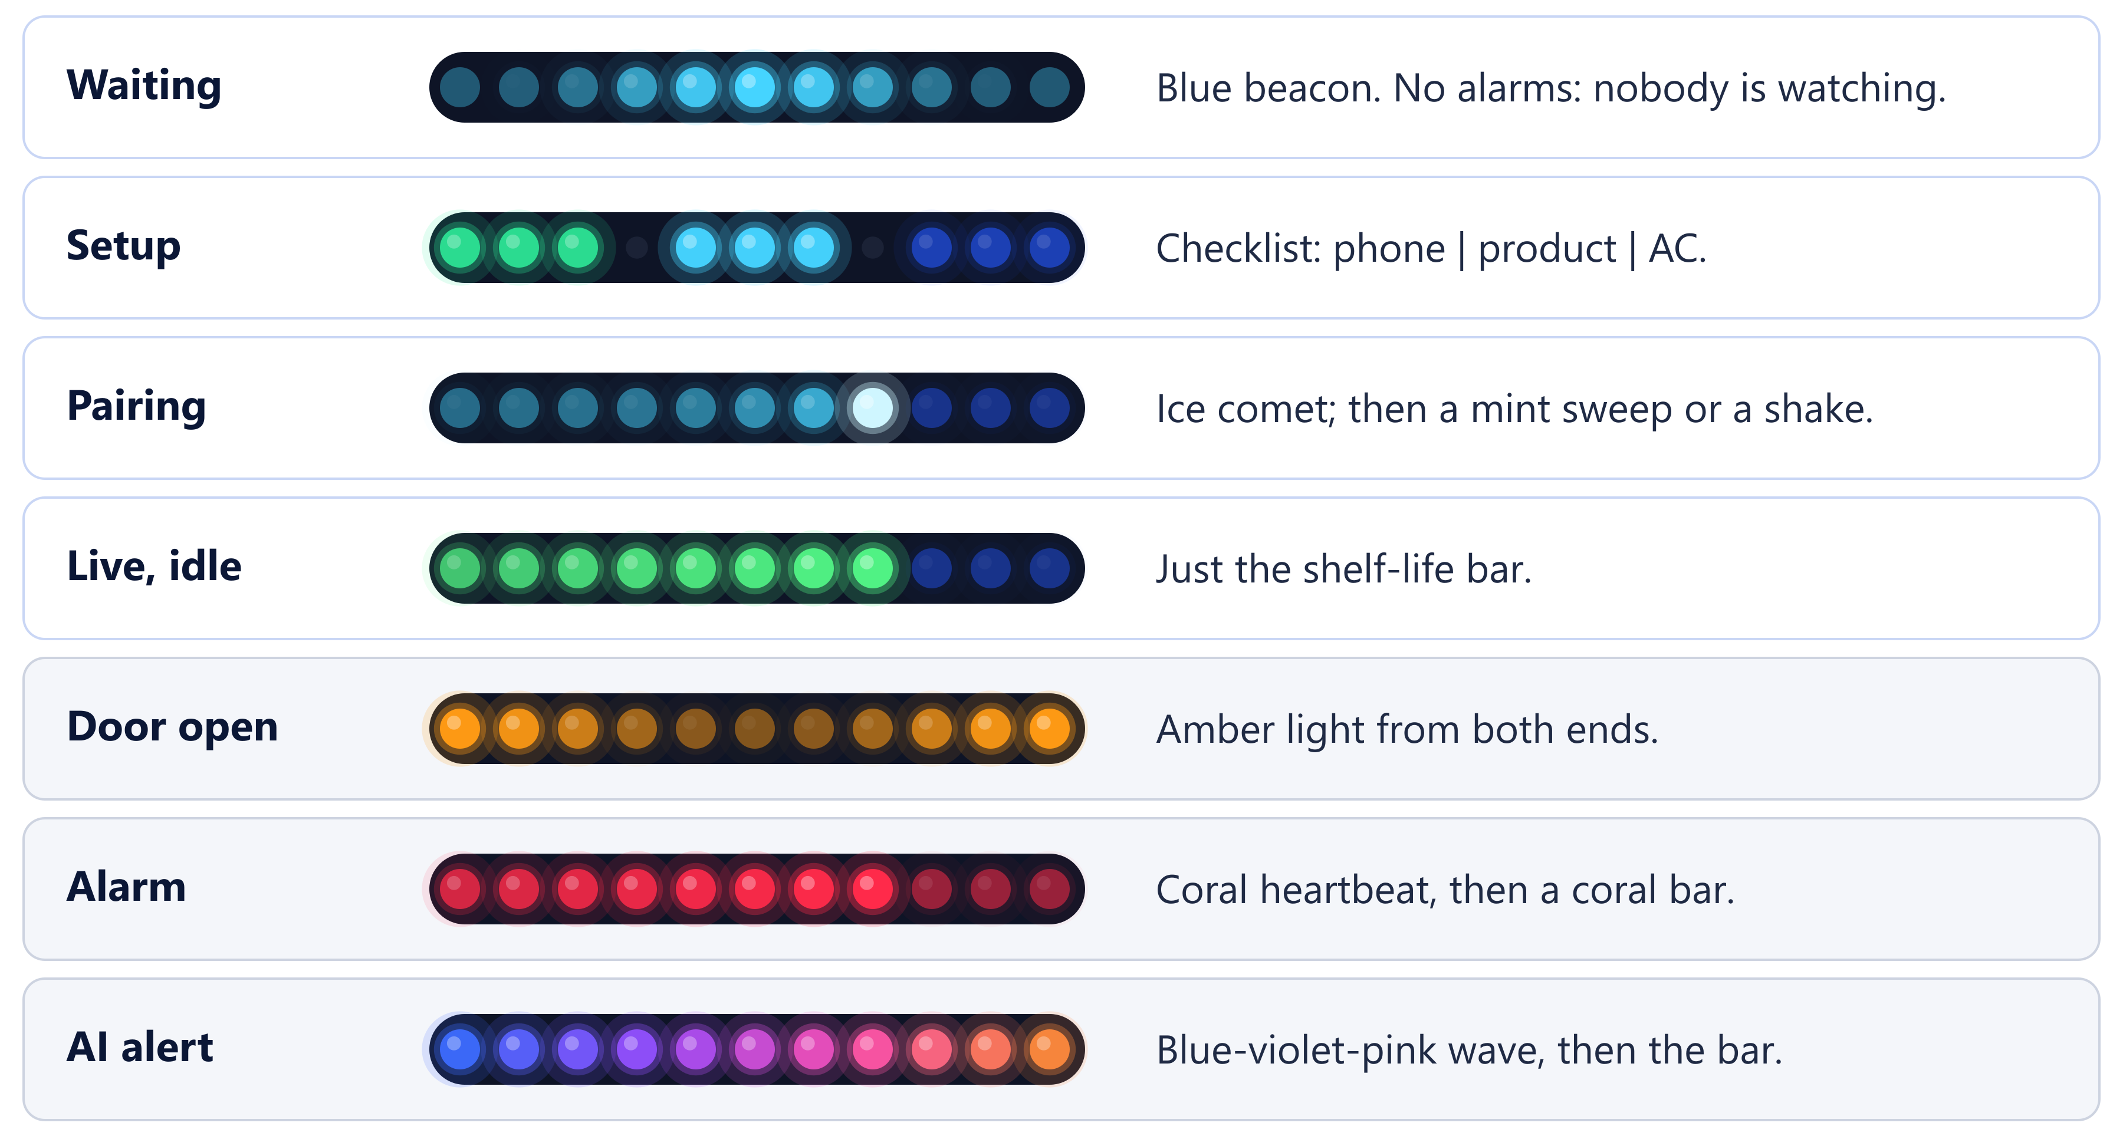
The light strip follows the trip, one look at a time
Notes:
Glanceable status for the driver. Before a phone connects: only a blue beacon, because nobody would see an alarm. During setup: a three-step checklist. Live: just the shelf-life bar on idle; problems replace it one at a time. 60 fps, gamma-corrected, cross-fades, no layering. Press d in the console for the full sequence.

Slide 12
Usability, improved by using it for real
We found | We fixed
The box never appeared in Chrome's Bluetooth list | Advertise the service ID, with a name filter as fallback
The phone app was only a monitor | Multi-product step with the AI load check, plus an AI panel with explanations
Admin panel dead when opened from another device | Allow the laptop's current addresses; API follows the page host
A new Wi-Fi network broke the hard-coded IP | No-IP-lock design, certificate reused while valid
Alert times 5.5 hours off on the phone | Server times parsed as UTC
Strip flickered between animations; alarms with no phone | Workflow engine: one look at a time, problems only while live
Each fix is in the code and documented. The full list is in Section 11.3 of the documentation.
Notes:
Usability evidence: every one of these came from running the real system on real hardware with a real phone, and each fix is in the code. This is our usability-testing log.

Slide 13


Tested at every layer
72
0
3/3
7 s
backend tests pass
firmware compiler warnings
web checks: lint, types, build
alert to AI explanation on the phone
Verified on the real board
End to end, with the real LLM
DHT22 on D8: 24.5 °C, 38 % RH
Reed switch on D4: open / closed
11-LED strip on D3, GRB order
Still to verify: IR LED on D5, AC pairing
Apples, pears, lettuce, bananas split into 3 compartments
Apples + bananas rejected, with reasons
Apples + pears created at −0.9 °C (ML, guarded)
Warm readings flagged against the setpoint
Notes:
Tests cover ingest and alerts, shelf life, thresholds, device auth, GPS, the LLM orchestrator, the Model 1 seam, analytics, the planner and mixed loads. Be honest about what's still to verify on hardware: the IR LED and AC pairing.

Slide 14

Live demonstration: ten minutes
0:00
1:00
2:00
4:00
5:00
6:00
7:30
Power on
Pair + register
AI load check
Confirm data
Go live
Trigger a problem
Admin panel
Frost bloom, then the blue beacon
Handshake on the strip
Apples, pears, lettuce, bananas
Rainbow proves both directions
Sweep, then the shelf-life bar
Warm it or open the door; AI explains
Fleet, shipment, Load Planner, AI Models
If something fails on the day
Bluetooth: press d in the console for the full light sequence. LLM slow: the alert is already there. Wi-Fi blocks devices: use the laptop's hotspot; the launcher finds the new address.
Notes:
Before the demo: start the launcher, accept certificates, warm up the LLM with Test LLM on the AI Models page, and keep the sensor in a cool box with an ice pack so the live view starts at the shelf-life bar. Take it out to show the alarm.

Slide 15





Future scope
Model 1 live
Model 2: root cause
Over-the-air updates
Train on our own logged trips and switch on learned anomaly detection; the seam is ready.
Add an INA219 current sensor to tell a compressor fault from an open door.
Update the boxes' firmware without a laptop and a cable.
No phone needed
Cloud and multi-fleet
Map and real-time push
LTE-M or LoRaWAN on the box, with the phone as an optional display.
PostgreSQL, a real TLS domain, Docker, accounts and roles.
GPS is already recorded; add a fleet map and instant alerts.
Notes:
Roadmap in order: switch on Model 1 with our own data; add the current sensor for Model 2; OTA updates; remove the phone dependency with cellular or LoRa; then cloud deployment, multi-tenancy and a native app for iOS.

Slide 16

Maintenance strategy
Area | What | When
Code | Tests, lint, build and firmware compile before every merge | Every change
Models | Retrain with train_all.py; promote only if scores hold | Catalog change / quarterly
Data | Timestamped database backup; additive schema changes | Weekly, before upgrades
LLM | AI Models page and /health; Test LLM | Daily in use
Hardware | DHT22 vs a reference thermometer; g, d, x test keys | Monthly
Security | Rotate secrets; certificate renews itself | Every 90 days
Model governance
Every model ships with its metrics file
Promotion gate: new scores must be at least as good
Model 4 is served only if physics agrees
Missing model? Physics and rules take over, no crash
The LLM can never act
Notes:
Maintenance is built in: every component reports its status (/health and the AI Models page), models retrain with one command and only replace the old ones if their scores hold, schema changes never delete data, and the certificate renews itself.

Slide 17
Sense. Act. Explain.
Thank you. Questions?
Code: github.com/UzairManjre/frostmind | Documentation: FROSTMIND_Phase7_Documentation.docx
Notes:
Close with the three verbs. Likely questions: why not a cloud LLM (privacy, cost, works without internet); why Model 1 isn't live (needs our own data, and would be confidently wrong across product bands); what if the LLM is wrong (it can't act; the deterministic alert stands).

