Slide 1



Next Word Predictor
Basil Riaz
Huzaifa Butt
Abdul Ahad
Athar

Slide 2

Mechanism
Textual Data
Preprocessing
Defining Sequences
Prediction
First, divide the sentence into wordsThen select the last word of the sentenceThen find the probability of the last word by looking at the vocabulary (dataset).Then, finally, select the next possible word.

Slide 3
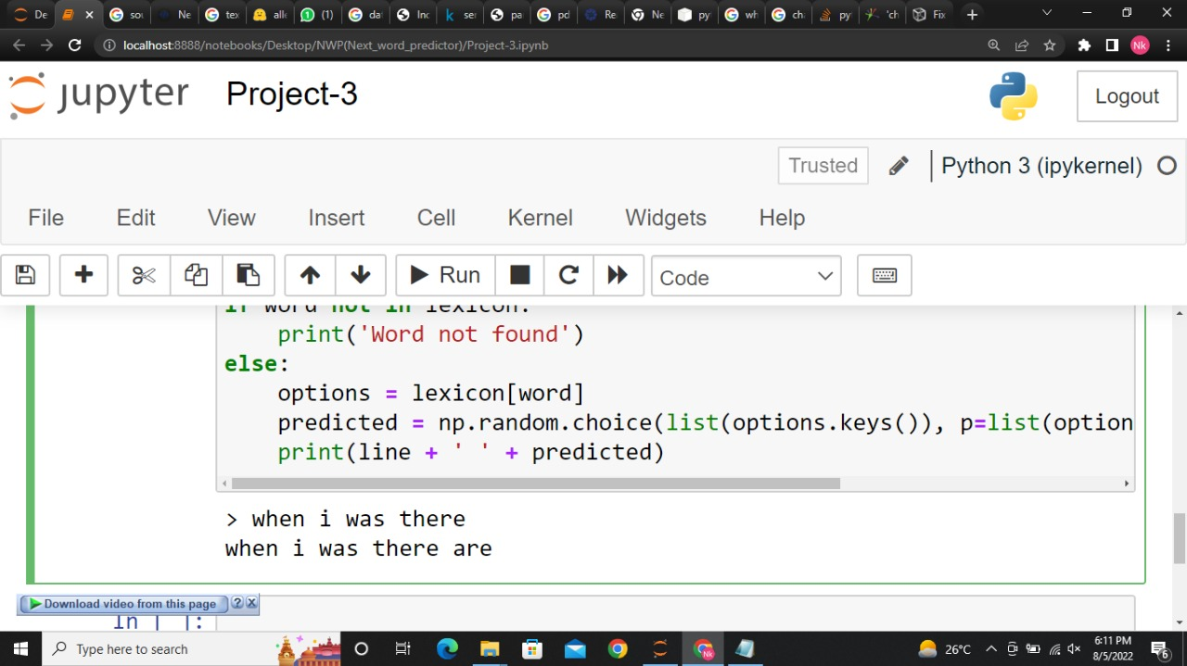
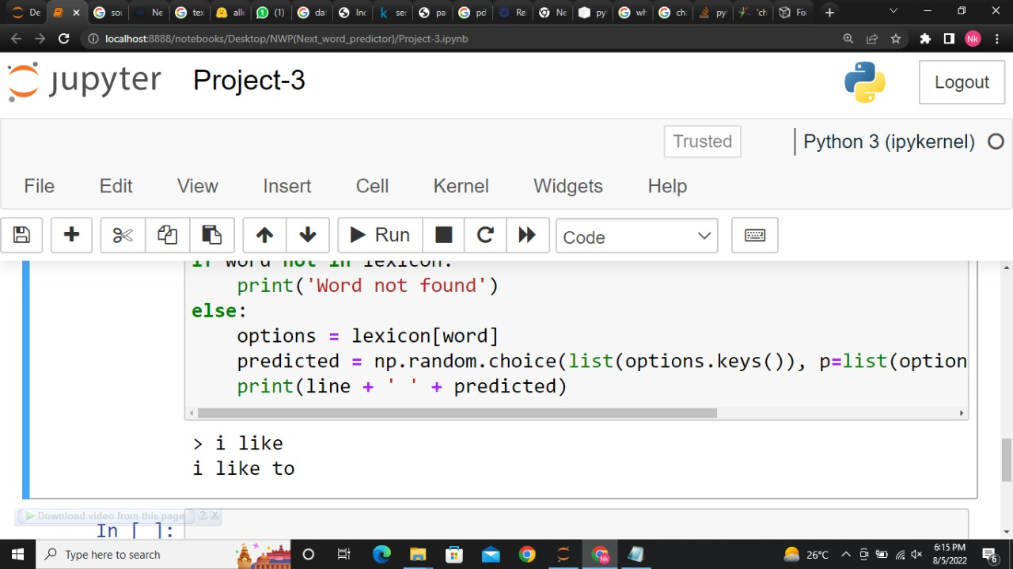
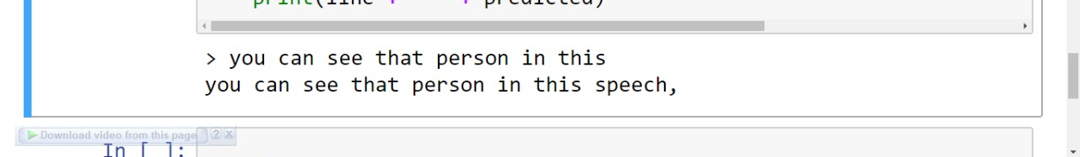
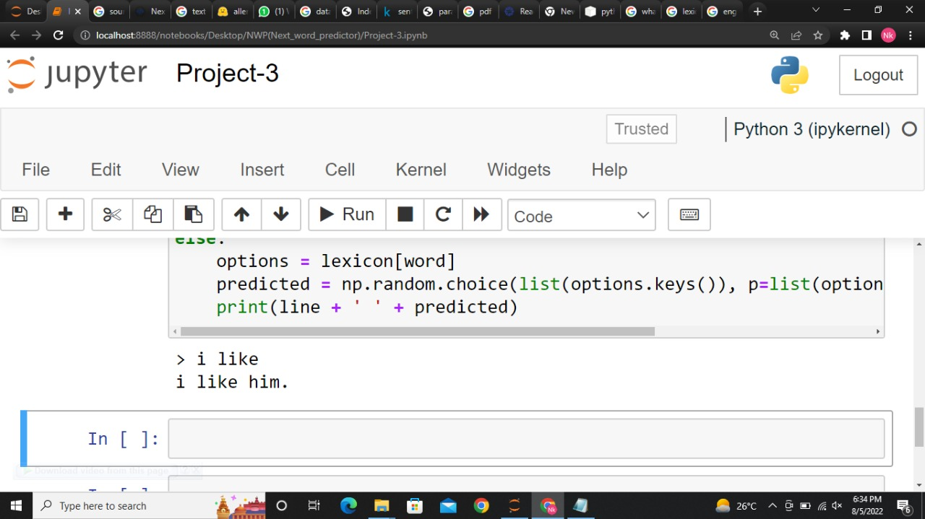
predictions

