Slide 1


DataViz Studio
Interactive Data Analytics Dashboard
Uzma Yasmeen & team
Batch-19/20

Slide 2

Team Members - Batch No: 19/20
Batch | Roll No. | Name | Contributions
19 | 2503A51L07 | Sahasra | Data gathering
20 | 2503A51L34 | Uzma Yasmeen | Coding
19 | 2503A51L05 | Sathya Sri Charan | Testing
20 | 2503A51L33 | Shiva | PPT Theory
19 | 2503A51L06 | Nagamrutha | PPT

Slide 3

Project Aim: Democratizing Data Analytics
The primary aim of this project is to develop an interactive, no-code data analytics dashboard. This platform empowers users to upload datasets in diverse formats, including CSV, JSON, and Excel, facilitating automated Exploratory Data Analysis (EDA), dynamic visualisations, Key Performance Indicator (KPI) generation, and comprehensive PDF reporting. Crucially, it ensures high performance through intelligent row sampling, visualising only 1000 rows when datasets exceed this limit, thereby maintaining responsiveness for large data volumes.

Slide 4

Introduction to DataViz Studio
DataViz Studio is a Streamlit-based web dashboard for easy data exploration without coding.
Supports uploading datasets in CSV, JSON, and XLSX formats.
Automatically detects data types and generates useful KPIs.
Creates meaningful visualisations and calculates correlation metrics.
Uses smart sampling to handle large datasets smoothly and fast.
Ensures efficient performance even with heavy Matplotlib visualisation.

Slide 5
Key Features and Project Overview
Multi-Format Upload
Automated EDA
Seamlessly upload CSV, JSON, or Excel datasets.
Gain quick insights with summary statistics and datatype detection.
Diverse Charting
Intelligent Sampling
Access multiple chart types: Bar, Line, Scatter, Histogram.
Automated sampling for large datasets, ensuring smooth visualisation (max 1000 rows).
Correlation Analysis
PDF Reporting
Generate informative correlation heatmaps for data relationships.
Export comprehensive reports with multiple visuals in PDF format.

Slide 6





Technological Integration: The Backbone of DataViz Studio
Pandas
Matplotlib & Seaborn
Streamlit
For robust CSV, JSON, and XLSX file handling and data manipulation.
Powerful libraries for generating high-quality graph rendering and statistical visualisations.
The framework powering the intuitive web interface and interactive components.
PdfPages
Sampling Logic
Utilised for seamless report generation and export capabilities.
Integrated algorithms to optimise large dataset visualisation performance without compromising insights.

Slide 7




Methodology: Data Ingestion and Preparation
Upload & Validation
Schema Inference
Supports diverse formats like CSV, JSON, and XLSX, ensuring data integrity upon upload.
Automatically detects data types and infers the underlying structure of the dataset.
Data Cleaning
Intelligent Sampling
Identifies and handles missing values, duplicates, and other inconsistencies for analysis readiness.
Applies adaptive sampling techniques to large datasets to maintain optimal performance.

Slide 8
Results and Discussion: Impact and Efficiency
1
2
Optimised Sampling
Arrow-safe DataFrame
We limit visualisations to 1000 rows to prevent lag, ensuring smooth interaction even with large datasets.
This feature prevents Streamlit from crashing, handling nullable integers or mixed data types gracefully for enhanced stability.
3
4
Persistent Session State
Flexible Export Features
Users can generate multiple graphs and view them in a combined dashboard without losing previous graphs, offering a comprehensive view.
Users can export individual graphs or a full PDF report with all insights, facilitating easy sharing and documentation of findings.
Notes:
These improvements ensure that our visualisation tools are more reliable, efficient, and user-friendly, supporting better data-driven decisions.

Slide 9

Streamlining Data Uploads: Code Snippets
Multi-format Upload
Intelligent Sampling Logic
Dynamic Visualization
Enabling users to easily upload various file types for analysis.
Optimizing performance for large datasets by intelligently sampling data.
Facilitating immediate visual representation of your data insights.
uploaded_file = st.sidebar.file_uploader(
"Upload",
type=["csv", "json", "xlsx"]
)
fig, ax = plt.subplots()
ax.plot(plot_df[x], plot_df[y], color=main_color)
st.pyplot(fig)
plot_df = df.copy()
if plot_df.shape[0] > 1000:
plot_df = plot_df.sample(1000, random_state=42)

Slide 10





Comprehensive Data Schema Overview
Accepts Diverse Formats
Seamlessly handles CSV, JSON, and Excel formats, providing broad compatibility for your data sources.
Auto-detection of Column Types
Intelligently identifies column types such as string, numeric, and datetime, saving you manual configuration time.
Missing Value Identification
Automatically pinpoints and highlights missing values, aiding in data cleaning and ensuring data integrity.
Provides Row/Column Count
Offers an immediate overview of your dataset's dimensions, including total rows and columns.
Automatic Numeric Field Selection
Automatically selects appropriate numeric fields for charting, simplifying the visualization process for users.

Slide 11
Key Performance Indicators
Mean
Median
Std Dev
Correlation
Count
Missing Values
Average numeric value.
Middle value in a sorted dataset.
Measures the spread of data points from the mean.
Indicates the strength and direction of a relationship between variables.
Total number of rows or entries.
Quantifies the absence of data, highlighting potential data quality issues.

Slide 12
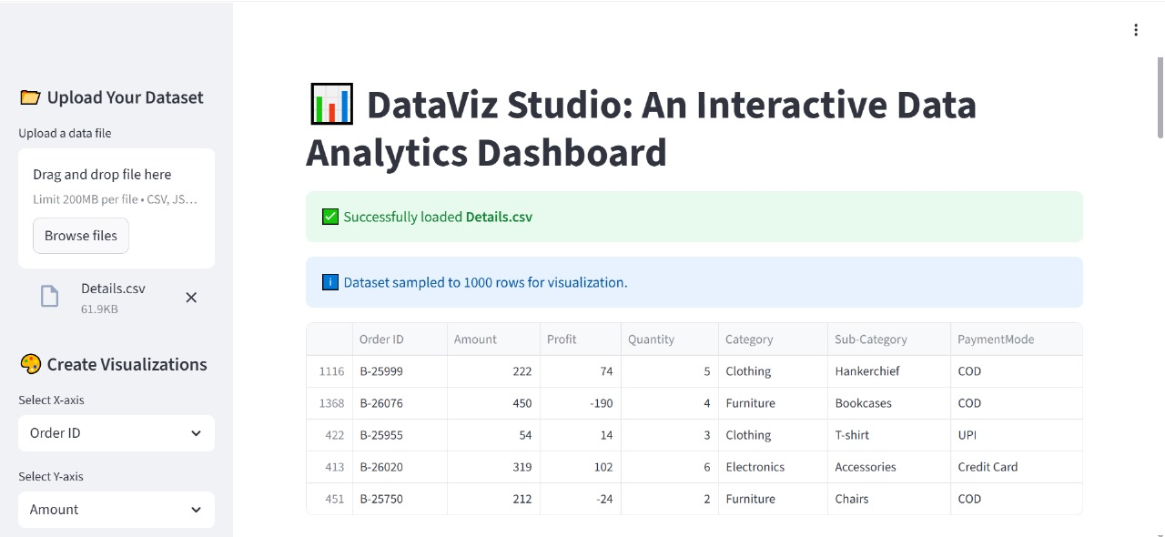

Slide 13

Conclusion & Future Enhancements
The project successfully delivered an intuitive, fast, and multi-format data analytics dashboard, empowering users to visually explore datasets, compute KPIs, and generate reports without any coding.
Future Work
Our roadmap includes integrating machine learning models, supporting real-time data streams, offering personalised dashboard themes, and enabling export options for individual charts.

