Slide 1



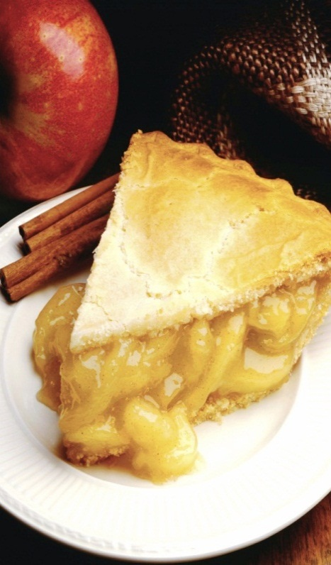
Food Delivery System
Notes:
NOTE: To replace a picture, just select and delete it. Then use the Insert Picture icon to replace it with one of your own!

Slide 2
Group Members
Uzma Fatima F20CSC03
Safa Basha F20CSC16
Bisma Imran F20CSC29
Submit To
Sir Shahid Munir
Miss Yamna Ahmed

Slide 3
Content
Title
Objective
Problem Statement
Solution / Proposed Approach
Features/ Functionalities
Deliverables
Future Work
Conclusion
References

Slide 4
Title
FOOD DELIVERY SYSTEM
The project is about taking food orders from different restaurants on a single platform thereby easing people’s lives who want to order food online.

Slide 5
Objective
The motto of this project is to diminish a number of problems faced by customers by making things digital and online. It solves the problem of time wastage, inaccuracy, and consumption of space. Not only does it aims to increase efficiency of restaurants staff but also enhances the services provided to customers via user friendly application.

Slide 6
Problem Statement
While in restaurant one needs to wait in long ques before placing order.
While placing order on call, availability of employee on phone is required.
Decrease in staff efficiency due pressure of taking multiple orders, leaving customers unsatisfied.
Orders taken on paper consumes more space.

Slide 7
Needs many physical copies of menu card so that each customer avails one.
Unreliability, whether the bill calculated is correct.
No visual confirmation that order was placed correctly.
Time consuming
In order to add more items, a new menu card would be needed to be printed, hence costly.

Slide 8
Solution/ Proposed Approach
Reduces time consumption by eliminating long ques
Increases restaurant staff efficiency; less pressure
Calculated bill will be accurate so no source of unreliability

Slide 9
Ensures data accuracy during order placement
Simplifies ordering process
Interactive interface; user can easily place order & also have visual confirmation before finalizing

Slide 10
Features / Functionalities
The customer will be able to select the restaurant, view the menu and place the order after logging in
The system will prompt the user to input the quantity
The system will allow user to order more than one meal.

Slide 11
The system will display food items ordered along with prices
The system will prompt the user to confirm the meal ordered
The system will display the total bill inclusive of tax
The system shall provide visual confirmation of order placement

Slide 12
Deliverables
main(): The main function necessary to be added in every c program. It will call the mainmenu() function.
mainmenu(): Prompts the user to whether select the sign in option or to exit.
signin(): Authenticates the user and direct it to choose restaurants.
restaurants(): Names of different restaurants

Slide 13
res1(),res2(),res3(): Menu of restaurants available.
billing(): Add tax and display the bill.
exit(): Prints a “Thank You” message

Slide 14
Future Work
The user will get promo cards depending on their number of orders placed.
The managers can create deals.
The managers can add description of the ingredients of their items
The system shall allow the manager to update price of a given food item, moreover a food item can be added.

Slide 15
Conclusion
An online platform to place orders from different restaurants, reducing paper work, increasing efficiency and reliability through confirmation of the order and displaying the net bill.

Slide 16
Reference
None

