Slide 1
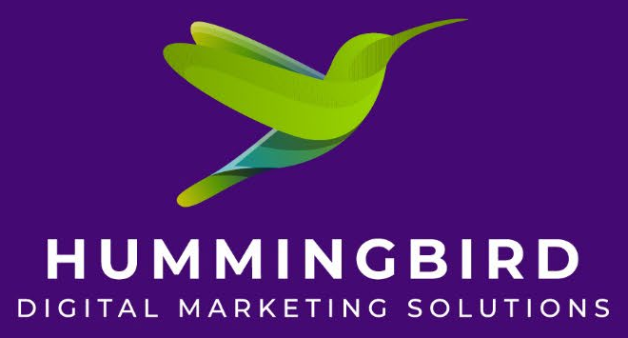
AL Habib Capital GROW
Growth plan: fix the foundations first, then test what brings funded accounts
Prepared for AL Habib Capital Markets (Pvt) Ltd | CEO and CFO briefing | September 2026
Scope: this deck outlines the scope of an annual digital marketing plan. All results shown are estimates until tested.

Slide 2
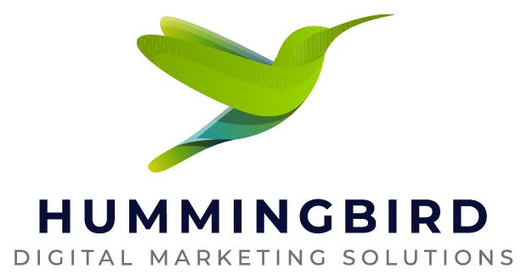
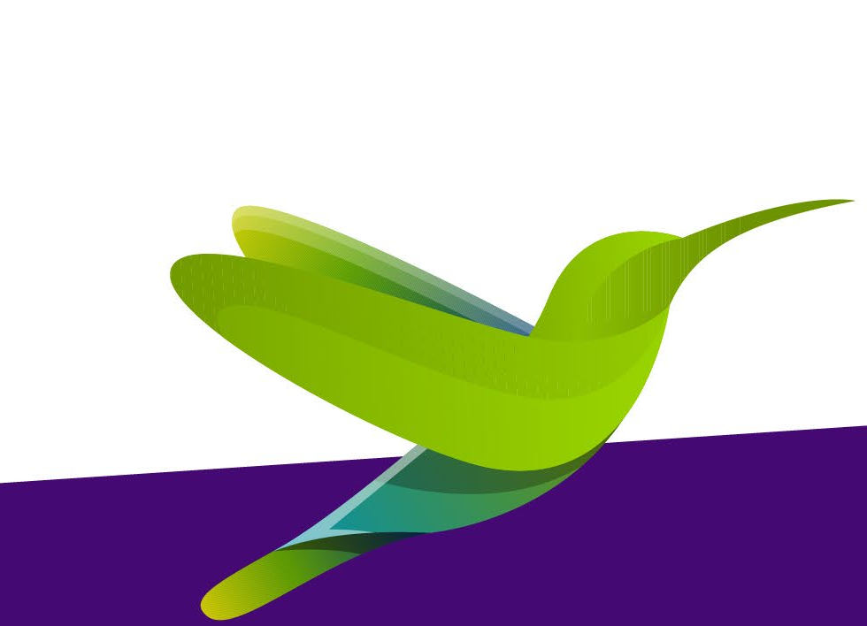
Summary: start lean, learn fast, then decide
607,025
~25,000
PKR 50,000
PKR 900,000
PSX investor accounts in July 2026, up 121% since 2022
new investor accounts opened every month, a record pace
a month for Hummingbird's organic work. First 3 months free
suggested media for a 6-month Instagram test
What we recommend, in order
Fix the foundations: social content, website, app store pages and answers in AI search (ChatGPT, Google). Low cost.
Add a small 6-month Instagram ad test, so the improved content actually reaches new people.
Review real results after 6 weeks of ads. Only then agree targets, or decide to scale or stop.
If there is no media budget: improve content and test one or two paid influencers instead.

Slide 3
Investor numbers have more than doubled
Total PSX investor accounts
Average new accounts per month
What this means: demand is already here. Around 290,000 people are likely to open a PSX account in the next 12 months. Still, fewer than 0.2% of Pakistanis invest, against 6% in India, so the headroom is very large. The question is which broker they choose.
Sources: Arab News (Aug 2026, citing Adviser to Finance Minister); ProPakistani (Feb and Aug 2026, citing NCCPL). FY = July to June.

Slide 4



Who is investing, and what they want to know
New investors, July 2026
Their top three questions
41%+
are aged 18 to 30, the largest group; 31 to 45 is second
How do I start, and how much do I need?
Answer: open in minutes with a small first amount, and a person to guide you.
84%
male and 16% female: women are an untapped segment
Is it halal?
Answer: Shariah-compliant stocks are available; show how to find them.
51% / 32%
come from Punjab and Sindh respectively
Is it safe, and who can I trust?
59%
open simple Sahulat accounts: small, first-time investors
Answer: a Bank AL Habib subsidiary, regulated, licensed since 2006.
Sources: NCCPL data via ProPakistani (Aug 2026, July new accounts); Arab News (2026). Questions: Hummingbird review of beginner guides, app reviews and SECP scam warnings; to be validated with search data in month 1.

Slide 5
Market size: who we can realistically win
TAM
~35M
TAM ~35 million
Working Pakistanis who are online: 77.2M employed people x 45.6% internet penetration.
SAM
~11M
SAM ~11 million
Urban working professionals aged 25 to 40 reachable on Instagram and Facebook (about half of Instagram's 22.4M ad reach, our estimate). Plus a warm pool of 607,000 existing investors who may switch brokers.
SOM
~7,800
SOM up to ~7,800 funded accounts a year
About 2.7% of the ~290,000 new PSX accounts expected in the next 12 months. Reachable only with sustained paid activity; the 6-month test will show the realistic share.
Sources: PBS Labour Force Survey 2024-25 via Pakistan Economic Survey 2025-26 (77.2M employed); DataReportal Digital 2026 Pakistan (45.6% online; Instagram ad reach 22.4M); Arab News Aug 2026 (607,025 investors, ~24k new/month).

Slide 6
Competitors: everyone says "easy and digital"
Competitor | What they tell customers | Where they show up | Play Store
KTrade | Fully digital account, no branch visit | YouTube, X, LinkedIn | 10K+, 3.4 stars
Finqalab | "Financial freedom one click away"; easy funding | Website, app stores | 50K+, 3.5 stars
AKD TradePro | Speed and tools for active traders | App stores, website | 100K+, 4.4 stars
Arif Habib (AHL) | Open a Sahulat account through the app | Facebook video tutorials, X | Two apps
Mahaana (funds) | Open in 10 minutes, from Rs 1,000, Shariah | Website, app stores | 10,000+ users
AHCML GROW | Not yet promoted as an app | Instagram (75 followers) | 500+
The gap no one owns: trust plus real human help. Competitor reviews repeatedly complain about slow support, crashes and account opening delays of weeks. At the same time, SECP keeps warning the public about fake trading apps and WhatsApp groups. A Bank AL Habib-backed broker with responsive WhatsApp support can own this space.
Sources: Google Play listings (Sept 2026); company websites; Investify.pk app review (2026). Live ad activity to be confirmed in the Meta Ad Library at kick-off.

Slide 7



How GROW wins: one clear promise
"Start investing with the bank you trust. Start small, with a real person to guide you."
Proposed campaign idea, in Urdu and English, to be tested in the pilot
Trusted
Guided
Accessible
Bank AL Habib subsidiary. Regulated PSX broker since 2006. Verified accounts only, so customers know it's not a scam.
WhatsApp support from day one, a free demo account and short Urdu lessons. Built for first-timers.
Start small with one clear minimum amount. Digital onboarding. Shariah-compliant options clearly shown.

Slide 8
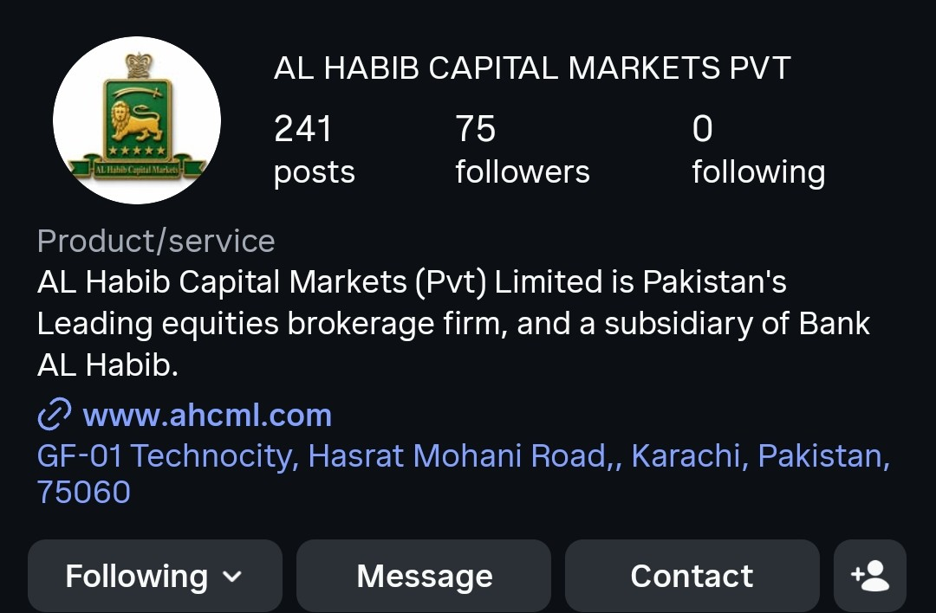

Current Instagram: what to fix, and what it will do
What we see | What we change | Likely result
75 followers, 2 likes per post | Run a follower and reach campaign; post Reels | Audience of 10,000+ to retarget
Daily news cards, too much text | Swap for short Urdu Reels, FAQs, how-to carousels | Far higher reach and saves
GROW app not mentioned anywhere | Put app download link and GROW in bio and every post | Direct path from post to install
Same stock-photo ad repeated | Real people and customer stories | More trust, better ad results
No highlights; category says "Product/service" | Add highlights: Start, Halal, Safety, FAQs; get verified | Answers questions, protects against fake pages
Screenshots of @alhabibcapitalmarkets taken 25 Sept 2026. Expected results are Hummingbird targets for months 1 to 6, not guarantees.

Slide 9
Why posting alone brings customers very slowly
Instagram and Facebook mainly show a page's posts to people who already follow it. They only push posts to new people when the post is paid for, or when it is already very popular.
Post without ads
A good post goes up
Shown mostly to the page's 75 followers
Seen by a few dozen people, mostly existing contacts
Almost no new customers
Same post with ads
A good post goes up
Ads show it to working people aged 25 to 40
Seen by thousands of new, relevant people
App installs and sign-ups we can measure
The takeaway: better content is essential, but on its own it has little benefit. Content and a small ad budget work together.
Illustration only. Follower and like counts from @alhabibcapitalmarkets, 25 Sept 2026.

Slide 10

Quick fixes that cost almost nothing
The app has two names
"AL Habib Capital GROW" on Android, "Growth Stock Trading" on iPhone.
Use one name everywhere so people and search engines find it.
Android listing shows a vendor as developer
Google Play lists Catalyst IT Solutions, not AHCML.
Publish under AHCML's own name to show it is genuine.
"Data isn't encrypted" on Google Play
The data safety section says this. It worries careful investors.
Check with the vendor and correct the declaration.
Two different minimum amounts
Website says from Rs 1,000; Instagram says Rs 5,000.
Agree one figure and use it everywhere.
Website doesn't mention GROW
It promotes older apps (eTrade, iTick) instead.
Add a GROW page with download links and FAQs.
Sources: Google Play and Apple App Store listings; www.ahcml.com; Instagram, all checked 25 Sept 2026.

Slide 11



Getting GROW recommended by AI search
More people now ask ChatGPT, Gemini or Google's AI answers "which app should I use to invest in PSX?" These tools recommend apps that clear, consistent, trusted sources talk about. Today, GROW is almost invisible to them.
Website
Answers AI can quote
Being mentioned elsewhere
A GROW page: what it is, fees, minimum amount, how to open, download links
Beginner guides in English and Urdu
Faster, mobile-friendly pages
FAQ page answering the real questions: how to start, is it halal, is it safe
Technical tags (schema) that tell Google this is an app and a regulated broker
Same facts on website, app stores and social
Launch story in business media (Profit, ProPakistani)
Get listed in "best PSX apps" guides
Encourage genuine app reviews and reply to every one

Slide 12
Three ways to start, ranked
 | What's included | Monthly cost | First 6 months | What to expect
1. Recommended Content + Instagram test | All organic work, plus PKR 150,000 a month of Instagram ads | PKR 200,000 | PKR 1.05M (PKR 900K media + PKR 150K fee) | Measurable funded accounts; real baseline after 6 weeks
2. Content + influencers | All organic work, plus 1 or 2 paid creators | PKR 50,000 + influencer fees | PKR 150K + influencer fees (to be agreed) | Tests if trusted voices drive sign-ups
3. Content only | Social content and posting, AI search, website, email | PKR 50,000 | PKR 150K (first 3 months free) | Stronger brand, but very few new customers
Why option 1: it is the smallest spend that gives a real answer. After 6 weeks we will know what one funded customer costs, and AHCML can scale, adjust or stop with real numbers instead of estimates.
All figures in PKR. Hummingbird fee covers content, posting, AI search and website optimisation, and email campaigns. Influencer fees, media spend and tools are extra.

Slide 13

The 6-month Instagram test: what it could deliver
PKR 150,000 a month x 6 months = PKR 900,000 media
What about Google Play ads?
1M to 1.5M
3,000 to 8,000
1,800 to 3,000
Google advises a daily budget of at least 50 times the target cost per install.
At PKR 150 to 300 per install, that is PKR 7,500 to 15,000 a day.
About PKR 225,000 to 450,000 a month, or PKR 1.35M to 2.7M over 6 months.
Our advice: add Google only once the Instagram test proves people fund their accounts.
People reached
New followers
App installs
550 to 1,200
150 to 400
PKR 2,250 to 6,000
Registrations
Funded accounts
Cost per funded account
These are estimates, not promises.
Real results depend on the app, onboarding speed and the offer. After 6 weeks of ads (about PKR 225,000 spent) we will share actual numbers and agree realistic targets for the remaining months with you.
ESTIMATES ONLY, based on typical Pakistan costs (PKR 150 to 250 per 1,000 views; PKR 300 to 500 per install). Google guidance: Google Ads Help, App campaign best practices.

Slide 14

Three influencers to shortlist
Malik Danish
Hafiz Basit Ali
Azad Chaiwala
@malikkdollar, Instagram
Ranked #1 business influencer in Pakistan (Favikon)
Top 5 business influencer (Favikon)
Educates Pakistanis on finance and investing. An audience already interested in investing.
Large following of young earners and freelancers looking to grow their income.
Talks about investment, entrepreneurship and financial literacy.
Content idea: "How I opened my first stock account" walkthrough
Content idea: "Put your savings to work" series
Content idea: Long-term wealth message, including overseas Pakistanis
Cost not included. Influencers charge based on their popularity and following, so fees will be agreed later. We will vet each one (no crypto or get-rich promotions, no political content), and all posts go through AHCML compliance.
Free option: joint posts with Bank AL Habib's own Instagram (about 110,000 followers).
Sources: Instagram (@malikkdollar bio); Favikon, Top Business Influencers in Pakistan 2026; HypeAuditor Pakistan finance ranking. Follower counts and rates to be confirmed.

Slide 15





Turning sign-ups into funded accounts
Most people who download an investment app never put money in. These are the changes we will test, one at a time, during the Instagram test.
WhatsApp help to finish sign-up
Follow-up for unfinished sign-ups
Ads open a WhatsApp chat; a real person guides them through account opening.
WhatsApp, SMS and email reminders at 1 hour, 1 day and 3 days.
First-deposit reward
Simple funding guide
For example, no commission on the first month's trades. Needs AHCML approval.
Step-by-step: how to transfer money in by Raast or bank transfer in 2 minutes.
Weekly Urdu beginner session
Refer a friend
Live on Instagram: how to place a first trade, answered live.
A reward for both people once the friend funds their account.

Slide 16

Hummingbird's fee and introductory offer
PKR 50,000 a month
First 3 months free
PKR 600,000 a year. Covers:
If AHCML has no marketing budget right now, Hummingbird will deliver the organic work free for the first three months. From month 4, AHCML can continue at PKR 50,000 a month.
Content creation and posting on Instagram, Facebook and LinkedIn
AI search optimisation, so GROW appears in AI answers
Website optimisation, including the GROW page and FAQs
Email campaigns to leads and existing clients
Not included
Ad spend (paid directly to Meta or Google), influencer fees, email and WhatsApp platform charges, and development work by AHCML's website or app vendor.
Monthly results report

Slide 17
The first 6 months
Month 1
Month 2
Month 3
Months 4 to 5
Month 6
Fix foundations
Start the test
6-week review
Improve
Decide
One app name and minimum amount
GROW page and FAQs on website
New Instagram bio, highlights, content plan
Tracking set up in the app
Instagram ads go live
WhatsApp help and follow-ups
Email to existing clients
Share real costs and results
Agree targets for months 4 to 6
Test first-deposit reward
Test one influencer
Media and business listings
Full results review
Scale, add Google, or stop

Slide 18
Risks, and what we need from AHCML
Risks we will manage
What we need to start
Compliance
Agreement that success means funded accounts
No promised returns. Every post and ad goes through AHCML sign-off.
Access to social pages, website and app store listings
Scam fatigue
Feeds are full of fake trading ads. Verified pages and trust signals are essential.
One confirmed app name and minimum amount
Onboarding friction
Client email list with consent to contact
If account opening or funding is slow, marketing cannot fix it.
A named compliance approver, 48-hour sign-off
Organic only
Without any paid push, better content alone will bring very few customers.
A decision on the Instagram test budget

Slide 19
Sources and notes
Market data
Arab News, "Pakistan's stock market crosses 600,000 investors", Aug 2026; ProPakistani, Feb and Aug 2026, citing NCCPL (age, gender, province, Sahulat share)
Arab News on Gen Z investors, 2026; Pakistan Economic Survey 2025-26 / PBS Labour Force Survey 2024-25; DataReportal, Digital 2026: Pakistan
Competitors, app and website
Google Play and Apple App Store listings; www.ahcml.com; company websites; Investify.pk; SECP public warnings on fake trading apps (2025)
Influencers and advertising
Favikon, Top 20 Business Influencers in Pakistan (2026); HypeAuditor, Pakistan finance Instagram ranking; Google Ads Help, App campaign best practices
Important
All results and costs in this deck are estimates based on typical Pakistan advertising costs. Realistic targets will be agreed with AHCML after 6 weeks of paid activity.

Slide 20
Next steps
Choose a starting option: content + Instagram test, content + influencers, or content only
Share access to social pages, website and app store listings
Kick-off meeting: quick fixes, compliance and content plan in week 1
This deck sets out the scope of an annual digital marketing plan. All figures are estimates until tested.
Uzma Mehtab
Director Global Business, Hummingbird Digital Marketing Solutions

