Slide 1
IMDB Movie Data Exploration (2010–2019)
Dataset: IMDB (SQLite) | Scope: 2010–2019
Tools: SQL (SQLite), Pandas, Matplotlib
Deliverables: Exploration summary, business question, cleaning tasks

Slide 2
Initial Exploration Findings
2010–2019 filtered; nulls excluded in critical fields
Genre normalization for grouping/aggregation
Ratings joined via movie_id (ready for analysis)

Slide 3
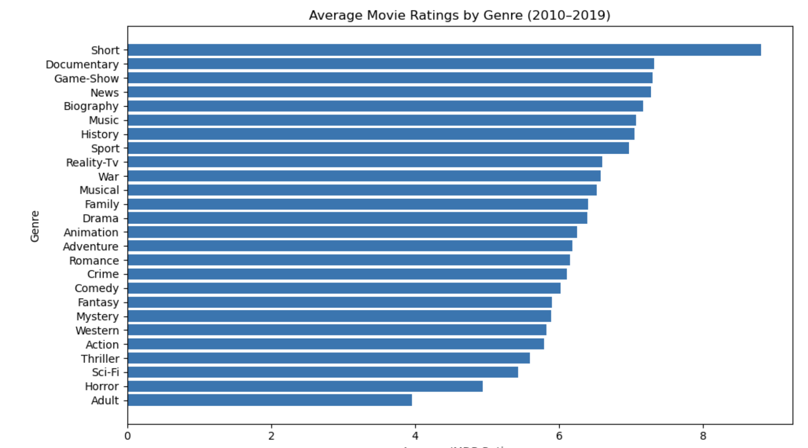
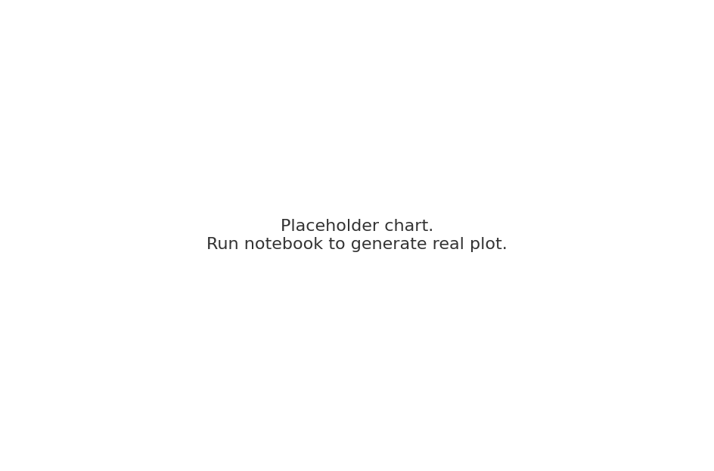
Average IMDB Ratings by Genre (2010–2019)

Slide 4
Business Question
Which genres consistently receive higher audience ratings (2010–2019)?
Drama and Documentary → highest ratings (strong storytelling, critical appeal)
Animation → strong ratings (family appeal, quality production)
Action, Horror, Thriller → lower ratings (high popularity but mixed reception)
How can this inform studio production investments and marketing?
Invest in Drama/Documentary/Animation for prestige and long-term audience trust

Slide 5
Data Cleaning Tasks Identified
Exclude nulls; no imputation
01
Normalize multi-genre labels (case, delimiters, explosion)
02
Investigate duplicate titles within the same year
03
Flag runtime and rating outliers
04

