Slide 1


Saftech Fonez
ECommerce Website

Slide 2
project's aims and objectives
Providing customers with a realistic based eCommerce Website
Eye-Catching website to the online market

Slide 3
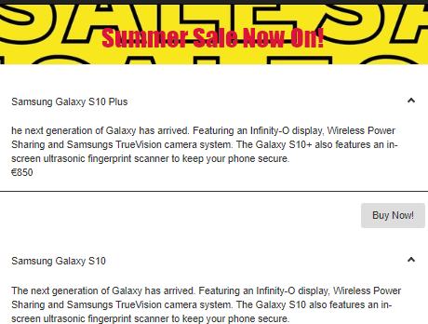
Project Aim
Have a website that is able to pull information from a remote server.
Combination of MySQL & AWS
PayPal Payment

Slide 4
architecture of the solution

Slide 5





Slide 6
problems encountered
Images using MySQL
Manipulating Data using JavaScript & Typescript

Slide 7

Conclusions
We have learnt a lot from when we started this project.
This project helped us realize that group work requires an extreme amount of communication, patient and good understanding between the member which we really had.

Slide 8

Designed By
USMAN SATTAR & SAMMAR TAHIR

