Slide 1
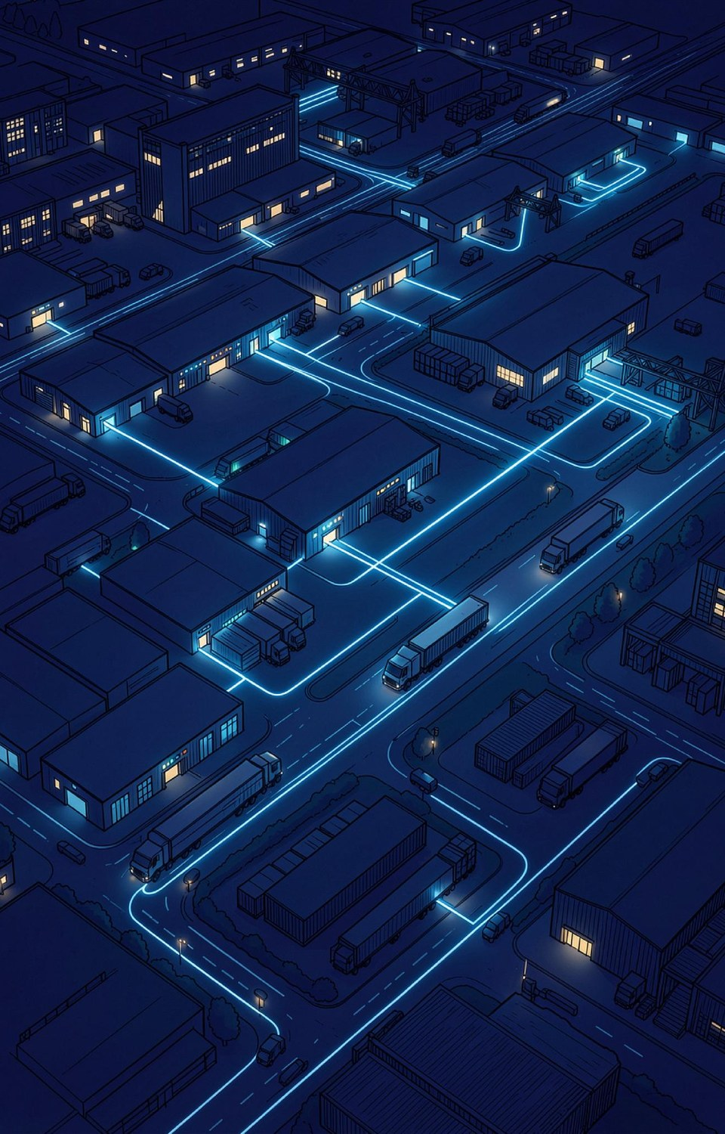
LOGISTICS ORCHESTRATION PLATFORM
LogiFlows
Intelligent End-to-End Logistics Coordination and Delivery Management System
One connected journey. Many logistics partners.
A unified web + Android platform for parcel booking, partner coordination, intelligent assignment, route optimization, real-time tracking, dynamic ETA, AI delay-risk prediction, and automated communication.
TRACK
CALCULATE
PREDICT
ACT

Slide 2




EXECUTIVE STORY
From Fragmented Operations to Intelligent Orchestration
THE PROBLEM
THE PLATFORM
Fragmented logistics operations and limited parcel visibility across partners.
One orchestration layer connecting the complete parcel lifecycle end-to-end.
THE INTELLIGENCE
THE OUTCOME
Tracking → ETA → AI delay prediction → proactive operational action.
One connected customer journey with better operational coordination and measurable results.
THE LOGIFLOWS OPERATING LOOP
Observe
Understand
Predict
Act
Learn
LogiFlows | Intelligent Logistics Coordination

Slide 3




THE PROBLEM
The Business Problem
Manual coordination of branches, employees and vehicles
Partner workflows with no shared coordination layer
Route and capacity decisions made without live data
Operations
Unclear parcel status; disconnected, delayed notifications
No single journey view across partners
No proactive communication on delays or exceptions
Customer Experience
No shared parcel identity across courier partners
Fragmented handoffs with manual exception handling
Missed optimization from uncoordinated data
“The parcel has a journey — but the systems do not always hold that journey together.”
Network

Slide 4

SYSTEM COMPARISON | 1 OF 2
Existing System vs Proposed Solution
EXISTING SYSTEM
LOGIFLOWS
Manual · Fragmented · Static · Reactive
Connected · Real-Time · Predictive · Proactive
Existing System / Problem | What LogiFlows Does | Problem Solved
Parcel information is spread across different stages. | Uses one Tracking ID for the complete journey. | One connected parcel journey.
Employee assignment can be manual. | Assigns employees using availability, location and workload. | Less manual coordination.
Customer may not know the current parcel location. | Uses QR scanning + employee/vehicle GPS for active tracking. | Better real-time visibility.
ETA may not change when delivery conditions change. | Continuously updates the Dynamic ETA. | More useful delivery estimates.
Delays are often handled after they happen. | Uses AI/ML to predict delay risk. | Earlier warning about possible delays.
LogiFlows | Intelligent Logistics Coordination

Slide 5

SYSTEM COMPARISON | 2 OF 2
Existing System vs Proposed Solution
Existing System / Problem | What LogiFlows Does | Problem Solved
Planning routes for multiple deliveries is difficult. | Uses route optimization based on route, destination and requirements. | Better route planning.
Large numbers of parcels are difficult to coordinate. | Groups and prioritizes parcels based on destination and capacity. | Better handling of high parcel volumes.
Employee rejection or vehicle problems cause delays. | Supports reassignment and updated planning. | Faster response to operational problems.
Customer, employee and branch updates are disconnected. | Sends relevant status updates and notifications. | Better communication.
Different courier partners may operate separately. | Connects multiple partners through one platform. | Connected multi-partner operation.
LogiFlows connects the important stages of parcel delivery into one intelligent workflow.
LogiFlows | Intelligent Logistics Coordination

Slide 6

OUR SOLUTION
One Parcel. One Identity. One Timeline.
LogiFlows is a multi-tenant logistics orchestration layer connecting independent courier partners through a unified parcel identity. Partners retain control of their branches, employees, and vehicles — while LogiFlows coordinates the journey and handoffs.
Customer
books and tracks
What Makes It Different
One permanent Tracking ID and QR code for the entire journey
LogiFlows
Unified Parcel ID
one permanent tracking identity
Multi-partner coordination without sacrificing operational control
Partner A
pickup leg
Partner B
transport leg
Intelligent employee assignment and parcel prioritization
Route optimization, dynamic ETA, and AI delay prediction
Proactive operational action and automated notifications
Partner C
last-mile leg
Receiver
confirms delivery
Complete delivery history with proof of delivery
LogiFlows | Intelligent Logistics Coordination

Slide 7








PARCEL JOURNEY
The Complete End-to-End Parcel Journey
01
02
03
04
05
06
07
Book
Pickup
Origin Hub
In Transit
Dest. Hub
Last Mile
Delivered
Customer books; Tracking ID and QR are generated
Employee scans the QR and takes custody
Branch verifies the parcel and batches shipments
Live GPS session with dynamic ETA updates
Handover to the destination branch
Assigned employee navigates the final route
OTP, signature or proof of delivery confirms receipt
Every event — status update, tracking event, assignment change, notification — is recorded against the same parcel ID, creating a complete, auditable delivery history from booking to proof of delivery.
LogiFlows | Intelligent Logistics Coordination

Slide 8



PLATFORM ROLES
Role-Based Operating Model
Sender / Customer
Pickup / Delivery Employee
Branch / Operations
Book parcels, track in real time, and receive important updates automatically.
Accept or reject assignments, scan QR codes, navigate routes, and capture proof of delivery.
Verify parcels, batch shipments, assign vehicles, and manage exceptions in real time.
Partner Admin
Receiver
One Shared Parcel Record
Manage branches, employees, vehicles, and parcels with full audit and override capability.
Track incoming parcels, view updated ETA, and confirm delivery upon receipt.
Every role works from the same live Tracking ID, so everyone sees the same journey.
LogiFlows | Intelligent Logistics Coordination

Slide 9
REAL-TIME TRACKING
One Identity, Many Custodians
The parcel keeps one permanent identity while the location source changes with custody. Authorized mobile devices provide movement data — no GPS hardware inside every parcel.
1
Scan QR
2
Verify
3
Start Tracking Session
4
GPS
Employee scans parcel to initiate custody.
Check assignment and parcel state.
Open live tracking session.
Capture latitude, longitude, speed, and accuracy.
5
Process
6
Map
7
Handover
8
Deliver
Validate, store, and broadcast location data.
Show live, verified, or estimated status.
Close session and start next custody session.
OTP, signature, or proof of delivery.
Live
Verified
Estimated
Last Known
Fresh GPS from active employee or vehicle
Recent branch checkpoint confirmation
Route-based position estimate
Stale or disconnected location
Never show stale GPS as live. One Parcel ID. Multiple tracking sessions. Complete handover history.

Slide 10




DYNAMIC ETA
Dynamic ETA: Not a Static Promise
GPS
+
Route
+
Service Time
+
Delay Model
+
Deadline
→
Dynamic ETA
What Changes the ETA
Current position and remaining route distance
Live movement speed vs. planned progress
Service time at each stop
AI delay prediction output
Delivery deadline constraints
At 3:20 PM a long stop pushes ETA to 5:38 PM. An operational intervention at 3:25 PM recovers 10 minutes.
Dynamic ETA ≠ Static Promise.
LogiFlows | Intelligent Logistics Coordination

Slide 11
AI DELAY PREDICTION
Predict Before It Happens
AI combines live and historical signals to estimate delay risk and expected delay minutes — enabling proactive operational decisions before problems escalate.
1
2
3
4
5
6
7
Collect
Clean
Predict
Estimate
Update ETA
Decide
Learn
live GPS and operational signals
validate and normalize data
ML risk classification and delay regression
expected delay minutes
recalculate journey timeline
reroute, reassign, or continue
store outcome for model improvement
FOUR SIGNAL GROUPS
Movement
Operations
History
Context
Remaining distance, current speed, progress vs. plan
Employee workload, stops remaining, resource availability
Route duration patterns, past performance, time-of-day trends
Service type, delivery deadline, route deviation
Low Risk
Continue normal operation
Medium Risk
Monitor and prepare fallback
High Risk
Reroute, reassign, or notify
Prediction supports operations — it does not replace human decisions.

Slide 12


NETWORK & VALUE
Multi-Partner Network and Business Value
Each courier company retains operational control. LogiFlows orchestrates handoffs through one shared parcel identity — no fragmented tracking, no manual coordination gaps.
Customer
Courier Partners
Employees
Operators / Admins
Platform
One tracking experience, better visibility, relevant updates
Network reach, automated operations, better coordination
Clear assignments, mapped routes, digital POD
Central control, exception handling, audit visibility
Service-fee opportunity, partner network effects, operational insights
One connected logistics network. One parcel journey. TRACK • CALCULATE • PREDICT • ACT
LogiFlows | Intelligent Logistics Coordination

Slide 13
PROJECT BUDGET
Estimated Project Cost
Practical budget for developing and demonstrating LogiFlows. All figures are approximate.
1
Development Software & Tools
2
Cloud Database & Hosting
3
Map & Routing Services
4
AI / Machine Learning
₹0 – ₹1,000
₹0 – ₹2,000
₹0 – ₹2,000
₹0 – ₹1,000
Open-source stack: Python, React, VS Code, Git, PostgreSQL, Docker
Free tiers for development: Neon/PostgreSQL, app hosting, storage
OpenStreetMap, OpenRouteService; depends on API usage and limits
Open-source Scikit-learn for delay prediction and ETA intelligence
5
Notification & Email Services
6
Testing & Deployment
7
Optional Hardware / Demo
INDICATIVE TOTAL
₹0 – ₹1,000
₹500 – ₹1,500
₹1,000 – ₹3,000
₹1,500 –
₹11,500
Free/student tiers for delivery updates and delay alerts
Domain, testing devices and accessories, demonstration setup
Android test device, QR printing, optional GPS accessories, demo materials
HOW WE KEEP THE PROJECT AFFORDABLE
Open-source technologies
Free/student cloud tiers
Smartphone-based GPS
Local ML with Scikit-learn

Slide 14




PROJECT OVERVIEW
Key Advantages
Practical benefits of the proposed solution.
Unified Parcel Journey
Real-Time Visibility
Dynamic ETA
Proactive Delay Management
One permanent Tracking ID links booking, pickup, hubs, transport, last mile and proof of delivery.
Employee and driver smartphone GPS gives live movement during active custody.
Recalculated continuously from location, route progress, service time and predicted delay.
AI delay-risk prediction flags problems before they escalate.
Intelligent Assignment
Multi-Partner Coordination
Lower Hardware Need
Complete Digital History
Employees and vehicles matched by availability, workload, location and requirements.
Different couriers handle different stages; the customer sees one journey.
No GPS hardware required inside every parcel.
QR scans, handovers and delivery confirmation form an auditable timeline.
LogiFlows | Intelligent Logistics Coordination

Slide 15


PROJECT OVERVIEW
Current Limitations & Future Scope
Mobile GPS Dependence
Internet Connectivity
FUTURE SCOPE
Quality depends on GPS availability, accuracy and battery.
Live updates need a network; offline data syncs later.
Better delay prediction with larger datasets
More advanced route optimization
Offline-first mobile tracking
More routing provider options
Automated anomaly detection
Improved partner API integration
Advanced analytics and forecasting
Routing API Dependency
AI Data Requirement
External map APIs bring limits, outages or usage costs.
Predictions improve as historical data grows.
Partner Integration
Operational Exceptions
Different courier systems make onboarding more complex.
Breakdowns, rejections or bad addresses still need humans.
Privacy & Security
Scalability Cost
Real-time visibility, predictive intelligence and coordination — kept practical for incremental development.
Tracking limited to authorized users and active custody.
More parcels, GPS updates and partners raise infrastructure cost.
LogiFlows | Intelligent Logistics Coordination

Slide 16




RESEARCH FOUNDATION
Recent IEEE Research Behind LogiFlows
Published work supporting the core technologies of the platform.
AI / ML
TRACKING
ROUTING
DECISION SUPPORT
Delivery Time Prediction
Real-Time Parcel Tracking
Route Optimization
Logistics Decision Support
IEEE ICDE 2023
IEEE IITCEE 2025
IEEE Trans. Knowledge and Data Eng., 2023
IEEE ICAIIC 2023
Delivery Time Prediction Using Large-Scale Graph Structure Learning Based on Quantile Regression
Real-Time Global Parcel Tracking System in the Supply Chain Using RFID and GPS
Empowering A* Algorithm With Neuralized Variational Heuristics for Fastest Route Recommendation
A Blockchain-based Decision Support System for E-commerce Order Prediction
DOI
10.1109/ICDE55515.2023.00261
DOI
10.1109/IITCEE64140.2025.10915357
DOI
10.1109/ICAIIC57133.2023.10067036
Dynamic ETA and AI prediction layer: ML-based delivery-time prediction from spatial, temporal and contextual data.
Real-time tracking foundation: location technologies such as GPS and RFID.
Route optimization and travel-time layer: travel-time-aware route recommendation.
Data-driven operational decision layer: intelligent decision support in logistics.
LogiFlows | Intelligent Logistics Coordination

Slide 17


PROJECT CONTRIBUTION
From Research to One Integrated Workflow
Research Foundation
System Integration
Practical Logistics Workflow
Tracking, routing, ETA prediction and decision support are well established.
LogiFlows unifies these capabilities into one connected parcel lifecycle.
One end-to-end, multi-partner orchestration platform.
INTEGRATED CAPABILITIES
ONE PARCEL ID
DYNAMIC CUSTODY
SMARTPHONE-BASED ACTIVE TRACKING
DYNAMIC ETA
AI DELAY-RISK PREDICTION
PROACTIVE OPERATIONAL ACTION
MULTI-PARTNER COORDINATION
Our contribution is the integration of these capabilities
into a unified multi-partner logistics orchestration workflow.

