Slide 1
Follow Along
https://github.com/V-FEXrt/some/repo

Slide 2
Introduction to Swift: A basic foundation in iOS Development
Ashley Coleman
ashley78@ksu.edu
https://github.com/V-FEXrt
Notes:
Follow me on GitHub. I try to post most of my code there, but currently it is mostly class projects so the line is a bit more gray.

Slide 3
Hack K-State
http://hack.cis.ksu.edu/
6pm April 29th to ~5pm May 1st
Looking for Sponsors
General
API
Prize
You get a booth and Slack channel

Slide 4
Why you should trust me
Started in Obj C, switched to Swift last August
Have been creating iOS apps for 3 years.
Successfully released 2 apps to the store.
Created numerous Hackathon apps
President of K-State Mobile Dev Club
Working towards MDC Associate’s Degree
Working towards CS Bachelor’s Degree
Internships since freshman year

Slide 5
Or maybe not….
Late adopter of Swift
Memory Squared <200 Downloads
Tilty Maze <2000 Downloads
Terrible, cringe worthy UI
50% rejection rate (2 apps rejected)
Still working on Assoc. (I’m on my 3rd year)
Haven’t expanded, or released any of the Hackathon apps

Slide 6
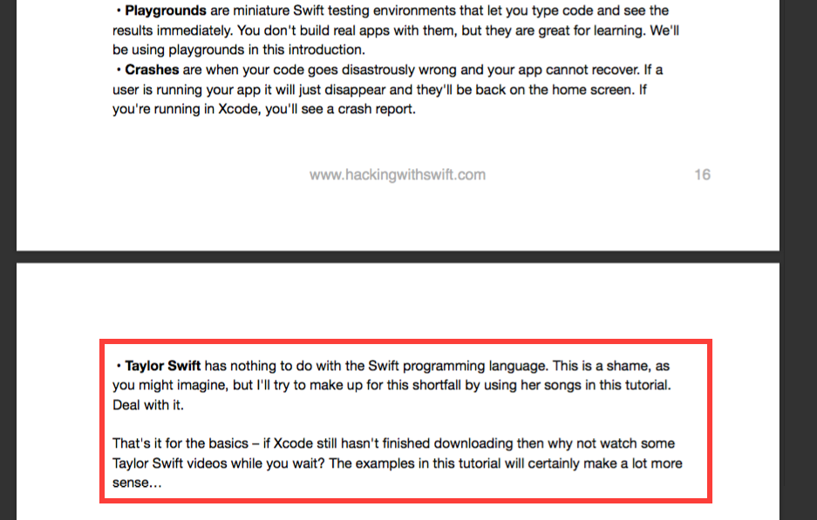

Slide 7
What is Swift?
Notes:
How would I define Swift? Honestly I’d Google it and find this.

Slide 8
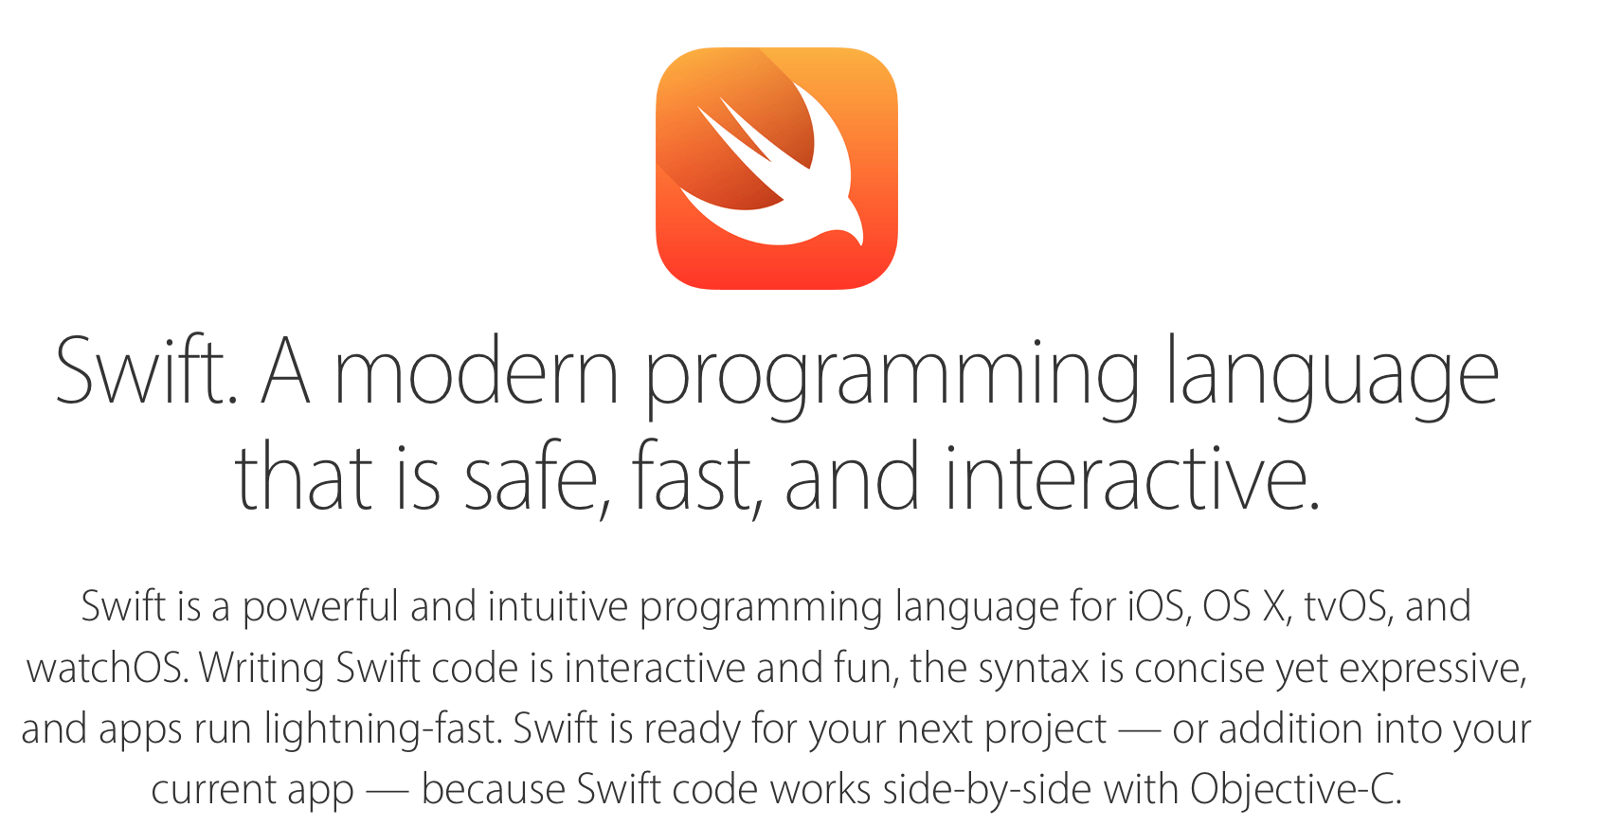
Notes:
How would I define Swift? Honestly I’d Google it and find this.

Slide 9
But what else..?
Multi-paradigm
Open Source
Statically Typed, but inferred

Slide 10
Demo
Mostly focused on Swift Syntax
I will try to work in some Cocoa API’s

Slide 11
Syntax Points
Basics
Variable Declaration/Literals
Control Flow
Functions
Operators
Advanced
Optionals
Classes/Structs
Enums
Protocols/Extensions
Generics
Closure

