Slide 1

EverTried
No Middlemen, Just Work
AI-Powered Hyperlocal Job Matching Platform — Connecting India's blue-collar workforce directly to employers, eliminating exploitation, and building trust at scale.
HACKATHON 2024
SOCIAL IMPACT
AI + TECH

Slide 2

The Human Cost of a Broken System
"A construction worker spends his entire morning traveling to labor nakas, only to return home empty-handed — no work, no income, no dignity."
Every day, millions of blue-collar workers across India face this reality. Without a reliable system to connect them to employers, they depend on middlemen who exploit their desperation, charge commissions, and often provide fake or misleading job leads. EverTried was built to change this.
🔍 No Visibility
💸 Exploitation
Workers have no way to discover nearby jobs without physical travel
Middlemen extract commissions from already low wages
❌ No Trust
Fake listings and unverified employers create constant risk

Slide 3
A Market Full of Gaps — and Zero Real Solutions
What Exists Today
What Workers Actually Need
Current job platforms are built for white-collar professionals. They assume smartphone fluency, English proficiency, and digital literacy — none of which apply to blue-collar workers.
India's 400M+ blue-collar workforce needs a system designed for them — one that understands their constraints and removes barriers rather than adding to them.
Passive job boards with no matching logic
No verification of employers or workers
Complex UIs that alienate low-literacy users
No hyperlocal focus or proximity awareness
Jobs within 1–5 km of their location
Simple, voice-first or WhatsApp-based access
Verified employers with transparent pay
A digital work history they can carry forward

Slide 4
Introducing EverTried — Built for Bharat
EverTried is an AI-powered, hyperlocal job matching platform that eliminates middlemen by connecting workers and employers directly. It is designed for real-world constraints: low digital literacy, regional languages, and limited internet access.
Direct Connection
AI Smart Matching
Workers and employers interact without intermediaries, cutting costs and building transparency.
Our engine matches workers by skills, location radius, and real-time availability — not just keywords.
Hyperlocal Discovery
Voice + WhatsApp
Jobs surfaced within 1–5 km using Google Maps API, reducing commute burden for workers.
Accessible via voice commands and WhatsApp — no complex app navigation required.

Slide 5
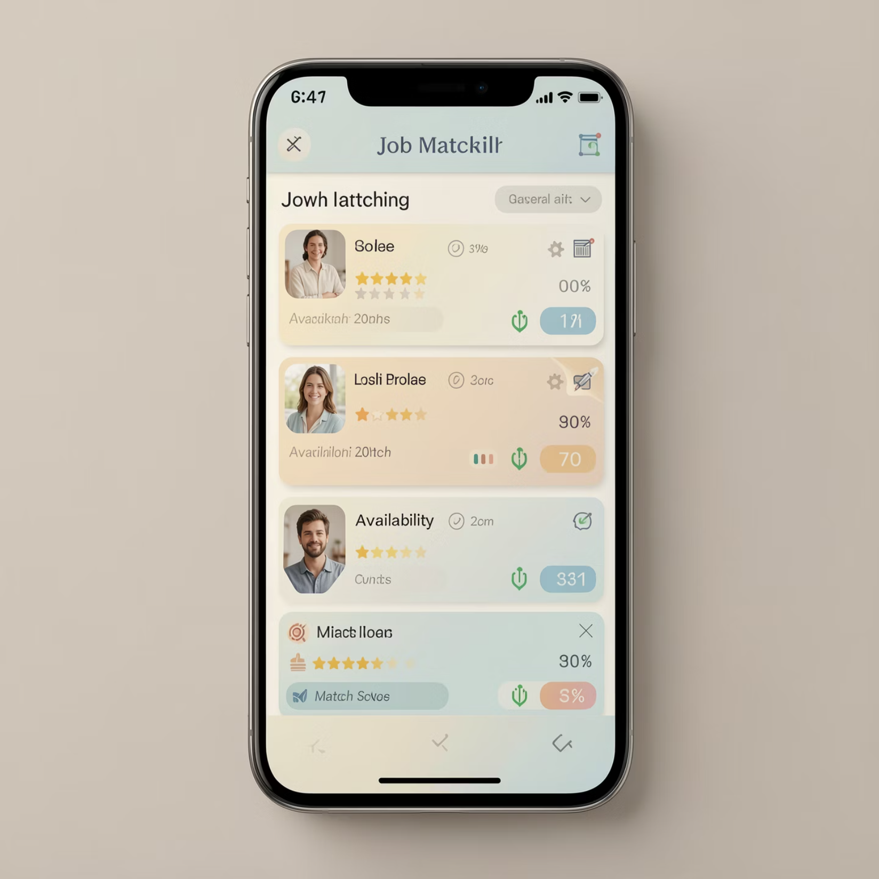
Key Features That Set EverTried Apart
Multi-Role Authentication
Instant Hiring System
Three distinct portals: Worker UI, Employer Dashboard, and Coordinator Panel — each with tailored experiences.
Employers post a job and receive matched worker profiles in seconds — no waiting, no browsing.
Trust & Rating System
Digital Work History
Both parties rate each other post-completion, building a verifiable digital reputation over time.
Workers carry a portable, verifiable record of completed jobs — their most valuable asset.

Slide 6
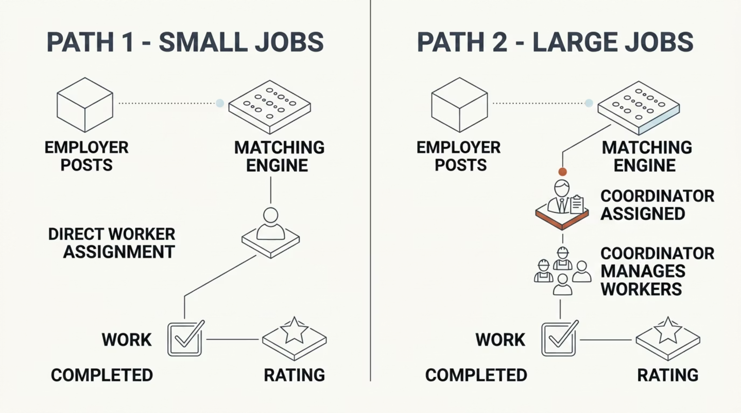

🔥 Core Innovation
Dual Job Routing System
EverTried's most powerful differentiator is its intelligent dual routing logic — a system no existing platform offers. Jobs are automatically classified and routed based on complexity and scale.
Small Jobs → Direct Assignment
Large Jobs → Coordinator Routing
For single-worker, short-duration tasks (plumbing, delivery, painting), the matching engine assigns the best-fit worker directly — zero overhead, maximum speed.
For multi-worker projects (construction, events, logistics), a verified Coordinator is assigned to manage the team, ensuring quality control and accountability at scale.

Slide 7
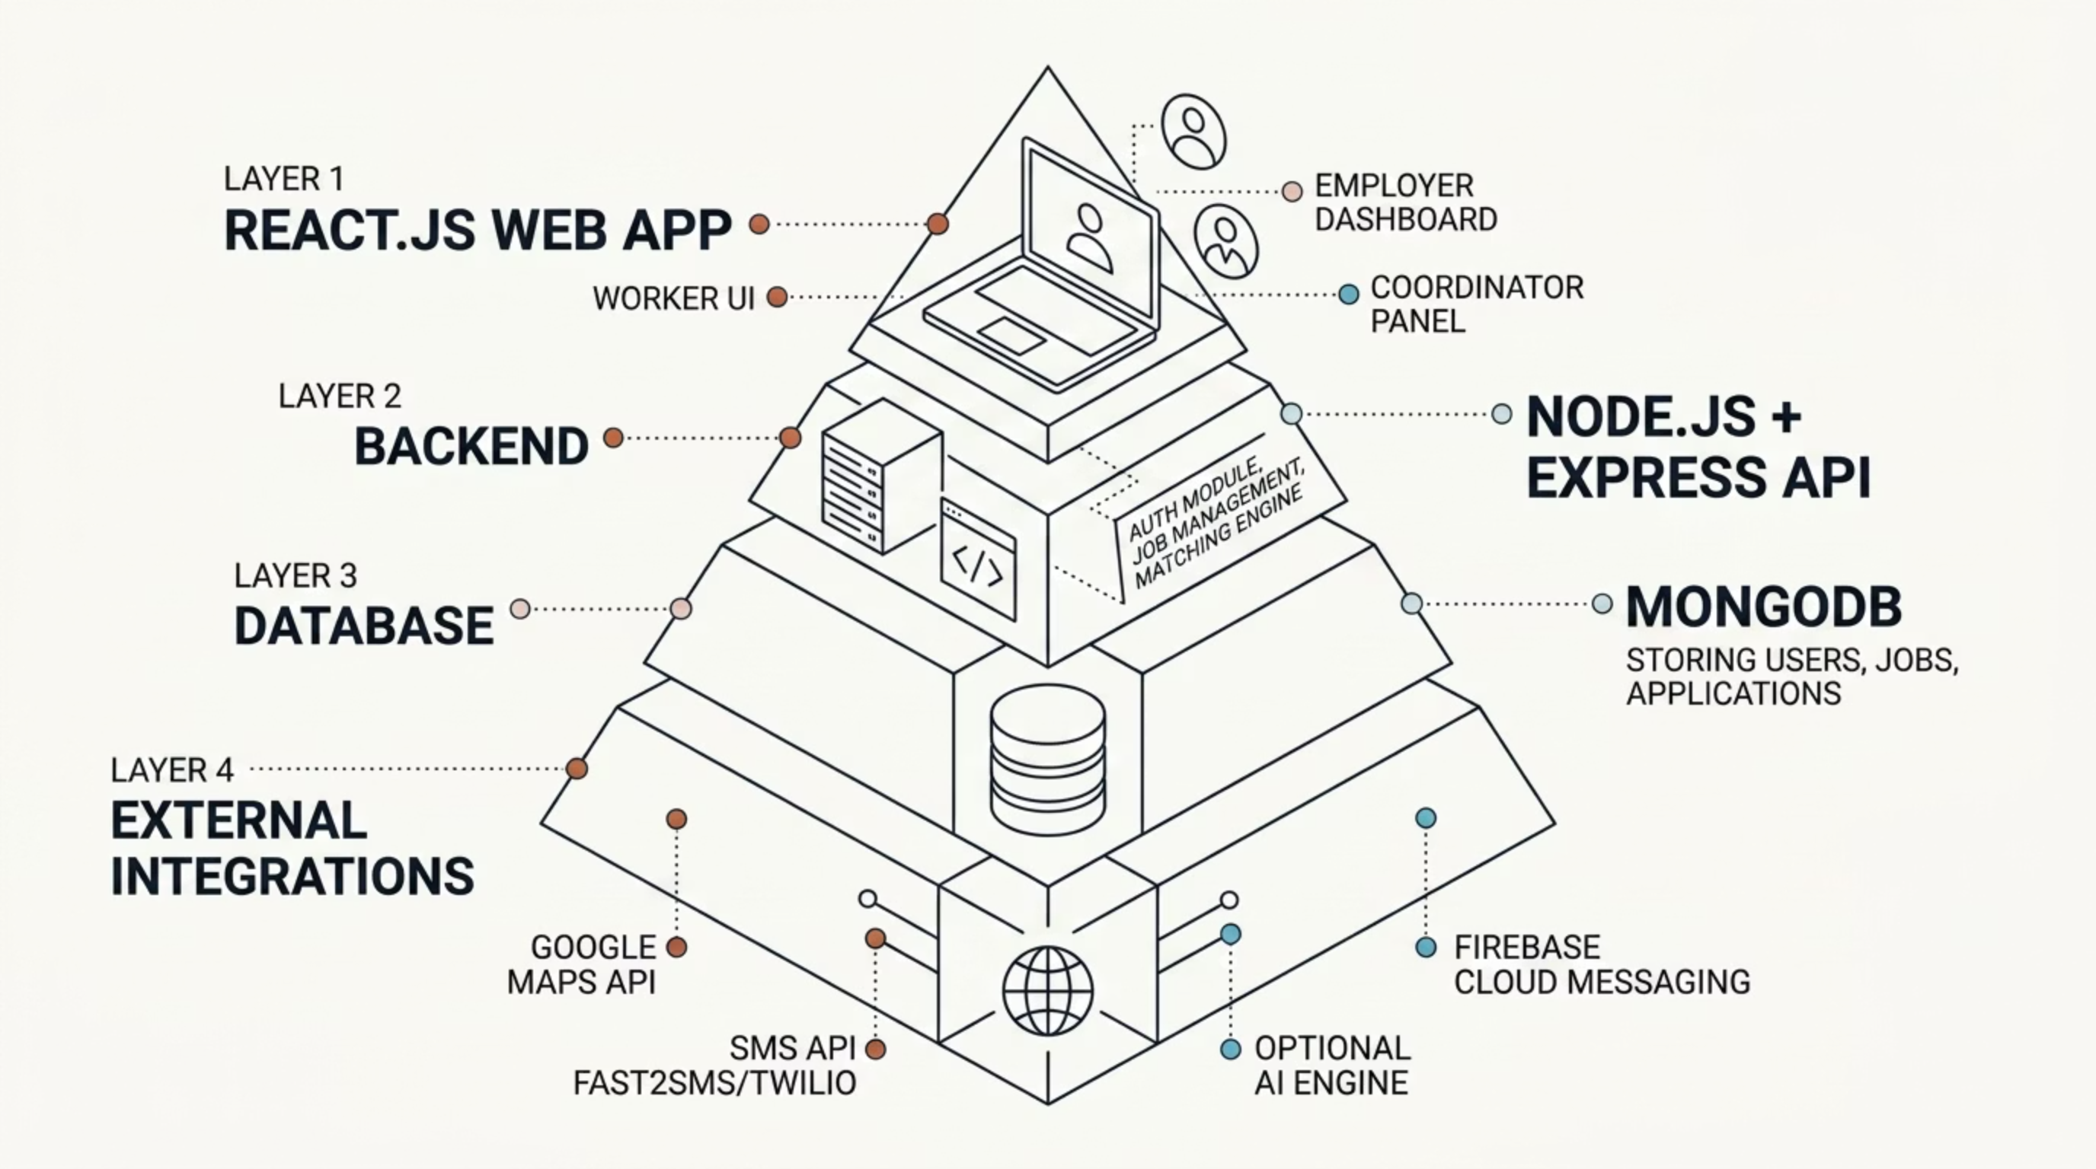

System Architecture
EverTried is built on a clean, scalable, three-tier architecture designed for high availability and low-latency matching across India's diverse network conditions.
Each layer is independently deployable, enabling horizontal scaling. The AI Matching Engine operates as an optional microservice, allowing the core platform to function even in low-connectivity environments.

Slide 8
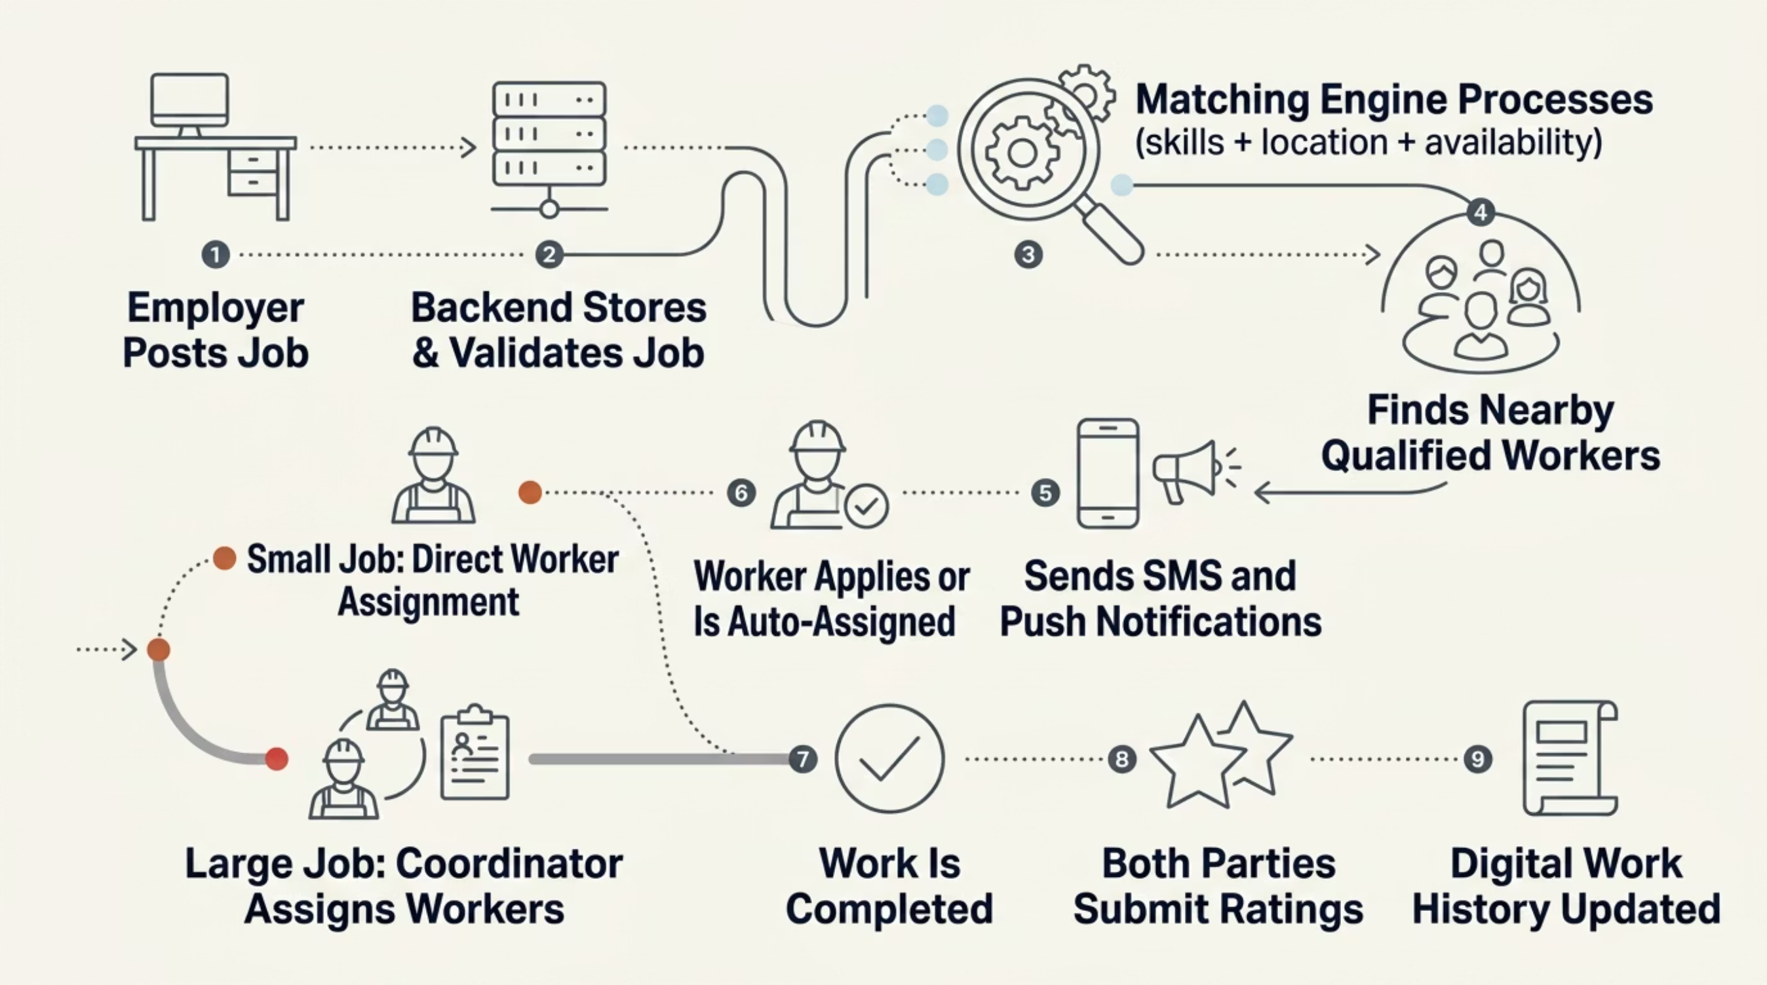

End-to-End Application Workflow
From job posting to completed work, every step is automated, tracked, and verified — ensuring speed for employers and fairness for workers.
Matching Engine Logic
Notification Pipeline
Matches are scored across four weighted dimensions: Skills match, Location radius (1–5 km), Real-time availability, and Past ratings + performance history.
Matched workers receive instant alerts via SMS (Fast2SMS/Twilio) and Firebase push notifications — ensuring reach even for users with intermittent internet access.

Slide 9





Tech Stack & Database Design
Frontend
Backend
React.js — Responsive, component-driven UI for Worker, Employer, and Coordinator portals. Deployed on Vercel / Netlify.
Node.js + Express REST API with modular Auth, Job Management, and Matching Engine services. Deployed on Render / Railway.
Database
Integrations
MongoDB Atlas with three core collections: Users (role, skills, rating, availability), Jobs (type, location, status), Applications (job-worker mapping).
Google Maps API (geolocation), SMS API (Fast2SMS/Twilio), Firebase Cloud Messaging (push notifications).
AI Matching Engine: A lightweight scoring algorithm ranks workers by composite match score — combining skill overlap, proximity, availability window, and historical rating data to surface the best candidate instantly.

Slide 10

Impact, Vision & The Road Ahead
400M+
Blue-Collar Workers
The workforce EverTried is built to serve across India
0
Middlemen Fees
Direct connection eliminates exploitative commissions entirely
5km
Max Job Radius
Hyperlocal matching reduces commute burden significantly
8
SDG Aligned
UN Sustainable Development Goal: Decent Work & Economic Growth
Future Roadmap
Our Commitment
AI-powered job recommendations based on work history
In-app payment integration for seamless wage settlement
Government scheme linkage for worker benefits
Multilingual + voice-first regional language support
EverTried is not just a job platform — it is a scalable ecosystem empowering millions of workers with dignity, transparency, and economic opportunity. Built for India. Built for Bharat.
No Middlemen. Just Work. Just Opportunity.

