Slide 1

Critical Design Review
OpenSpace and Climate Reanalyzer Interface
-
V-Model Violets
Brianna Gannett, Brennon Tiensivu, Hunter Savarese, Matthew Keast, Emily Scott

Slide 2
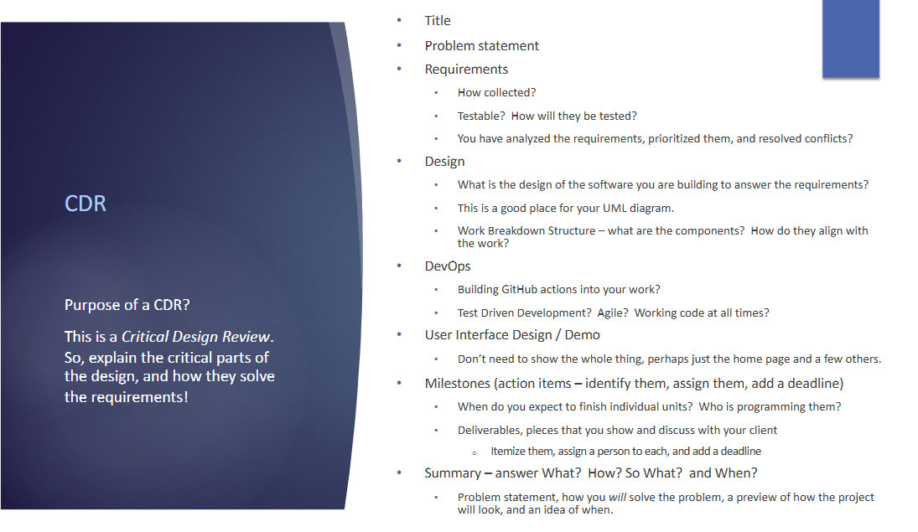
Guidelines

Slide 3
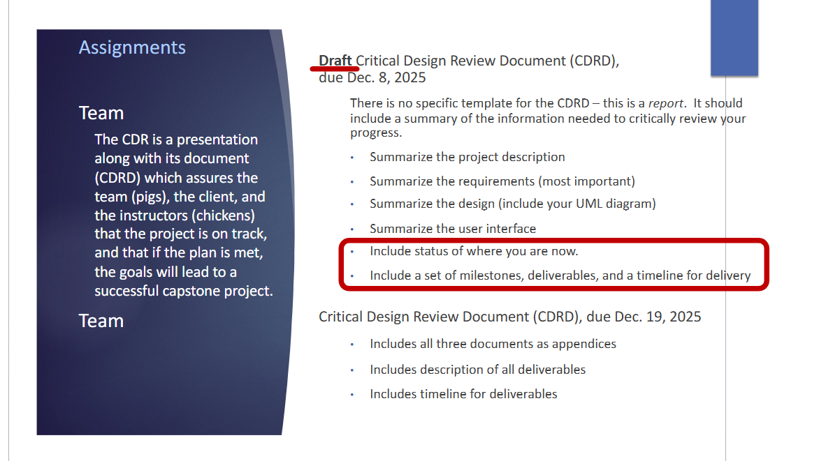
Guidelines

Slide 4
Background
Describe climate reanalyzer/openspace
Quick climate reanalyzer demo on website?
Screen recording of openspace interface?
Describe how openspace displays tiles

Slide 5
Project Description

Slide 6
System Requirements

Slide 7
System Design

Slide 8
Devops: Github/Source Code Demo

Slide 9
User Interface

Slide 10
Current Status

Slide 11
Prototype Demo

Slide 12
Milestones & Timeline

