Slide 1



DineInSync
Applied Database Technologies – DSCI-D532
INDIANA UNIVERSITY

Slide 2

OUR TEAM
Vivek
Munnangi
-Project Lead
Shivangi Sharma
Venkat Nikhil Chimata
Venkat
Gowthami
Gokul
Data
Analyst

Slide 3









Goal: To Design Application to store/update customer details.
To Store Customer Dining preferences
To Store Allergies and Cooking Preferences
To Fetch Preference information while searching existing customer

Slide 4
PROJECT IDEA
Our database application aims to revolutionize the restaurant industry by providing a comprehensive solution for managing customer details, including allergies, preferences, and specific food preparation specifications. Through a user-friendly web interface, restaurant owners and receptionists can efficiently retrieve and update customer information, enhancing the dining experience for patrons while ensuring their safety and satisfaction. By leveraging advanced database technologies, our system will streamline the process of handling reservations and walk-ins, facilitating personalized service and minimizing errors in food preparation.
Objective:
Our primary objective is to develop a robust database application that empowers restaurant owners and staff to seamlessly manage customer details, allergies, and preferences. By centralizing this information, we aim to enhance the efficiency of restaurant operations and improve the overall dining experience for customers. Additionally, our system will facilitate the storage and retrieval of customer data, enabling personalized service and efficient food preparation.
Usefulness:
Our database application offers significant benefits to both restaurant owners and customers. For restaurant owners, it provides a comprehensive solution for managing customer information, reservations, and food preparation specifications.
Unlike existing databases that may lack integration or user-friendliness, our system offers a seamless and intuitive interface tailored specifically to the needs of the hospitality industry.
For customers, our system ensures a personalized dining experience by allowing restaurants to cater to individual preferences and allergies. This level of customization sets our database application apart from others in the market, offering unparalleled convenience and safety for diners.

Slide 5
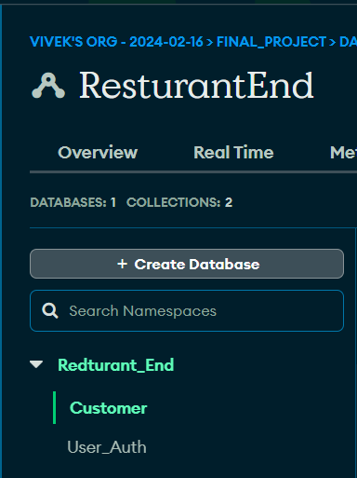
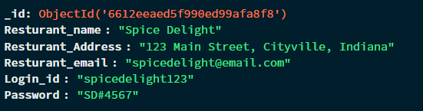
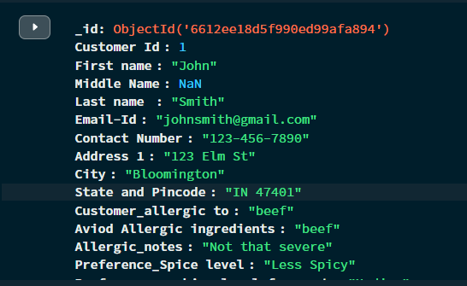
DATABASE DESIGN
The database is designed using Mongodb.
There are two collections in the database, they are customer and user authentication collections.
The information inside each collection is as shown in the figure, The relation depicted here is that of customer profile, where each field provides specific information about the customer. This data will be used by a restaurant to tailor their offerings to meet the customer’s preferences and allergy restrictions. The relation in the customer’s table is One-to-One. Each JSON document represents information about a single customer.
The relation depicted here is that of a single restaurant entity. Each field provides specific information about the restaurant, mainly the Login ID and Password. This collection represents a One-to-One relation. Each JSON document represents information about the restaurant entities.
Constrains:
Customer Id must be an integer and be unique.
Email-ID must contain the ‘@’ symbol and be unique.
Contact Number must be a 10-digit integer value.
Preference_Spice level must be either Less Spicy, Medium Spicy, Very Spicy, No Preference or Blank.
Preference_cooking level for meat must be either Rare, Medium, Well Done, No Preference or Blank.
Preference_Cooking oil must be either Olive Oil, Vegetable Oil, Olive Oil, No Preference or Blank.
Restaurant Email must contain the ‘@’ symbol.
Login_id must be unique.
Password must be secretive i.e., encrypted.

Slide 6
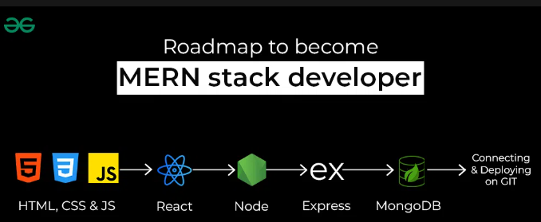
TECHNOLOGY USED
The MERN stack is a collection of JavaScript-based technologies that are used together to develop web applications. The stack consists of MongoDB, Express, React, and Node.js.
MongoDB is a highly scalable document database that makes it easy to store and retrieve data in JSON documents.
Express is a lightweight web application framework that provides a range of app-building tools and supports a variety of programming languages, including JavaScript.
React is an open source, front-end JavaScript library for building user interfaces based on components.
Node.js is a runtime environment that can be used to run JavaScript code on the server side. This allows developers to use the same language for both the front and back ends of their applications.

Slide 7
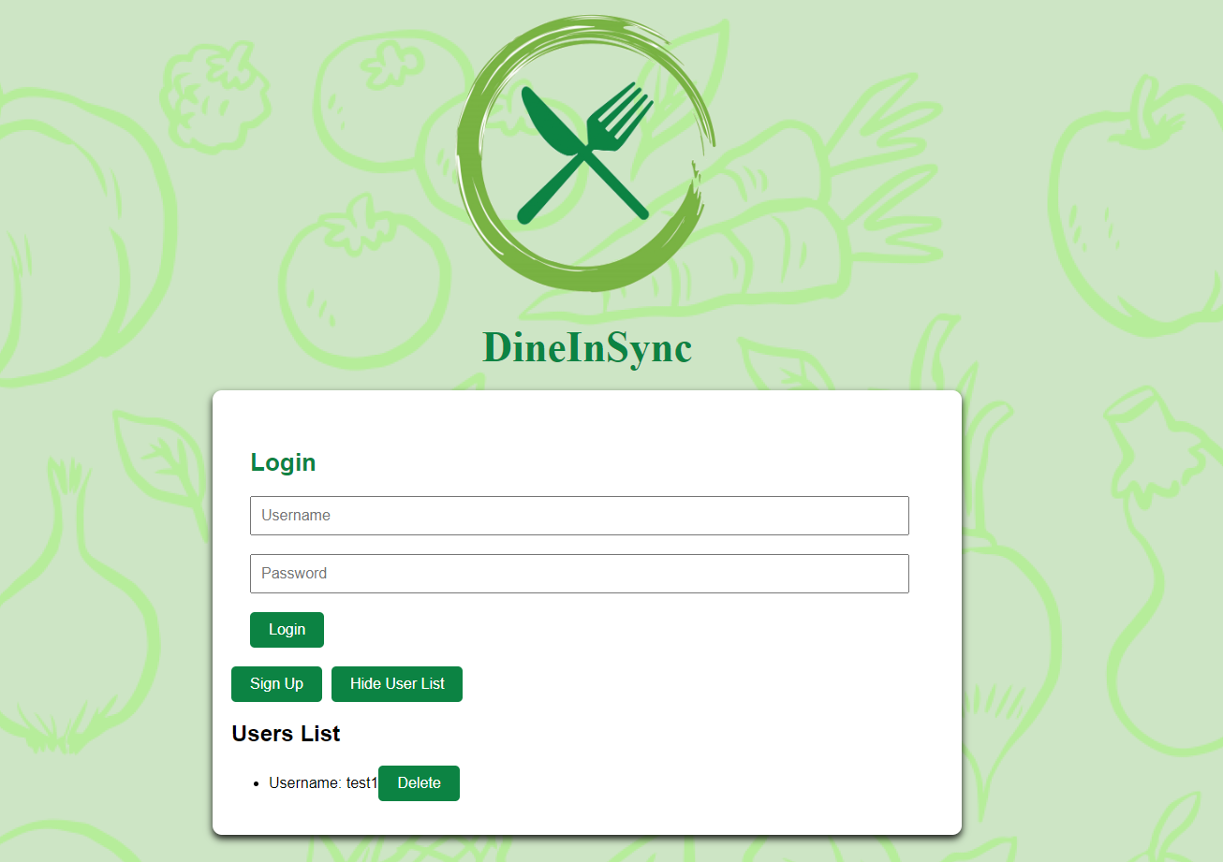
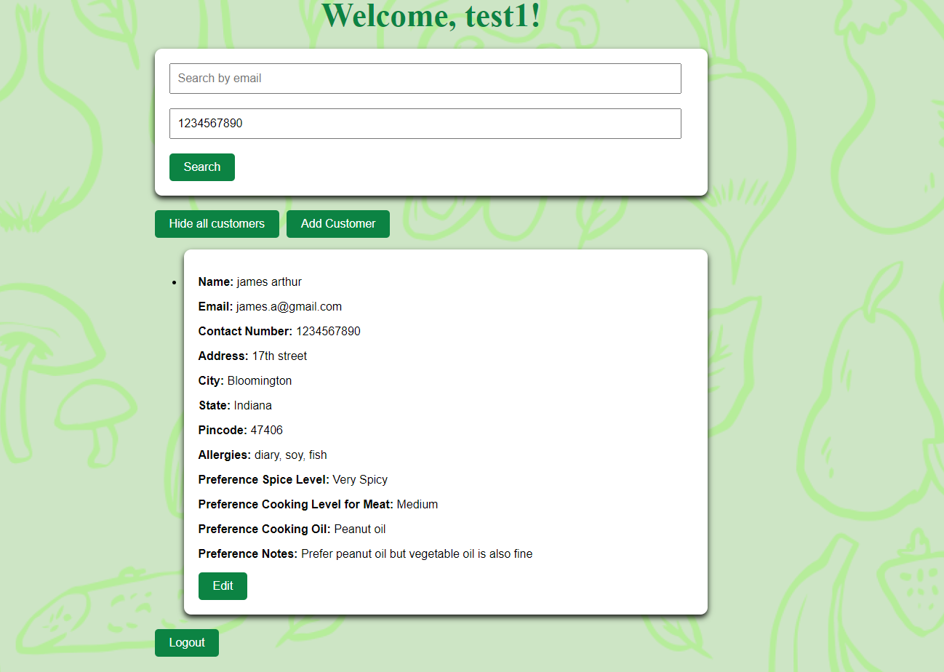
FRONTEND DESIGN

Slide 8
DIFFICULTIES FACED AND RESOLUTIONS
Difficulties:
Learning multiple technologies simultaneously.
Connecting backend with frontend
Troubleshooting errors across the stack
Resolutions:
Leveraged online tutorials and documentation to understand each technology.
Utilized tools like postman and console logging for effective debugging.

Slide 9
FUTURE SCOPE
Offer Personalized menu suggestions based on past orders and preferences.
Incorporate social features such as user reviews, ratings, and shared options.
Partner with food delivery services for seamless integration
Empower customers with the ability to update their personal details. Dietary preferences, and allergy information within the application.

