Slide 1

Agentic AI Workshop
By
Vrunda Patel
AI Engineer
IBM Ecosystem Engineering Lab

Slide 2
ML
# | Project Title | Problem Type | Algorithm | Dataset Link
1 | House Price Prediction | Regression | Linear Regression | Kaggle - House Prices
2 | Email Spam Detection | Binary Classification | Logistic Regression | UCI Spam Dataset
3 | Customer Churn Prediction | Binary Classification | Decision Tree | Telco Churn Dataset
4 | Social Network Ad Click Prediction | Binary Classification | Support Vector Machine | Social Network Ads
5 | Handwritten Digit Recognition | Multi-class Classification | K-Nearest Neighbors | MNIST Dataset
6 | Titanic Survival Prediction | Binary Classification | Naive Bayes | Titanic Dataset
7 | Credit Card Fraud Detection | Binary Classification | Random Forest | Credit Card Fraud
8 | Employee Attrition Prediction | Binary Classification | XGBoost | IBM HR Dataset
9 | Diabetes Prediction | Binary Classification | ANN (MLPClassifier / TensorFlow) | Pima Indians Diabetes
10 | Loan Approval Prediction (Ensemble Model) | Binary Classification | Voting Classifier (Logistic + DT + RF) | Loan Prediction
Supervised ML

Slide 3
ML
# | Project Title | Problem Type | Algorithm | Dataset Link
1 | Customer Segmentation | Clustering | K-Means | Mall Customers
2 | Movie Genre Clustering | Clustering | Hierarchical Clustering | MovieLens Dataset
3 | Social Network User Grouping | Clustering | DBSCAN | Facebook Users
4 | Credit Card Anomaly Detection | Anomaly Detection | Isolation Forest / LOF | Credit Card Fraud
5 | Network Intrusion Detection | Anomaly Detection | One-Class SVM | NSL-KDD Dataset
6 | Image Compression with PCA | Dimensionality Reduction | PCA (Principal Component Analysis) | Olivetti Faces Dataset
7 | Market Basket Analysis | Association Rules Mining | Apriori / FP-Growth | Groceries Dataset
8 | Topic Modeling on News Articles | Topic Modeling | LDA (Latent Dirichlet Allocation) | 20 Newsgroups
9 | Music Recommendation using Clustering | Clustering | K-Means / Spectral Clustering | Spotify Dataset
10 | Gene Expression Pattern Discovery | Clustering | Agglomerative Clustering | Gene Expression
Unsupervised ML

Slide 4
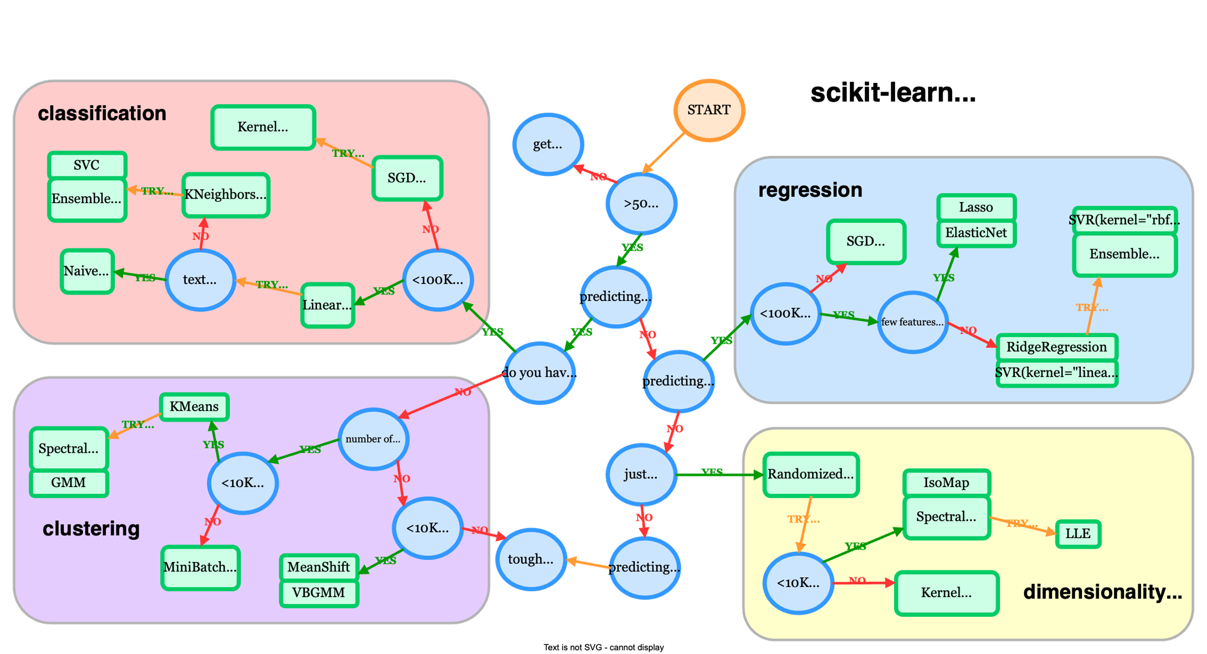
Scikit-learn's cheat sheet
Notes:
https://scikit-learn.org/stable/machine_learning_map.html

Slide 5
DL
Image Recognition CNN
https://poloclub.github.io/cnn-explainer/
Neural Network
tensorspace
Play with neural network visualization
Notes:
Iris dataset : https://archive.ics.uci.edu/dataset/53/iris

Slide 6
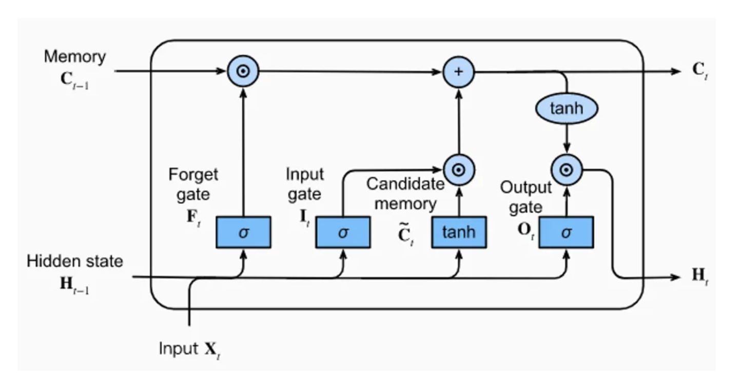
RNN/LSTM – Sequential
Notes:
https://medium.com/@ottaviocalzone/an-intuitive-explanation-of-lstm-a035eb6ab42c
The three gates (forget gate, input gate and output gate)

Slide 7

Transformer – Game Changer (2017)
Motivation: Why Not RNN/LSTM?
RNNs process sequences sequentially, so they’re slow for long sequences.
LSTM has limited memory and doesn’t scale well.
Introduced in the paper: "Attention Is All You Need" (Vaswani et al., 2017)

Slide 8
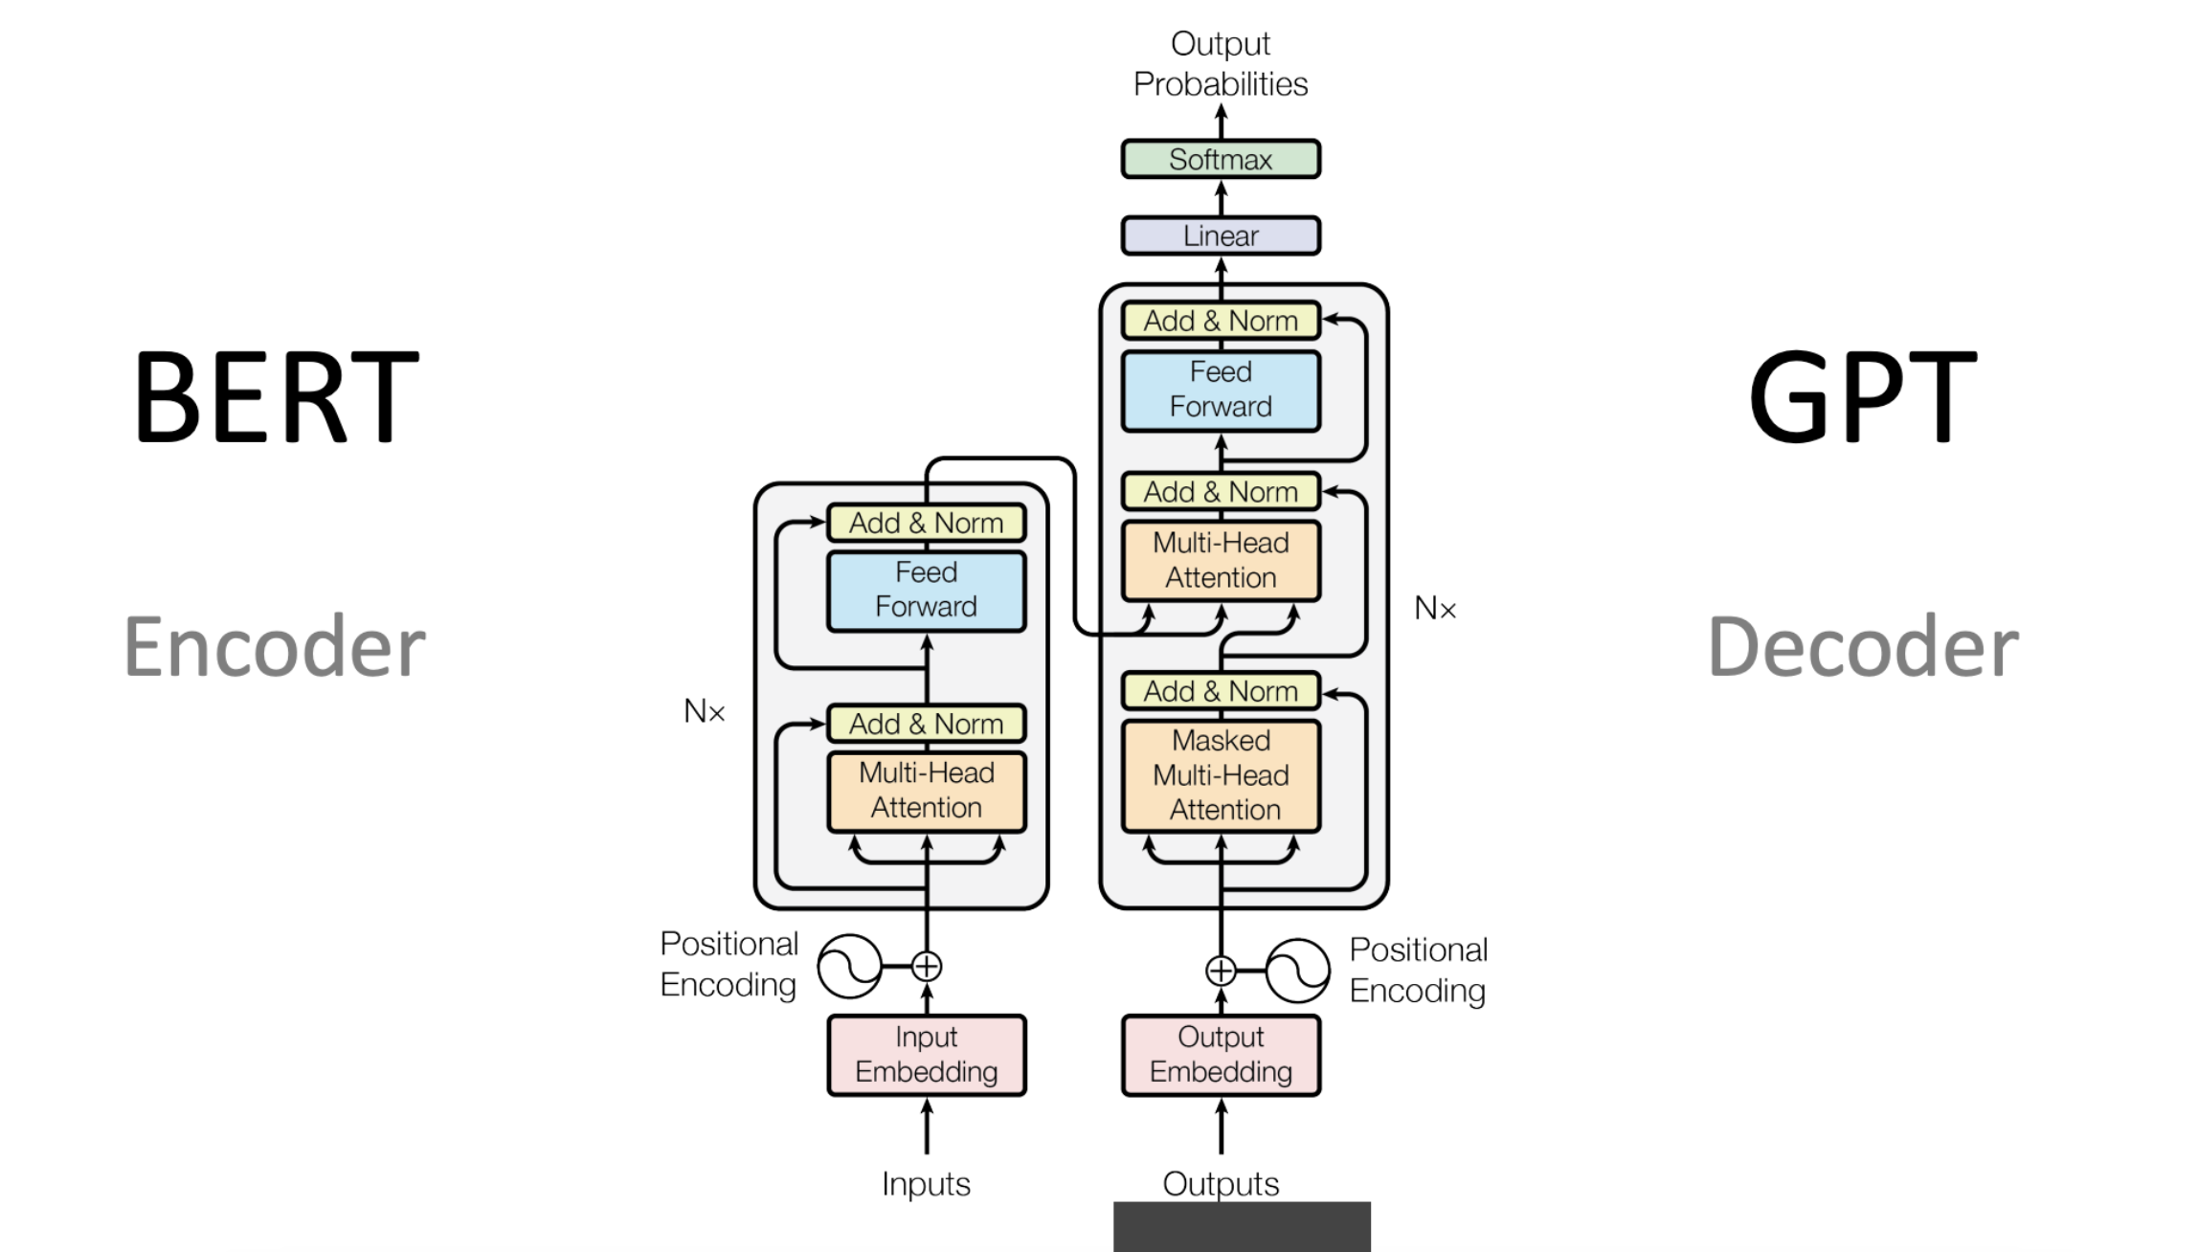

Slide 9
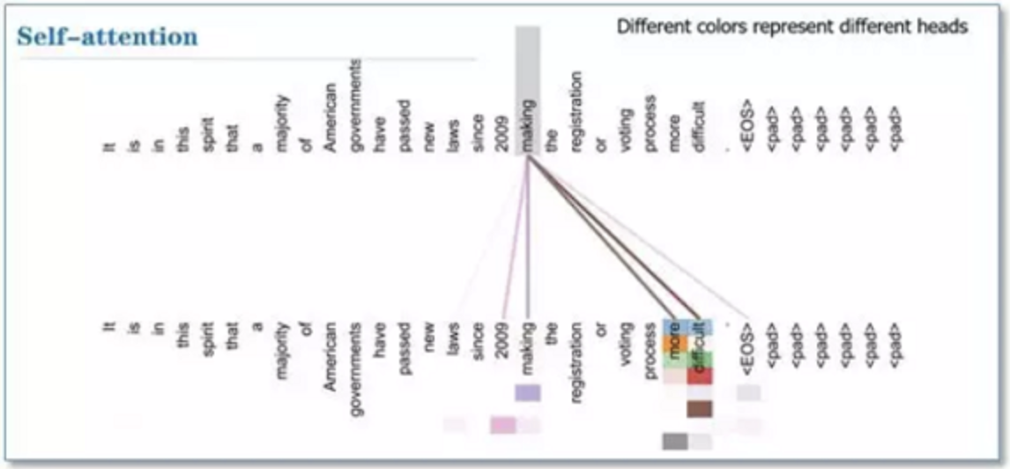

Slide 10
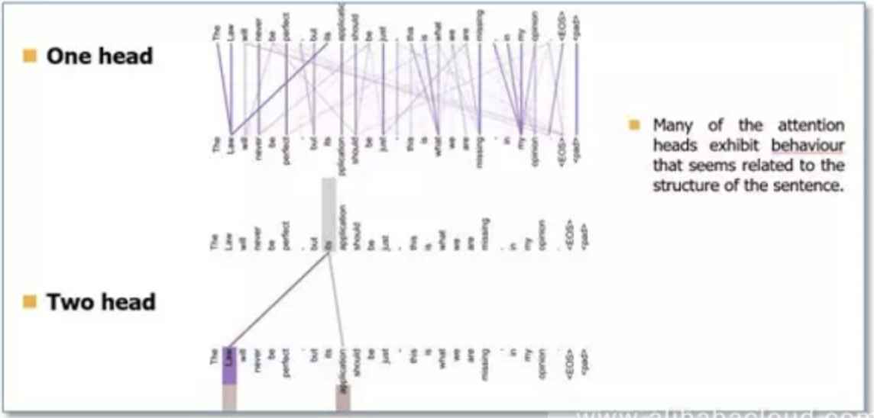

Slide 11
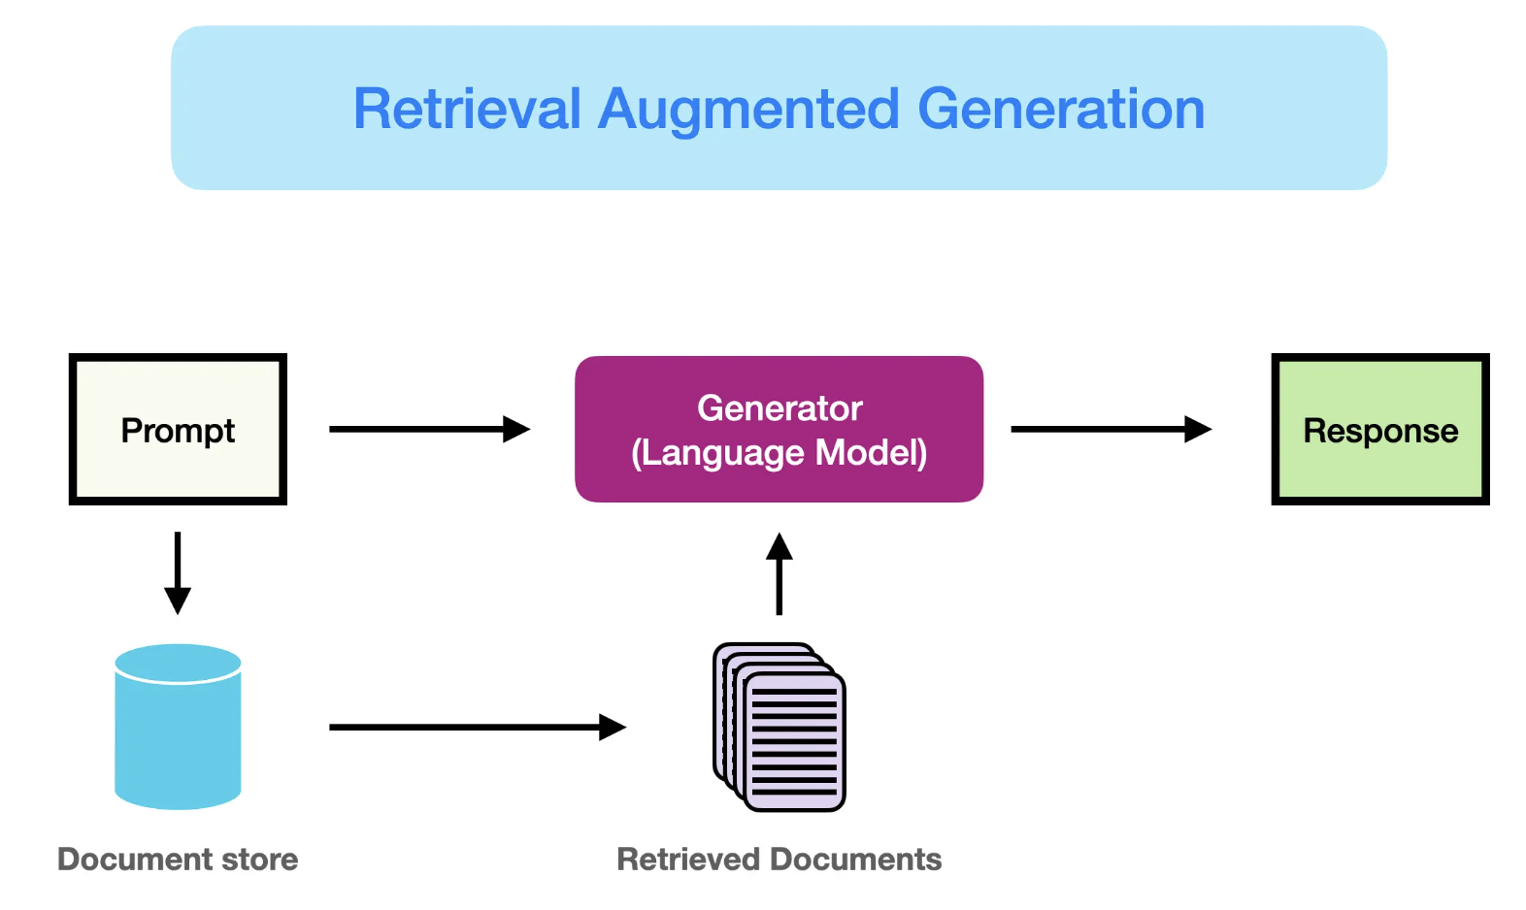
RAG LLM

Slide 12
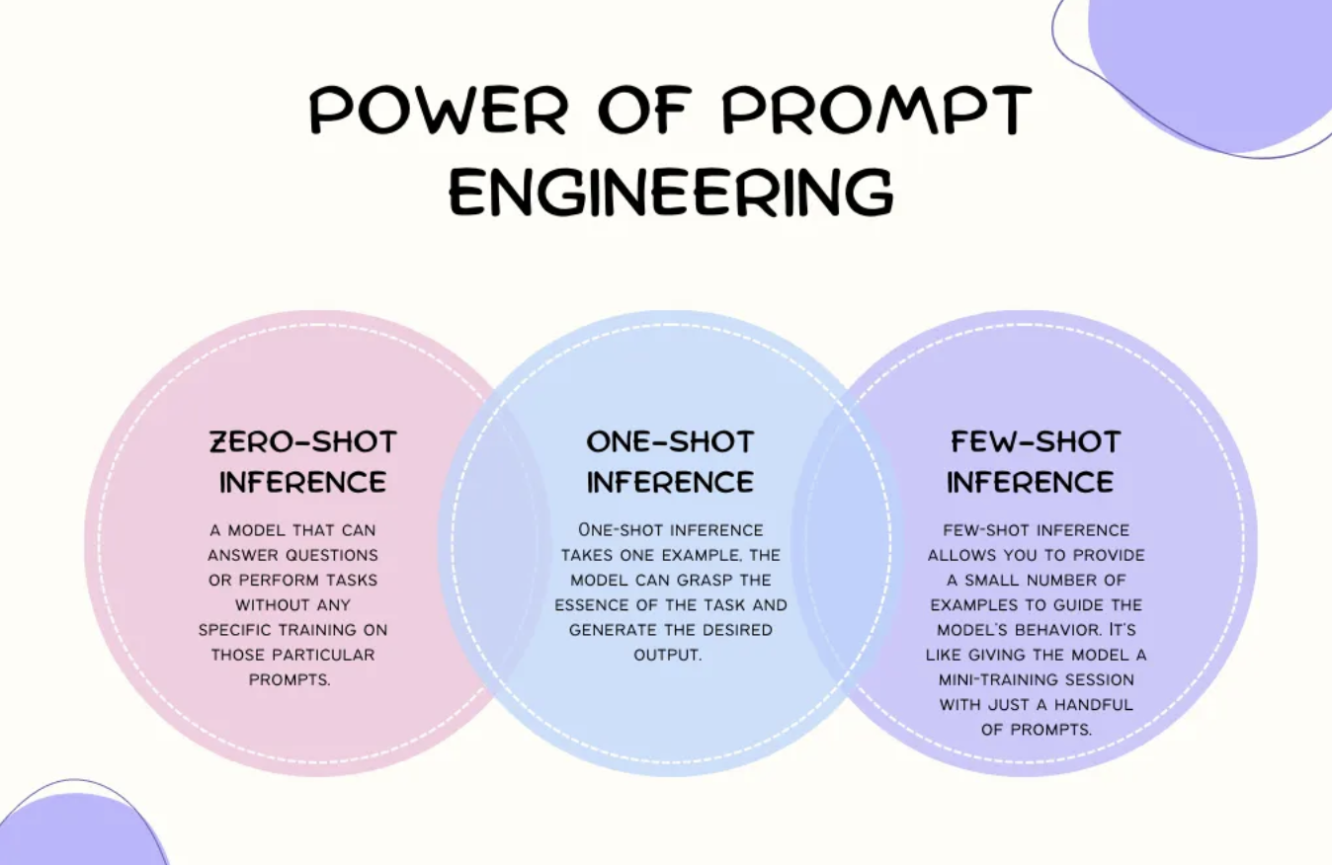
Prompting

Slide 13
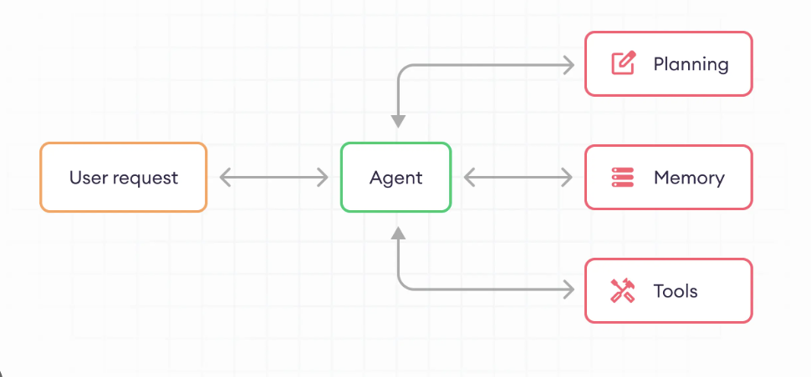
LLM Agents

Slide 14
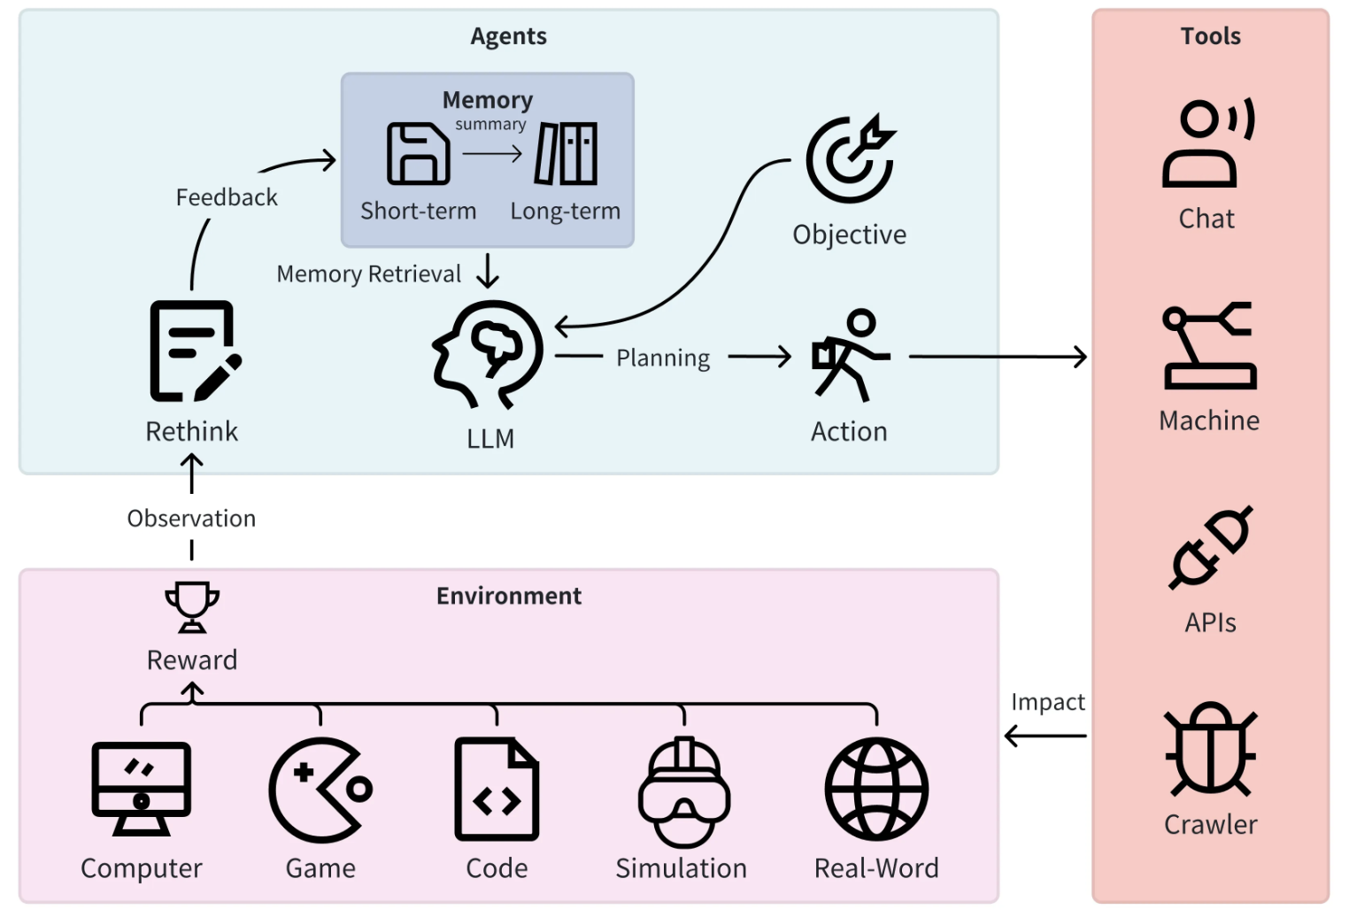

Slide 15
Agentic AI system "Goal-oriented reasoning loop"
Reasoning: Agent thinks “first I must search, then I must calculate.”
Autonomy: Chooses and uses tools without your instruction.
Chaining: Each output feeds into the next logical step.
Tool-use: Wikipedia + calculator.

Slide 16
Real time use cases for Agentic AI
🏢 1. Enterprise Automation
Task | Description
📄 Contract Analysis Agent | Reads legal contracts, flags risk clauses, generates summaries
🧾 Finance Bot | Fetches budget data, compares invoices, finds anomalies
🤝 Meeting Assistant | Joins meetings, transcribes, extracts action items, sets calendar events
🛠️ IT Support Agent | Diagnoses issues, fetches docs, creates tickets automatically
👨‍💻 2. Developer Tools
Task | Description
🧪 Test Case Generator Agent | Reads code → creates test cases + expected outputs
📊 Code Reviewer | Reads PRs, reviews logic, suggests improvements
🚀 Auto Deployment Agent | Detects app changes → builds Docker → deploys to cloud

Slide 17
Contact me
Mail : patelvrunda697@gmail.com
LinkedIn: vrunda2909
Github: V-Patel29

