Slide 1
CUSTOMER CHURN ANALYSIS
POWER BI DASHBOARD
BY:
Vadagam pravalika

Slide 2
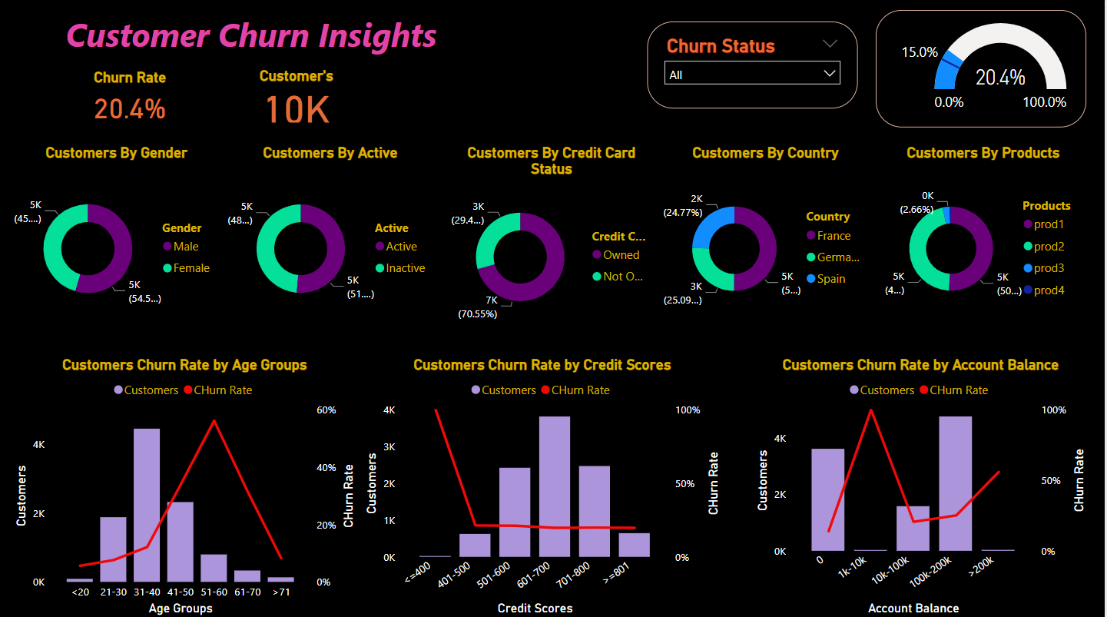
DASHBOARD

Slide 3
OVERVIEW :
What is Customer churn? This is essentially the rate at which customers leave a business against the total customers that are actively in business. This is also known as churn rate or customer attrition.

Slide 4
Objective:
The objective of this analysis is to discover various factors contributing to increased customer churn rate at the bank, and provide the business users with these insights which they can use to make informed decisions and strategize on how to improve customer retention and reduce churn rate.

Slide 5
About the Data:
The raw data was provided in the form of a CSV file with 10,000 rows of data. Data was sourced from a commercial bank who was looking to improve its customer churn rate.
Note: all personally Identifiable information has been removed from this data to protect customer’s private and sensitive information.

Slide 6
Data Dictionary
customer_id: This is the customers’ unique id which identifies them bank wide.
credit_score: this is the rating of the customers’ credit worthiness, generated based on the information on their credit report.
country: This is the country the customer hails from.
gender: This is the sex of the customer, grouped into male and female.
age: This refers to the customer’s age.
tenure: The number of years of relationship this customer has maintained with the bank.
balance: The deductible balance on their bank account as at time this data was generated.
products_number: This shows the bank account type the customer has.
credit_card: This column shows if a customer has a credit card or not, represented as either 1 or 0 respectively.
active_member: These numerical values show whether an account is active or not, represented as either 1 or 0 respectively.
estimated_ salary: This is the average annual salary received into the account.
churn: This field shows if the customer is still with the bank or not, represented by either 0 or 1 respectively.

Slide 7
Analytical Steps
Data Preparation
Data Categorization and Grouping
Formatting
Data Transformation
Data Modeling
Visualisation — Report
Insights
Recommendation
Conclusion

Slide 8
Insight’s
Churn rate for male customers is 65% but the overall male churn rate is at 25%.
In terms of those with credit card facility, the churn rate is highest amongst lowest credit score group of >400
Surprisingly, the customers whose account balance are <=200k are the most churned in terms of account balance.
Overall, Churn rate is very high at 56.2% for middle aged customers between 51–60 years of age.
For the products, churn rate is high @ 27.7% amongst customers in the Prod 1 group. The age account and credit score factors are same here. Similar situation for prod 2 =, however in prod 2, the churn rate is at all time 100% for customers between the 1k-1ok account balance.

Slide 9
Recommendation
The stakeholders could consider creating products that target seniors close to their early retirement age to avoid losing them.
An incentive program could be considered for customers who have maintained longer relationship with the bank.
In the same way, an exclusive package such as travel and vacation packages, subsidized investment portfolio, e.t.c., could be considered for the customers in the >200k account balance group, to reduce the rate at which they leave the bank.
The business needs to understand why there is 100% churn rate for Prod 2 customers with account balance of 1k-10k and how to get them back in business.

Slide 10
Conclusion
I conducted a comprehensive Power BI analysis, transforming raw data into a polished report that highlights crucial insights into customer churn factors at the bank. The report equips stakeholders, especially in managing churn among salaried customers, by pinpointing key factors and enabling them to assess the impact of strategic changes over time. It ensures effective churn management through focused and data-driven decision-making.

