Slide 1


BANNARI AMMAN
INSTITUTE OF TECHNOLOGY
(An Autonomous Institution, Affiliated to Anna University, Approved by AICTE, Accredited by NAAC with ‘A+’ Grade)
IOT HACKATHON
Team Name:BYTE BRAINS
Problem Statement: INDUSTRIAL HARMFUL GAS DETECTION AND SAFETY
Team Details: (Sameera, Deekshita, Sushma, Sudarshana)

Slide 2
Problem statement:
INDUSTRIAL HARMFUL GAS DETECTION AND SAFETY
Industrial environments often release harmful gases that can lead to health hazards, environmental pollution, or even fatal accidents if undetected. Existing systems can be expensive and lack real-time intelligence for automated alerts or preventive measures.

Slide 3
Abstract:
Our project develops a real-time industrial gas detection system. It detects harmful gas leaks, automatically shuts down affected equipment, and provides diagnostic alerts, ensuring safety, minimizing downtime, and offering a reliable, cost-effective solution for industrial environments.

Slide 4
Proposed Solution:
Our proposed solution is a Real-Time Industrial Gas Detection and Safety System designed to ensure safety and prevent hazardous incidents caused by gas leaks in industrial environments. The system incorporates the following key features:
Gas Detection Sensors: The system uses high-precision gas sensors (e.g., MQ-2 or MQ-135) to continuously monitor the presence of harmful gases such as CO, CO₂, NH₃, and LPG.
Automated Equipment Shutdown: In the event of a gas leakage or system fault, the solution automatically shuts down the affected equipment to prevent further escalation or damage.
Fault Isolation: The system isolates the specific fault or affected area to minimize operational disruption and ensure safety.
Diagnostic Alerts: It provides clear and actionable diagnostic statements, identifying the exact issue for rapid resolution by maintenance teams.
Real-Time Notifications: The system features visual (LED), sound (buzzer), and remote (Wi-Fi-enabled) notifications to inform operators and safety personnel instantly.
By implementing this solution, industries can detect harmful gas leaks early, reduce downtime, and enhance workplace safety in a cost-effective and scalable manner.

Slide 5
Methodology
The system uses gas sensors to continuously monitor harmful gas levels in real time. Upon detecting a leak or fault, it triggers an automatic shutdown of affected equipment, isolates the fault, and activates sound and visual alarms. A diagnostic statement is generated, enabling rapid issue resolution before system reactivation.
BIT V-PRAYUKTI'25

Slide 6
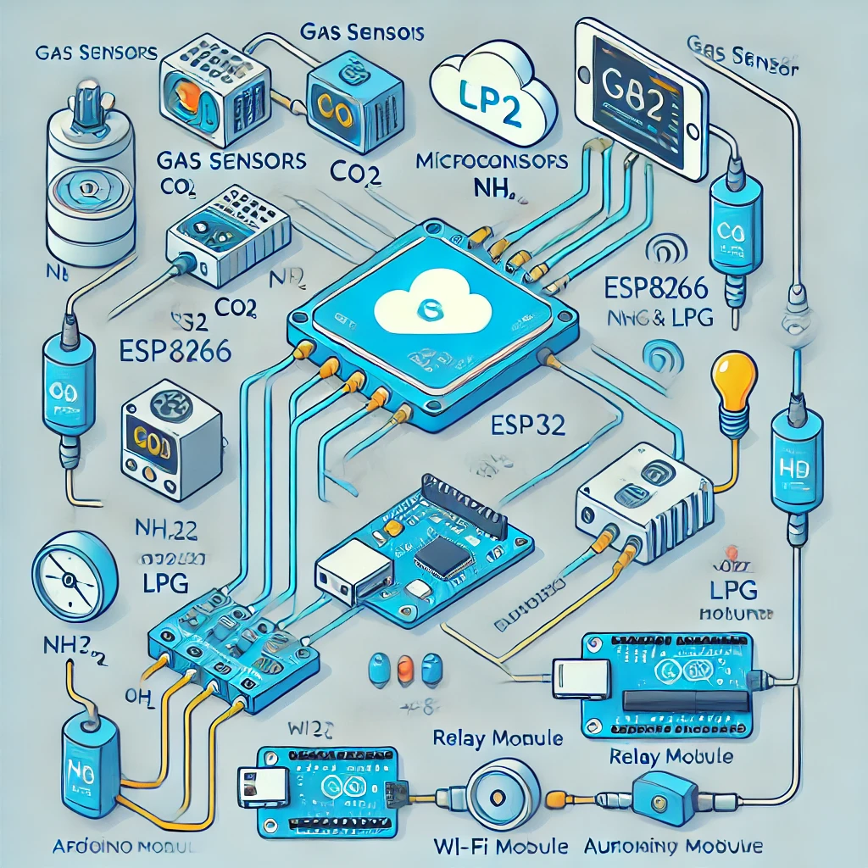
Approach:
(Explain the working in a flow/block diagram)

Slide 7
Components required during the course of Hackathon:
Microcontroller: Arduino Uno / ESP8266 / ESP32
Gas Sensor: MQ-135 (for CO₂, NH₃, benzene) or MQ-2 (for LPG, CO, smoke)
Buzzer & LED: To provide sound and visual alerts
OLED Display - To show gas concentration
WiFi Module: ESP8266 or ESP32Jumper Wires & Breadboard, Circuit Connections

Slide 8
Elevator pitch video (1 minute)
Share the public link

