Slide 1


BANNARI AMMAN
INSTITUTE OF TECHNOLOGY
(An Autonomous Institution, Affiliated to Anna University, Approved by AICTE, Accredited by NAAC with ‘A+’ Grade)
IOT HACKATHON
Team Name: TOKYO REVENGERS
Problem Statement: Guidance Assistant for Physically Disabled & Visually Impaired Persons
Team Details: (Narayanan N, Barath Vikraman J M, Deepak V, Rohith E)

Slide 2
Problem statement:
Guidance Assistant for Physically Disabled & Visually Impaired Persons

Slide 3
Abstract:
This project presents assistive technologies for individuals with disabilities using Raspberry Pi and sensors. The Smart Obstacle Detection System aids wheelchair users with obstacle alerts and route optimization. The Voice-Activated Object Identifier identifies objects using voice commands and computer vision. The Braille-to-Speech Reader converts Braille into audio output, improving accessibility. The Voice-Controlled enables appliance control through voice commands, offering ease and independence. These solutions are designed to be cost-effective, user-friendly, and impactful.

Slide 4
Proposed Solution:
The proposed solutions leverage Raspberry Pi and sensors to create accessible assistive technologies. For wheelchair users, the Smart Obstacle Detection System integrates ultrasonic sensors and haptic feedback for real-time navigation. The Voice-Activated Object Identifier combines a camera and ML for object recognition via voice commands. The Braille-to-Speech Reader uses image processing to convert Braille text into speech. The Voice-Controlled Home Automation system employs IoT to control appliances through voice input, ensuring ease of use and enhancing independence.

Slide 5
Methodology: The methodology involves designing sensor-based systems powered by Raspberry Pi: ultrasonic sensors for obstacle detection in wheelchairs, a camera and ML for object identification, image processing with OpenCV for Braille text conversion, and voice recognition with IoT integration for home automation, ensuring real-time functionality and user accessibility.
BIT V-PRAYUKTI'25

Slide 6
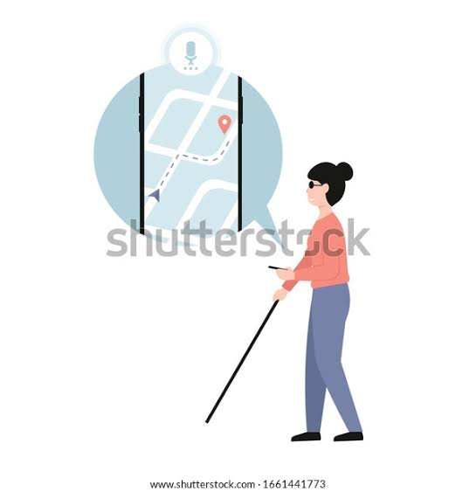
Voice Guidence
General Voice Guidance Script
1. Greeting & Introduction "Hello and welcome! I’m here to guide you. Please follow my instructions carefully for a smooth and safe experience.“
2. Navigation Guidance "Proceed straight for 200 meters, then turn left.""Take the next right turn and continue for half a mile."You have reached your destination. Thank you for using this guidance service!“
3. Safety Instructions "Please watch your step and use the handrail when necessary.""For your safety, keep all personal belongings secured. "If you need assistance, please press the help button or contact support."

Slide 7
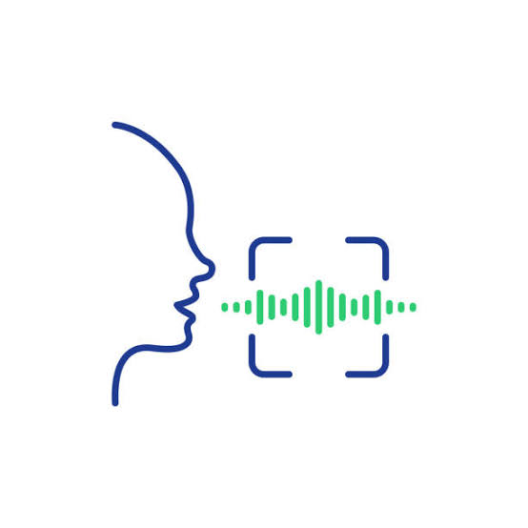
Voice control
Voice control is a technology that enables users to operate devices and perform tasks using spoken commands. It relies on speech recognition and natural language processing (NLP) to interpret and execute user in
Speech Recognition: The system converts spoken words into text.Natural Language Processing (NLP): It interprets the meaning of the command.Action Execution: The system triggers the appropriate response, such as opening an app, making a call, or controlling a smart device.structions without the need for physical input.

Slide 8
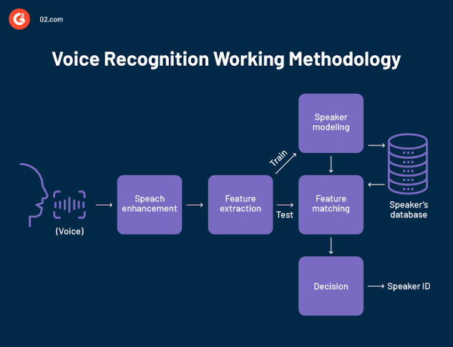

Slide 9
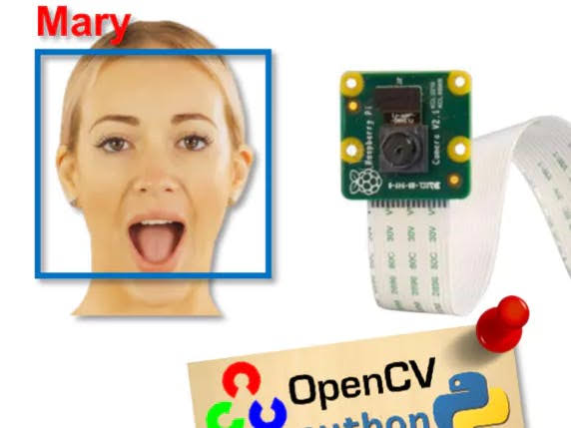
Face Detection
Face detection using a Raspberry Pi for blind individuals is a computer vision-based assistive technology that identifies human faces in real-time and provides audio feedback to help visually impaired users recognize people around them.
A camera module to capture images Face detection algorithms (like OpenCV's Har cascades or deep learning models)Face recognition (optional) to identify known individuals Text-to-speech (TTS) to announce detected faces aloud This technology enhances independence for blind users by allowing them to recognize people without physical assistance.

Slide 10
Page Reader
Page reading for blind people refers to the use of assistive technologies that help individuals with visual impairments access written content. These technologies convert text into audio or Braille, allowing blind users to "read" printed materials. One common method is screen readers, software that reads aloud the text displayed on a computer, smartphone, or tablet screen. Popular screen readers, like JAWS and NVDA, use text-to-speech technology to vocalize the content, enabling blind users to navigate and comprehend digital documents. Another solution is Braille displays, which convert text into Braille characters that can be felt through touch. These devices have small, refreshable cells that allow users to read documents in Braille, whether they are digital or in print form. Additionally, tactile books, which have raised symbols or images, offer an alternative for blind individuals, especially for younger users. Advances in technology have also led to the development of optical character recognition (OCR) systems, which scan printed text and convert it into a machine-readable format for further conversion into audio or Braille

Slide 11
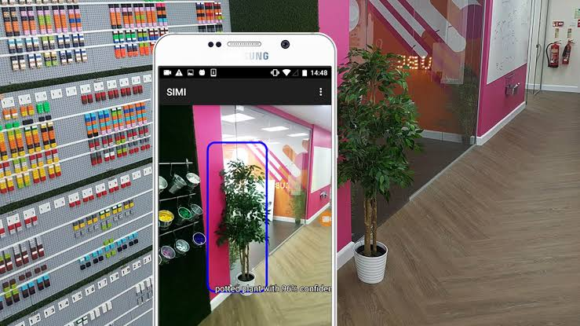
Object Detection
Object detection for blind people can be a life-changing technology, enabling them to navigate their surroundings more safely and independently. It involves real-time detection and verbal feedback to help them understand their environment.
Smart Glasses: Equipped with a camera and speaker to describe objects.Mobile Apps: Apps like Seeing AI, Be My Eyes, or Lookout use object detection.Wearable Devices: Smart belts, vests, or canes with vibration or audio alerts.

Slide 12
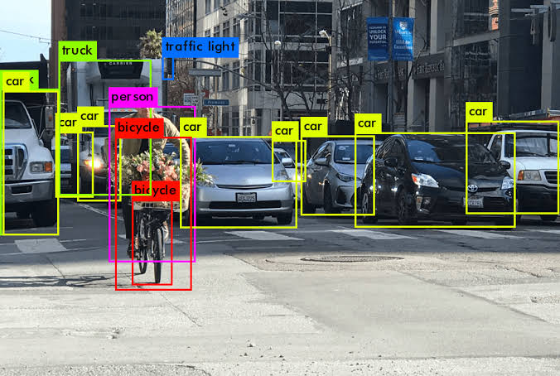

Slide 13
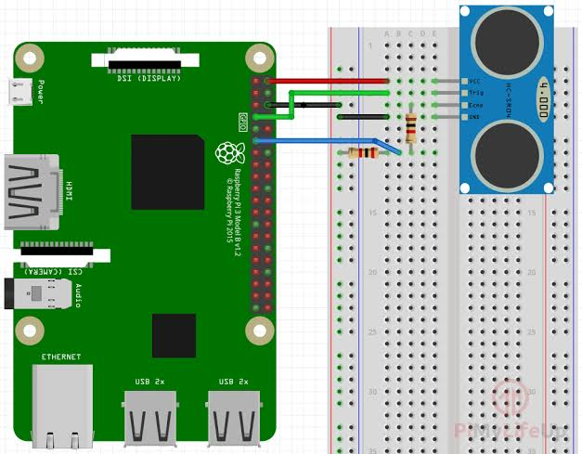
Distance Measurement
Distance measurement using Raspberry Pi refers to the process of determining the distance between the device and an object using sensors like ultrasonic, LiDAR, infrared, or camera-based depth estimation. The Raspberry Pi processes sensor data and calculates distances, enabling applications such as obstacle detection, navigation assistance, and automation in robotics and smart devices.
Obstacle Detection for Visually Impaired Users – Smart canes or wearable devices.Autonomous Vehicles & Robots – Avoiding collisions.Smart Surveillance – Motion detection using distance sensors.Home Automation – Proximity-based lighting or door opening.

Slide 14
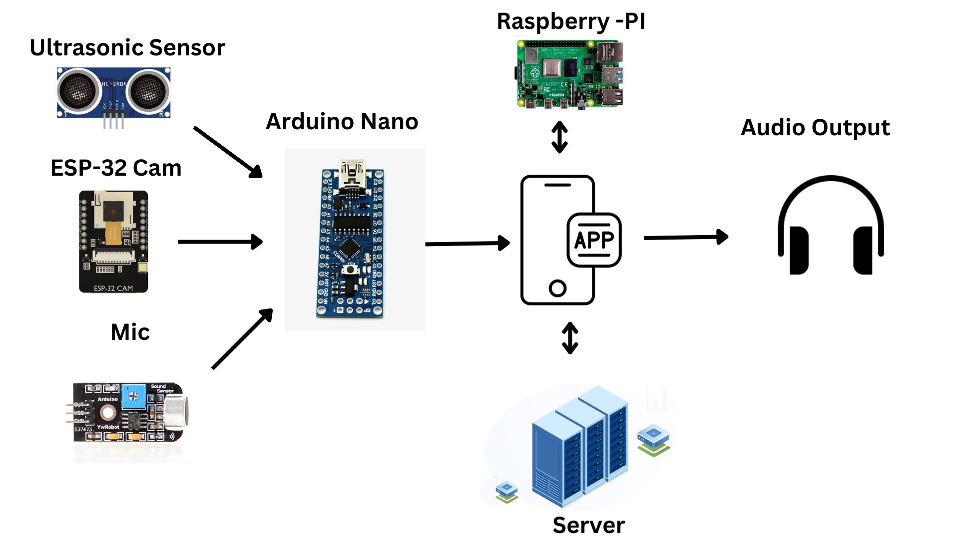
Approach:
(Explain the working in a flow/block diagram)

Slide 15
Components required during the course of Hackathon:
Input : Ultrasonic sensors, Camera module
Processing Unit : Raspberry Pi
Navigation : Ultrasonic sensors,GPS module
Output : Speaker, IoT app/web interface,
Additional Systems : TTS module, ML models for object and IoT integration

Slide 16
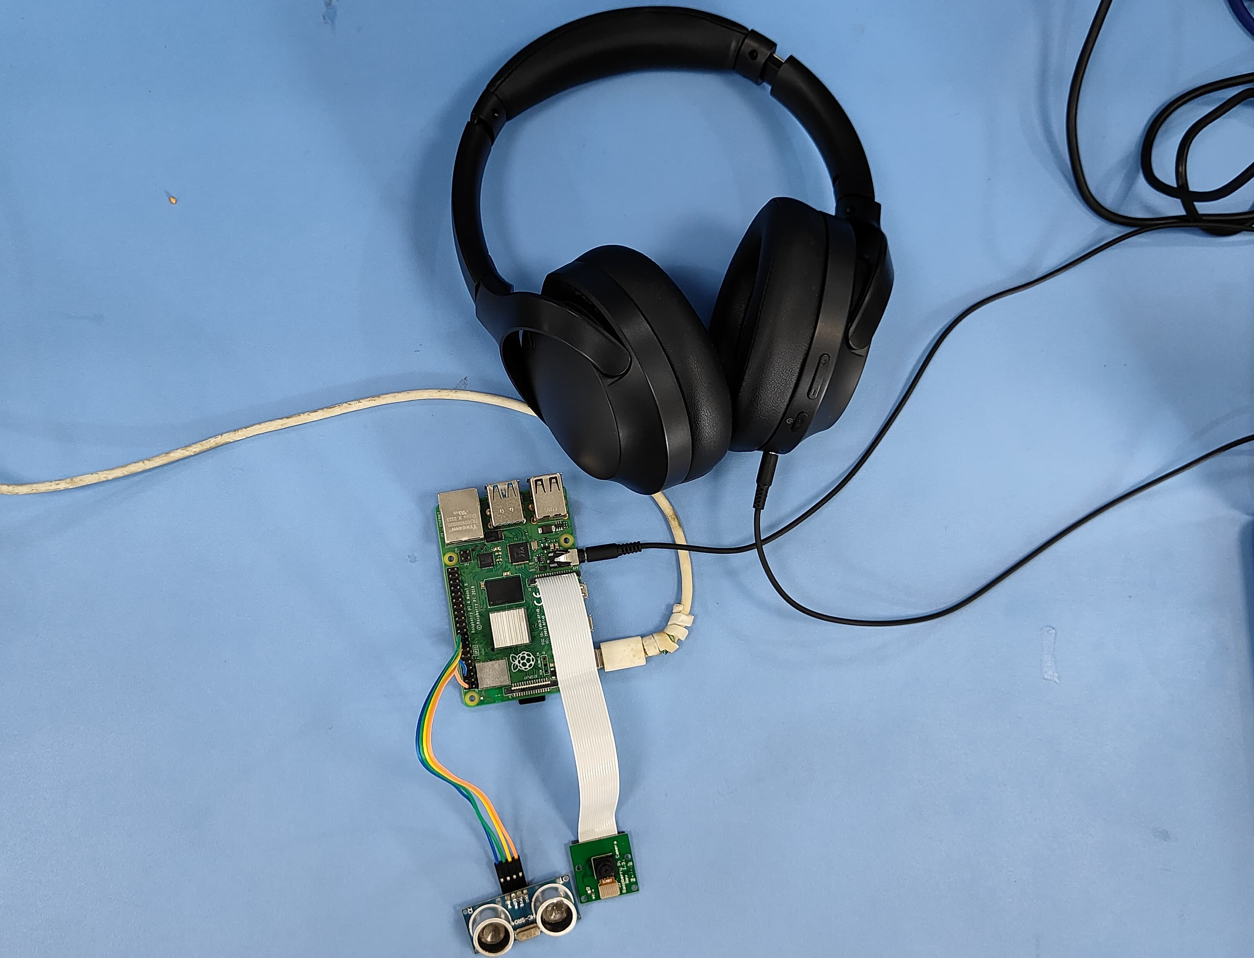
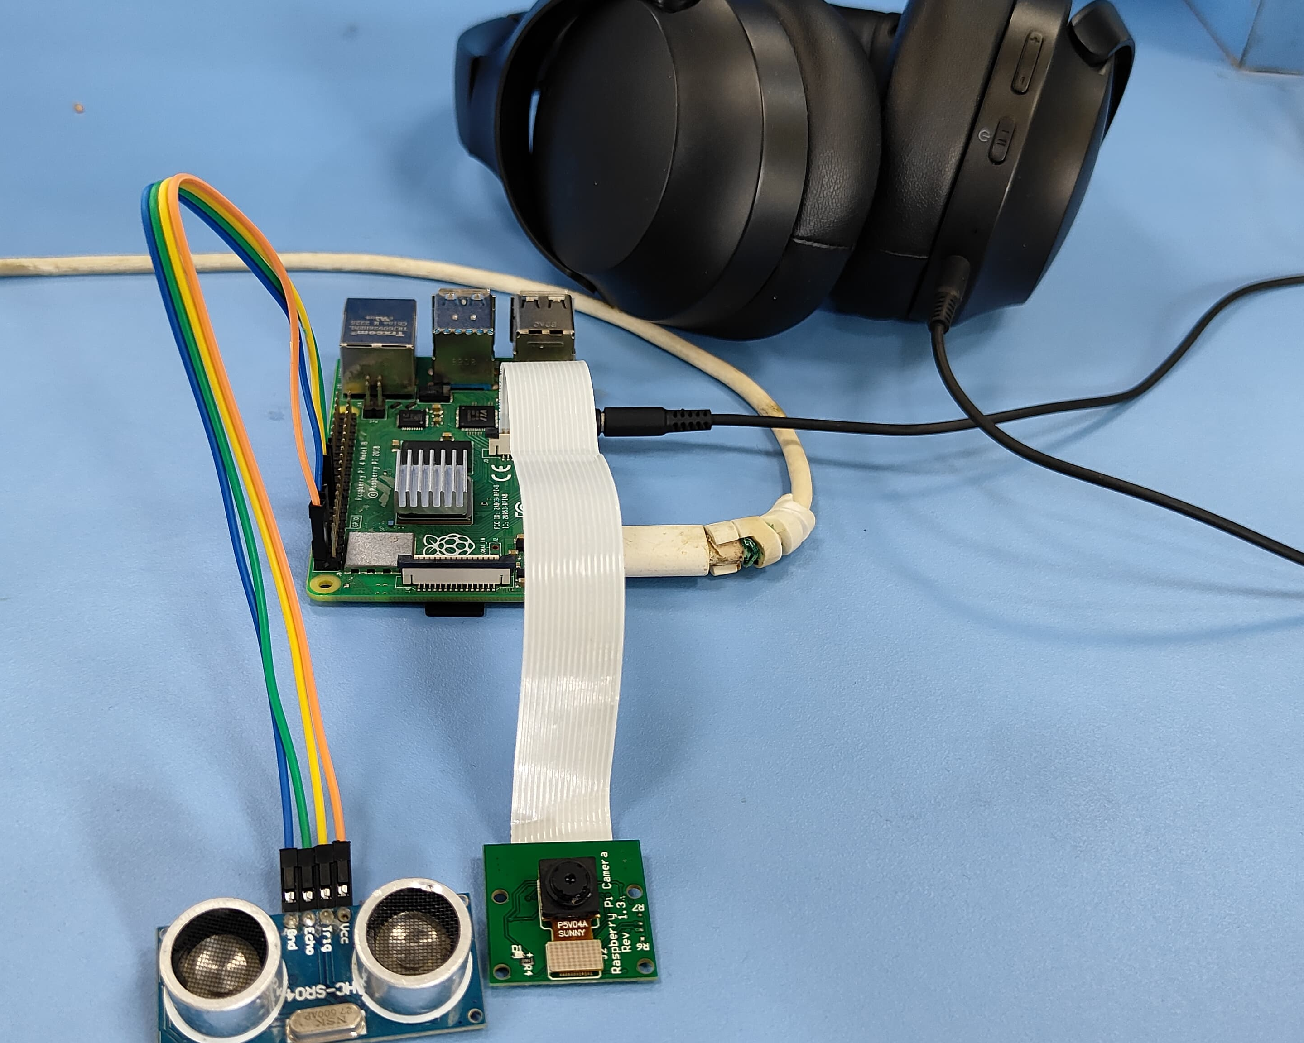
Output

