Slide 1

28 April 2023
Parallel SUPPORT VECTOR MACHINES
All relevant code is at link: https://github.com/V-Rang/CSE-392-Parallel-Algorithms-for-Scientific-Computing-Project---Parallel-Support-Vector-Machines
Dilip Geethakrishnan and Venugopal Ranganathan

Slide 2
OUTLINE
Problem Statement
Sequential – Complexity & Algorithm
Parallel – Complexity & Algorithm
Implementation Details
Results

Slide 3
OUTLINE
Problem Statement
Sequential – Complexity & Algorithm
Parallel – Complexity & Algorithm
Implementation Details
Results

Slide 4
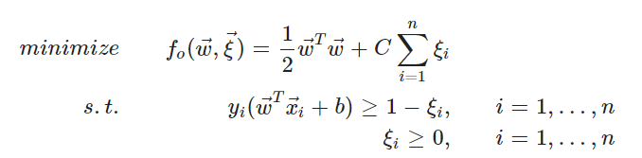

Problem Statement
The aim is to improve/study some performance of SVM’s. We do this by the following:
Parallelize Matrix multiplications on GPUs
Improve performance of Matrix inversion by using parallelized Randomized SVD.
In this study, we compare the performances of some standard SVM libraries, as well as modify a variant of SVM, called Least-Squared SVM. In Least squared SVM, we arrive at a step where we have a system to solve, of the form Ax=b. We then use the RSVD to find the pseudo inverse.

Slide 5
OUTLINE
Problem Statement
Sequential – Complexity & Algorithm
Parallel – Complexity & Algorithm
Implementation Details
Results

Slide 6
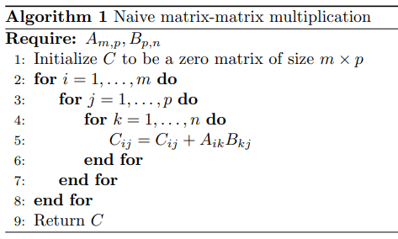
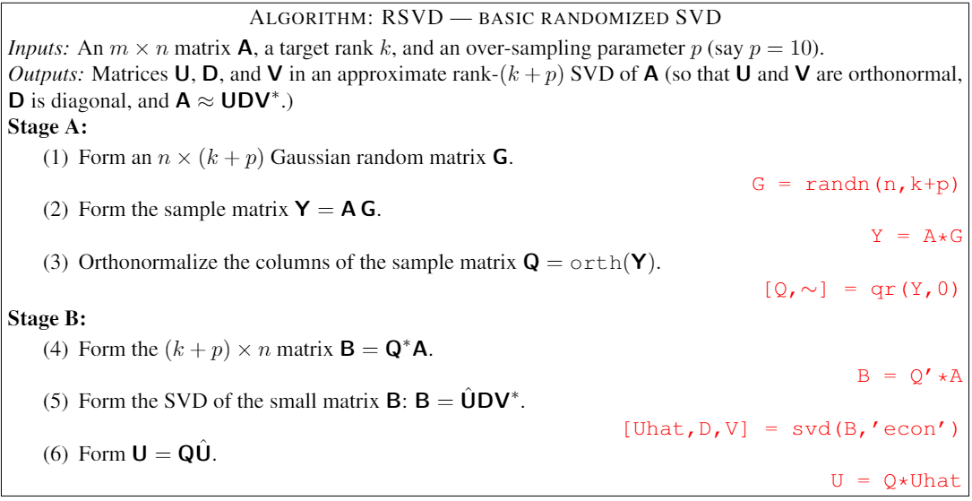
Sequential – Complexity & Algorithm
Matrix-matrix multiplication – O(n³)
Randomized Singular Value Decomposition – O(mnk + nk²)
“Finding Structure with Randomness” -Halko, Martinsson, Tropp (2011)

Slide 7
OUTLINE
Problem Statement
Sequential – Complexity & Algorithm
Parallel – Complexity & Algorithm
Implementation Details
Results

Slide 8
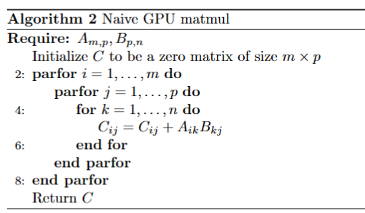
Parallel – Complexity & Algorithm
Naïve Gpu Matrix-matrix multiplication shown for analysis.
Work: O(mn²).
Depth: O(n)

Slide 9
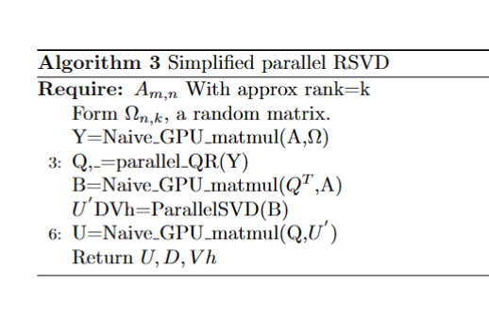
Parallel – Complexity & Algorithm
Naïve Gpu Matrix-matrix multiplication shown for analysis. We replace the other operations with parallel variants from various libraries and compare results.
For simplicity, we assume m=n
Steps:
Forming omega: work =O(n*k) Depth = O(n*k)
Y=A*O , O(nk²), O(k)
Q=QR(Y) O(nk²)
B=Q^{T}A O(nk²) , O(k)
U’DVh=SVD(B) O(nk²)
U=QU’ O(nk²) ,O(k)

Slide 10
OUTLINE
Problem Statement
Sequential – Complexity & Algorithm
Parallel – Complexity & Algorithm
Implementation Details
Results

Slide 11
Implementation Details
LS-SVM
PLS-SVM
LIBSVM
Original
CPU-rSVD
Torch-rSVD
C++-rSVD
PyCUDA rSVD

Slide 12
Implementation Details
LS-SVM
PLS-SVM
LIBSVM
Original
CPU-rSVD
Torch-rSVD
C++-rSVD
PyCUDA rSVD

Slide 13
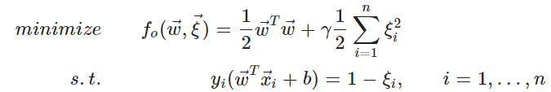
Implementation Details
LS-SVM
Original
https://github.com/RomuloDrumond/LSSVM

Slide 14
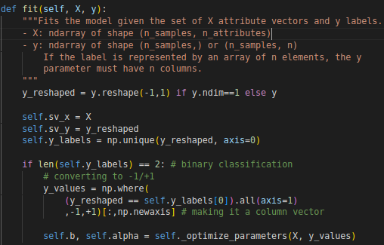
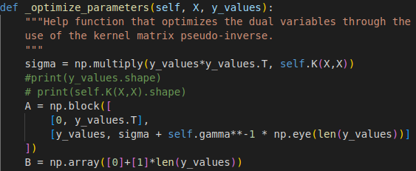
Implementation Details
LS-SVM
Original

Slide 15
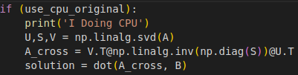
Implementation Details
LS-SVM
Original

Slide 16
Implementation Details
LS-SVM
PLS-SVM
LIBSVM
Original
CPU-rSVD
Torch-rSVD
C++-rSVD
PyCUDA rSVD

Slide 17
Implementation Details
LS-SVM
CPU-rSVD

Slide 18
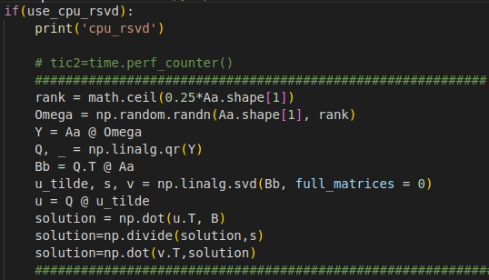
Implementation Details
LS-SVM
CPU-rSVD

Slide 19
Implementation Details
LS-SVM
PLS-SVM
LIBSVM
Original
CPU-rSVD
Torch-rSVD
C++-rSVD
PyCUDA rSVD

Slide 20
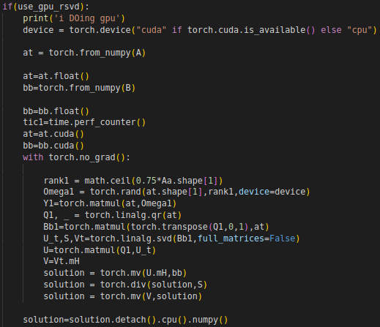
Implementation Details
LS-SVM
Torch-rSVD

Slide 21
Implementation Details
LS-SVM
PLS-SVM
LIBSVM
Original
CPU-rSVD
Torch-rSVD
C++-rSVD
PyCUDA rSVD

Slide 22
Implementation Details
LS-SVM
C++-rSVD

Slide 23
Implementation Details
LS-SVM
PLS-SVM
LIBSVM
Original
CPU-rSVD
Torch-rSVD
C++-rSVD
PyCUDA rSVD

Slide 24
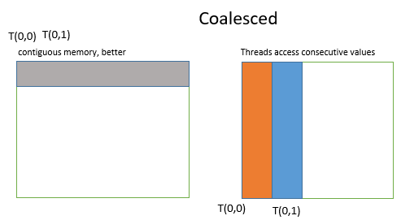
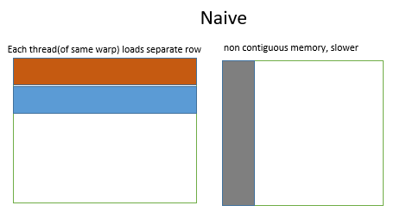
Implementation Details
Matrix Multiplication on the GPU:
Started with the Naïve Kernel. First improvement was by Memory Coalescing the access to data. Threads are launched as a set of warps, with T(0,0)→T(0,31). But the Naïve implementation makes the threads of the same warp access different memory locations, reducing efficiency. Code changed to reverse access pattern.
Shared memory used with Tiling.
Loop unrolling for the lowest level loop.
Did some benchmark measurements and approximate FLOP counts for this kernel.
Language: CUDA/C++, also implemented in pycuda.
LS-SVM
PyCUDA rSVD

Slide 25
Implementation Details
LS-SVM
PLS-SVM
LIBSVM
Original
CPU-rSVD
Torch-rSVD
C++-rSVD
PyCUDA rSVD

Slide 26
Implementation Details
Parallel RSVD:
Used a simple python implementation of LSSVM*
Started with NumPy implementation for the algorithm, used np.linalg.svd() and then multiplied them correctly to get the pseudo inverse(A⁺), and finally did solution=(A⁺*b)
First changed this to the RSVD algorithm and then changed the multiplication order multiply b with the svd(A) in the correct order to minimize matrix-matrix multiplies.
To get an idea of the parallelism we could expect, used torch to transfer the data to the GPU, and implemented the RSVD algorithm on the GPU.
Implemented a C++ BLAS/LAPACKe RSVD algorithm, using blas libraries for QR, svd, etc.
Implemented a PyCUDA version of RSVD,(using scikit-cuda for QR)where we also plug in our Matrix-Matrix kernel, and measure different benchmarks.
PLS-SVM
Implementations:
OpenMP
CUDA
HIP
OpenCL
SYCL
https://github.com/SC-SGS/PLSSVM

Slide 27
Implementation Details
LS-SVM
PLS-SVM
LIBSVM
Original
CPU-rSVD
Torch-rSVD
C++-rSVD
PyCUDA rSVD

Slide 28
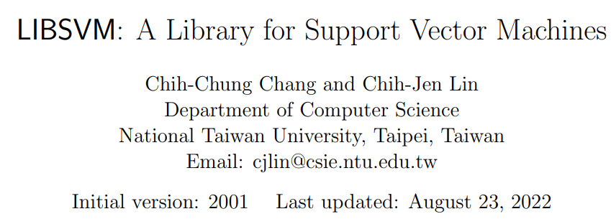
Implementation Details
LIBSVM
svm-train, svm-predict, svm-scale

Slide 29
Implementation Details
LS-SVM
PLS-SVM
LIBSVM
Original
CPU-rSVD
Torch-rSVD
C++-rSVD
PyCUDA rSVD

Slide 30
OUTLINE
Problem Statement
Sequential – Complexity & Algorithm
Parallel – Complexity & Algorithm
Implementation Details
Results

Slide 31
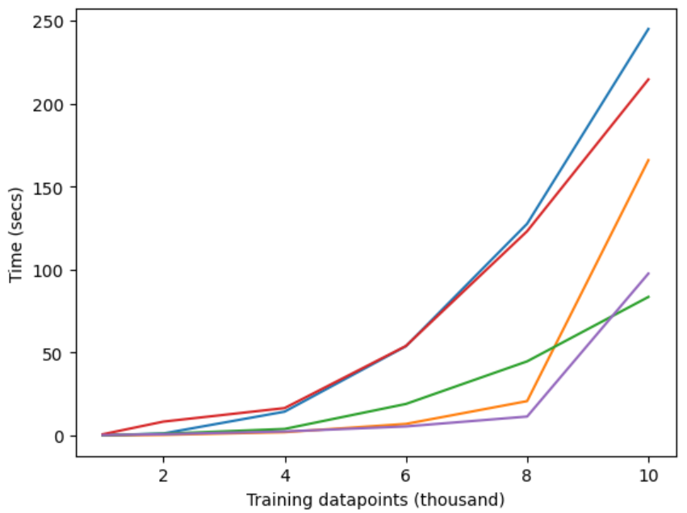
Results
CPU_original
C++_rsvd
#Features = 2
CPU_rsvd
PyCUDA
GPU_rsvd

Slide 32
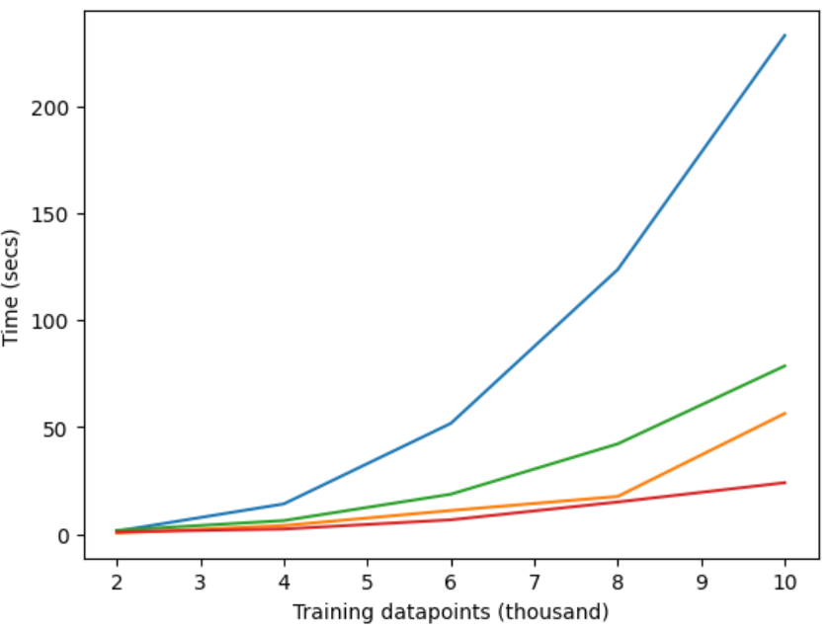
Results
CPU_original
#Features = 200
CPU_rsvd
GPU_rsvd
PyCUDA

Slide 33
OUTLINE
Problem Statement
Sequential – Complexity & Algorithm
Parallel – Complexity & Algorithm
Implementation Details
Results
END

