Slide 1
Wild Sound : Wildlife Monitoring System
Using AI
Group Members:
Ajith K Guide:
Riya Roy Dr Geethu Mary George
Shintu Damodharan HOD , CSE(CyberSecurity)
V S Aneena
‹#›
Notes:
‹#›
‹#›
‹#›
‹#›

Slide 2
DEPARTMENT OF COMPUTER SCIENCE & ENGINEERING
Vision of the Department
Creating eminent and ethical leaders in the domain of Computational Sciences through quality
professional education with a focus on holistic learning and excellence.
Mission of the Department
To create technically competent and ethically conscious graduates in the field of Computer
Science and Engineering by encouraging holistic learning and excellence.
To prepare students for careers in Industry, Academia and the Government.
To instill Entrepreneurial Orientation and research motivation among the students of the
department.
To emerge as a leader in education in the region by encouraging teaching, learning, industry
and societal connect.

Slide 3
Programme Educational Objectives (PEOs)
1. The graduates shall have sound knowledge of Mathematics, Science, Engineering and
Management to be able to offer practical software and hardware solutions for the problems of
industry and society at large.
2. The graduates shall be able to establish themselves as practicing professionals, researchers or
Entrepreneurs in computer science or allied areas and shall also be able to pursue higher
education in reputed institutes.
3. The graduates shall be able to communicate effectively and work in multidisciplinary teams
with team spirit demonstrating value driven and ethical leadership.

Slide 4
Programme Outcomes
Engineering Graduates will be able to:
1. Engineering knowledge: Apply the knowledge of mathematics, science, engineering fundamentals, and an engineering specialization to the solution of complex engineering problems.
2. Problem analysis: Identify, formulate, review research literature, and analyze complex engineering problems reaching substantiated conclusions using first principles of mathematics, natural sciences, and engineering sciences.
3. Design/development of solutions: Design solutions for complex engineering problems and design system components or processes that meet the specified needs with appropriate consideration for the public health and safety, and the cultural, societal, and environmental considerations.
4. Conduct investigations of complex problems: Use research-based knowledge and research methods including design of experiments, analysis and interpretation of data, and synthesis of the information to provide valid conclusions.
5. Modern tool usage: Create, select, and apply appropriate techniques, resources, and modern engineering and IT tools including prediction and modeling to complex engineering activities with an understanding of the limitations.

Slide 5
6. The engineer and society: Apply reasoning informed by the contextual knowledge to assess societal, health, safety, legal and cultural issues and the consequent responsibilities relevant to the professional engineering practice.
7. Environment and sustainability: Understand the impact of the professional engineering solutions in societal and environmental contexts, and demonstrate the knowledge of, and need for sustainable development.
8. Ethics: Apply ethical principles and commit to professional ethics and responsibilities and norms of the engineering practice.
9. Individual and team work: Function effectively as an individual, and as a member or leader in diverse teams, and in multidisciplinary settings.
10. Communication: Communicate effectively on complex engineering activities with the engineering community and with society at large, such as, being able to comprehend and write effective reports and design documentation, make effective presentations, and give and receive clear instructions.
11. Project management and finance: Demonstrate knowledge and understanding of the engineering and management principles and apply these to one’s own work, as a member and leader in a team, to manage projects and in multidisciplinary environments. 12. Life-long learning: Recognize the need for, and have the preparation and ability to engage in independent and life-long learning in the broadest context of technological change.

Slide 6
Programme Specific Outcomes (PSOs)
On the completion of Computer Science & Engineering program, the students will possess:
An ability to apply knowledge of data structures and algorithms appropriate to computational problems.
An ability to apply knowledge of operating systems, programming languages, data management, or networking principles to computational assignments.
An ability to apply design, development, maintenance or evaluation of software engineering principles in the construction of computer and software systems of varying complexity and quality.
An ability to understand concepts involved in modeling and design of computer science applications in a way that demonstrates comprehension of the fundamentals and trade-offs involved in design choices.

Slide 7
CONTENTS
Introduction
Motivation
Literature Survey
Inferences from Literature Survey
Problem Statement
Dataset Details
Proposed Method
Architecture Diagram/Flow Diagram
Novelty of the Proposed Method
Algorithm Steps
Conclusion
References

Slide 8
INTRODUCTION
WILD-SOUND : ‘Wildlife Monitoring System Using AI’ is an innovative solution designed to bridge the gap between conservation and safety by leveraging intelligent acoustic technology
Real Time Monitoring :The system focuses on real-time detection and identification of wild animals through sound-based monitoring.
Sound Recognition : It listens to environmental sounds and recognizes animal presence and activity near vulnerable areas.
Repellent System : Upon detecting potential threats, it activates suitable deterrents to safely guide animals away from human settlements.
Alerting System : It also provides timely alerts to concerned individuals or authorities, supporting quick responses and enhancing wildlife protection.

Slide 9
MOTIVATION
Rising human-wildlife conflicts in Kerala : Attacks from wildlife especially elephants, tigers and wild boar have led to frequent crop damage, property destruction, and even loss of human lives.
Animal Intrusion : Many regions in Kerala, such as Wayanad, Palakkad, and Idukki, share close borders with forest areas, making villages and farmlands highly vulnerable to animal intrusion.
Traditional Measures : Methods like electric fencing and firecrackers are often ineffective, unsafe, or harmful to both humans and animals.
Sustainable Solution : A sustainable and humane solution is required that can help farmers and communities in Kerala coexist safely with wildlife while supporting conservation efforts.
.

Slide 10
LITERATURE SURVEY
S.No | Article Title | Published Year | Journal Name | Methods/ Algorithm Used | Merits | Demerits
1. | Sound Analysis Based Animal Recognition and Repel System for Agriculture | 2023 | Moratuwa Engineering Research Conference (MERCon) | Sound Pattern Matching using Raw Audio | Real-time sound-based detection; non-invasive method | Limited to specific animal sounds; not robust to background noise
2. | AI-based Elephant Intrusion Detection using YOLO v5 and Thermal Cameras | 2023 | Sripatum Review of Science and Technology (Elsevier) | YOLO v5, Image Processing | High detection accuracy; works in low-light conditions | Expensive hardware; training requires large datasets

Slide 11
INFERENCE FROM SURVEY
Diverse Approaches for Detection
The surveyed papers explore sound-based and vision-based (thermal imaging + AI) techniques for animal intrusion detection.
Sound analysis is non-invasive and works in real-time but struggles with background noise and limited animal sound datasets.
AI-based vision systems (YOLO v5 + thermal cameras) offer high accuracy, especially in low-light conditions, but require expensive hardware and extensive training data.
Trade-offs Between Cost and Performance
Low-cost solution: Sound-based systems are economical but less robust in noisy environments.
High-accuracy solution: AI-based thermal imaging provides better detection but at a higher cost, making it less scalable for small-scale farms.
Gaps and Future Improvements
Hybrid systems combining sound and vision could improve reliability.
Noise filtering algorithms could enhance sound-based detection.
Lightweight AI models may reduce computational costs for vision-based systems.

Slide 12
PROBLEM STATEMENT
1. Frequent Human-Wildlife Conflicts :
Communities near forest areas in Kerala face repeated intrusions by wild animals, leading to crop loss, property damage, and threat to human life.
2. Ineffective Traditional Methods :
Conventional deterrents like firecrackers and electric fences are either harmful, inconsistent, or ineffective in preventing animal entry.
3. Lack of Real-Time Monitoring :
There is no reliable system in place for continuously monitoring animal presence and movement near human settlements and farmlands.
4. Need for Intelligent and Humane Solutions :
Current systems fail to combine real-time detection, species-specific deterrence, and timely alerts in a way that ensures both human safety and wildlife protection.

Slide 13
DATASET DETAILS
Target Sound | Dataset Name / Source | Details | Download Link
Tiger | Macaulay Library(Cornell Lab) | Wildlife vocalizations(searchable) | Macaulay: Tiger sounds
Elephant | ElephantVoices Sound Library | 100+ Africa and Asian elephant calls | ElephantVoices
WildBoar | BBC Sound Effects Archive | Wild boar grunts and noises | BBC Wild Boar Sounds
Gunshot | Google AudioSet+ freesound | Annotated gunshot audio segments | AudioSet Gunshot
Chainsaw | Freesound.org | Chainsaw engine,cutting,revving sounds | Freesound Chainsaw
Human voice | Mozilla Common voice | 1000+ hours of multilingual voice data | Common Voice

Slide 14
PROPOSED SYSTEM
Overview :
A fully automated, solar-powered animal recognition and repelling system. The device detects an animal, identifies its species from audio signatures, activates the appropriate ultrasonic and visual deterrents, and immediately notifies the user ,all without human intervention.
Key Components :
PIR Sensors – Detect motion and trigger the recognition process
Microphone – Captures environmental audio for analysis
Raspberry Pi 4 – Central controller for processing and system logic
SOPARE Engine – Identifies animal type based on sound pattern recognition
LDR Sensor – Detects darkness to activate LED only in low-light conditions
High-Intensity LED – Provides visual deterrent (used at night)
Ultrasonic Speaker – Emits species-specific frequencies to repel animals
GSM Module (SIM800L) – Sends SMS alerts to notify the user
Solar Panel + Battery – Powers the system continuously and portably

Slide 15
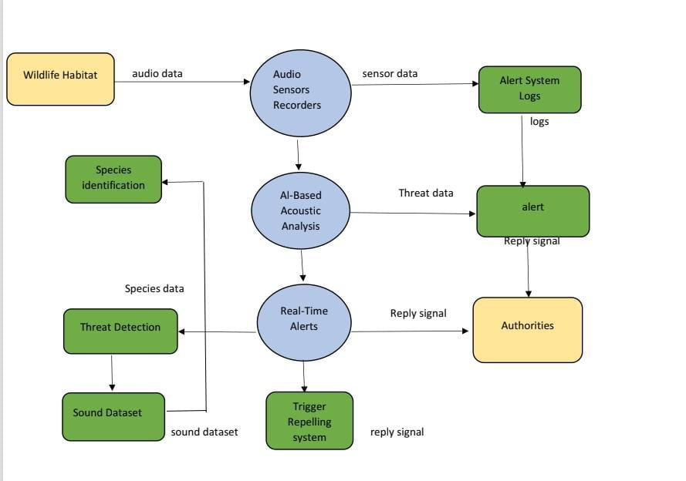
Flow Diagram

Slide 16
NOVELTY OF THE PROPOSED SYSTEM
Animal Identification via Sound : This design uses audio pattern recognition (SOPARE) to identify animals based on their real-time vocalizations or movement sounds.
Local Processing (Edge AI) : The use of a Raspberry Pi enables local decision-making and processing, eliminating the need for internet connectivity or cloud services.
Species-Specific Repelling : The system emits ultrasonic frequencies customized to specific species, maximizing discomfort and effectiveness while avoiding overuse of generic deterrents.
Dual-Mode Repelling System : Combines ultrasonic sound and bright LED flashing. The LED activates only in dark conditions, intelligently conserving power and enhancing deterrence at night.
Real-Time SMS Alerts : Integrates a GSM module to instantly notify the user of animal type and system status, enhancing response capability and remote monitoring.
Solar-Powered Portability : Designed with a solar-charged battery, the system functions independently of grid power and can be easily deployed in off-grid or remote areas.

Slide 17
ALGORITHM
Step 1: Initialization
Load SOPARE configuration parameters (e.g., sample rate, chunk size, threshold values).
Initialize the audio processing environment.
Step 2: Training Phase (One-time Setup)
Record audio samples of target classes (e.g., elephant, tiger, chainsaw).
Convert the recorded sound into numeric feature chains.
Store the processed features as known patterns in the audio factory.
Step 3: Real-time Sound Capture (Recognition Phase)
When motion is detected, start recording live audio using a microphone.
Store the incoming audio in a temporary buffer.
Step 4: Noise Filtering
Analyze the amplitude of the incoming sound.
Apply a threshold filter to remove low-amplitude background noise.

Slide 18
ALGORITHM
Step 5: Feature Extraction
Process the filtered audio to extract waveform features (e.g., frequency peaks, time-domain patterns).
Convert the audio into short-term feature chains that describe the sound’s shape and intensity.
Step 6: Pattern Matching
Compare the real-time feature chain with all stored patterns in the audio factory.
Measure similarity using internal SOPARE distance metrics.
Step 7: Classification
If a match exceeds the similarity threshold, classify the sound with the matching label (e.g., "tiger").
If no match is found, return “unknown”.
Step 8: Output Result
Pass the identified label to the rest of the system (e.g., to trigger ultrasonic repellents or SMS alerts).
Reset buffer and return to listening mode.

Slide 19
CONCLUSION
‘WILD SOUND’ offers a smart and non-invasive approach to monitor and identify wildlife activity near human habitats.
It enhances safety by providing real-time detection and species-specific deterrence using most sustainable and efficient repellent system.
The system also includes alert mechanisms to inform authorities or locals instantly, enabling timely intervention and thus avoiding any dangers .
Overall, it supports coexistence between humans and wildlife while contributing to conservation and reducing crop losses.

Slide 20
References
Dissanayake, C. M. (2023). Sound Analysis-Based Animal Recognition and Repel System for Agriculture. In 2023 Moratuwa Engineering Research Conference (MERCon), IEEE.
K. Anand, G. Srimathi, and R. Srimathy, "Integrated Wildlife Monitoring System for Real-Time Anti-Poaching and Conservation," 2024 International Conference on Innovative Computing, Intelligent Communication and Smart Electrical Systems (ICSES), Chennai, India, 2024
J. Chappidi and D. M. Sundaram, "Animal Intrusion Detection System using YOLO v11," in Proc. 2025 Int. Conf. Recent Advances in Electrical, Electronics, Ubiquitous Communication, and Computational Intelligence, 2025, doi: 10.1109/RAEEUCCI63961.2025.11048278.

