Slide 1
Maker Checker Application

Slide 2
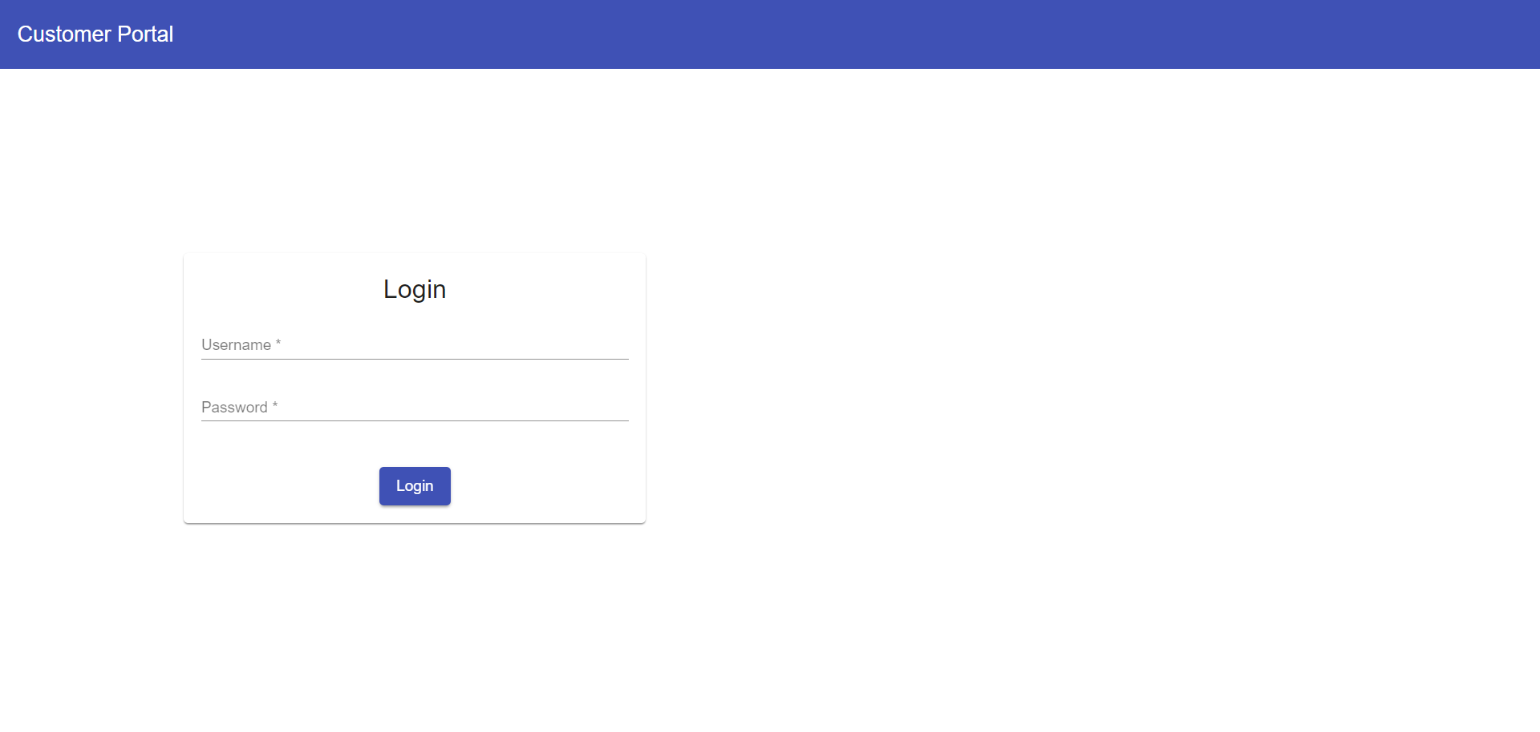
Login Page

Slide 3
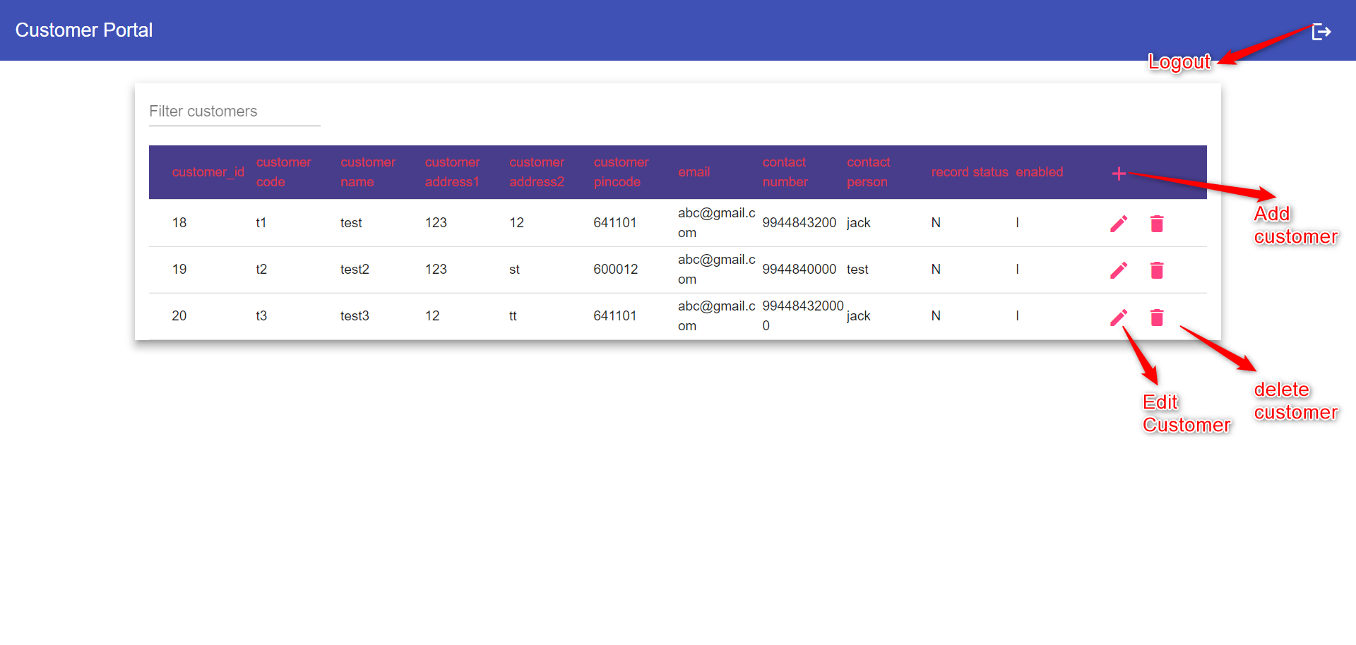
Maker Component

Slide 4
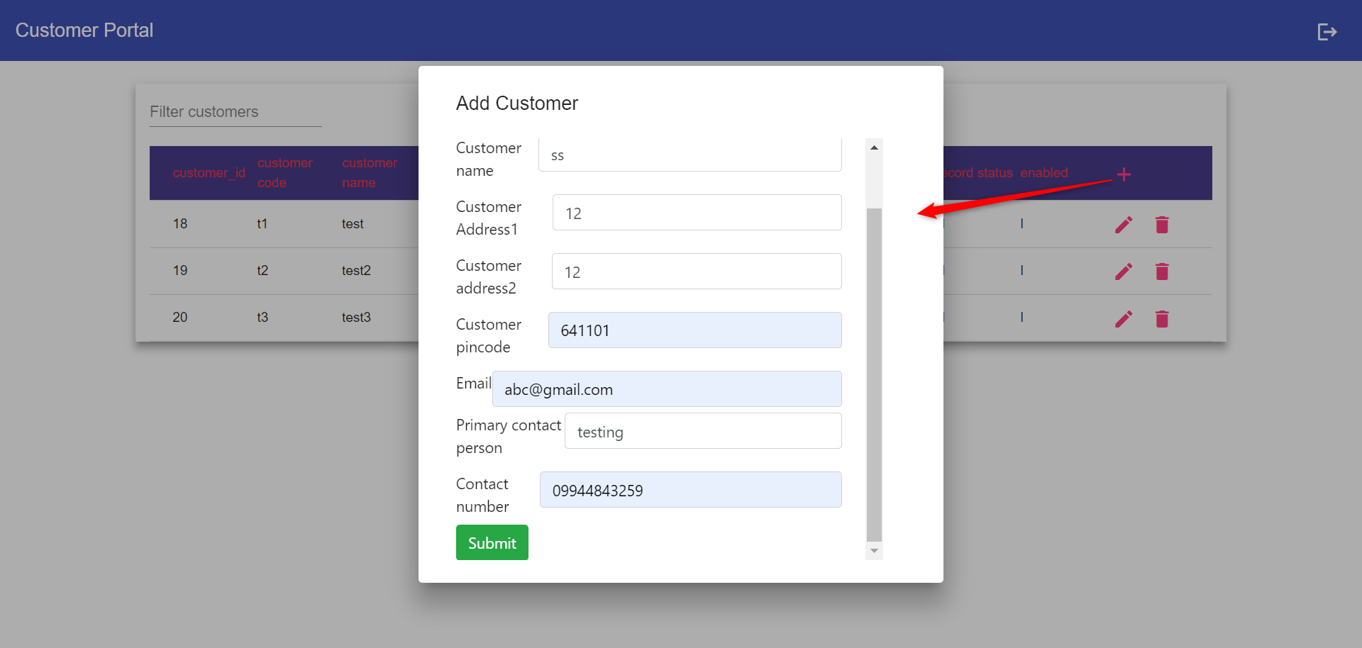
Add Customer

Slide 5
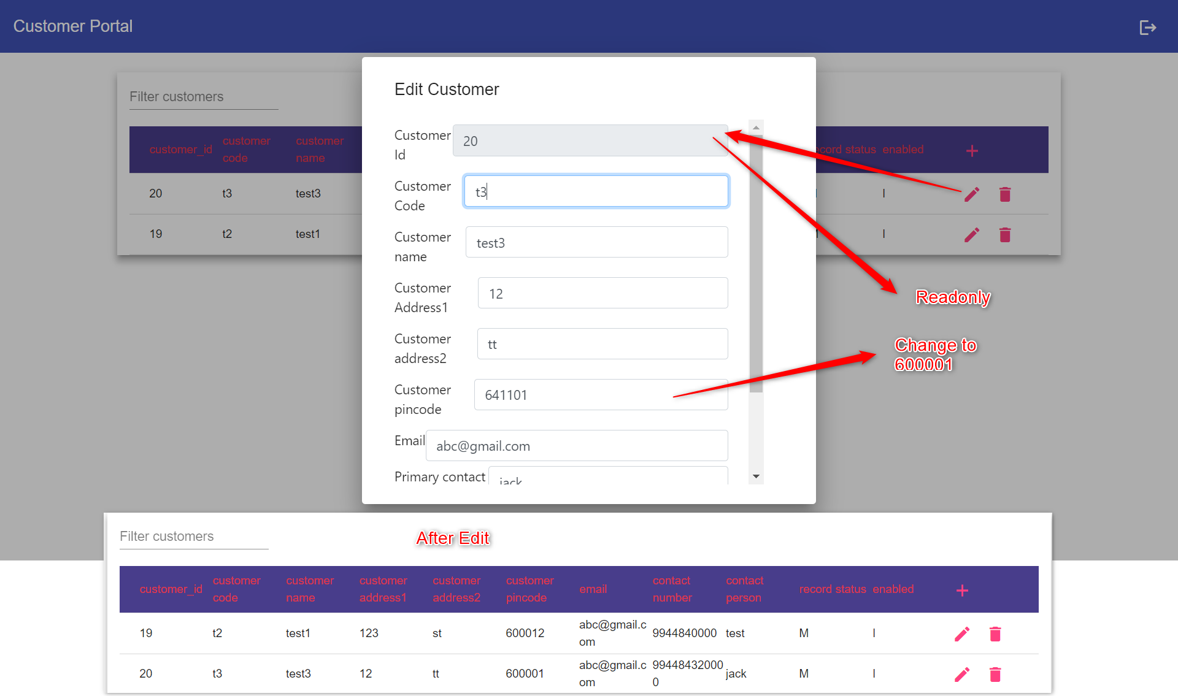
Edit Customer

Slide 6
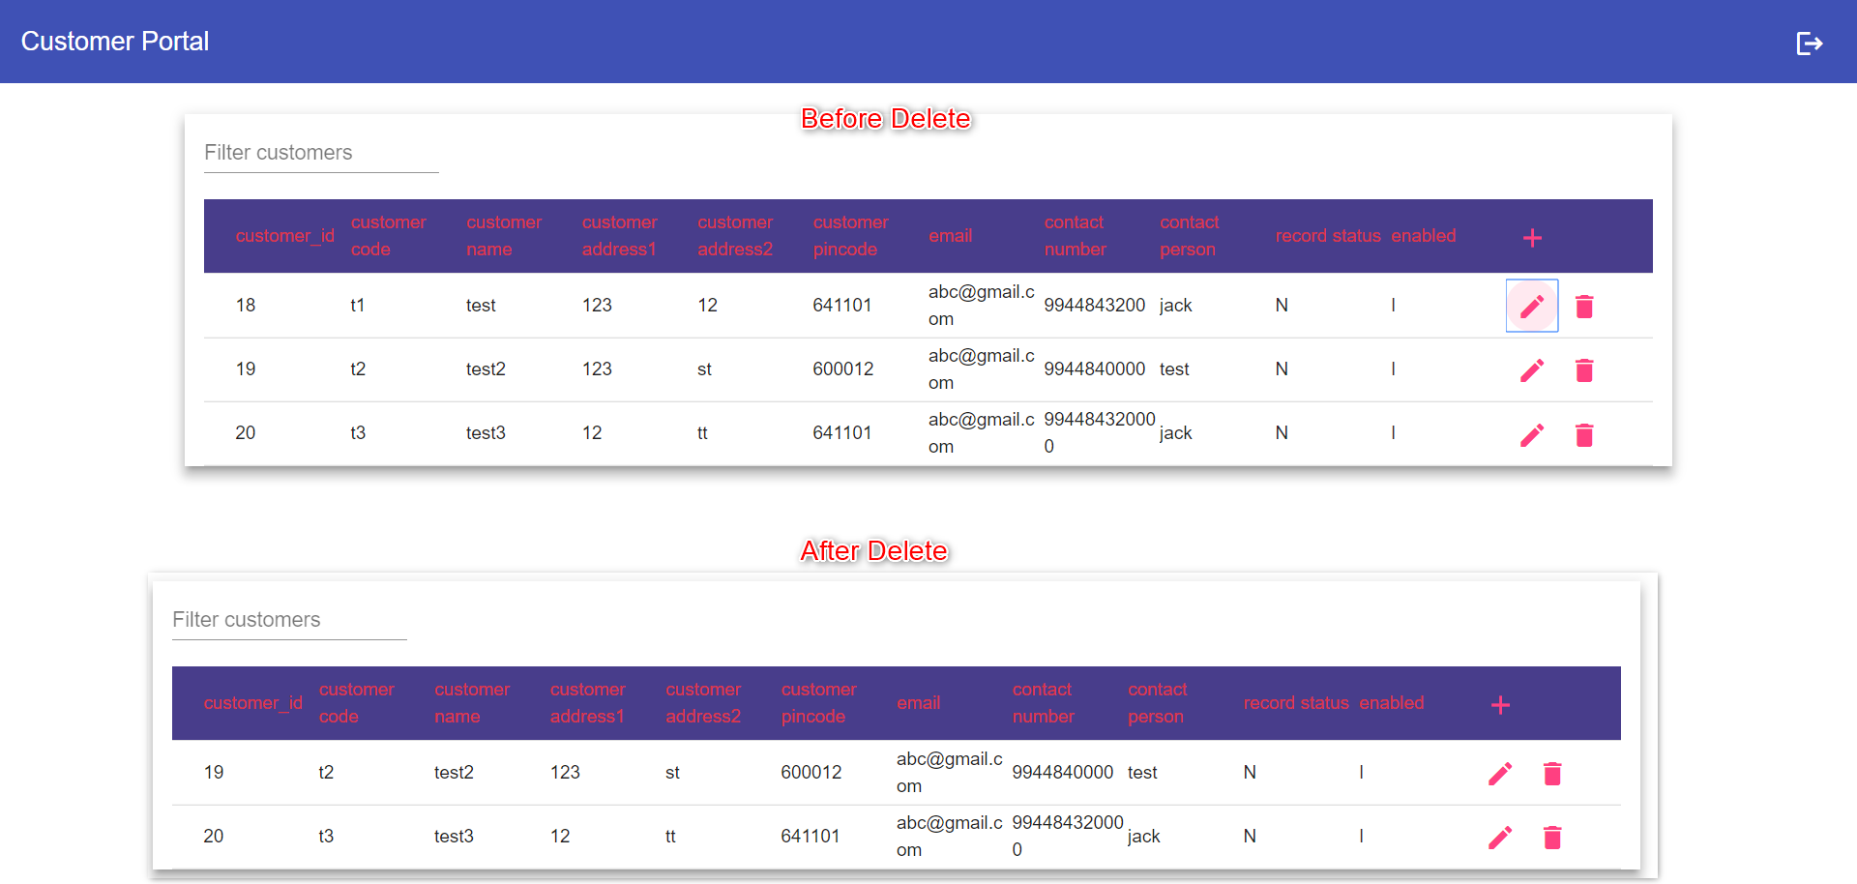
Delete Customer

Slide 7
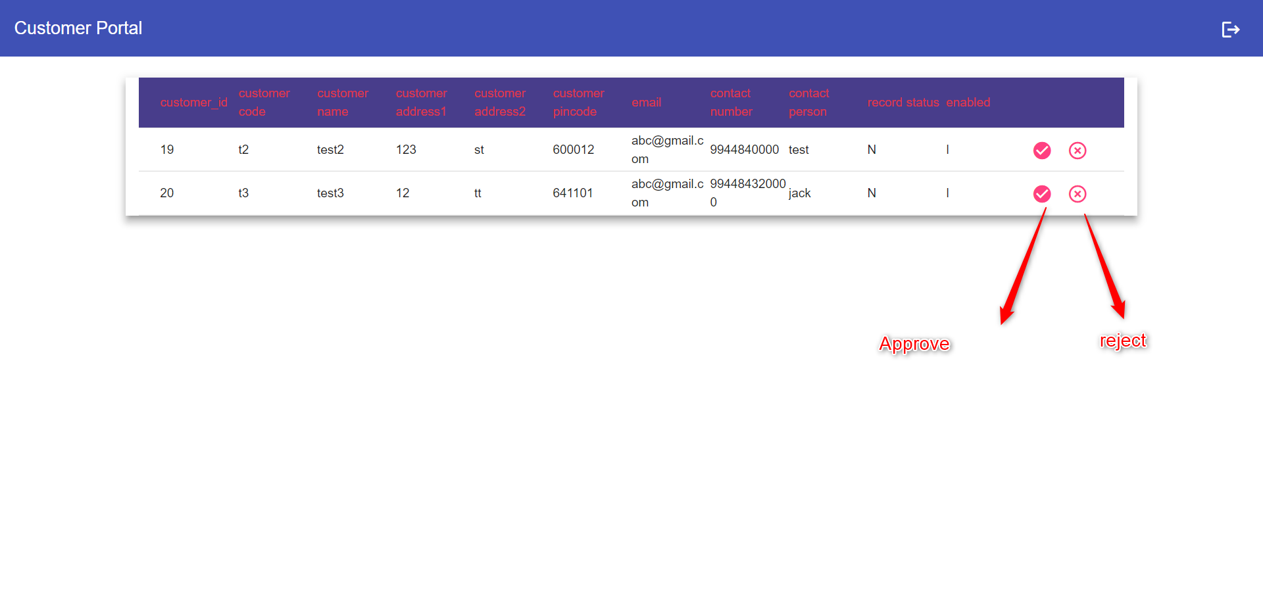
Checker

Slide 8
Code Snippets

Slide 9
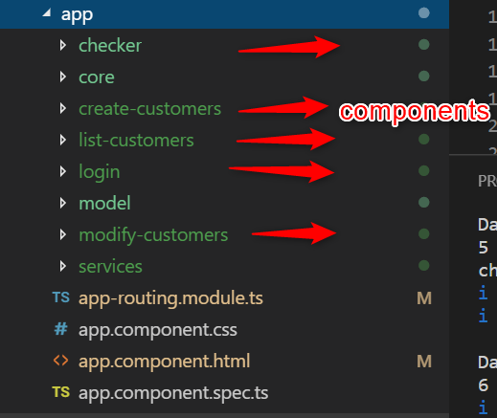
Angular Components

Slide 10
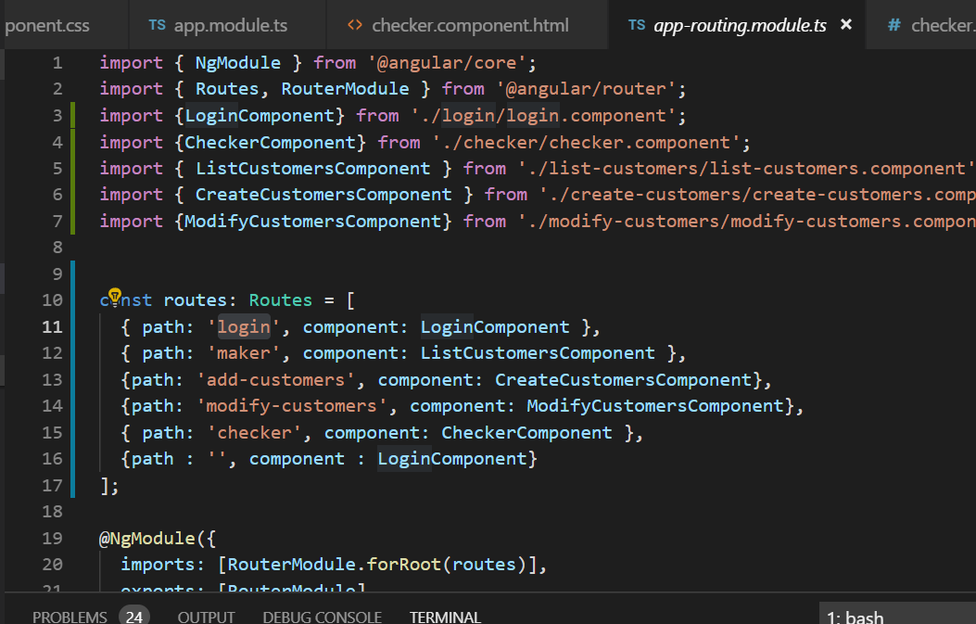
Routing Module

Slide 11
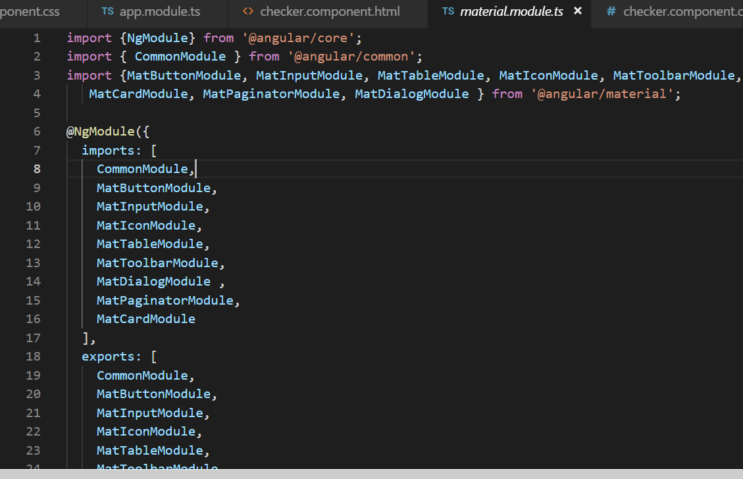
Angular Material Core module

Slide 12
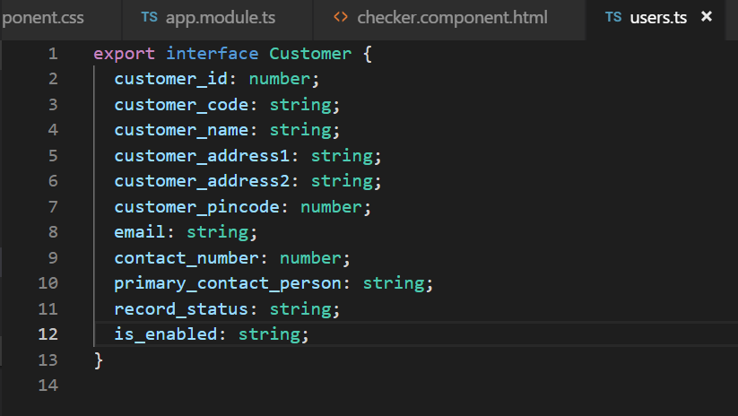
Model

Slide 13
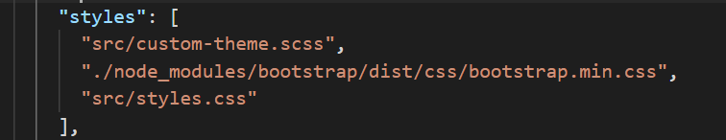
Bootstrap css library

Slide 14
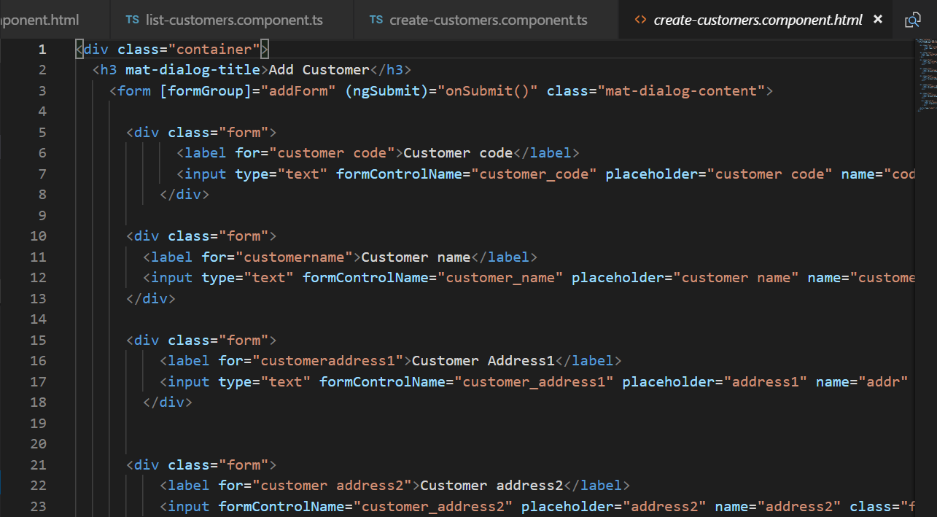
Angular Forms

Slide 15
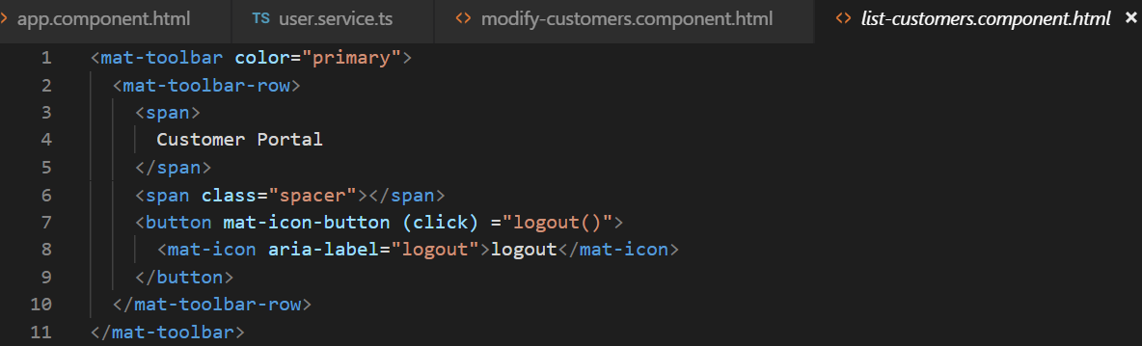
Angular Material - Toolbar

Slide 16
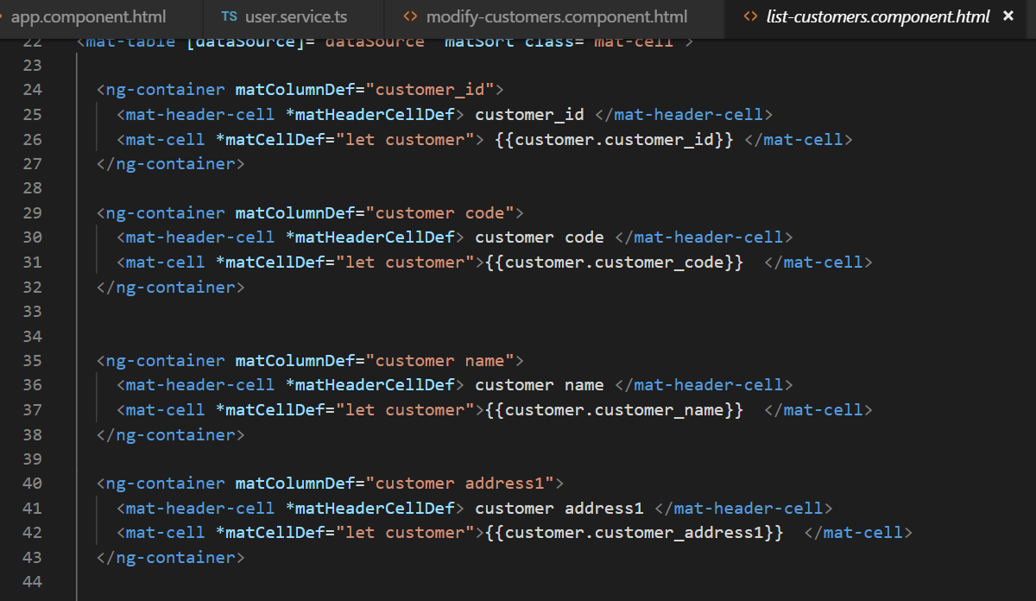
Angular material - Table

Slide 17
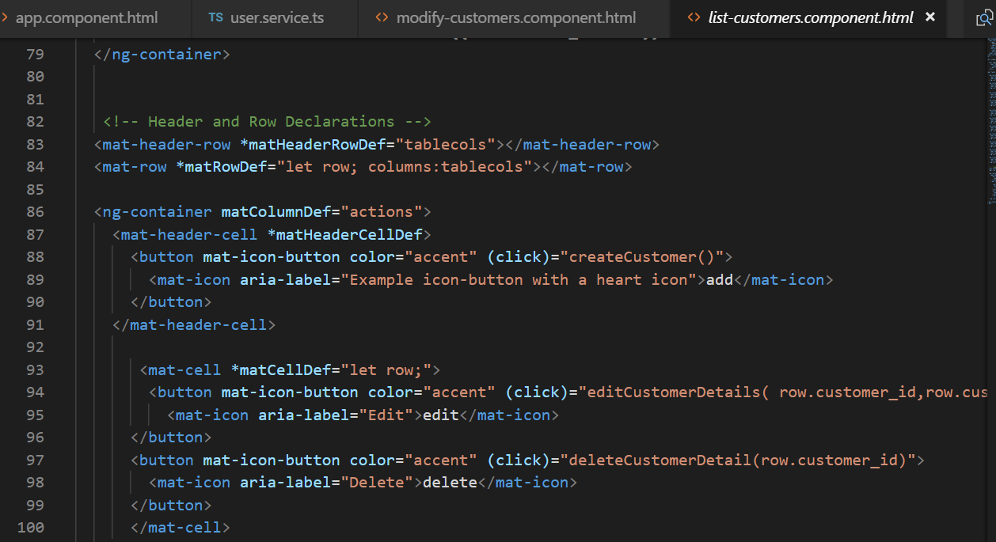
Angular Material - button

Slide 18
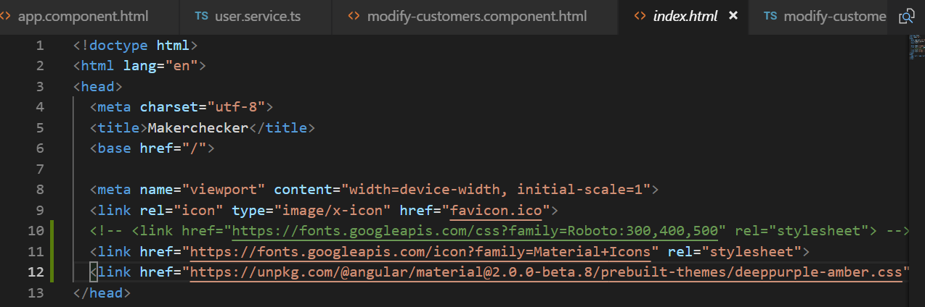
Angular Material - Theme

Slide 19
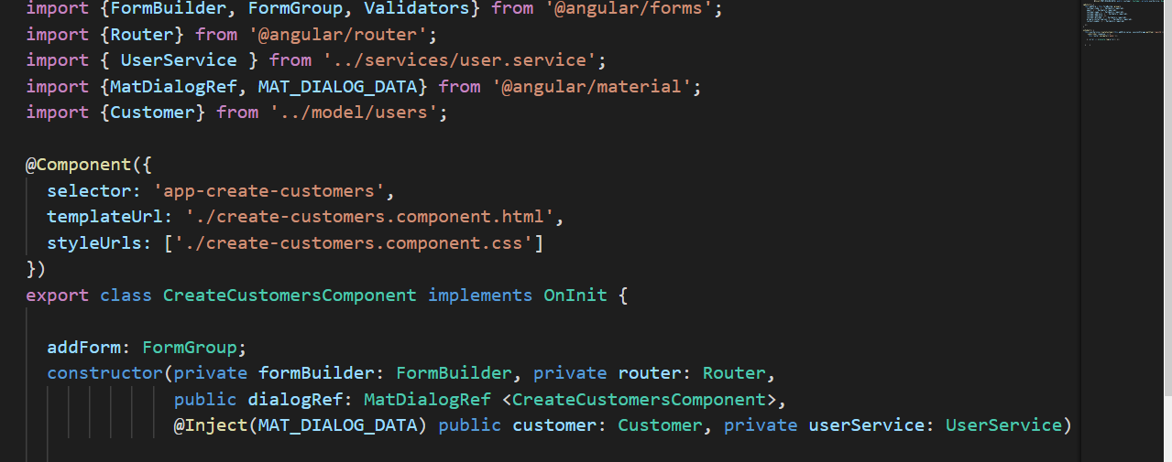
Angular Material – Dialog Module

Slide 20
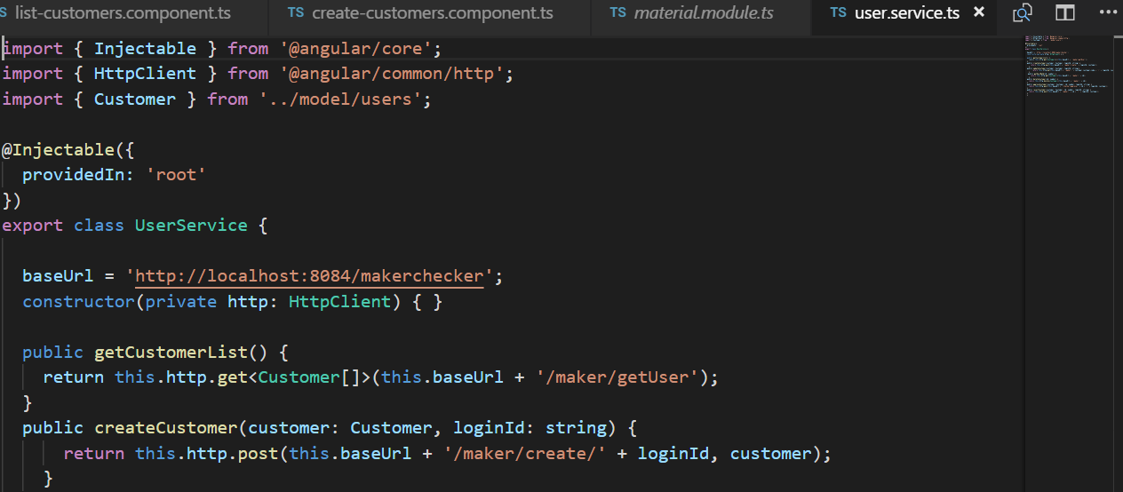
Angular Core and Http

Slide 21
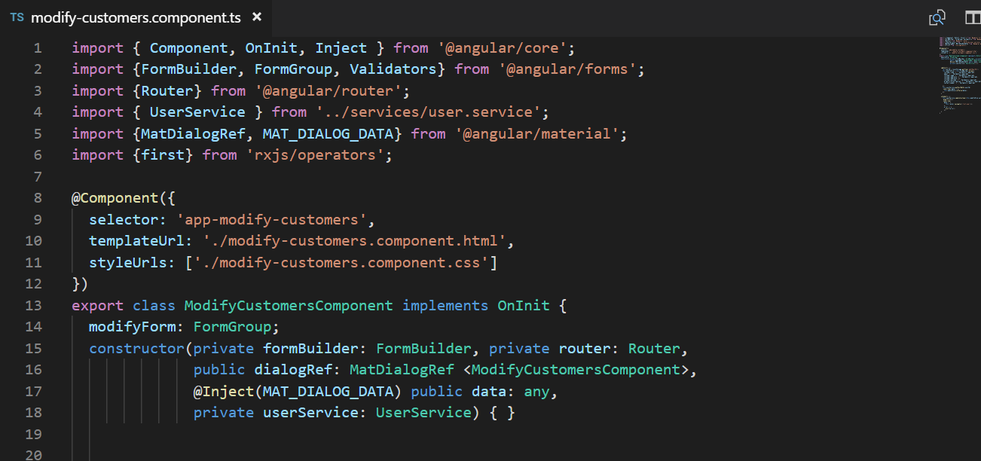
rxjs operator

Slide 22
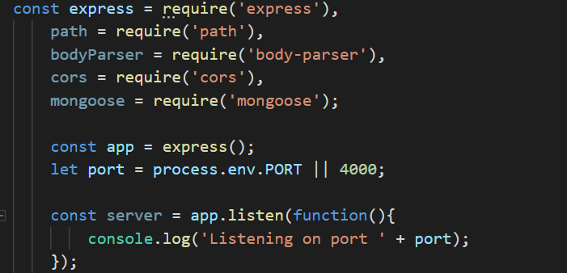
Node and express

Slide 23
Spring Boot

Slide 24
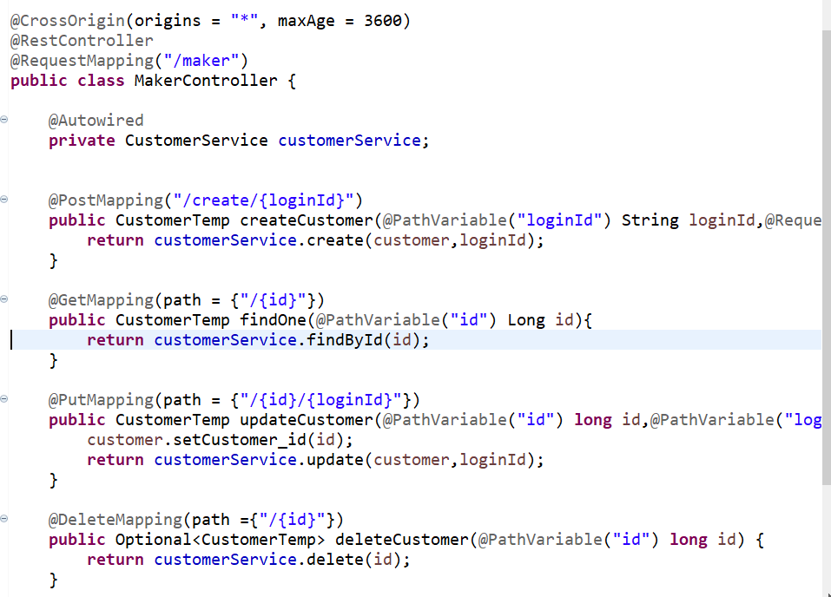
SpringBoot RestWebservice – CRUD Operations

Slide 25
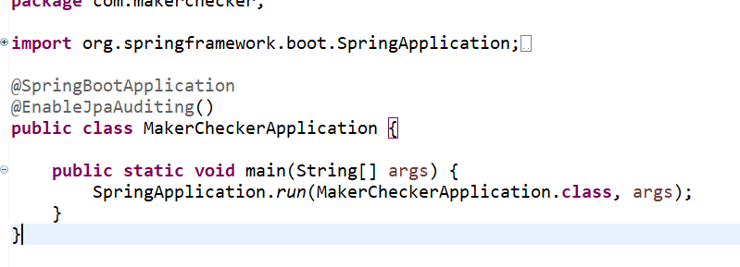
Enable JPA Auditing

Slide 26
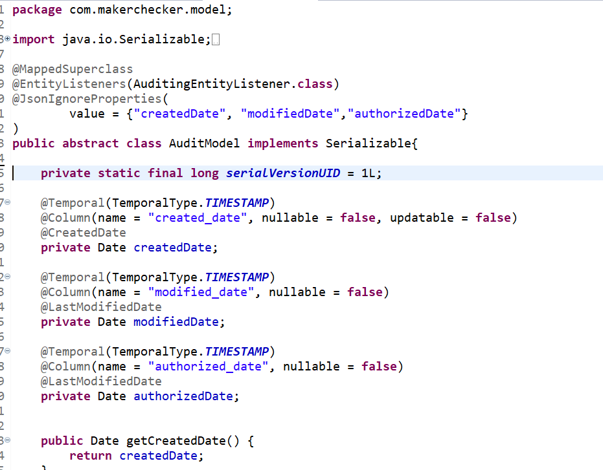
Spring Data JPA Auditing – Saving created, modified, authorized date automatically

Slide 27
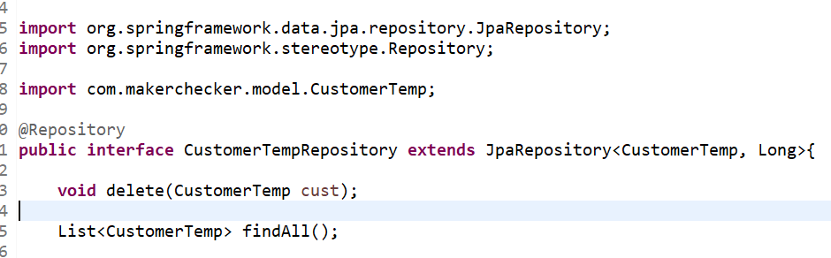
Spring Data JpaRepository

Slide 28
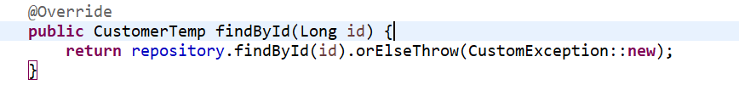
Java8 – Optional Class

Slide 29


Bugs

Slide 30
Edit Customer - Error when displaying the form values in edit form.
ERROR: Cannot find form control with name: createdDate.
Solution:
@JsonIgnoreProperties(
value = {"createdDate", "modifiedDate","authorizedDate"}
)

