Slide 1

Introduction to R
Facilitator:
Varshita Sher (Vishi)
Connect with me:
linkedin.com/in/varshitasher
medium.com/@vishi2020
twitter.com/vishi222

Slide 2
Before we begin..
Please follow carpentries code of conduct.
Keep on mute at all times, unless you have a query.
-------------------------------------------------------------
No question is a stupid question !!
Use Zoom chat for asking questions.
Slides will be made available afterwards. (feel free to take screenshots as I teach)

Slide 3
Quick Intro
Name
Background
Current software – Excel, MATLAB, etc.
Experience with R/RStudio
Expectation from workshop

Slide 4
Module 1: Intro to programming & the R environment

Slide 5
What can R help you with?
Cleaning the data
Filtering data
Handling Null or NAs
Mathematical calculations – log , sq. root
String operations – concatenation, regex
Statistical analyses – t tests, ANOVAs
Visual representation of data – histogram, bar plot
and list goes on..

Slide 6
Why use R over Excel?
Faster computations
Easy project organization
Better graphics (easily customizable too)
Advanced statistic capabilities
Automation + Reproducibility

Slide 7
Why R?
R provides a way to do quantitative analysis
Computationally advantageous
Ability to handle and sort large data sets
Flexibility in statistical analysis
Text visualization and graphics
Open source (i.e. continually updated and free)

Slide 8
Objectives
Learn Basic R commands
Learn how to think about programming
Connecting data structure, functions, available information, and statistical tests
Learn basic trouble-shooting skills

Slide 9
For help after the course:
Go to the Scientific Programming Study Group
http://sciprog.ca/
Go to the UBC R Study Group
https://minisciencegirl.github.io/studyGroup/
Use Google, stackoverflow

Slide 10
This is what R (NOT Rstudio) looks like:

Slide 11
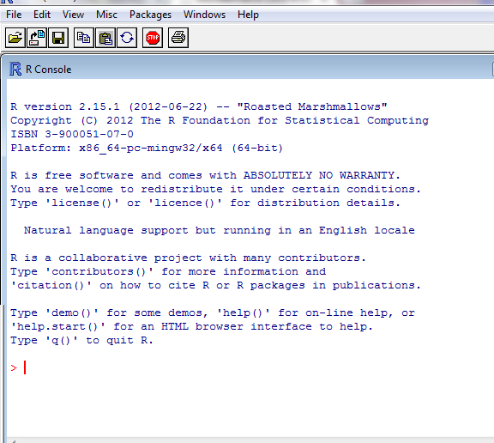
Notes:
R is a programmng language for scientific computing; Rstudio is IDE – Integrated Development Environment (develop and edit R programs)

Slide 12
The Command Line

Slide 13
Disadvantages
You cannot go back to edit previous code
What happens if you make a mistake?
You can’t easily see your previous code
If you exit R, although you can save everything you’ve done, you loose the code of what you did to create it
It is impossible to collaborate

Slide 14
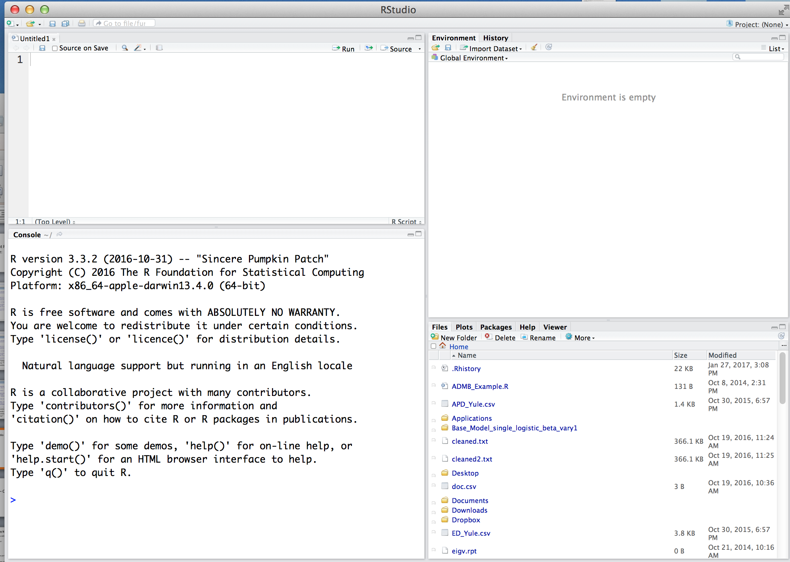
R Studio
Notes:
IDE for developing programs in R
R: programming langugage for statistical calculations.

Slide 15
R Studio
Everything here is part of your workspace

Slide 16
R Studio
Text Editor to write Script
Workspace info
Helpful tools
(Plots, Help, Files, etc.)
The R Console
Notes:
Switch to Rstudio to write a script with print(“helloworld”)

Slide 17
Scripts
A series of commands written in a text editor and saved with a “.r” extension so they can be re-run, or “sourced”, to R on a different occasion

Slide 18
Why use a script?
Allows fast editing, troubleshooting, and sharing
Example programs
R editor, TinnR, RStudio, Sublime

Slide 19
Things to include in an R script
A short description of what the script does - comments
The last time the script was updated
Lots and lots of notes!

Slide 20
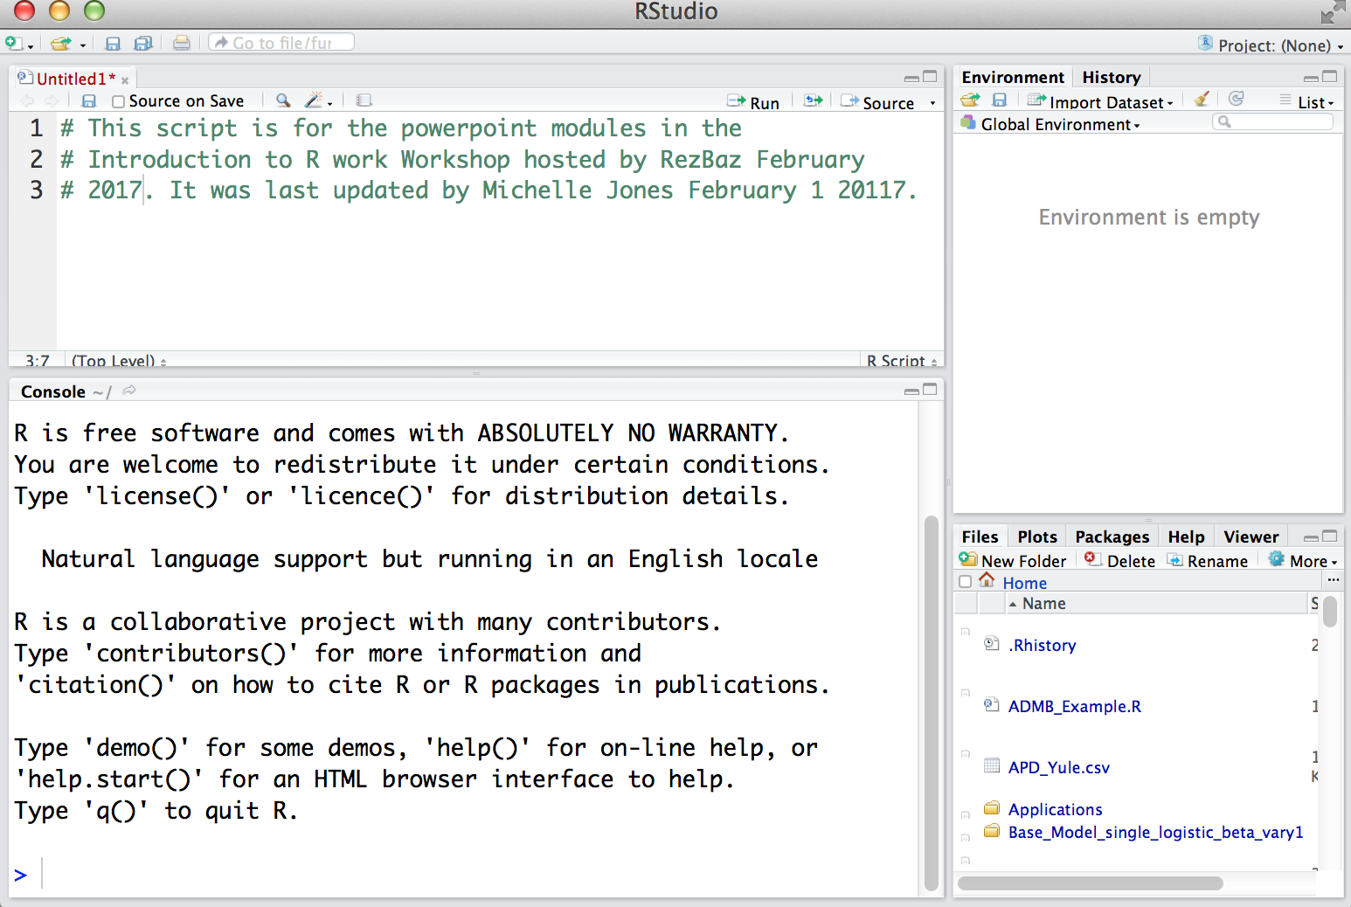
Example R Script

Slide 21
Example R Script
*Notice each line has a hashtag. This will tell R you are making comments, not trying to deliver commands.
Always put more notes in a script than you think you need because in a week your memory won’t be as good as you think
Notes:
Switch - Go back and add a personal comment using #. Maybe today’s date.

Slide 22
Connecting to R
If you aren’t working in R, how do you get commands from the script to R?
Select the “run” icon from R studio
Send directly to R with the keyboard short cut:
Mac: CMD + Enter
Windows: CTRL + R
Notes:
Switch: now run that print command and try other print statements too

Slide 23
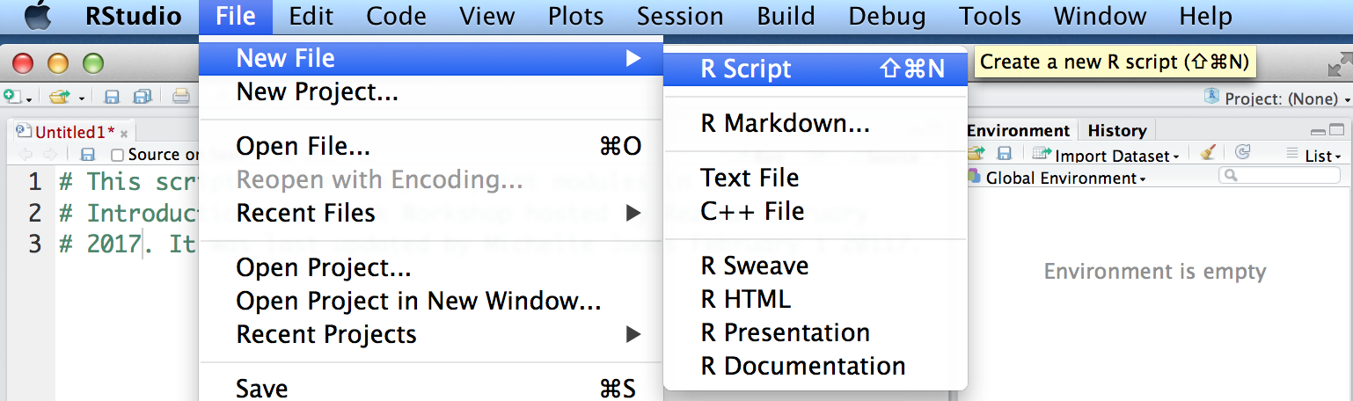
Your turn
Open RStudio and start a script for today’s workshop
If you do not have a script panel open up automatically go to file>New File ->R script

Slide 24
The Working Directory
The working directory is the pathway to the folder that R is currently connected to. R can only be in one folder of your computer at a time.
All data, other scripts, etc. must be in the same folder as the working directory, although the working directory can be changed many times in 1 script
All plots and files saved from R will go to the working directory
To know where R is working from:
getwd()
Notes:
switch

Slide 25
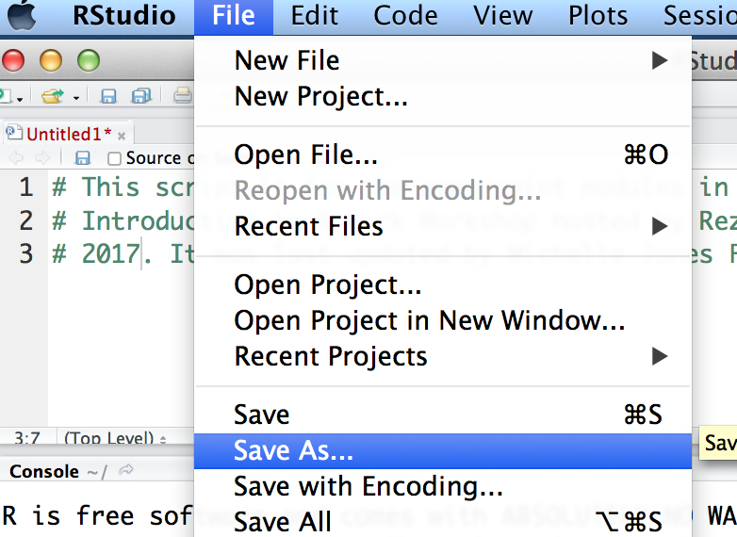
Lets set up a working directory
Create a folder on the desktop for today’s workshop called “R.Intro”
Save the script you’ve already started into the new folder making sure you use a .r extension

Slide 26
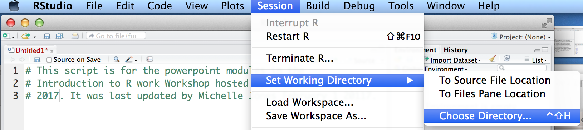
Lets set up a working directory
Create a folder on the desktop for today’s workshop called “R.Intro”
Save the script you’ve already started into the new folder making sure you use a .r extension
Now change the working directory in R to go to this folder:

Slide 27
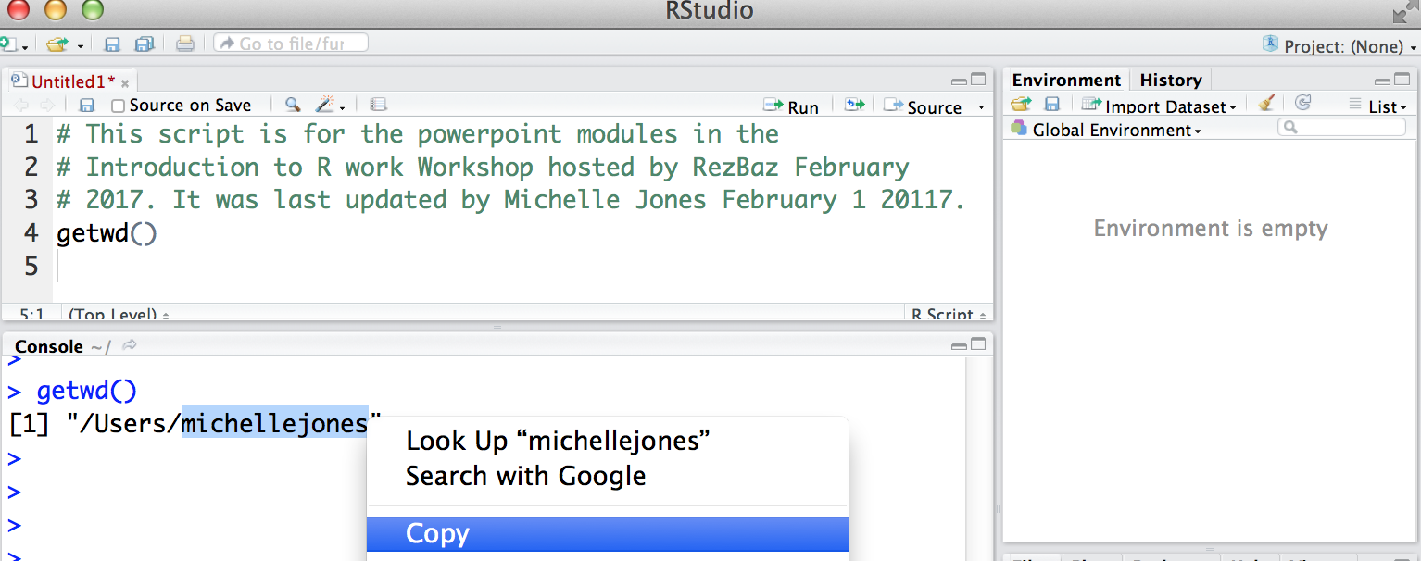
Lets set up a working directory
Once you’ve set the working directory once, copy and paste the pathway back into your script.
This way you don’t need to set it manually every time this script is opened
First, use the getwd() command to print the pathway and copy it to clipboard from the R console

Slide 28
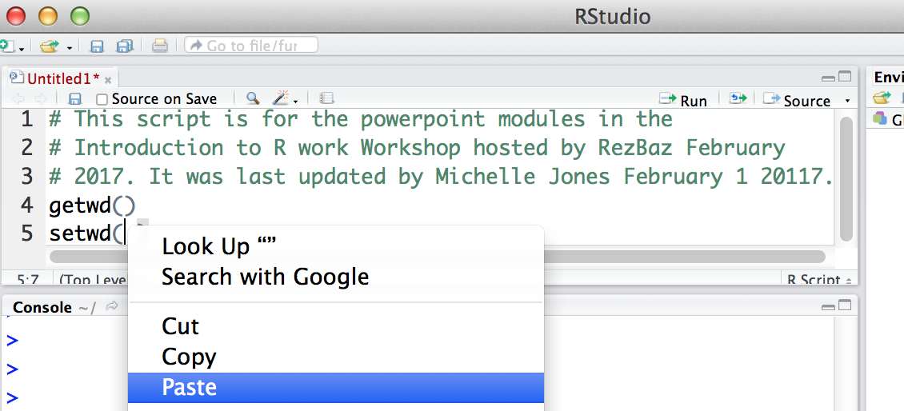
Lets set up a working directory
Second, paste the pathway into the setwd() command which manually sets your working directory

Slide 29
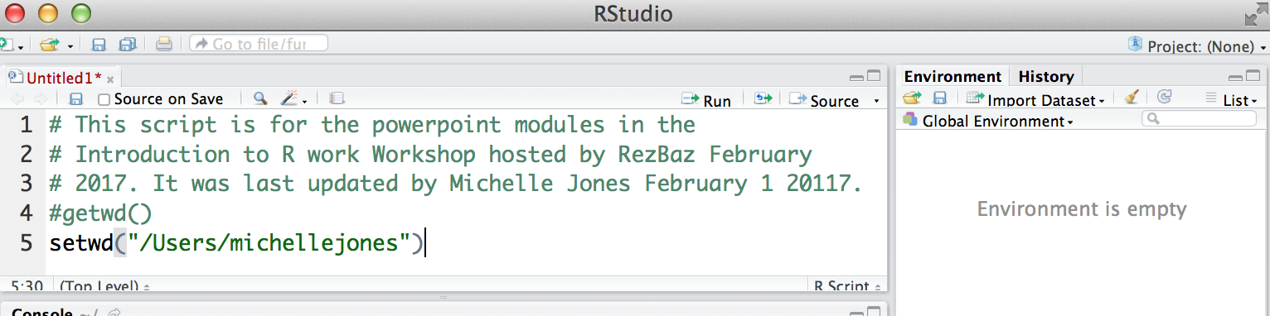
Finally, comment out the command to get the working directory. Now, every time you run this script it will automatically synch to this folder.
Lets set up a working directory
If you change the location of this folder on your computer after the workshop, you will need to change the pathway in your script

Slide 30
And, we’re ready to go!

Slide 31
Basic R terminology
When you save a series of calculations you place them in an object
To assign an object use <-
“object name”<- “something you want to save”
> example1<-1+3+4*10
To see what an object contains, type it’s name > example1
Notes:
switch

Slide 32
When you assign your calculations into an object, you actually have to open the object to see what is inside
Example 1
Step one: Put in object
example1<-1+3+4*10
All the calculations are saved in your object
Example 1
Results from your all the calculations are saved in your object
Step two - open the object:
example1

Slide 33
Your turn
Make the following two objects:
> object1<-1+4+5
> object2<-5*2
Print out what is inside these objects
> object1
> object2
Now add the two objects together
>object 1+object2
We save things in objects so that we can access them in subsequent calculations (e.g. object1 +object2)

Slide 34
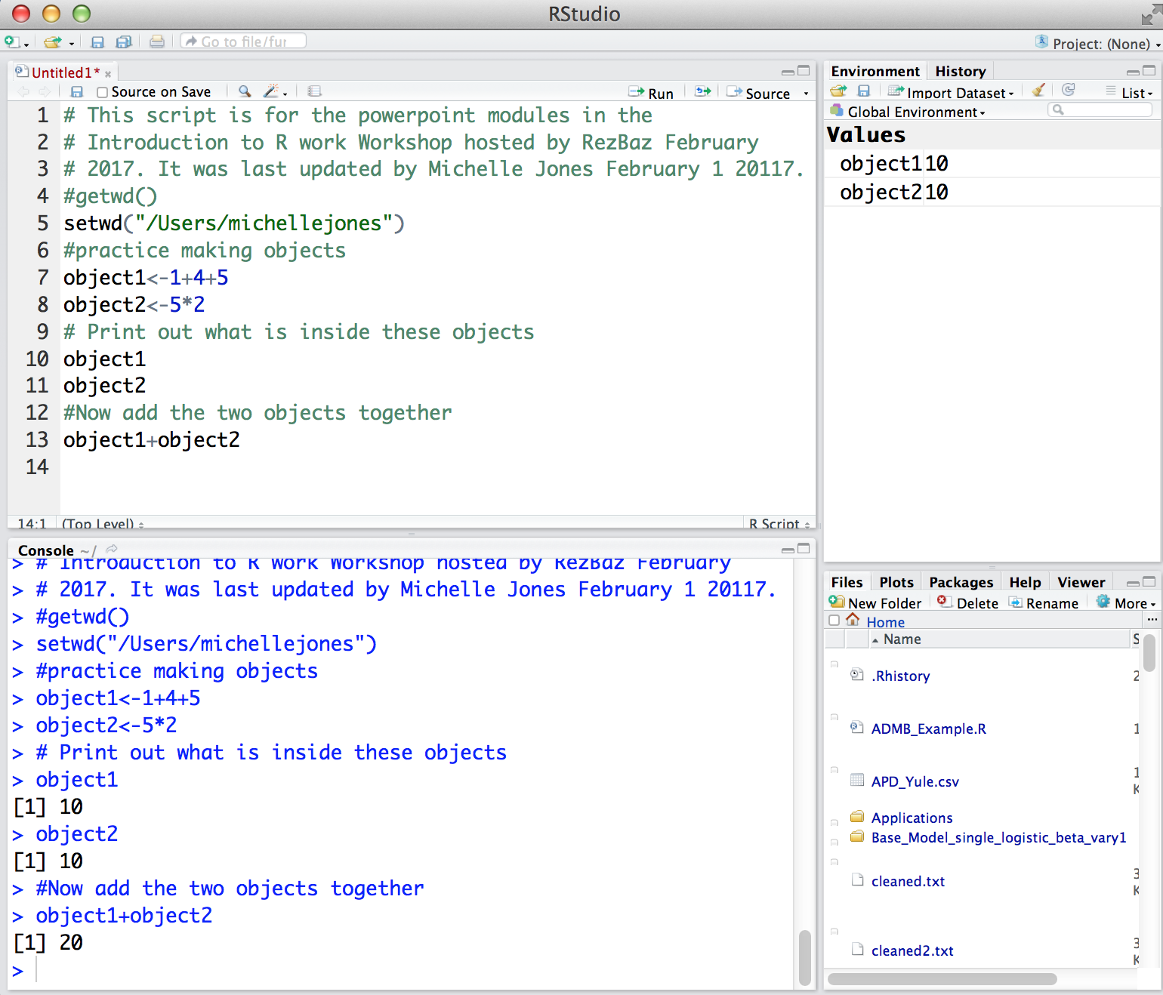

Slide 35
To see all the objects in your workspace
ls()
or
objects()
To remove an object rm()
rm(“object1”)
Notes:
switch

Slide 36
General Programming Tips
Use a new folder for each project
Annotate your script – using the “#” symbol allows you to write notes within a script
Use explicit names when saving objects
Be systematic

Slide 37
Other Math Functions
x <- 10
> log(x) # log base e
> log10(x) # log base 10
> exp(x) # e raised to x
> abs(-x) # absolute value
> sqrt(x) # square root
Notes:
switch

Slide 38
Logical Tests – Good for Sorting Data
i.e – is this true?
(Valuable for filtering– e.g. If this is true then…..)
X<-2 Y<-3
> X == Y # Test for equivalence
> X != Y # Test for non-equivalence
> X > Y # Greater than
> X < Y # Less than
> X >= Y # Greater than or equal to
> X <= Y # Less than or equal to
Notes:
switch

Slide 39
Trig Functions
x <- seq(from = 0.1, to = 1, by = 0.1)
> sin(x) # sine
> cos(x) # cosine
> tan(x) # tangent
> asin(x) # arc-sine
> acos(x) # arc-cosine
> atan(x) # arc-tangent
> pi # 3.14159……
Notes:
switch

Slide 40
Concept Check
Make three objects named X, Y and Z.
In X, put the product of 5 and 4
In Y, put the sum of 5 and 5
In Z, put the difference between 30 and 10
List all the objects that are now stored in R
Test to see if Z and X are equivalent
If they are, remove one of them from the R workspace and list all objects
If you wanted your deleted object back, what could you do?

Slide 41
Concept Check Answers
Objects X, Y, Z
X<-5*4
Y<-5*5
Z<-30-10
See all objects
ls()
Test equivalence
Z==X
OR
X == Z
Remove Z
rm(Z)

Slide 42
Basic Stats
x <- 1:100
> mean(x) # average
> median(x) # median
> var(x) # variance
> sd(x) # standard deviation
> quantile(x) # main quantiles
> max(x) # maximum value
> min(x) # minimum value
> summary(x) # summary statistics
Notes:
switch

Slide 43
Help Functions
R has extensive documentation for every function and package
Ex/
help(package=“name of package")
help(plot) # view help for function plot
?plot # same as help(plot)
Google

Slide 44
Help File Format
name {} (package where it exists)
Description – What the command does
Usage – how to type the command
Default arguments (….) - what happens with no specifications
Arguments – different options for customizing the command
Value – what will be returned

Slide 45
Help File Format (cont..)
See also – similar commands of interest, or other functions used in the background
Details – specific considerations in the command
References
Examples

Slide 46
Open a help file
Type this command into the R console:
> help(mean)
Notes:
switch

Slide 47
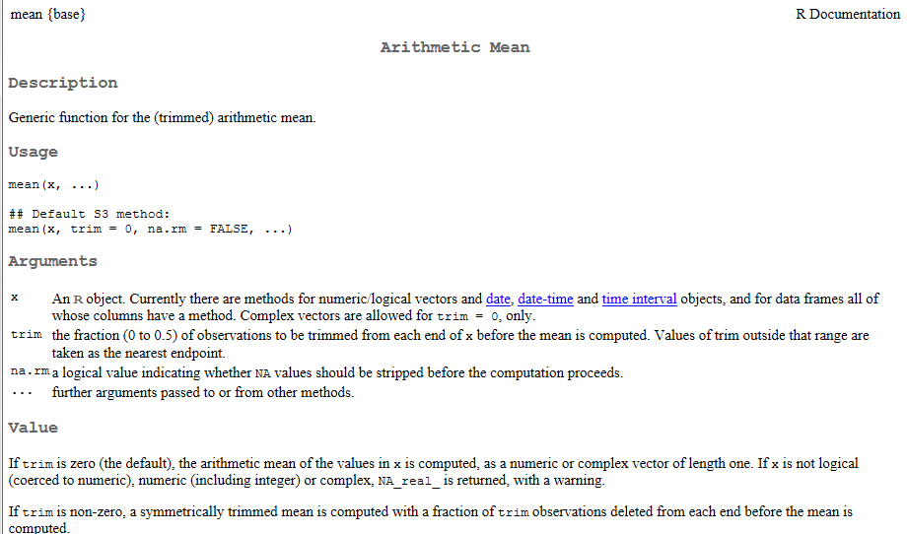
Package where the function lives
How to write the command in R
Defaults if you neglect to make different specifications
Inputs and options to customize the function
Output from the command

Slide 48
Warnings versus Errors
Warning: Something unusual happened, but the code still ran
>x<-c(1,2,-2,4,5)
> sqrt(x)
Error: The function could not be completed
x <- rnorm(10)
y <- rnorm(11)
> cor(x, y)
Notes:
switch

Slide 49
Vectors
A vector is a one dimensional, ordered collection of numbers, strings, etc.
1, 2, 3, 4, 5
A, B, C, D, E, F
TRUE, FALSE, FALSE, TRUE
blue, red, purple, orange

Slide 50
Examples of vectors
x <- c(1, 2, 3, 4, 5) # numeric
y <- c("A", "B", "C", "D") #character
u <- c(TRUE, FALSE, FALSE, TRUE) #logical

Slide 51
Examples of vectors
u <- c(TRUE, FALSE, FALSE, TRUE) #logical
class(u) #logical
The class of data is the kind of information it contains and tells R what kind of functions can be performed on it.
length(u) # 4
Length tells you how many elements in a vector

Slide 52
Subsetting Data
Subsetting is when you extract a certain portion (subset) of the data structure
x <- 15:25
> x[3] # the third entry in x
> x[5:8] # the 5th through the 8th entry in x
> x[x > 18] #all values where x is greater than 18
> x[c(2,5,8)] # take out the 2nd, 5th, and 8th value in X
CONCEPT CHECK
Can you guess what this statement means?
> x[x !=18]
How would you save these entries for later use?

Slide 53
Concept Check
1. Given that X<-c(2,4,3,2,6,8,10); What’s difference between
X[2] and X[X==2] ?
2. Can you guess what this statement means?
X[X !=8]

Slide 54
End Module One Questions?

