Slide 1
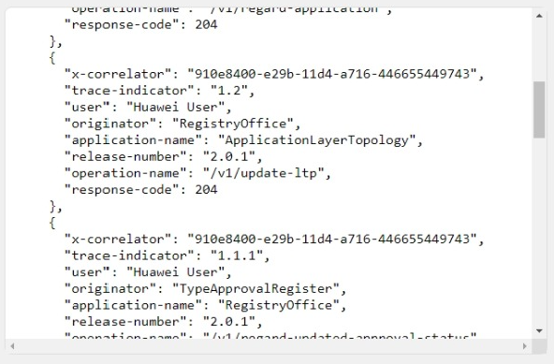
Username:
Password:
x-correlator:
Visualize Flow

Slide 2
Username:
User Name
Password:
*****
x-correlator:
click
Visualize Flow

Slide 3
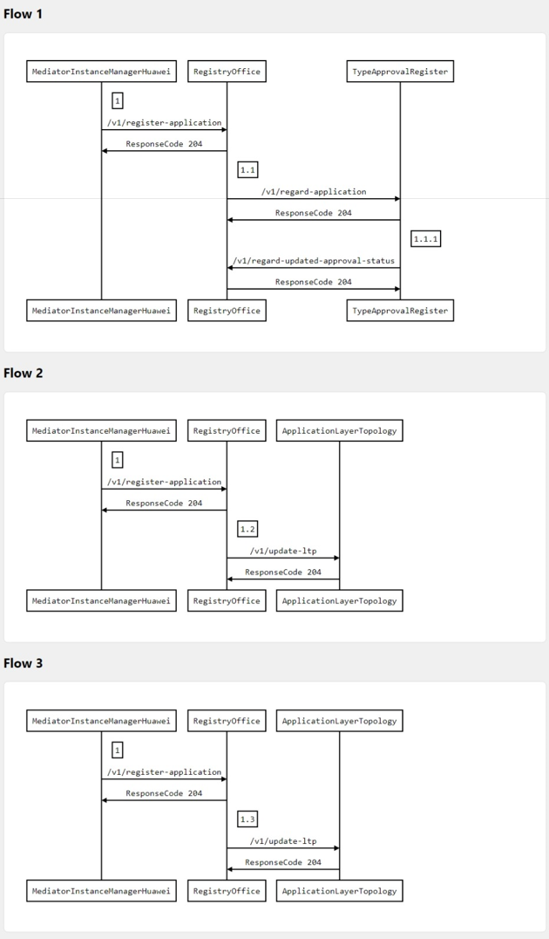
Username:
User Name
Password:
*****
x-correlator:
Visualize Flow

Slide 4
Username:
Password:
Start Flow Visualization

Slide 5
x-correlator:
Visualize Flow
Log out

Slide 6
x-correlator:
Visualize Flow
Log out

