Slide 1
Session Affinity Engine
A High-Performance C++17 Layer-4 Load Balancer Simulation
Sticky Sessions via 5-Tuple Hashing • Consistent Hashing • Dual LB Failover
Rate Limiting • Security Pipeline • Full Audit Logging
C++17 • STL Only • Zero External Dependencies • 14/14 Tests Passing

Slide 2
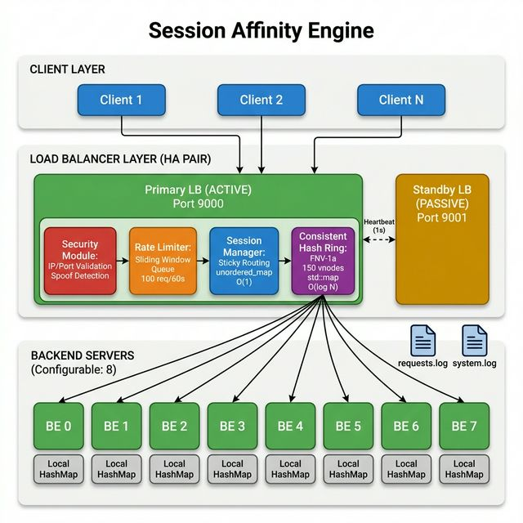
System Architecture — Block Diagram

Slide 3
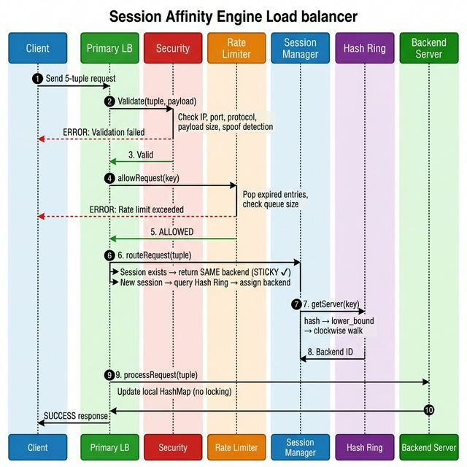
Request Flow — Sequence Diagram
6-Stage Pipeline: 1. LB Active Check 2. Security Validation 3. Rate Limiting 4. Session Routing 5. Backend Forwarding 6. Response Relay Fail-fast design: each stage short- circuits on failure.

Slide 4
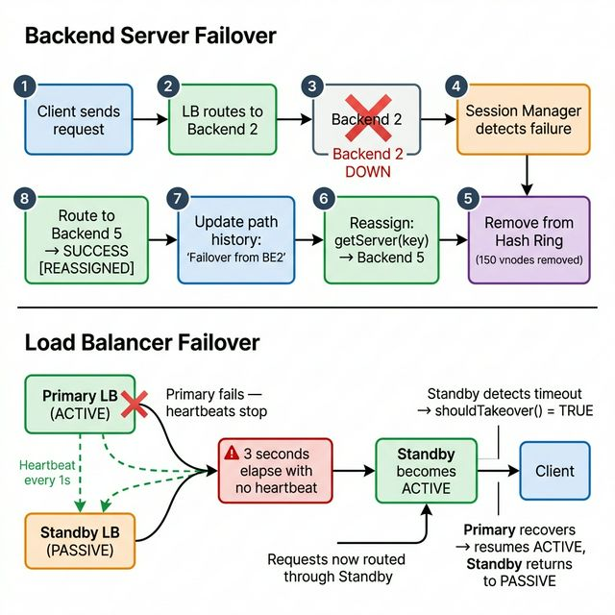
Failover — Backend & Load Balancer
Backend Failure:
• Remove 150 vnodes
• ~12.5% keys redistribute
• Sessions auto-reassigned
LB Failure:
• Heartbeat timeout (3s)
• Standby takes over
• Zero manual intervention

Slide 5
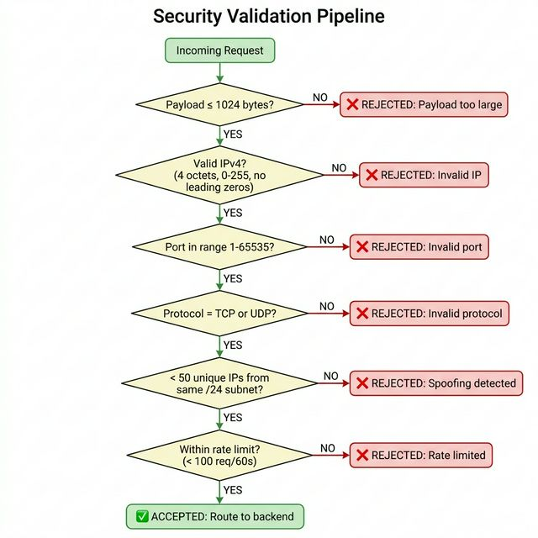
Security Validation Pipeline
6 Layers of Defense:
1. Payload size check
(≤ 1024 bytes)
2. IPv4 validation
(0-255, no leading zeros)
3. Port range check
(1-65535)
4. Protocol whitelist
(TCP/UDP only)
5. Spoof detection
(<50 IPs per /24 subnet)
6. Rate limiting
(100 req/60s sliding window)

Slide 6
Key Design Tradeoffs
Decision | Why We Chose This | Tradeoff
unordered_map for sessions | O(1) average lookup — critical for high throughput | O(N) worst-case on hash collisions
Consistent hashing (150 vnodes) | Only ~12.5% sessions redistribute on failure | Distribution is approximate, not perfectly uniform
Sliding window rate limiter | Exact fairness + doubles as audit history | More memory than a simple counter
Lazy session expiry | No background threads — simpler, no concurrency bugs | Dead sessions linger until cleanup called
Active-passive LB | Zero split-brain risk — one LB routes at a time | Standby sits idle until primary fails

Slide 7
Scope of Improvement
1. Real Network Protocol Support
Replace in-process simulation with actual UDP sockets (sendto/recvfrom) for real client–server communication over the network
2. Separate Client Binary
Extract client logic into its own executable that sends requests to the LB over the network, making the system truly distributed
3. Multithreaded Request Handling
Use a thread pool to process requests in parallel across CPU cores, with each thread handling a subset of incoming connections
4. Lock-Free Data Structures
Replace mutex-guarded unordered_map with a lock-free concurrent hash map (CAS-based) to eliminate contention on the session table hot path

