Slide 1
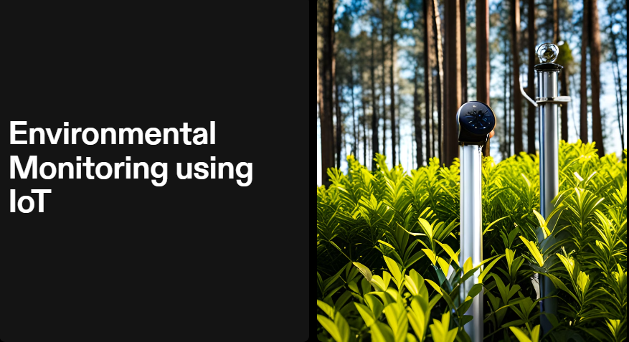

Slide 2
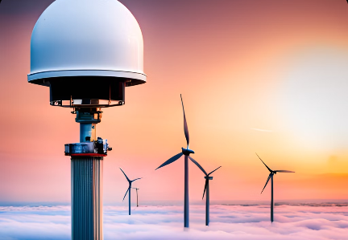
Introduction to IOT and environmental monitoring
The Internet of Things (IOT) has revolutionized the way we monitor and manage our environment. With the help of IOT, we can collect and analyze data in real-time, allowing us to make informed decisions about our natural resources. Environmental monitoring using IOT involves the use of sensors, data collection, and analysis to track changes in our environment. This page will provide an overview of IOT and environmental monitoring, including its benefits and applications.
Benefits of IOT in Environmental Monitoring
Real-time monitoring allows for early detection of environmental problems, such as pollution or climate change.
Data analysis can identify trends and patterns in environmental data, helping us to better understand our ecosystem.

Slide 3
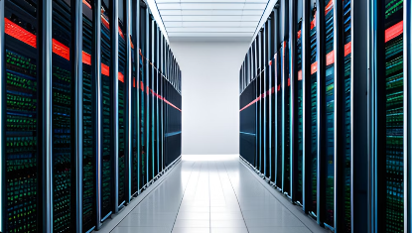
Sensors and data collection
Types of Sensors
Temperature sensors for monitoring ambient temperature.
Humidity sensors for measuring moisture in the air or soil.
Air quality sensors for measuring pollutants such as CO2, CO, and NO2.
Data Collection
Sensors collect data on environmental factors such as temperature, humidity, and air quality.
Data can be collected through wired or wireless connections, and stored in a cloud-based database for analysis.

Slide 4
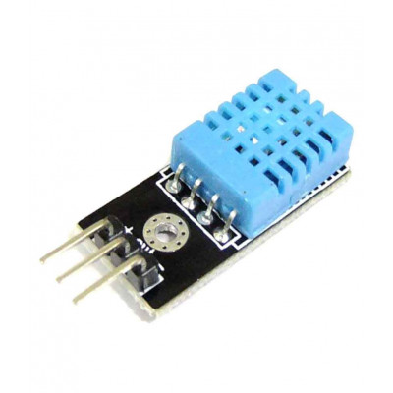
hardware used in environmental monitoring
Temperature and humidity sensor
Temperature Sensor:
Function: Temperature sensors measure the ambient temperature of a given area or object.
Types: There are various types of temperature sensors, including thermocouples, resistance temperature detectors (RTDs), and thermistors, each with different accuracy levels and application suitability.
Humidity Sensor:
Function: Humidity sensors measure the moisture content or relative humidity (RH) in the air.
Types: Capacitive, resistive, and thermal conductivity sensors are common types of humidity sensors, each with its specific sensing mechanism

Slide 5
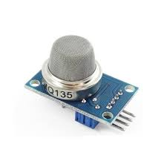
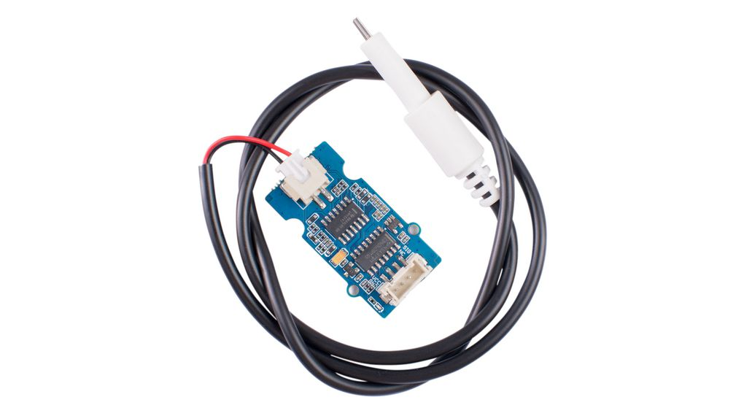
2. Air quality sensor
3. Water quality sensor
Air quality sensors are devices designed to measure the level of pollutants and particulate matter present in the air. These sensors detect various harmful substances such as particulate matter (PM2.5 and PM10), carbon dioxide (CO2), volatile organic compounds (VOCs), ozone (O3), and other pollutants. By providing real-time data on air quality, these sensors help individuals, communities, and governments monitor pollution levels and take necessary measures to improve air quality. Air quality sensors are widely used in environmental monitoring systems, smart buildings, industrial facilities, and wearable devices to raise awareness about air pollution and its impact on health and the environment.
Water quality sensors are devices used to assess the physical, chemical, and biological characteristics of water. These sensors measure parameters such as pH levels, dissolved oxygen, turbidity, conductivity, temperature, and the presence of specific contaminants like heavy metals, pesticides, or bacteria. By collecting accurate data on water quality, these sensors help in monitoring the safety and suitability of water for various purposes, including drinking, industrial processes, agriculture, and aquatic ecosystems.

Slide 6
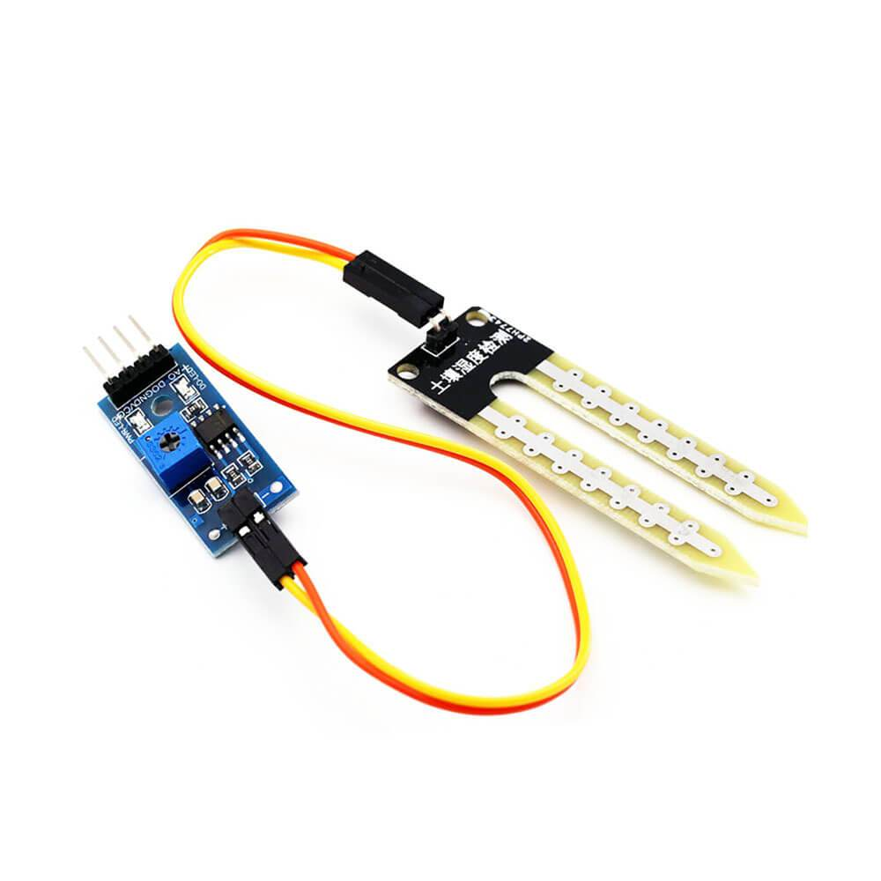
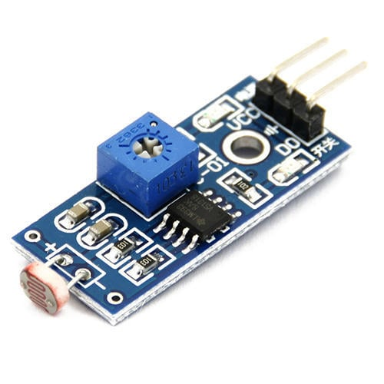
4. Soil sensor
5.Light sensor
Soil sensors, also known as soil moisture sensors or soil moisture meters, are devices used to measure the moisture content in the soil. These sensors provide information about the water content in the soil, which is crucial for efficient irrigation and proper plant growth. Soil sensors work by measuring the volumetric water content in the soil, indicating how much water is available to the plants. By analyzing this data, farmers and gardeners can optimize their irrigation practices, conserve water, and prevent overwatering or under watering. Soil sensors are essential tools in precision agriculture, helping farmers make informed decisions about irrigation schedules and improving crop yield while conserving water resources.
A light sensor, also known as a photo resistor or photocell, is a device that detects and measures the intensity of light in its surroundings. When exposed to light, the sensor's resistance changes, and this variation is used to determine light levels. Light sensors are commonly used in various applications, such as automatic street lights, photography equipment, ambient light adjustment in electronic devices (like smart phones and laptops), and energy-saving systems that adjust lighting based on natural light availability. They play a crucial role in ensuring energy efficiency and enhancing user experience in electronic devices and lighting systems.

Slide 7
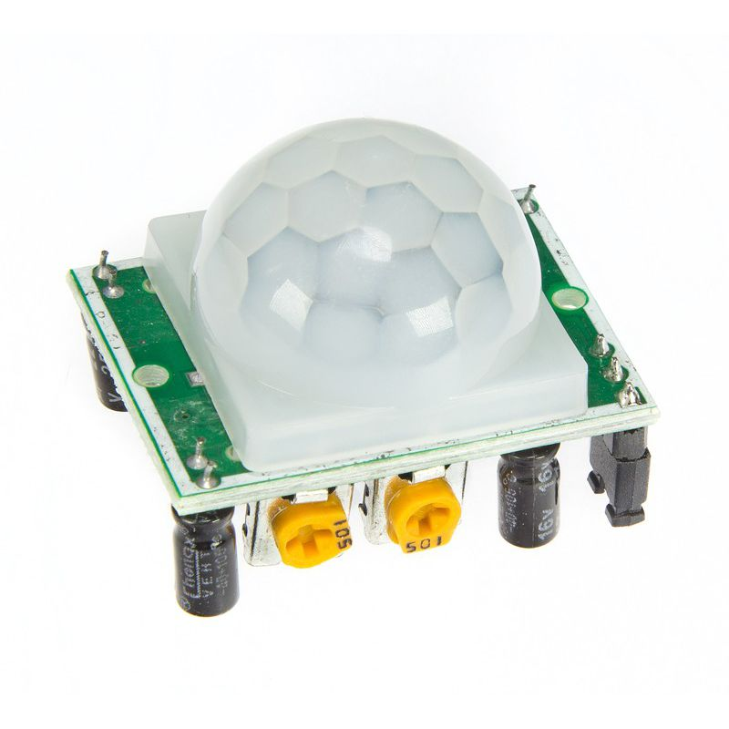
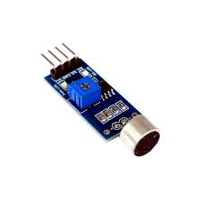
6.Motion sensor
7.Sound sensor
A motion sensor is a device that detects movement in its vicinity. It uses various technologies like infrared, ultrasonic, or microwave to sense changes in the surrounding environment. When motion is detected, it triggers actions such as turning on lights, activating alarms, or recording video, making motion sensors valuable in security systems, lighting control, and automation applications.
A sound sensor, also known as a microphone or sound detector, captures audio signals and converts them into electrical signals. These sensors are used in various applications, including voice recognition systems, noise monitoring, and smart devices that respond to sound commands. Sound sensors are essential components in audio technology, enabling devices to interact with the surrounding environment based on detected sounds.

Slide 8
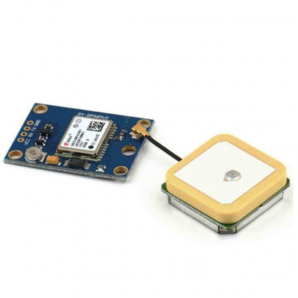
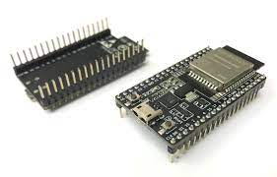
8. GPS module:
9. ESP32
A GPS module is a device that receives signals from satellites to determine its precise location on Earth. It provides accurate latitude, longitude, and altitude information, enabling navigation and location-based services in devices like smartphones, cars, and drones. GPS modules are crucial for mapping, tracking, and various applications requiring accurate positioning.
The ESP32 is a versatile microcontroller with integrated Wi-Fi and Bluetooth capabilities, commonly used in environmental monitoring systems. It enables wireless communication, data collection from sensors (such as temperature and humidity sensors), and real-time data transmission to cloud platforms. ESP32-based solutions are popular for their low power consumption, making them ideal for battery-operated environmental monitoring devices.

Slide 9
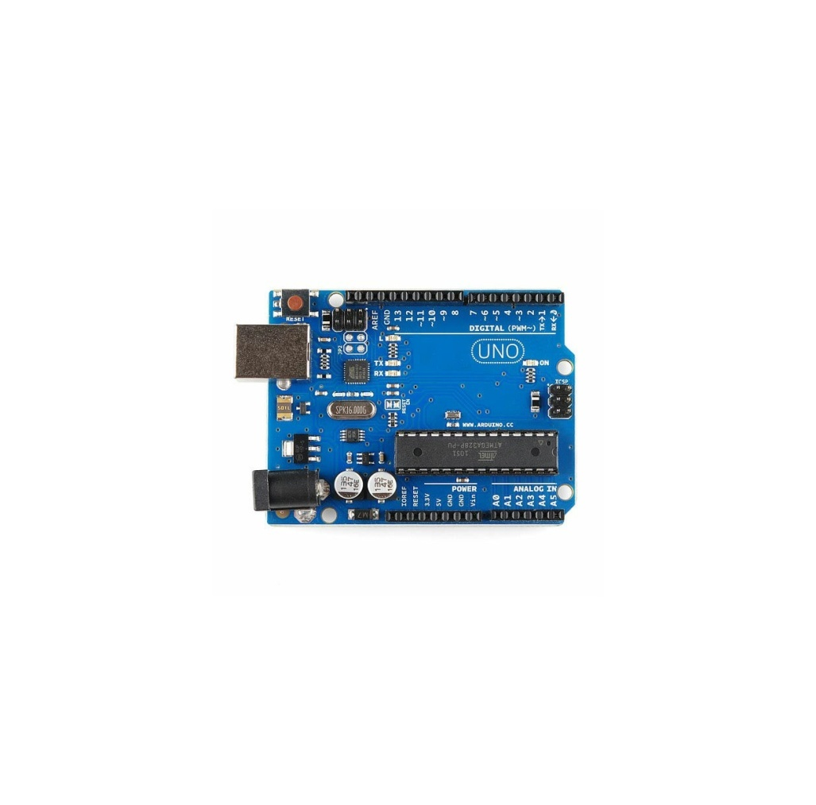
9. Arduino uno
The Arduino Uno is a popular microcontroller board extensively used in IOT-based environmental monitoring systems. Its ease of use and versatility make it a preferred choice for hobbyists and professionals alike. In environmental monitoring, Arduino Uno interfaces with various sensors (like temperature, humidity, and air quality sensors) to collect data. This data is then processed and transmitted to the cloud or other devices through Wi-Fi or other communication modules. Arduino Uno's flexibility and vast community support enable the creation of custom, low-cost, and efficient IoT solutions for monitoring and analyzing environmental conditions.

Slide 10
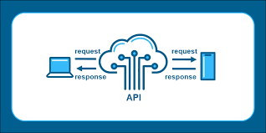
10. API and cloud
APIs (Application Programming Interfaces):
Function: APIs facilitate communication and data exchange between IOT devices and external applications or services. They allow devices to send data to the cloud and receive commands or information from the cloud platform.
Use in Environmental Monitoring: APIs enable IOT devices (sensors and controllers) to transmit real-time data (such as temperature, humidity, and pollution levels) to cloud platforms for analysis and storage. They also allow external applications to retrieve this data, enabling monitoring, analysis, and decision-making.
Cloud Platforms:
Function: Cloud platforms provide scalable, remote computing resources and storage over the internet. They process and store large volumes of data from IOT devices securely.
Use in Environmental Monitoring: Cloud platforms receive data from IoT devices via APIs. They store, process, and analyze this data, allowing users to monitor environmental conditions in real time. Cloud platforms often offer features like data visualization, alerts, and historical analysis. Popular cloud platforms like AWS IoT, Azure IoT, or Google Cloud IoT are commonly used in environmental monitoring IoT applications.

Slide 11
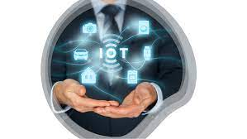
Conclusion
In conclusion, IOT technology revolutionizes environmental monitoring by enabling real-time data collection from sensors. Through IOT devices, data is transmitted to cloud platforms via APIs, facilitating efficient storage, analysis, and visualization. This seamless integration offers valuable insights, empowering informed decision-making for sustainable resource management and environmental conservation.

